Slide 1


Slide 2
Unit 1:
My new school
LESSON 2. A CLOSER LOOK 1

Slide 3
Objectives
After this lesson, students will be able to:
- use the words related to the topic My New School;
- use the combinations:
to play, to do, to have, to study + Noun;
- pronounce the sounds /a:/ and /ʌ/ correctly;

Slide 4

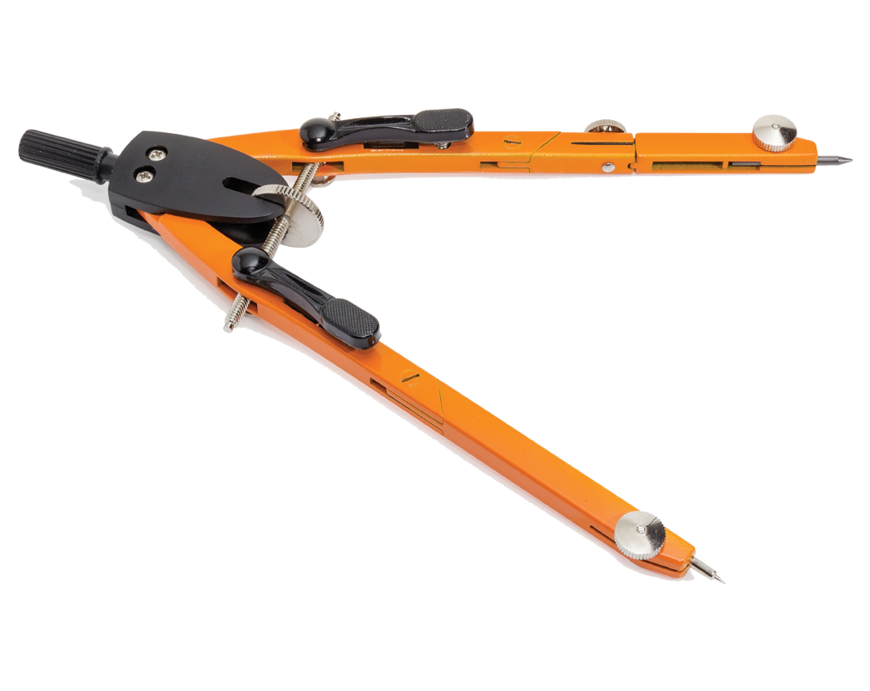
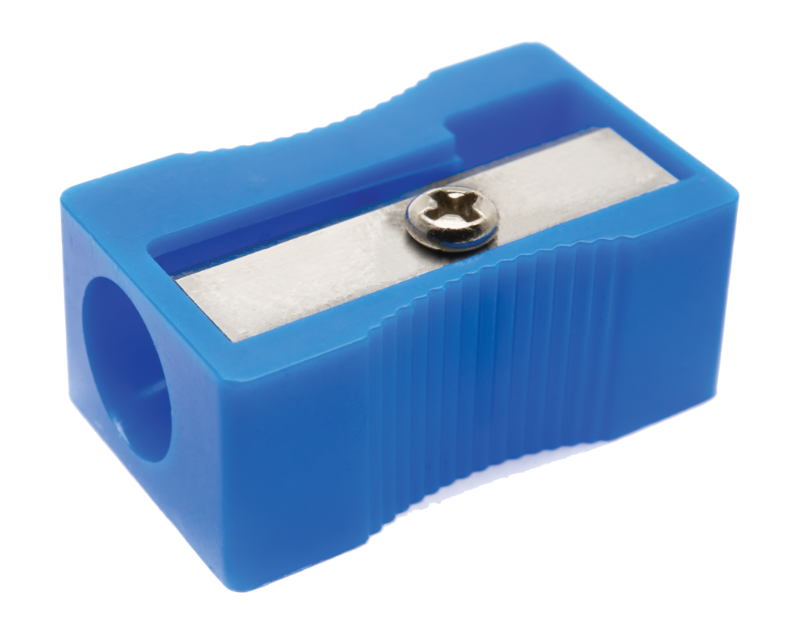
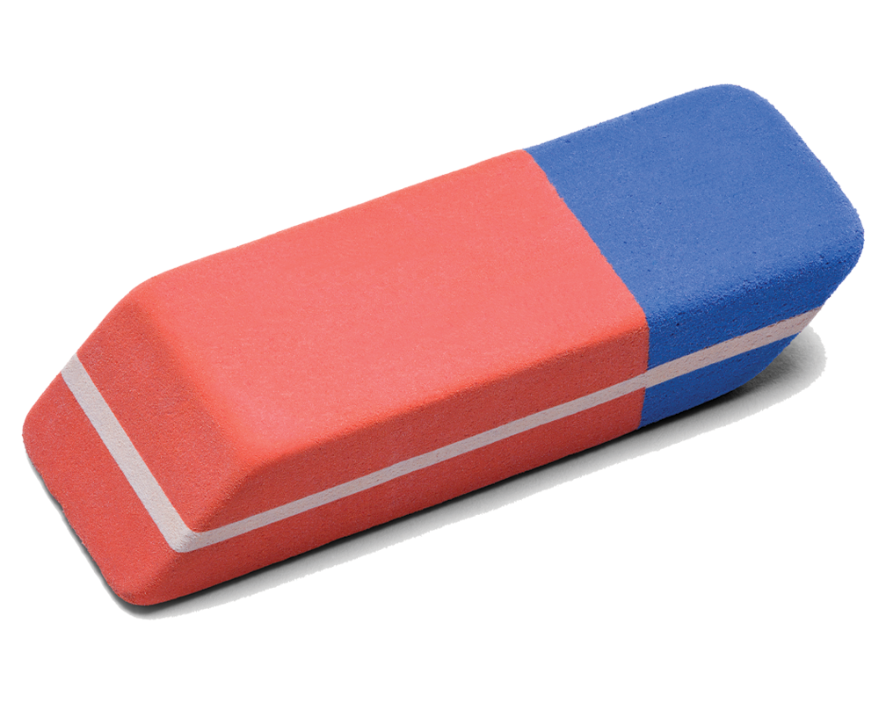
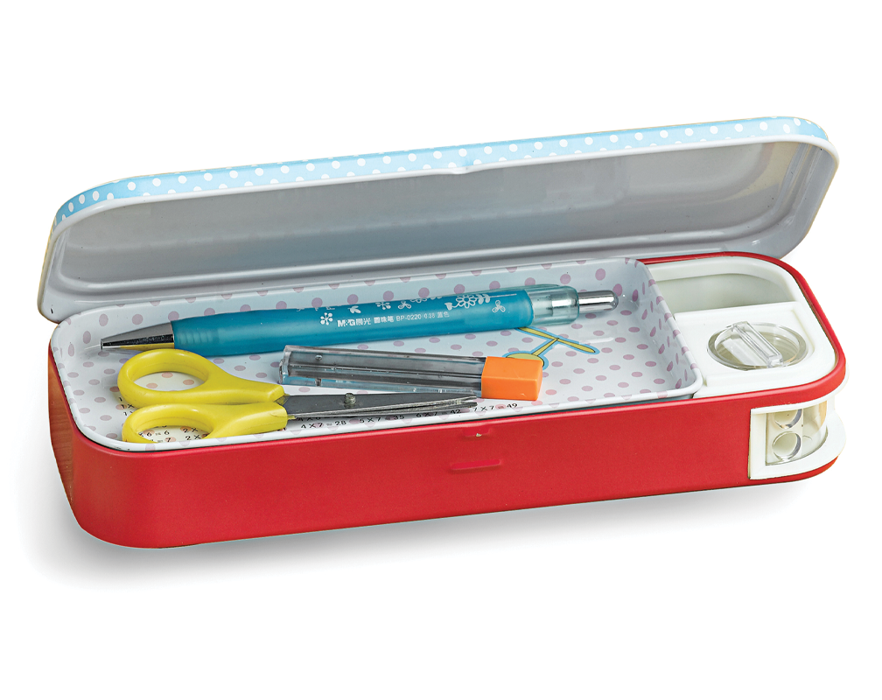
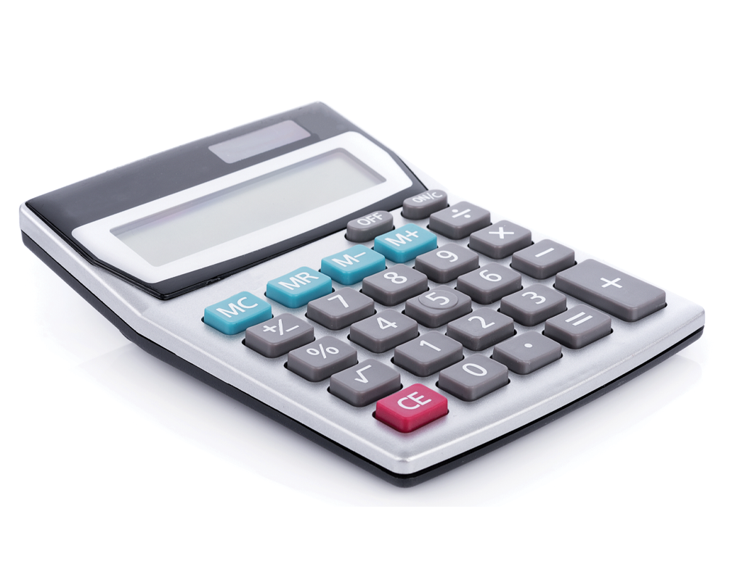
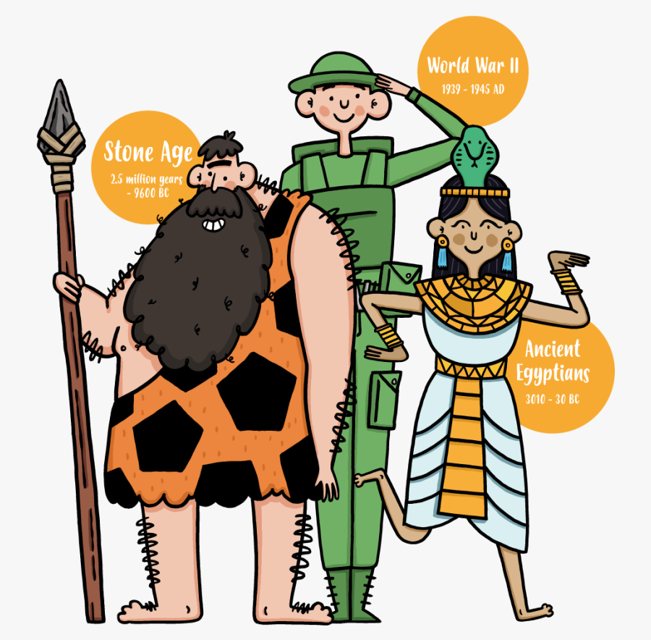

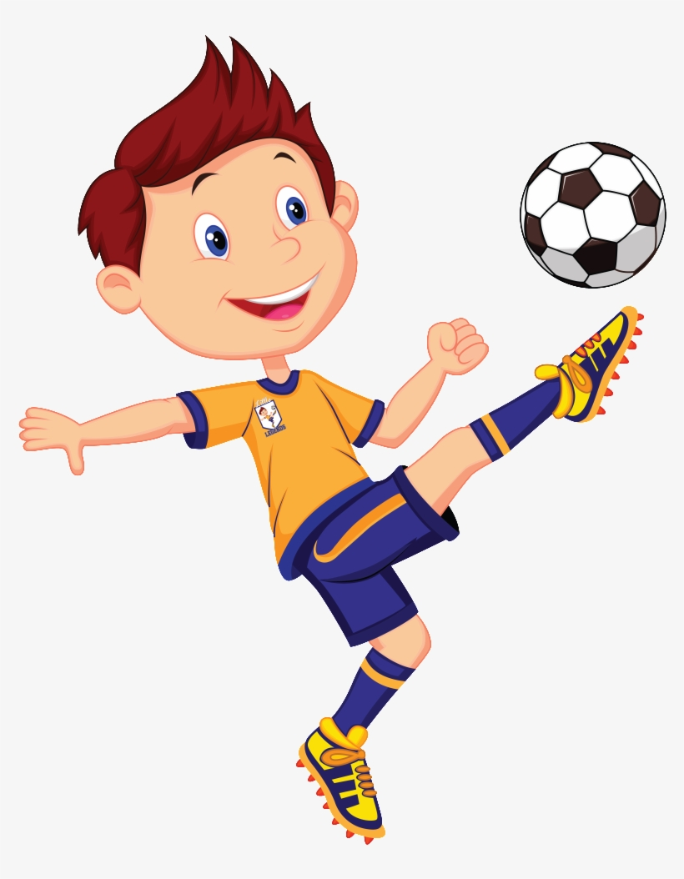

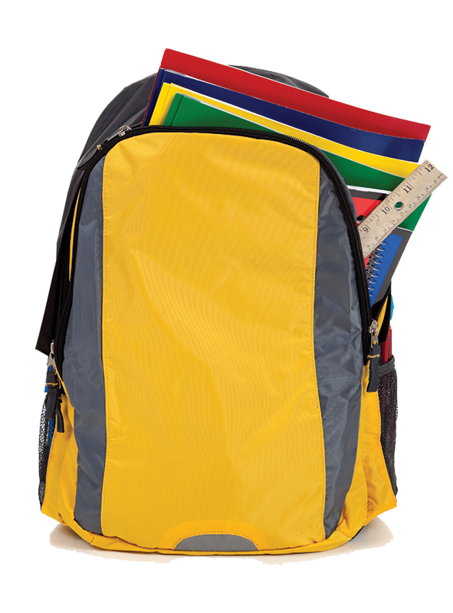

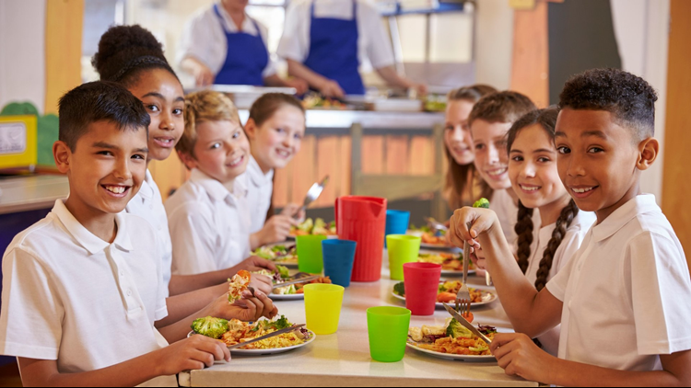

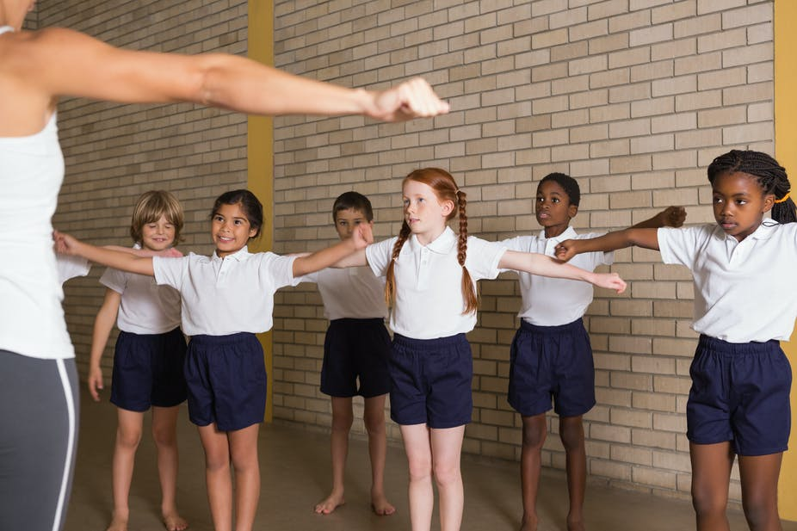

Kim’s game
Look and remember in 1 minute.
Then write down.
Notes:
https://www.menti.com/vs5ab73du8

Slide 5

Let’s check
Listen and repeat
compass
pencil sharpener
rubber/ eraser
pencil case
calculator
history
science
football
homework
school bag
english
school lunch
lesson
exercise
music

Slide 6
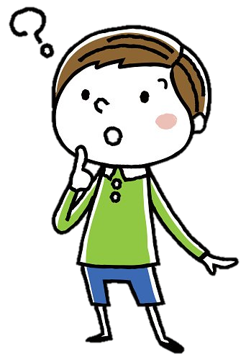
I do music on Monday.
I play music on Monday.
WHICH IS THE CORRECT ANSWER?
I study music on Monday.
I have music on Monday.

Slide 7
Ex 2. (p 8) Work in pairs. Put the words below in the correct columns.
school lunch
CAN YOU ADD MORE WORDS TO EACH COLUMN?
homework
English
history
exercise
football
lessons
science
music
play | do | have | study
Notes:
Put the words in 1 into groups. Can you add more words?

Slide 8
Ex 3. (P 8) Put one of these words in each blank.
lessons football homework
science exercise
1. Vy and I often do our __________ after school.
2. Nick plays _________ for the school team.
3. Mrs Nguyen teaches all my history _______.
4. They are healthy. They do _______ every day.
5. I study Maths, English and ________ on Mondays.
homework
football
lessons
exercise
science

Slide 9
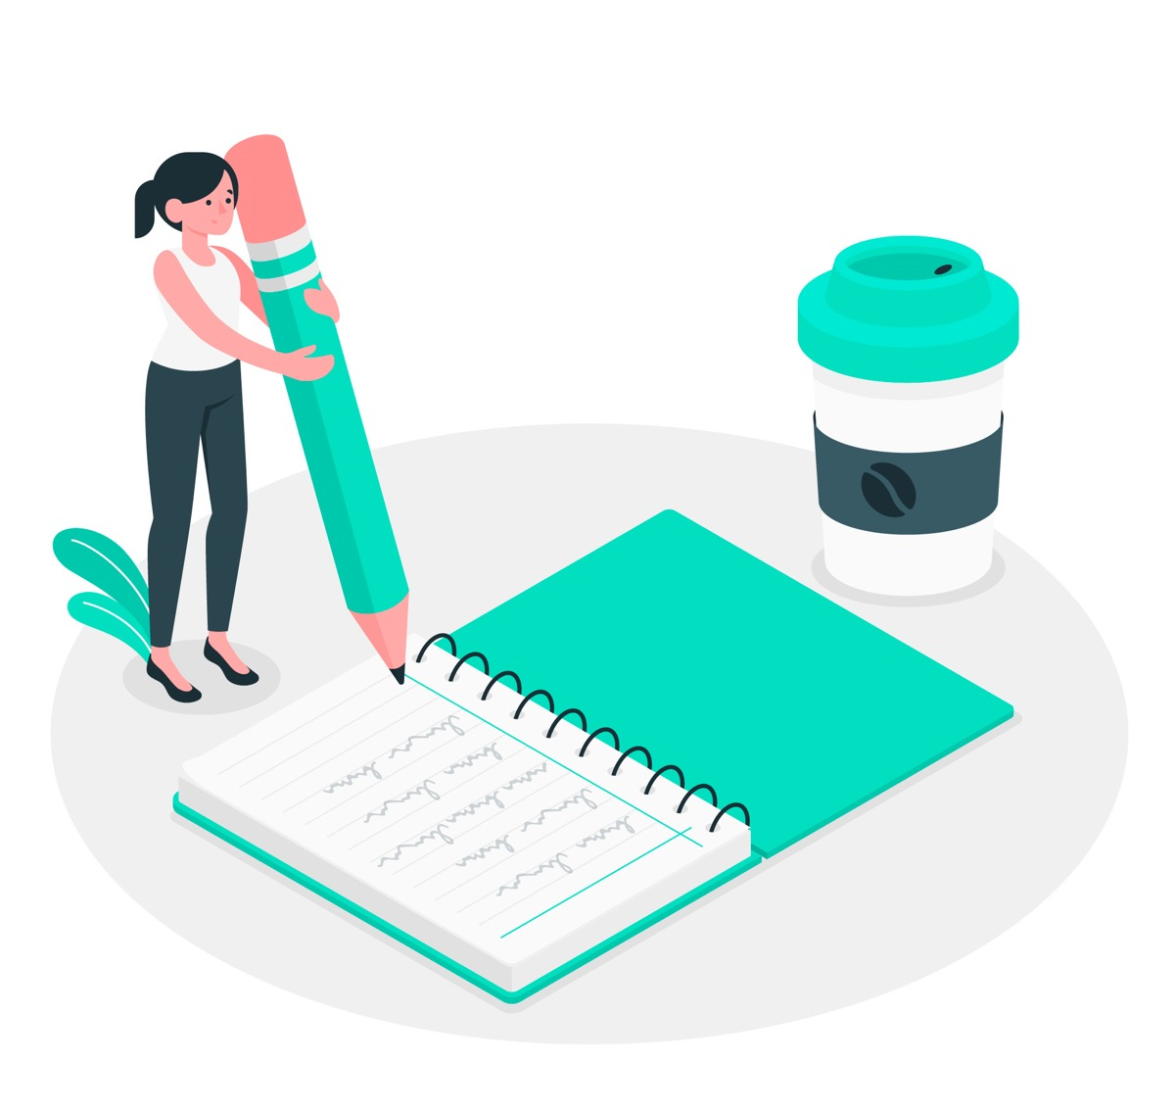
Writing competition
Write at least 3 sentences about yourself everyday.
Example:
At school, we have English lessons on Monday and Tuesday.
Notes:
Using words they have learnt.

Slide 10
PRONUNCIATION
/a:/ and /ʌ/
father and mother

Slide 11
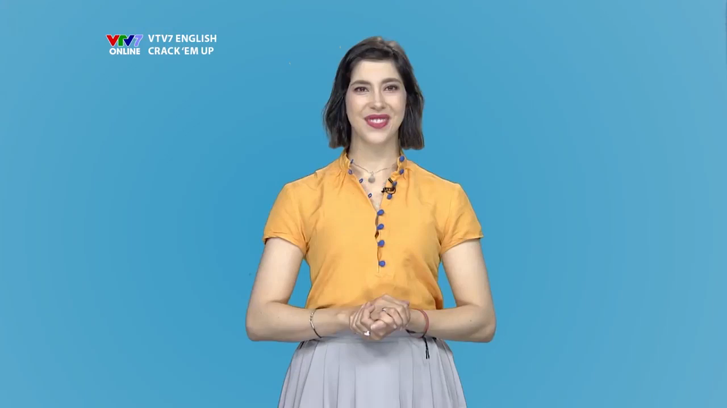

Slide 12
Ex. 4 (p 8) Listen and repeat
/ɑː/ | /ʌ/
smart | subject
art | study
carton | Monday
class | compass
01
02

Slide 13
Ex 5. (p 8) Listen and repeat.
Ex 5. (p 8) Circle the sounds /a:/ and /ʌ/
1. My brother has a new compass.
2. Our classroom is large.
3. They look smart on their first day at school.
4. The art lesson starts at nine o'clock.
5. He goes out to have lunch every Sunday.

Slide 14
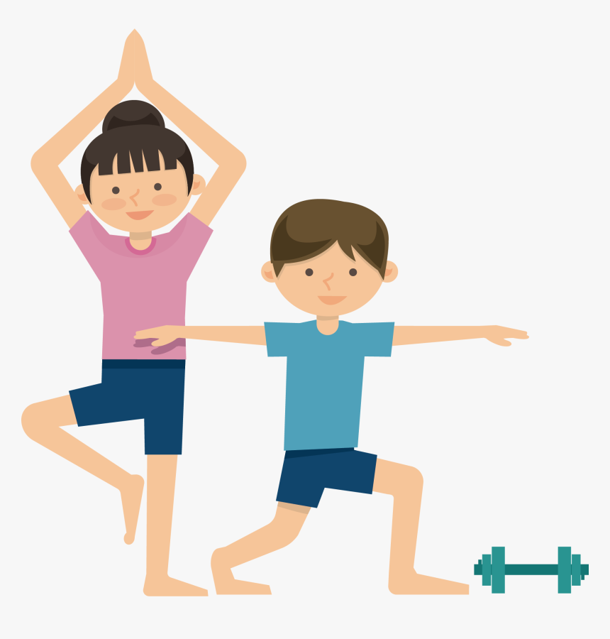
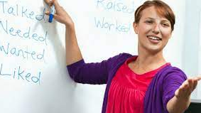

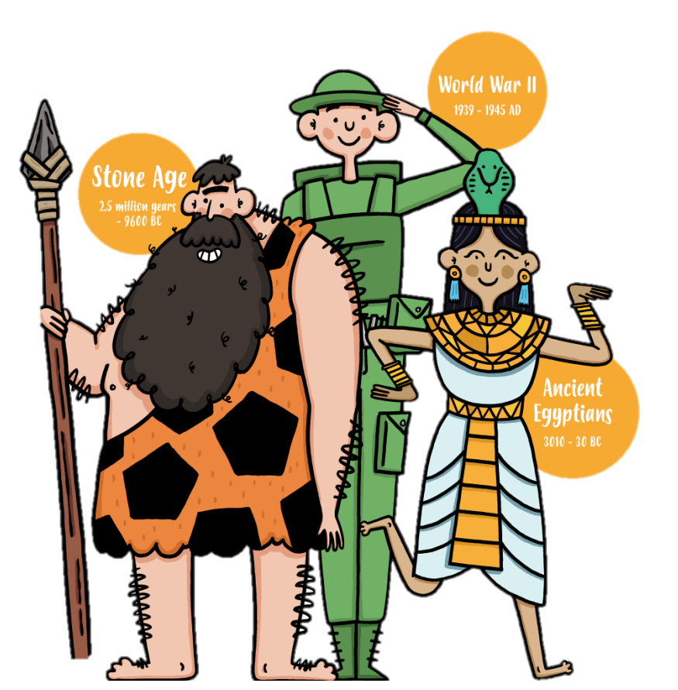

RECAP
Write their name under each picture.
3
4
1
2
lesson
English
science
exercise
5
6
7
8
music
homework
history
football

Slide 15
Do you have any questions?
Thank you!

