Slide 1

Good morning!

Slide 2



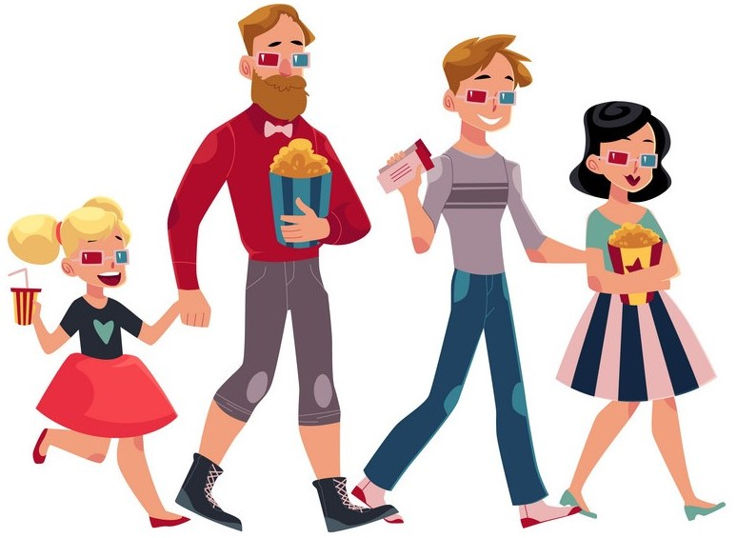
Unit
8
FILMS
LESSON 1: GETTING STARTED
Let’s go to the cinema tonight!

Slide 3

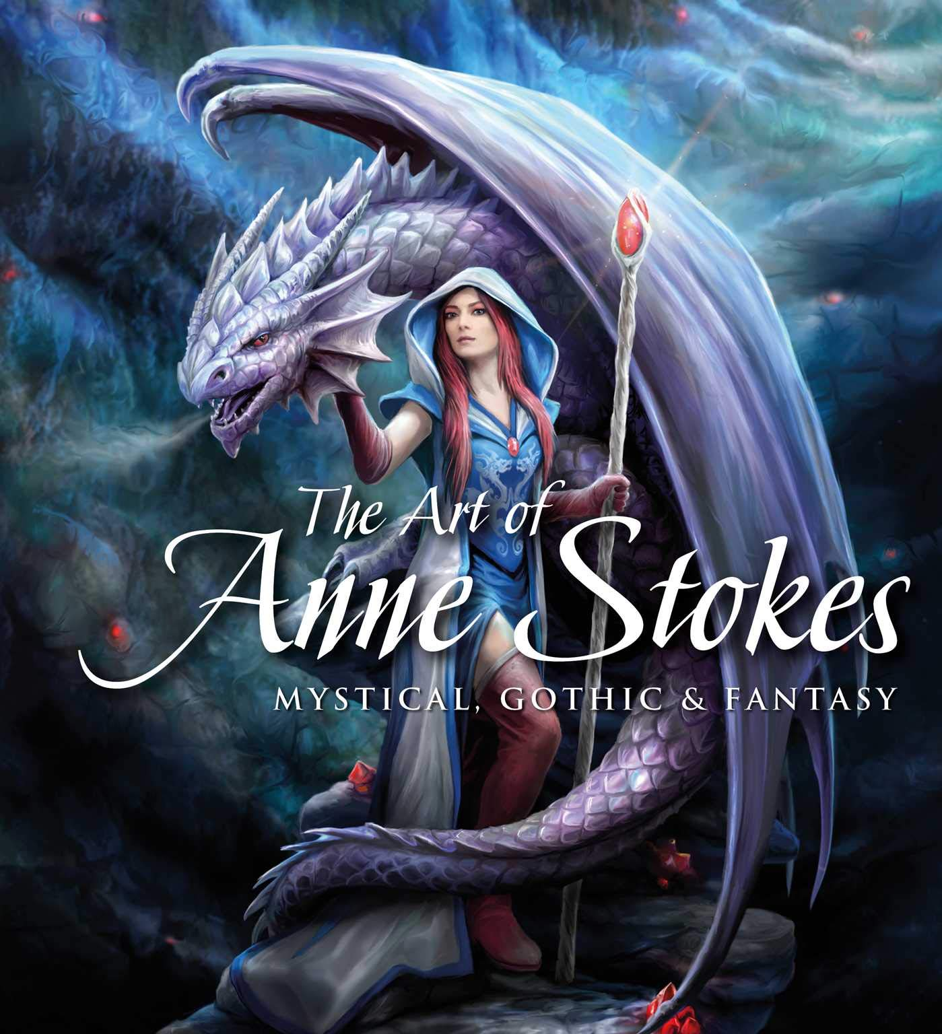
I. VOCABULARY
- fantasy (n):
/ˈfæntəsi /
phim viễn tưởng

Slide 4

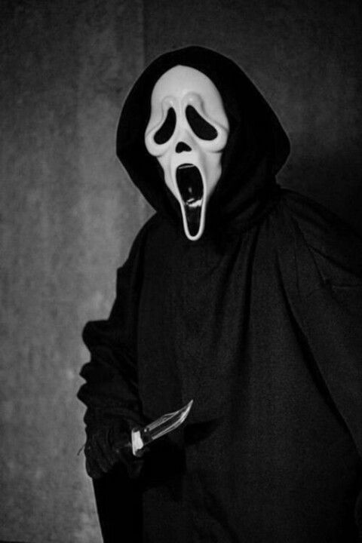
VOCABULARY
- horror film (n)
phim kinh dị
/'hɒrə fɪlm/

Slide 5
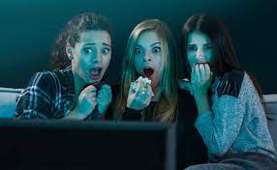
VOCABULARY
- frightening (adj)
/ˈfraɪtnɪŋ/
: đáng sợ
= scary

Slide 6
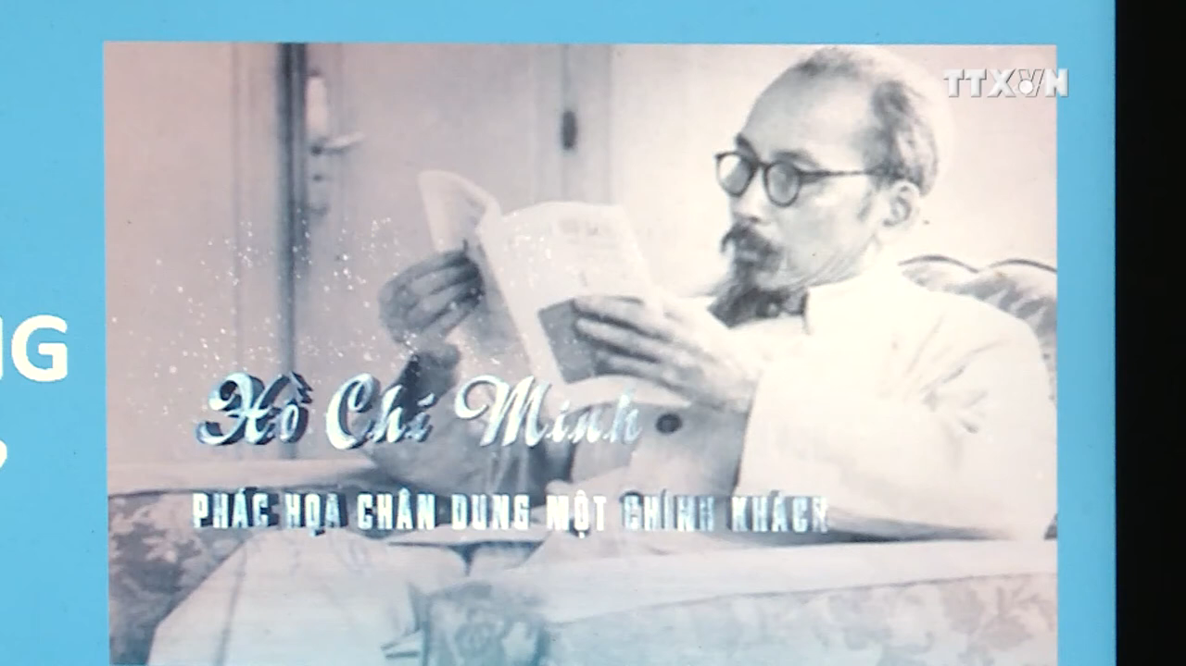

VOCABULARY
- documentary (n)
phim tài liệu
/dɒkjʊˈmentəri/

Slide 7
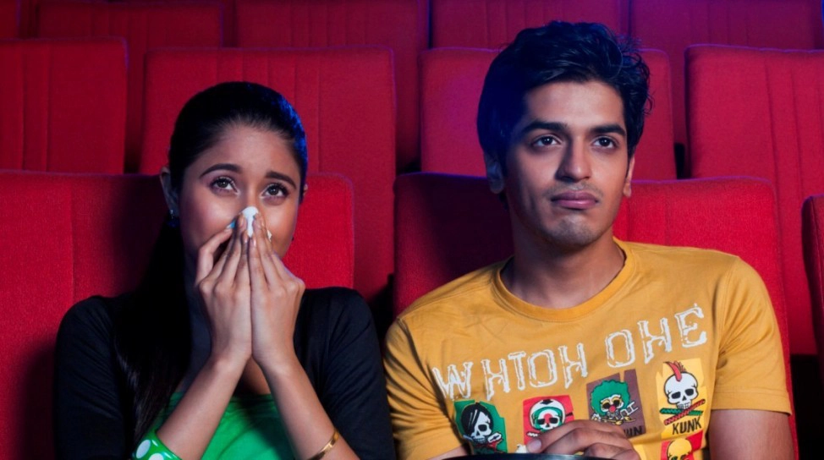
VOCABULARY
The film was moving. We cried a lot when we watched it.
-> moving (adj):
/ˈmuːvɪŋ/
xúc động

Slide 8


VOCABULARY
The film is very good! I like it very much.
- review (n) :
/rɪˈvjuː/
bài phê bình, bài bình luận

Slide 9
I. VOCABULARY
New words | Pronunciation | Meaning
-fantasy (n) | /ˈfæntəsi / | phim viễn tưởng
-horror film (n) | /'hɒrə fɪlm/ | phim kinh dị
-frightening (adj) | /ˈfraɪtnɪŋ/ | đáng sợ
-documentary (n) | /dɒkjuˈmentri/ | phim tài liệu
- moving (adj): | /ˈmuːvɪŋ/ | xúc động
- review (n) | /rɪˈvjuː/ | bài bình luận

Slide 10
I. VOCABULARY
New words | Meaning
 | a. phim tài liệu
 | b. phim kinh dị
 | c. bình luận
 | d. phim viễn tưởng
 | e. xúc động
 | f. ghê sợ
1. horror film (n)
2. documentary (n)
3. fantasy (n)
4. frightening (adj)
5. review (n)
6. moving (adj)

Slide 11
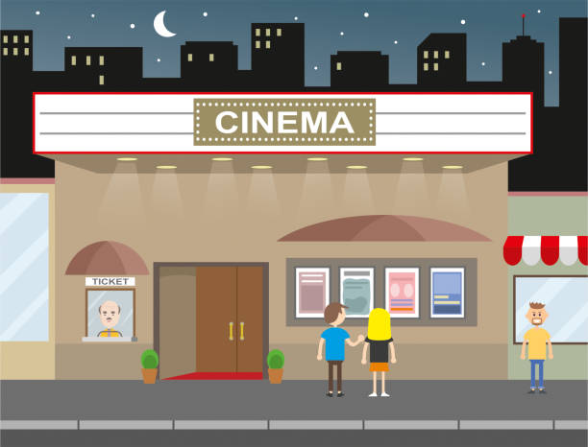
II. PRACTICE
1
Listen and read.
Mark: Let's go to the cinema tonight!
Mi: Good idea! What shall we see?
Mark: A Nightmare is on at Sao Mai Cinema tonight.
Mi: Is it a fantasy?
Mark: No, it's a horror film.
Mi: That's too scary for me. Look! An Old Pier is on at Town Cinema. It's a documentary.
Mark: I don't really like documentaries. They're often boring. What about Our Holiday?
Mi: What kind of film is it?
Mark: It's a comedy.
Mi: And who stars in it?
Mark: Kate Harrison and Lily Collins.
Mi: Um, they're pretty good. What's it about?
Mark: It's about two women living in different countries and they decide to exchange houses.
Mi: What are the reviews like?
Mark: Well, although a few people say it's a bit silly, most say it's funny and interesting.

Slide 12
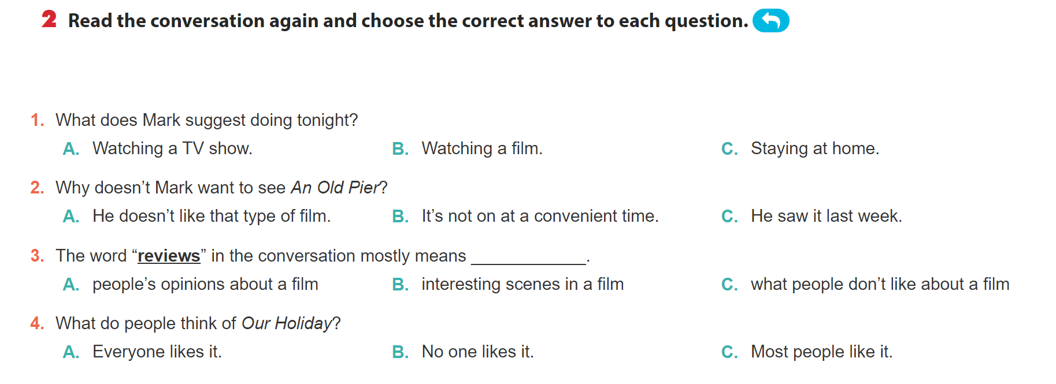

Slide 13



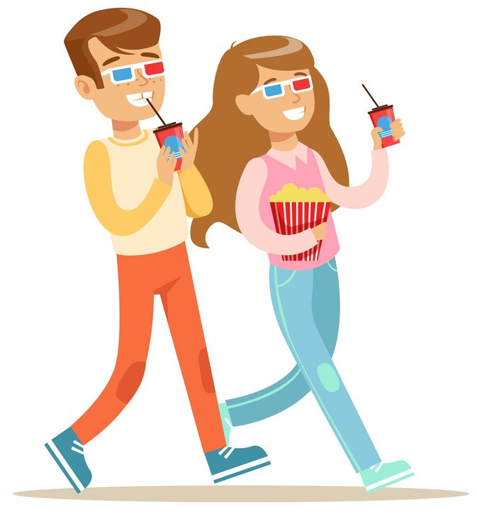
1. What does Mark suggest doing tonight?
a. Watching a TV show.
b. Watching a film.
c. Staying at home
Mark: Let’s go to the cinema tonight!
Hoa: Good idea! What shall we see?

Slide 14
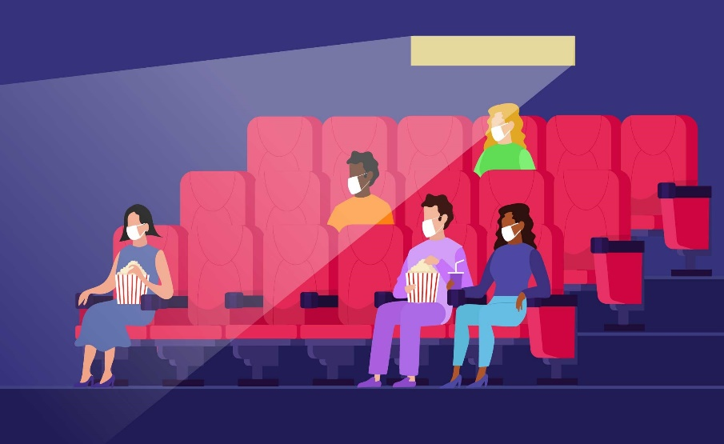
2. Why doesn’t Mark want to see An Old Pier?
a. He doesn’t like that type of film.
b. It’s not on at a convenient time
c. He saw it last week.
Hoa: That’s too frightening for me. Look! An Old Pier is on at the Town Cinema. It’s a documentary.
Mark: I don’t really like documentaries. They’re often boring. What about Our Holiday?

Slide 15

3. The word “reviews” in the conversation mostly means….
a. people’s opinions about the film
b. interesting scenes in the film
c. what people don’t like about the film

Slide 16
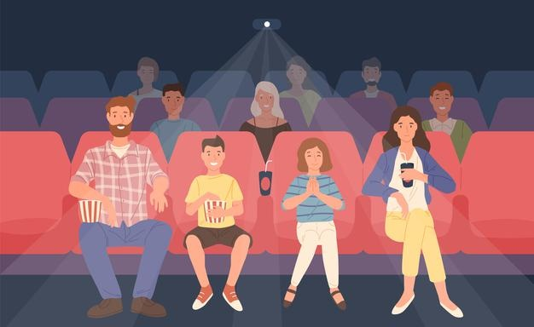
4. What do people think of Our Holiday?
a. Everyone likes it.
b. No one likes it.
c. Most people like it.
Hoa: What are the reviews like?
Mark: Well, although a few people say it’s a bit silly, most say it’s funny and interesting.

Slide 17
* PRACTICE
3
Choose the correct word or phrase to complete each of
the following sentences.
comedy
fantasy
science fiction film
1. A film that tries to make the audience laugh is a (comedy / documentary).
Types of films
horror film
docu-mentary
cartoon

Slide 18
* PRACTICE
3
Choose the correct word or phrase to complete each of
the following sentences.
Game: Who is faster?
comedy
fantasy
science fiction film
2. A film that is based only on
imagination, not on real facts, is a (comedy/ fantasy).
Types of films
horror film
docu-mentary
cartoon

Slide 19
* PRACTICE
3
Choose the correct word or phrase to complete each of
the following sentences.
comedy
Game: Who is faster?
fantasy
science fiction film
3. A film that shows real life events or stories is a (documentary/ horror film).
Types of films
horror film
docu-mentary
cartoon

Slide 20
* PRACTICE
3
Choose the correct word or phrase to complete each of
the following sentences.
comedy
Game: Who is faster?
fantasy
science fiction film
4. A film that is set in the future, often about science, is a (cartoon/ science fiction).
Types of films
horror film
docu-mentary
cartoon

Slide 21
* PRACTICE
3
Choose the correct word or phrase to complete each of
the following sentences.
comedy
Game: Who is faster?
fantasy
science fiction film
5. A film in which strange and frightening things happen is a
(horror film/ comedy).
Types of films
horror film
docu-mentary
cartoon

Slide 22
4
Complete the following sentences with the words in the box.
funny
interesting
frightening
moving
boring
1. Going to the hospital can be _________________ for a child.
2. The film was so _______________ that the audience couldn’t stop laughing.
3. Many people cried when they saw the _______________ scenes of the film.
4. The film last night was so _______________ that we fell asleep.
5. This book is ________________. I got a lot of useful information from it.
frightening
funny
moving
boring
interesting

Slide 23

* PRODUCTION
5
Work in pairs. ask and answer about a type of film. Use some of the adjectives in Task 4.
Example:
A: Do you like documentaries?
B: Yes, I do./(No, I don’t.)
A: Why?/ (Why not?)
B: I think they’re interesting/ (boring).

Slide 24
* CONSOLIDATION
Topic of the unit
FILMS
Vocabulary
Types of films
Adjectives describing films

Slide 25

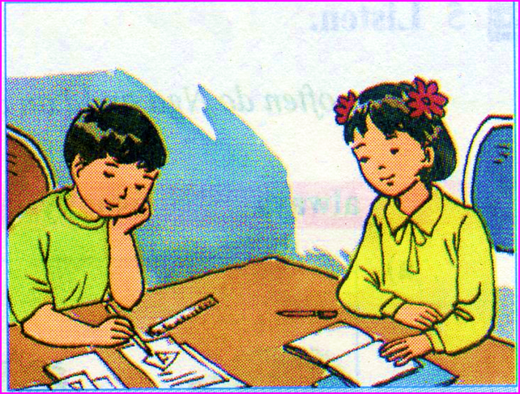
homework
1. Learn the new words and write at least 3 sentences with the new words you like.
2. Prepare: Unit 8 - A closer look 1

Slide 26

Thanks for your attendance!
Goodbye. See you again
Notes:
26

