Slide 1


Slide 2


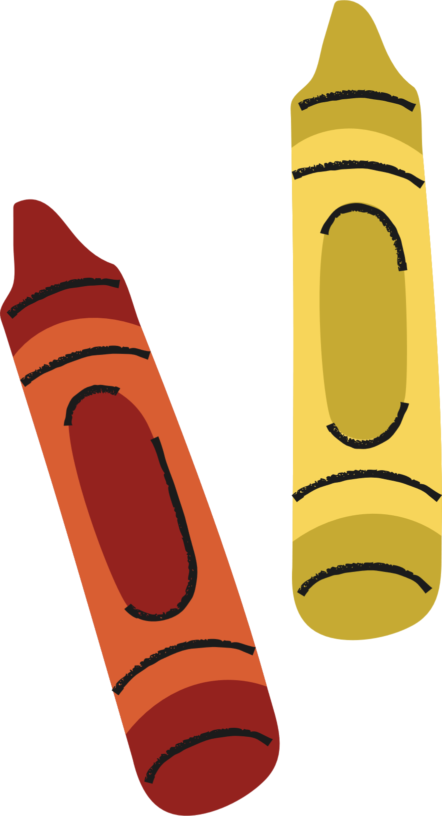



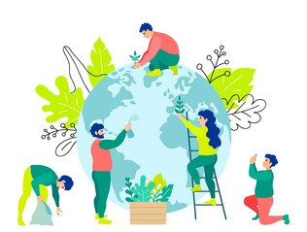


Saturday, October 21st, 2023
UNIT 3:
COMMUNITY SERVICE
LESSON 5: SKILLS 1
Let's learn and have fun!

Slide 3



LESSON 5: SKILLS 1
WARM-UP
Game: Who is faster?
Aims of the stage:
To introduce the topic of reading.
To enhance students’ skills of cooperating with team mates

Slide 4
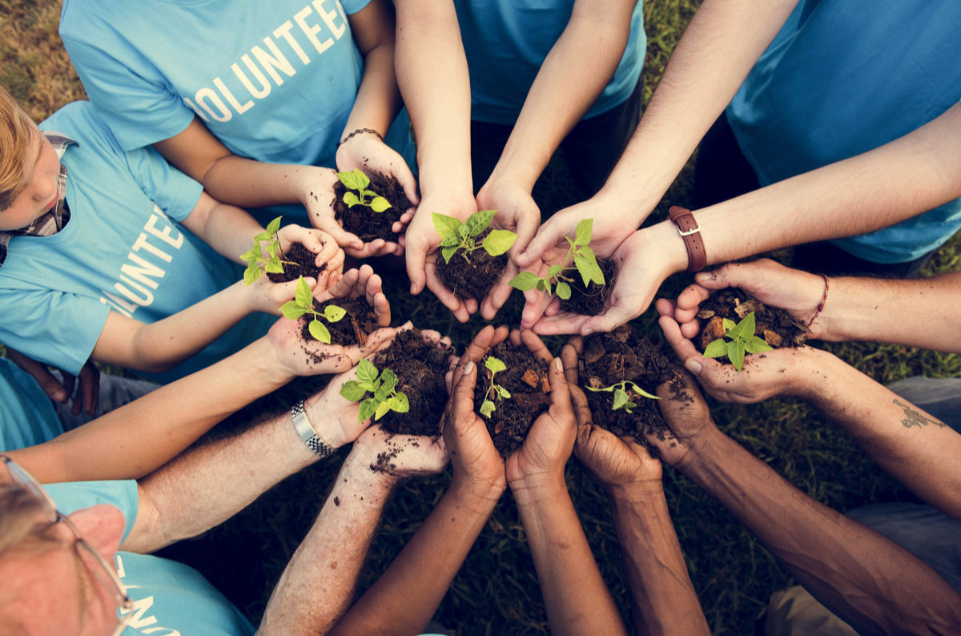

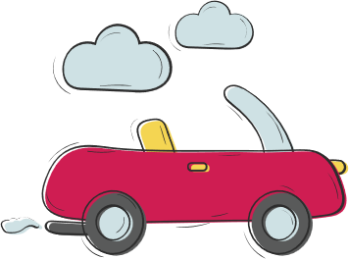

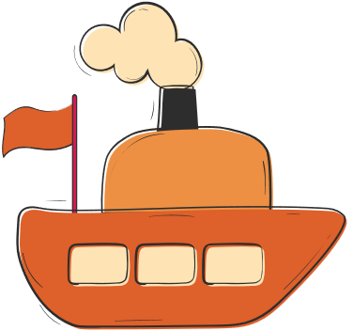

WARM-UP

Slide 5
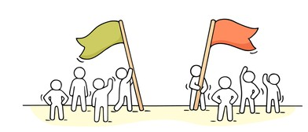
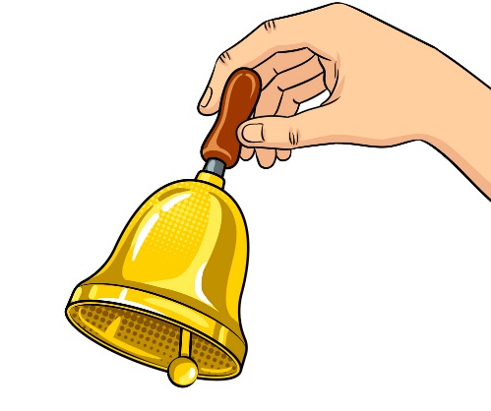
WARM-UP: WHO IS FASTER?
Two teams
Look at the pictures
Ring the bell
Answer
“What is a community activity?

Slide 6
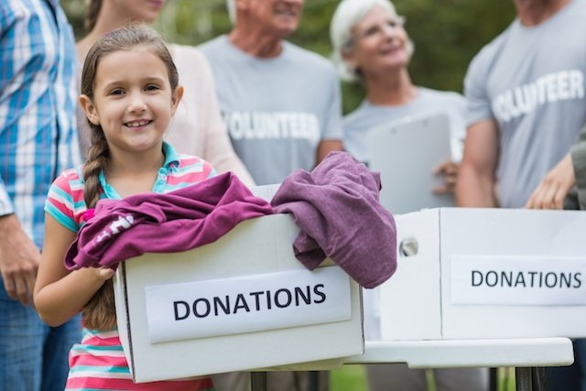
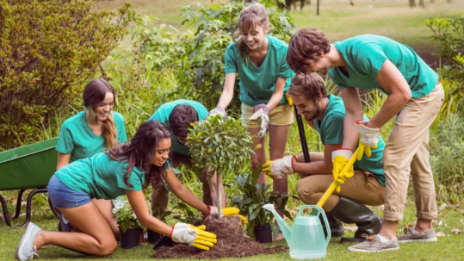
WARM-UP: WHO IS FASTER?
1.
2.
donating clothes
planting trees

Slide 7
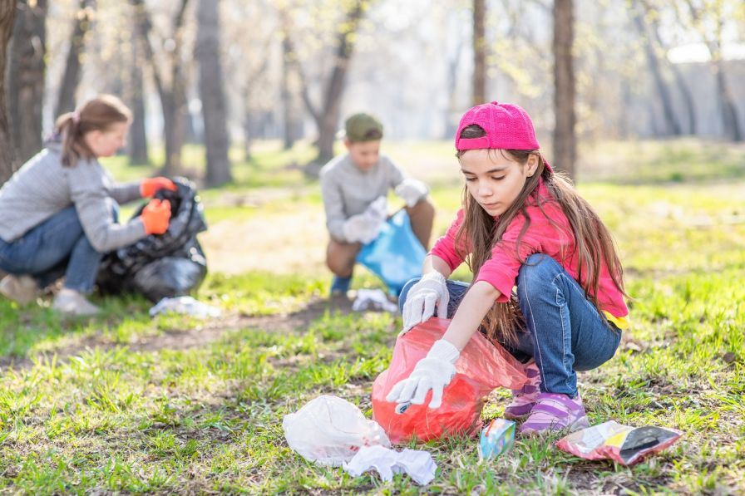
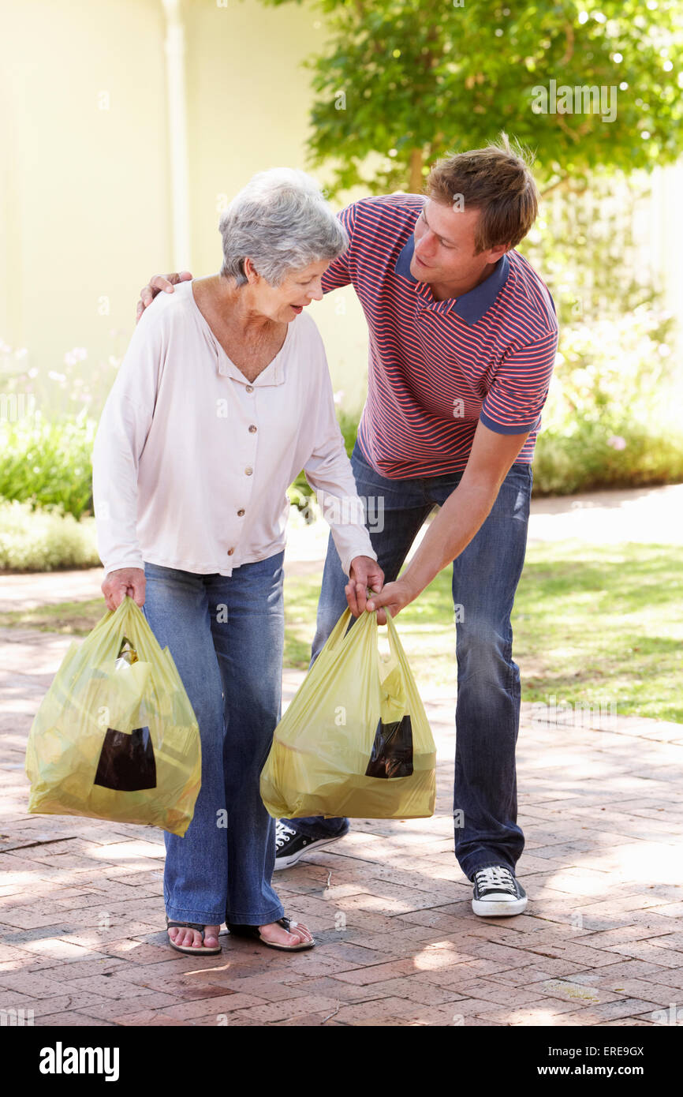
WARM-UP: WHO IS FASTER?
3.
4.
picking up litter
helping old people

Slide 8

WARM-UP: WHO IS FASTER?
5.
tutoring

Slide 9
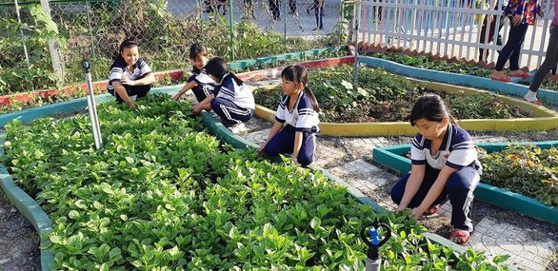

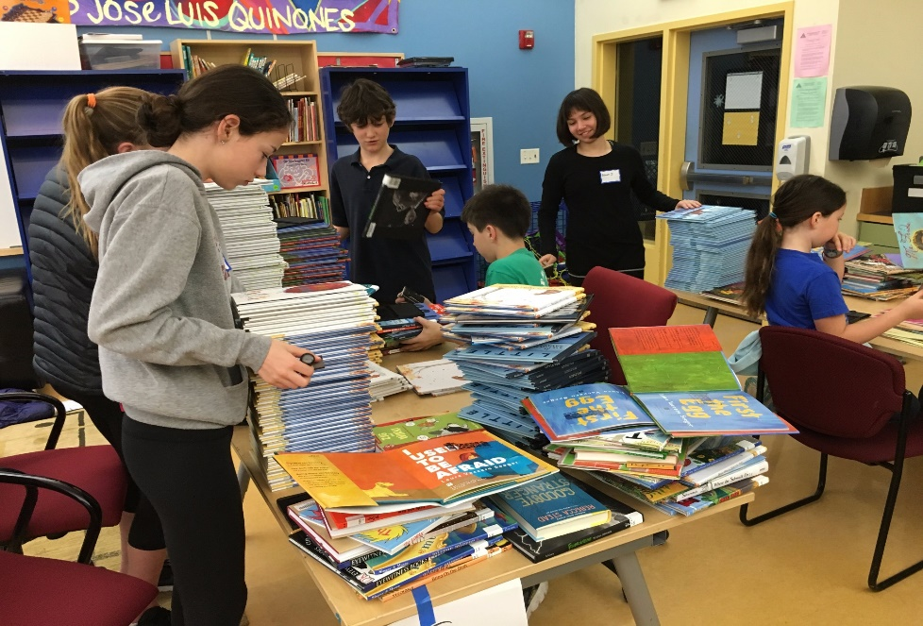
PRE-READING
1
1: Work in pairs. Circle the activities you would like to do at your school.
A. growing vegetables in the school garden
B. tutoring other students
C. collecting books for the school library
I would like to………………………..

Slide 10



Unit
3
COMMUNITY SERVICE
LESSON 5: SKILLS 1
I. READING
Unit
Projects in Bright Future School

Slide 11


VOCABULARY
monthly (adj/adv)
/ˈmʌnθli/
hằng tháng

Slide 12

VOCABULARY
proud (adj)
/praʊd/
hài lòng, tự hào

Slide 13
Reading
* Vocabulary
1. monthly (adj/adv): | hằng tháng |  | /ˈmʌnθli/
2. proud (adj): | hài lòng, tự hào |  | /praʊd/

Slide 14
2
Read the passage and match the highlighted words with their meanings.
Bright Future School has many community activities for students. The school believes that a good way for students to develop themselves is through community service. All students can join any of these different projects: – Tutoring: Upper grade students tutor lower grade students. – Postcard-to-Help: Students make and sell postcards to raise money for local children. – Visit-to-Read: Students visit a nursing home monthly and read books to the elderly. – Garden-to-Give: Students grow vegetables and donate them to local schools. – Paper-Plant-Exchange: Students collect paper and exchange it for plants. They then look after the plants in their school garden. Students learn that they can help people and the world around them when they do community service. They feel useful and proud because they do good things.
tutor
monthly
donate
exchange
proud

Slide 15
2
Read the passage and match the highlighted words with their meanings.
tutor
monthly
donate
exchange
proud
1. give
donate
2. give and receive
exchange
3. every month
monthly
4. pleased
proud
5. teach
tutor

Slide 16
WHILE-READING
Bright Future School has many community activities for students. The school believes that a good way for students to develop themselves is through community service. All students can join any of these different projects: – Tutoring: Upper grade students tutor lower grade students. – Postcard-to-Help: Students make and sell postcards to raise money for local children. – Visit-to-Read: Students visit a nursing home monthly and read books to the elderly. – Garden-to-Give: Students grow vegetables and donate them to local schools. – Paper-Plant-Exchange: Students collect paper and exchange it for plants. They then look after the plants in their school garden. Students learn that they can help people and the world around them when they do community service. They feel useful and proud because they do good things.
tutor
monthly
donate
exchange
proud

Slide 17
3
Read the passage again and tick True or False.
 | True | False
1. Community service allows students to develop themselves.
2. Each student can join only one project.
3. They tutor younger students.
4. Local children receive postcards from the Postcard-to-Help project.
5. Students receive plants when they give paper.

Slide 18

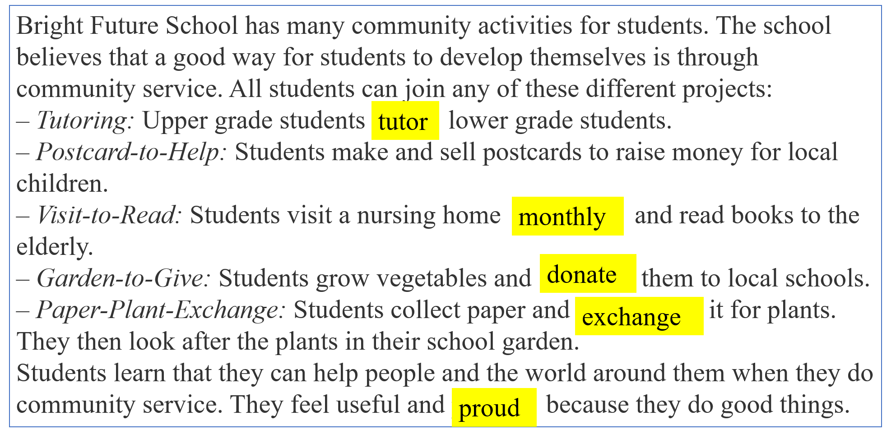
3
Read the passage again and tick True or False.
 | True | False
1. Community service allows students to develop themselves.
The school believes that a good way for students to develop themselves is through community service.

Slide 19
3
3
Read the passage again and tick True or False.
Read the passage again and tick True or False.
 | True | False
2. Each student can join only one project.
All students can join
any of these different projects

Slide 20
3
Read the passage again and tick True or False.
 | True | False
3. They tutor younger students.
Upper grade students tutor lower grade students.

Slide 21
3
Read the passage again and tick True or False.
 | True | False
4. Local children receive postcards from the Postcard-to-Help project.
Postcard-to-Help: Students make and sell postcards to raise money for local children.

Slide 22
3
Read the passage again and tick True or False.
 | True | False
5. Students receive plants when they give paper.
Students collect paper and exchange it for plants.

Slide 23
WHILE-READING
3
Read the passage again and tick True or False.
 | True | False
1. Community service allows students to develop themselves.
2. Each student can join only one project.
3. They tutor younger students.
4. Local children receive postcards from the Postcard-to-Help project.
5. Students receive plants when they give paper.

Slide 24
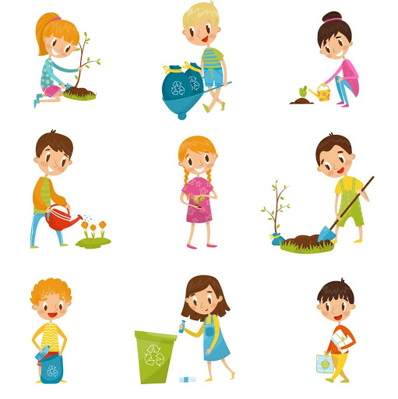
Unit
3
COMMUNITY SERVICE
LESSON 5: SKILLS 1
II. SPEAKING
What project you can do?

Slide 25
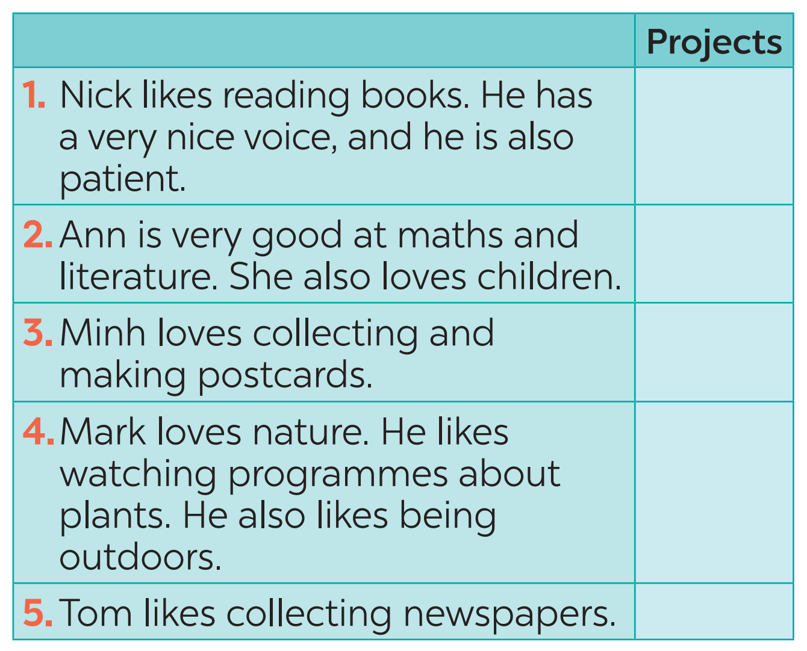
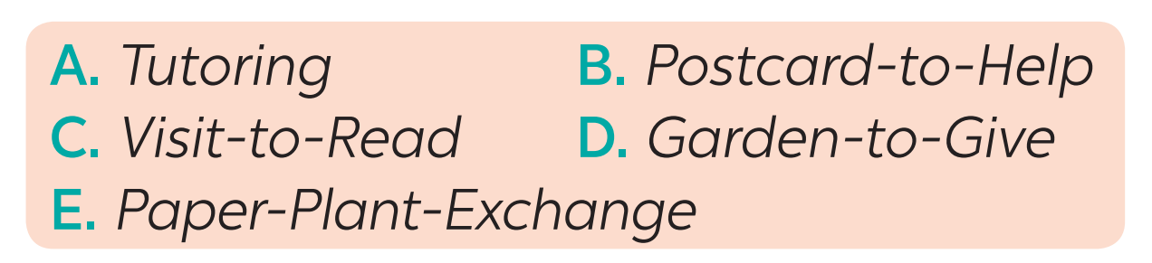
4
Read about these students.
Write the names of the projects you think they should join in the Projects column.
C
A
B
D
E

Slide 26
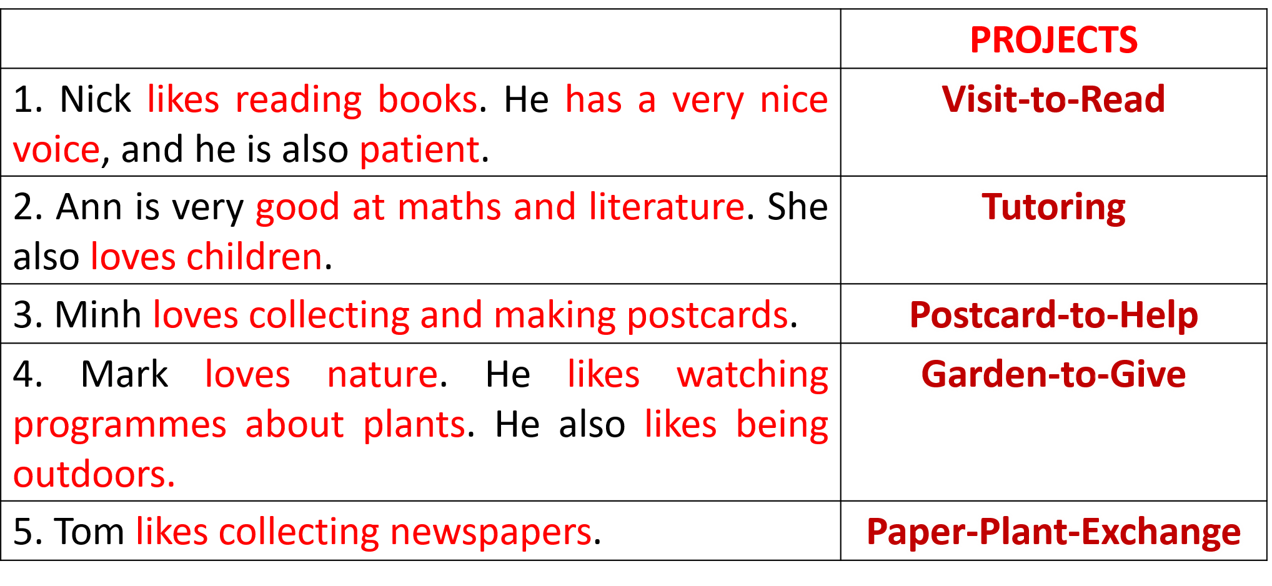
5
Discuss which project in Task 4 you would like to join, and why. Report your group’s answers to the class.
Example: I will join the Tutoring project because I’m good at maths and English. I also love children.
Report:
Lan will join the Tutoring project because she is good at maths and English. She also loves children.

Slide 27
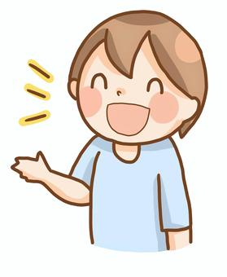
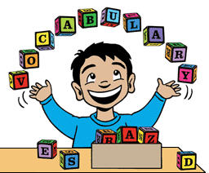

FEEDBACK
1. PRONUNCIATION
2. VOCABULARY
3. FLUENCY

Slide 28
III. Wrap-up
READING
SPEAKING
Projects in Bright Future School
What project you can do?

Slide 29

IV. HOMEWORK
1. Do exercises in Workbook
2. Prepare for the next lesson:
Lesson 6: Skills 2

Slide 30









