Slide 1

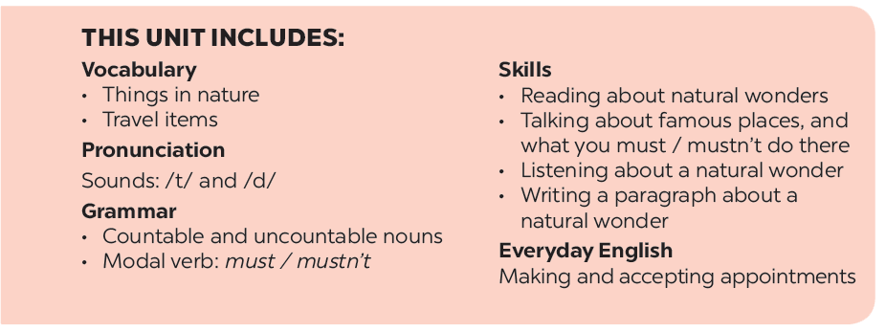

Slide 2
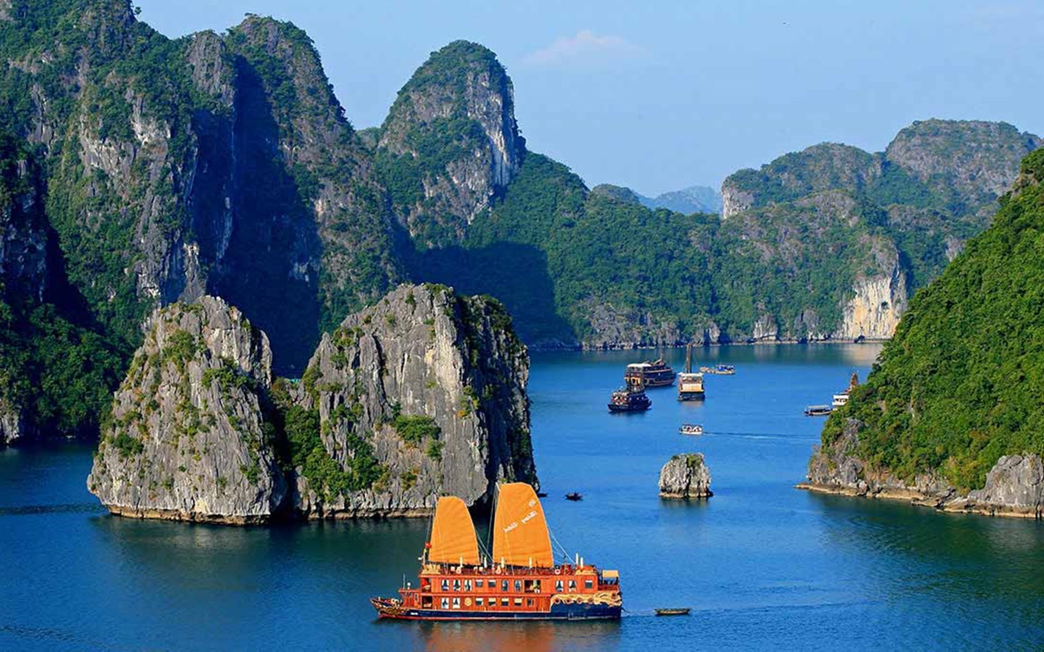
UNIT 5:
NATURAL WONDERS OF VIETNAM
LESSON 1: GETTING STARTED

Slide 3







Geography Club
Listen and read.
Listen and repeat the words, then label the pictures.
Complete the following sentences with the words from the box.
Work in groups. Choose the correct answer to each of the questions.

Slide 4



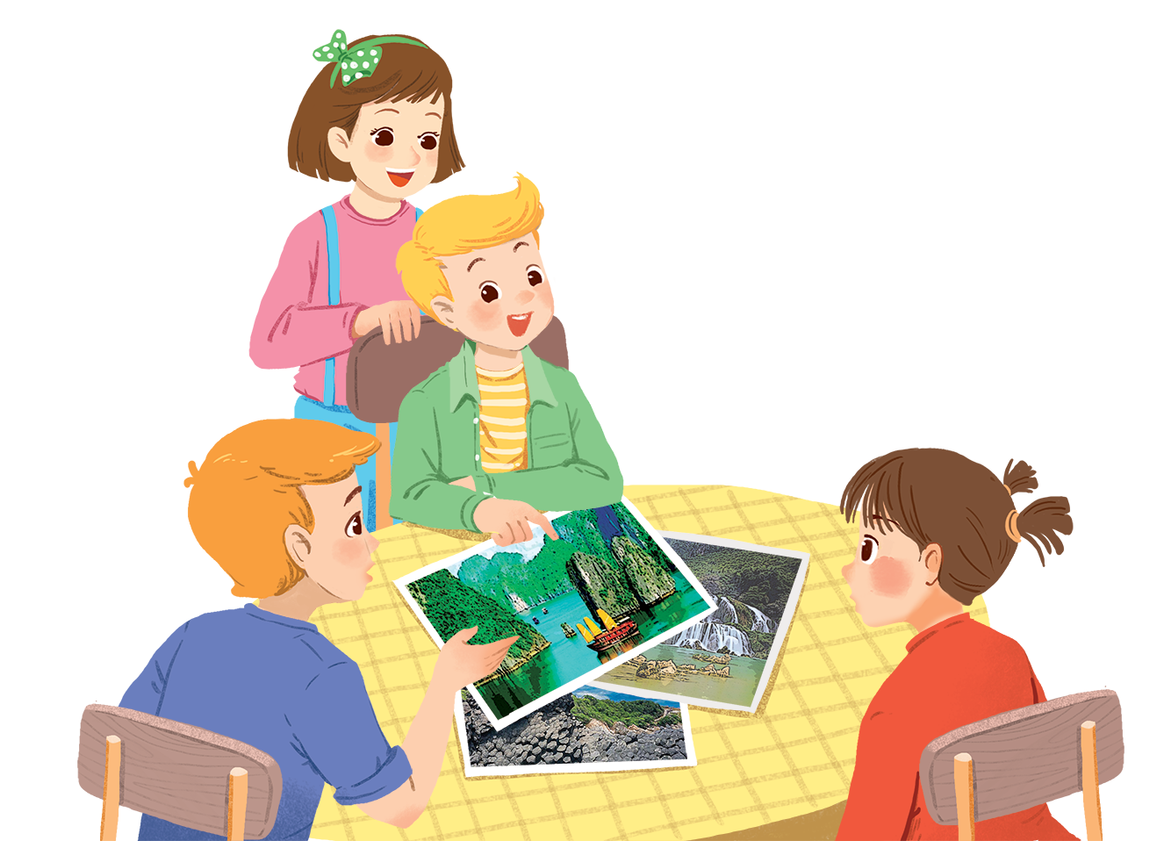
Listen and read.
Geopraphy Club

Slide 5

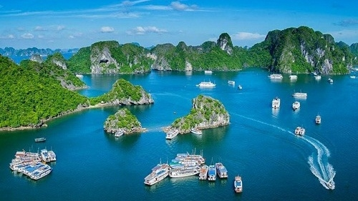
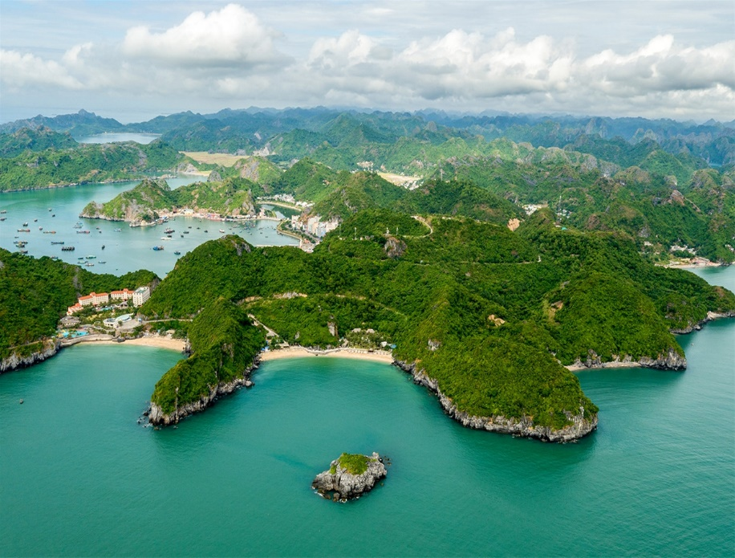
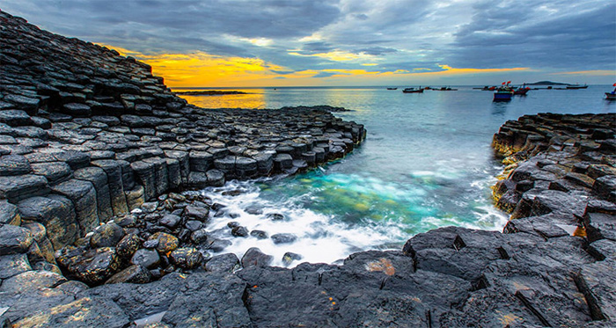
UNIT 5. NATURAL WONDERS OF VIETNAM
Lesson 1: Getting started
I. Listen and read
*Vocabulary
natural wonder (n)
island (n)
Gành Đá Đĩa
– Phú Yên

Slide 6
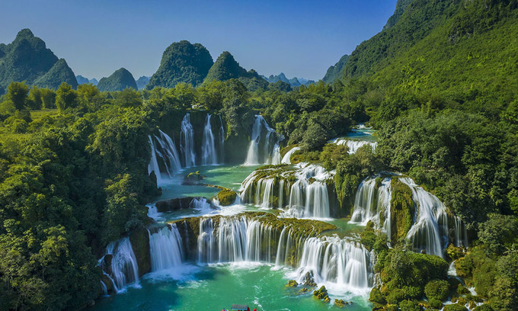
UNIT 5. NATURAL WONDERS OF VIETNAM
Lesson 1: Getting started
I. Listen and read
*Vocabulary
rock (n)
waterfall (n)
Gành Đá Đĩa– Phú Yên

Slide 7
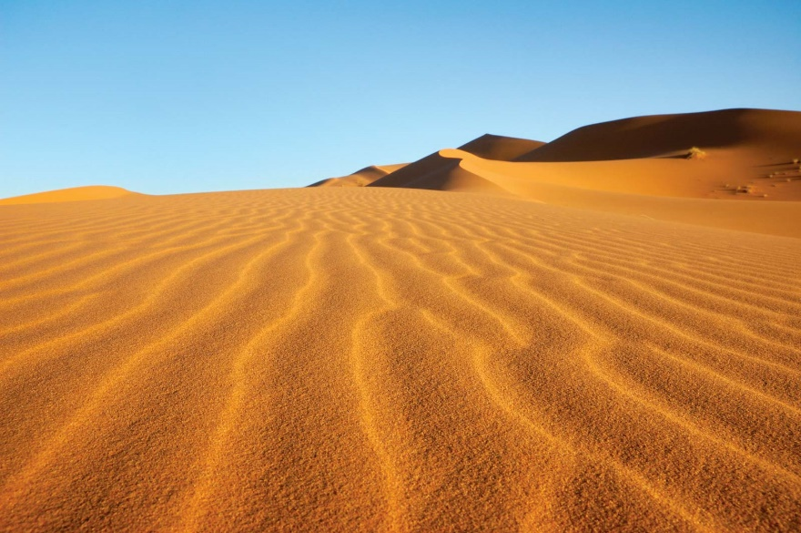
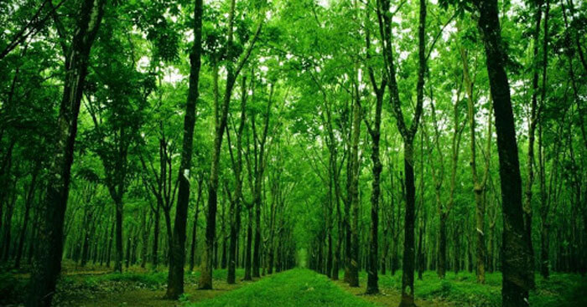
UNIT 5. NATURAL WONDERS OF VIETNAM
Lesson 1: Getting started
I. Listen and read
*Vocabulary
desert (n)
forest (n)

Slide 8
UNIT 5. NATURAL WONDERS OF VIETNAM
Lesson 1: Getting started
I. Listen and read
*Vocabulary
1. | natural wonder | (n) | kì quan thiên nhiên
2. | island | (n) | đảo
3. | amazing | (adj) | tuyệt vời
4. | scenery | (n) | phong cảnh
5. | rock | (n) | tảng đá
6. | waterfall | (n) | thác nước
7. | desert | (n) | sa mạc
8. | forest | (n) | rừng

Slide 9
1. | natural wonder | (n) | kì quan thiên nhiên
2. | island | (n) | đảo
3. | amazing | (adj) | tuyệt vời
4. | scenery | (n) | phong cảnh
5. | rock | (n) | tảng đá
6. | waterfall | (n) | thác nước
7. | desert | (n) | sa mạc
8. | forest | (n) | rừng

Slide 10
Geopraphy Club
Alice: Hello, welcome to our Geography Club.
(Knock at door)
Alice: Come in, Elena. We’re just starting now.
But remember you must always be on time.
Elena: Sure. Sorry.
Alice: Today I’m going to talk about some natural wonders of Viet Nam.
Nick: Great! What’s that in the first picture?
Alice: It’s Ganh Da Dia in Phu Yen.
Elena: Wow. It looks amazing!
Nick: Is picture 2 Ha Long Bay?
Alice: Right. What do you know about it?
Nick: It has many islands.
Alice: Yeah! The scenery is wonderful. This picture shows Tuan Chau, a large island.
Tommy: How about picture 3?
…

Slide 11

Complete the following sentences with the words from the box.
scenery
amazing
natural
islands
wonders
1.
People didn’t make Ganh Da Dia.
They are rocks.
natural
Ha Long Bay has thousands of big and small .
2.
islands
scenery
3.
Ha Long Bay is charming and the is wonderful.
Ganh Da Dia has rock columns of different shapes and sizes.
4.
amazing
5.
wonders
There are many natural and man-made in Viet Nam.

Slide 12

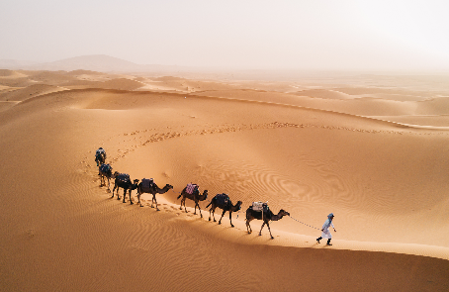
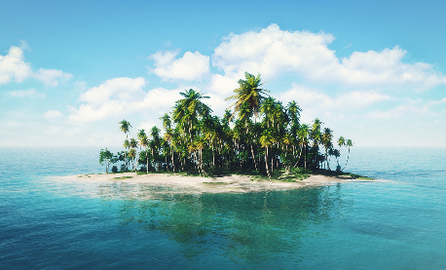
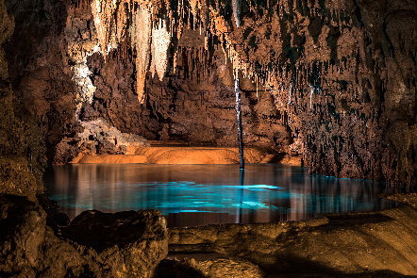
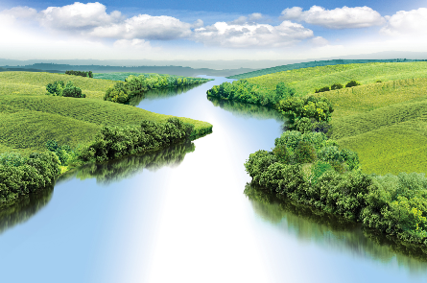
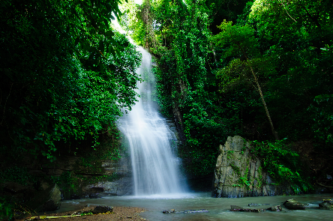
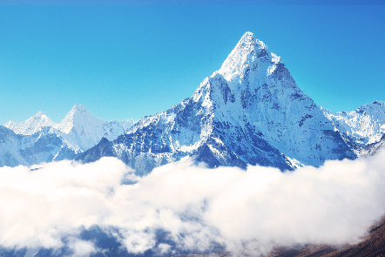
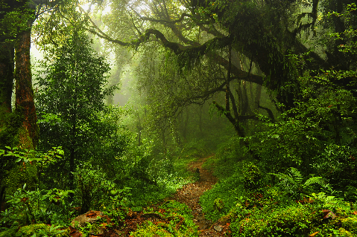
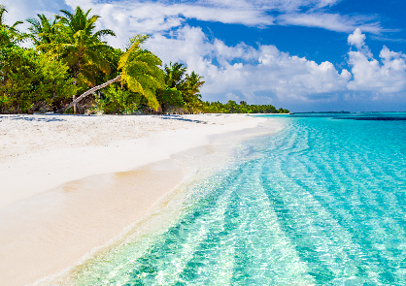
Listen and repeat the words, then label the pictures.
1. mountain
3. waterfall
5. cave
7. beach
2. river
4. forest
6. desert
8. island
a.
b.
c.
d.
e.
f.
g.
h.

Slide 13

1. mountain
3. waterfall
5. cave
7. beach
2. river
4. forest
6. desert
8. island
a.
a. desert

Slide 14
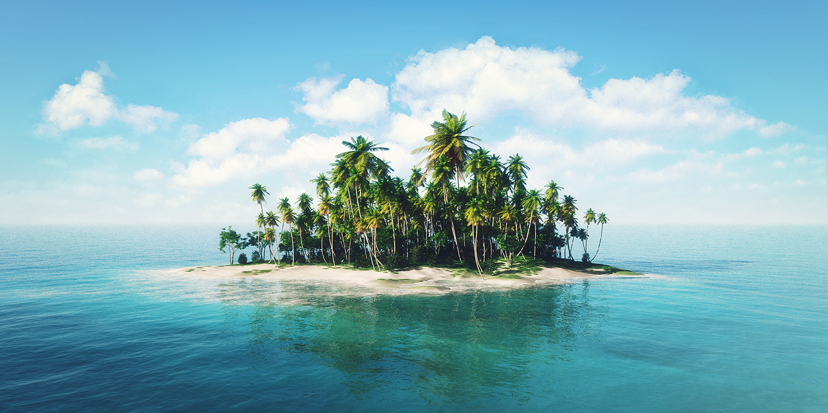
1. mountain
3. waterfall
5. cave
7. beach
2. river
4. forest
6. desert
8. island
b.
b. island

Slide 15
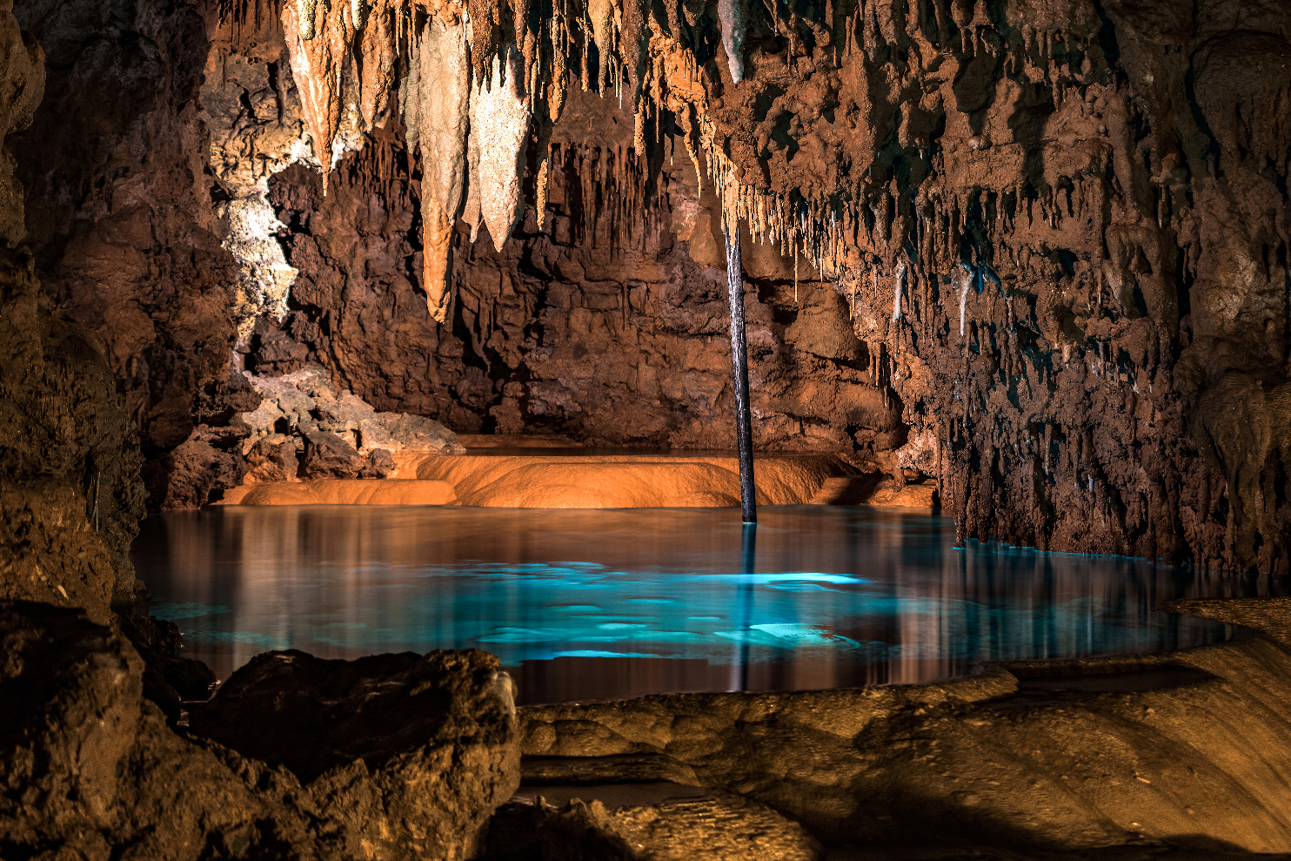
1. mountain
3. waterfall
5. cave
7. beach
2. river
4. forest
6. desert
8. island
c.
c. cave

Slide 16

1. mountain
3. waterfall
5. cave
7. beach
2. river
4. forest
6. desert
8. island
d.
d. river

Slide 17

1. mountain
3. waterfall
5. cave
7. beach
2. river
4. forest
6. desert
8. island
e.
e. waterfall

Slide 18
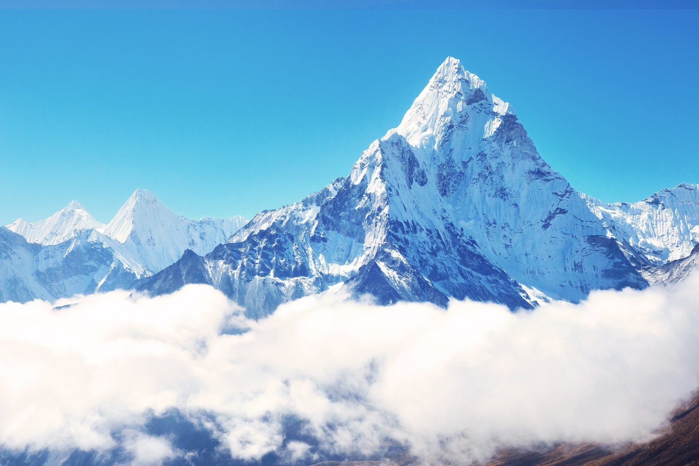
1. mountain
3. waterfall
5. cave
7. beach
2. river
4. forest
6. desert
8. island
f. mountain
f.

Slide 19

1. mountain
3. waterfall
5. cave
7. beach
2. river
4. forest
6. desert
8. island
g.
g. forest

Slide 20
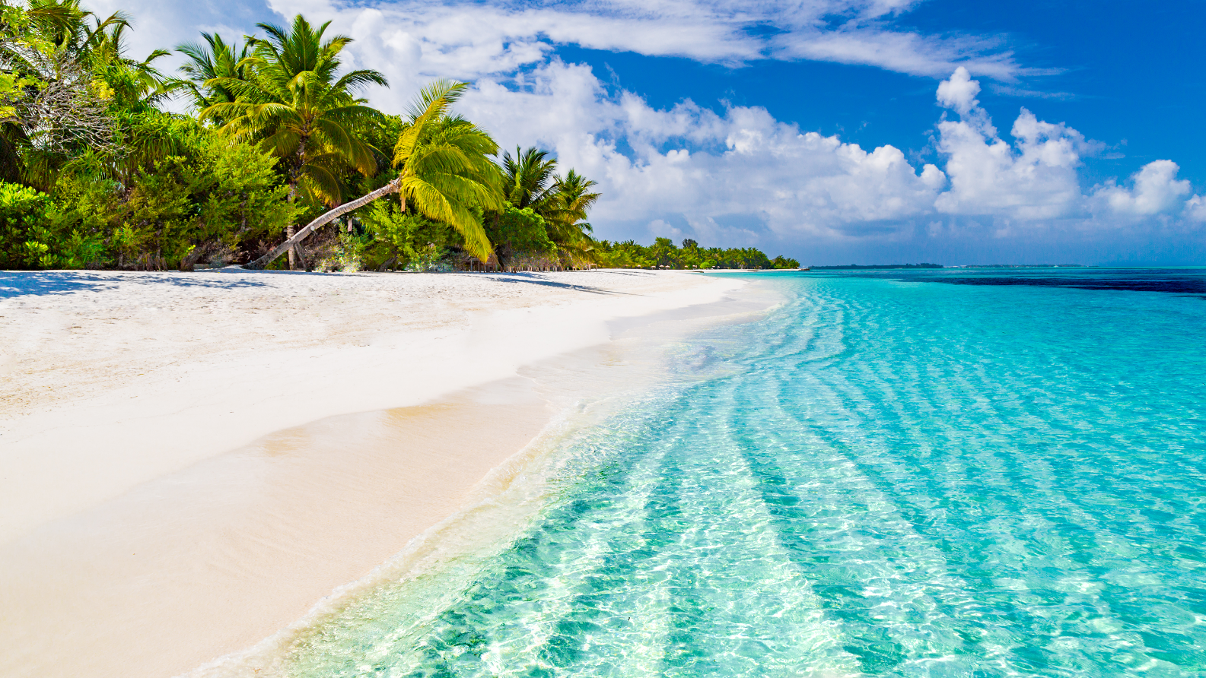
1. mountain
3. waterfall
5. cave
7. beach
2. river
4. forest
6. desert
8. island
h.
h. beach

Slide 21


Work in groups. Choose the correct answer to each of the questions.
1.
Which is an island in Viet Nam?
A.
Con Dao
B.
Son Doong
2.
Where is Mount Fansipan?
A.
In Lao Cai
B.
In Quang Binh
3.
Which of the following is a national park?
A.
Thong Nhat Park
B.
Cat Tien Park
4.
Which of the following wonders is a cave?
A.
Cuc Phuong
B.
Phong Nha
5.
Which waterfall is in Cao Bang?
A.
Giang Dien Waterfall
B.
Ban Gioc Waterfall

Slide 22
III. Wrap- up
UNIT 5
GETTING STARTED
Topic of the unit
Vocabulary
NATURAL WONDERS OF VIETNAM
Things in nature
desert, cave, waterfall, river,…..

Slide 23

V. Homework
Learn by heart all the vocabulary
Prepare: Unit 5 – A Closer look 1

