Slide 1

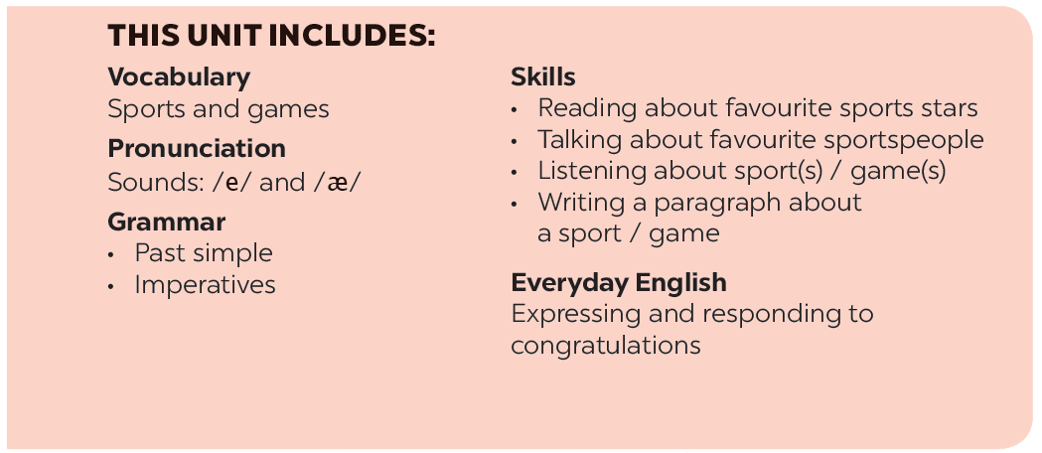

Slide 2
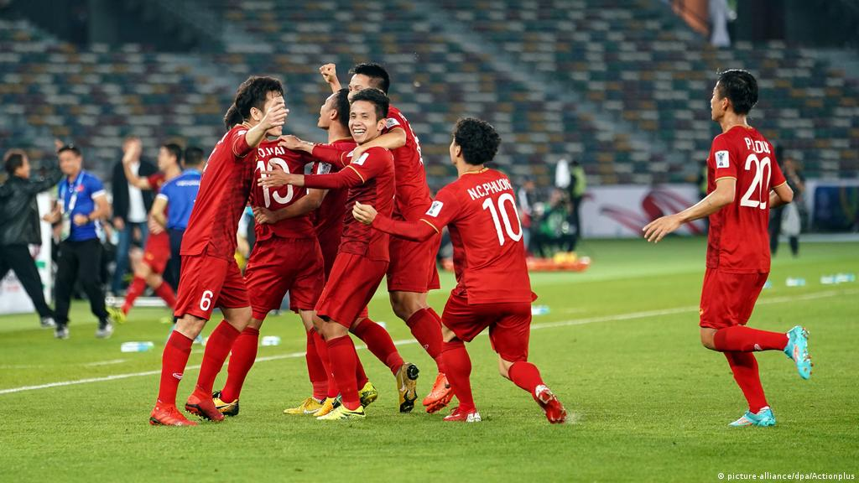
UNIT 8: SPORTS AND GAMES LESSON 2: A CLOSER LOOK 1

Slide 3







Vocabulary
Pronunciation
/e/ and /æ/
Write the right words under the pictures.
Listen and repeat. Pay attention Track to the sounds /e/ and /æ/.
What sports are these things for? Match each thing in column A with a sport in column B.
Listen and repeat. Underline the words having the sounds /e/ and /æ/.
Fill each blank with one of the words from the box.

Slide 4
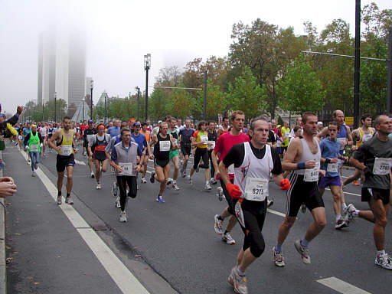
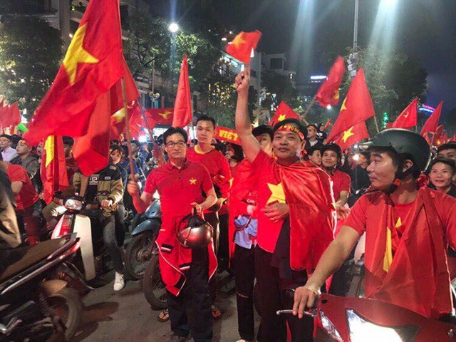
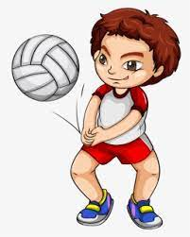
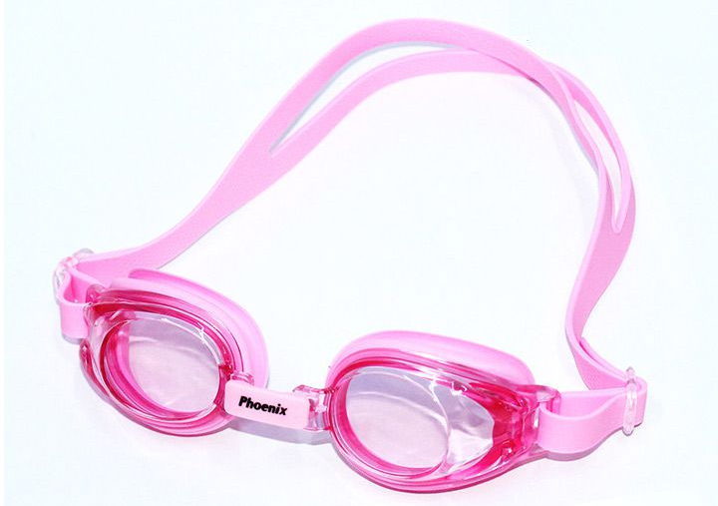
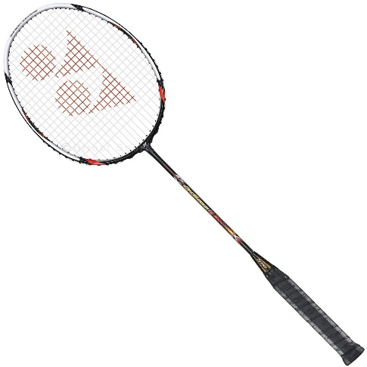
UNIT 8: SPORTS AND GAMES LESSON 2: A CLOSER LOOK 1
I. Vocabulary
racket (n): cái vợt (cầu lông)
goggles (n): kính bơi
sporty (adj): yêu thích thể thao, giỏi thể thao
marathon (n): cuộc chạy đua đường dài
competition (n): cuộc đua
congratulation (n): lời chúc mừng

Slide 5




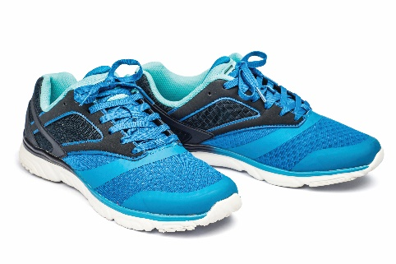
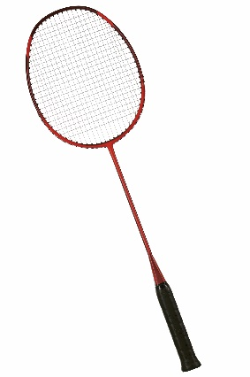
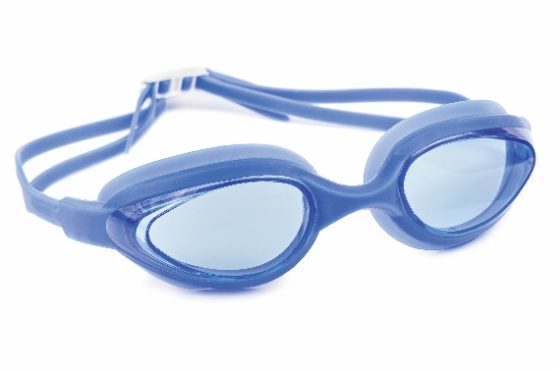
Write the right words under the pictures.
ball
racket
sports shoes
boat
goggles
1. ball
2. sports shoes
3.
1.
2.
3. boat
4. racket
5. goggles
4.
5.

Slide 6

What sports are these things for? Match each thing in column A with a sport in column B.
A
B
1.
bicycle
c.
cycling
a.
boating
2.
ball
d.
ball games
b.
swimming
a.
boating
c.
cycling
3.
boat
4.
goggles
b.
swimming
d.
ball games
5.
racket
e.
badminton
e.
badminton

Slide 7

Fill each blank with one of the words from the box.
champion
competition
sporty
marathon
congratulations
competition.
1.
She won an international sports
_______.
2.
He became the world tennis
_______ when he was very young.
champion when he was very young.
“Can you send my
_______ to the winner of the contest?”
3.
congratulations to the winner of the contest?”
_______. He does exercise every day.
4.
My friend David is very
sporty. He does exercise every day.
5.
The first
_______ took place in 1896.
marathon took place in 1896.

Slide 8

II. Pronunciation
/e/ and /æ/
1. Sound /e/

Slide 9

II. Pronunciation
/e/ and /æ/
2. Sound /æ/

Slide 10


Listen and repeat the words. Pay attention to the sounds /e/ and /æ/.
/e/ | /æ/
chess tennis exerise contest | racket match marathon active

Slide 11

Listen and repeat. Underline the words having the sounds /e/ and /æ/.
1.
They cannot take part in this contest.
2.
They began the match very late.
3.
Please get the racket for me.
4.
We play chess every Saturday.
5.
My grandpa is old, but he’s active.

Slide 12
III. Wrap- up
UNIT 8
A CLOSER LOOK 1
Vocabulary
Pronunciation
Sports and games
ball
racket
goggles
boating
cycling
……
/e/ and /æ/

Slide 13

IV. Homework
Learn by heart all the vocabulary
Prepare: Unit 8 – A Closer look 2

