Slide 1


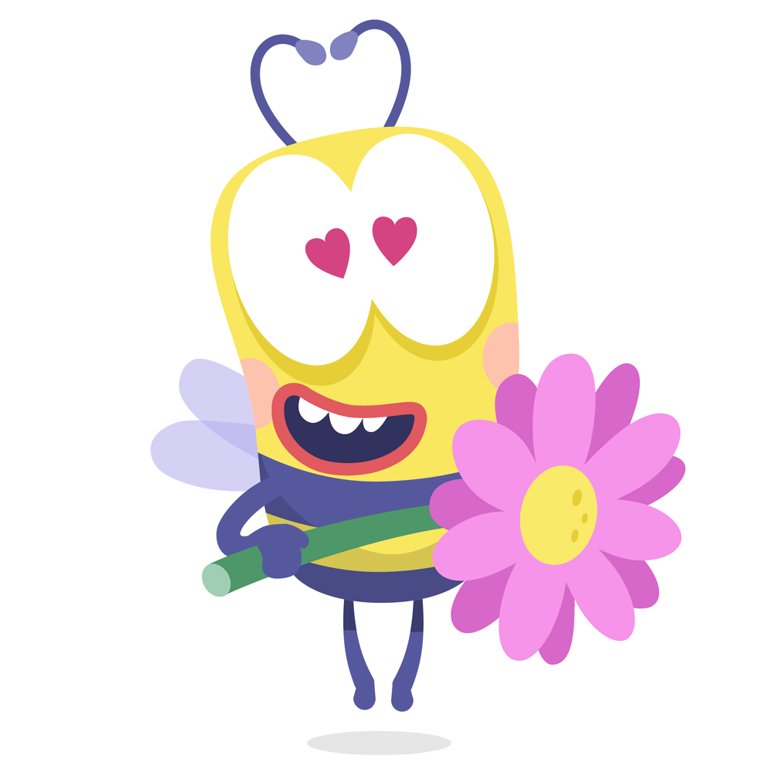



WELCOME TO CLASS 7B1!
Teacher: NGUYỄN BÍCH NGỌC
THANH LIỆT Secondary School

Slide 2


WARM-UP: CHATTING

Slide 3
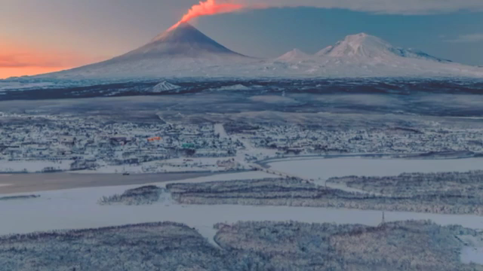
WARM-UP: CHATTING

Slide 4
WARM-UP: CHATTING
- Do you like the piece of music you have listened?
- Do you know what kind of music it is?
- When do you listen to music?
- How do you feel when you listen to music?
- Is music important to our life?

Slide 5




Unit
4
MUSIC AND ARTS
LESSON 1: GETTING STARTED
A talk at the school gate
Unit
HOBBIES

Slide 6
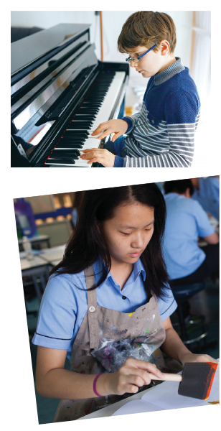
Unit
4
MUSIC AND ARTS
Unit
HOBBIES

Slide 7
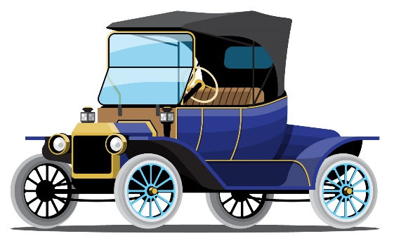
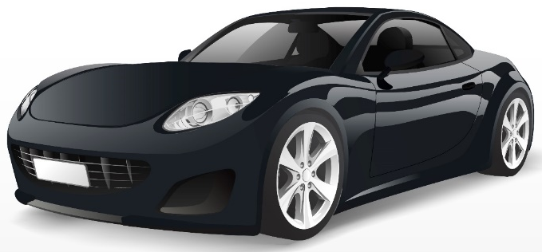
PRESENTATION
classical (adj)
modern
/ˈklæsɪkəl/
cổ điển

Slide 8
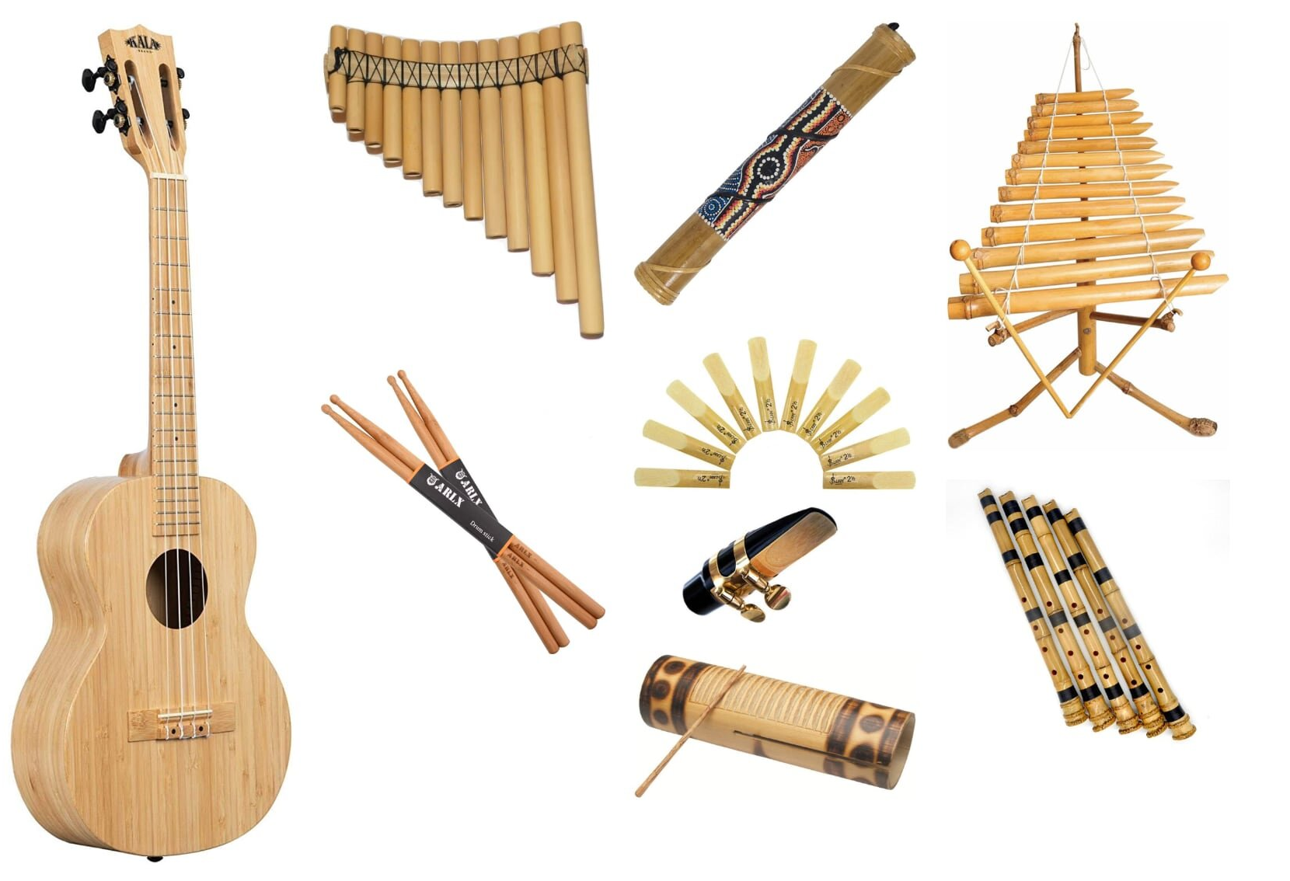
PRESENTATION
musical instruments (n)
/ˈmjuːzɪkəl ˈɪnstrəmənts/
nhạc cụ

Slide 9

PRESENTATION
landscape (n)
/ˈlændskeɪp/
cảnh quan

Slide 10
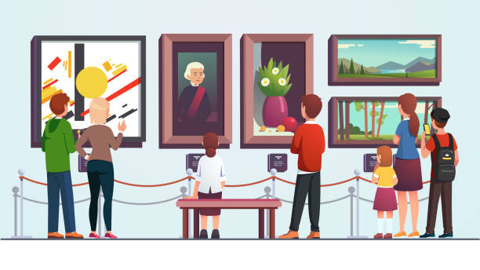
PRESENTATION
art gallery (n)
/ˈɑːt ˌɡæləri/
phòng trưng bày
nghệ thuật

Slide 11
PRESENTATION
New words | Pronunciation | Meaning
classical (adj) | /ˈklæsɪkəl/ | cổ điển
spare time (n) | /speər taɪm/ | thời gian rảnh rỗi
musical instruments (n) | /ˈmjuːzɪkəl ˈɪnstrəmənts/ | nhạc cụ
landscape (n) | /ˈlændskeɪp/ | cảnh quan
art gallery (n) | /ˈɑːt ˌɡæləri/ | phòng trưng bày nghệ thuật

Slide 12

PRESENTATION: LISTEN AND READ.
Trang: Hi Nick. What are you listening to?
Nick: I’m listening to music. I like classical music, and I often play the piano in my spare time.
Trang: Wow. I can’t play any instruments.
Nick: And what about you? What’s your hobby?
Trang: I like painting and taking photos.
Nick: Taking photo? I’ve never tried it. Is it fun?
Trang: Yeah, it is, but not as fun as painting.
Nick: Right. They seem quite different from each other. What do you normally paint?
Trang: Landscapes and animals, just for pleasure, you know. I sometimes share them with my friends.
Nick: Really? Um, maybe we should go to an art gallery next weekend?
Trang: Sounds good, but I’d prefer to go to the music festival at my school.
Nick: Well … OK. That’s fine.

Slide 13
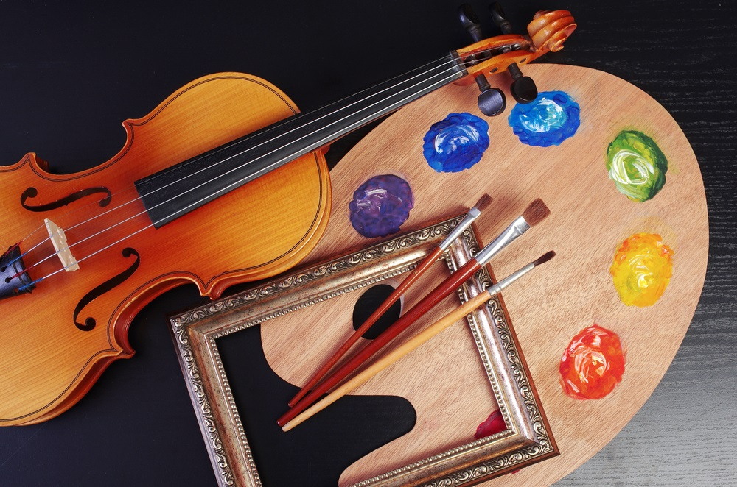
PRACTICE
1
Tick the correct answer.
1. What are Trang and Nick talking about? A. Playing the piano. B. Drawing and painting. C. Music and arts.
Trang: Hi Nick. What are you listening to?
Nick: I’m listening to music. I like classical music, and I often play the piano in my spare time.

Slide 14
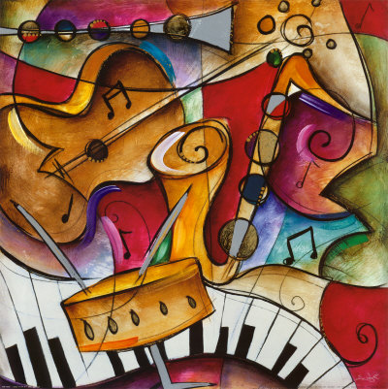
PRACTICE
2
Complete each of the sentences with a suitable word or phrase from the box.
photos like different from art gallery musical instruments
Nick wants to go to a(n) _____________ next week.
You can use your smartphone to take ________.
This photo is very bright. It is _____________ that dark one.
Nick and Trang agree that taking photos is not _____________ painting.
My friend David is very talented. He plays three _______________________.
art gallery
photos
different from
like
musical instruments

Slide 15
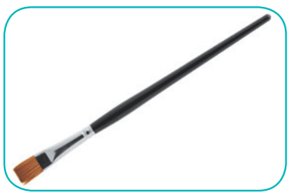

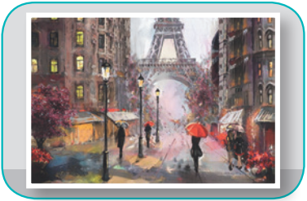
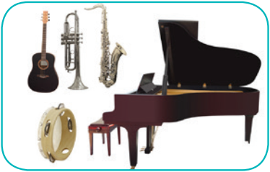
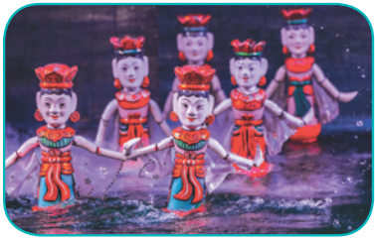
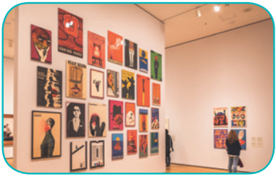
PRACTICE
3
Write the correct word or phrase under each picture. Then listen and repeat.
camera water puppet show art gallery
painting paintbrush musical instruments
paintbrush
camera
painting
1. ______________
2. ____________
3. ____________
musical instruments
water puppet show
4. __________________________
5. _________________________
art gallery
6. ____________

Slide 16


PRACTICE
4
Quiz “How artistic are you?”.

Slide 17
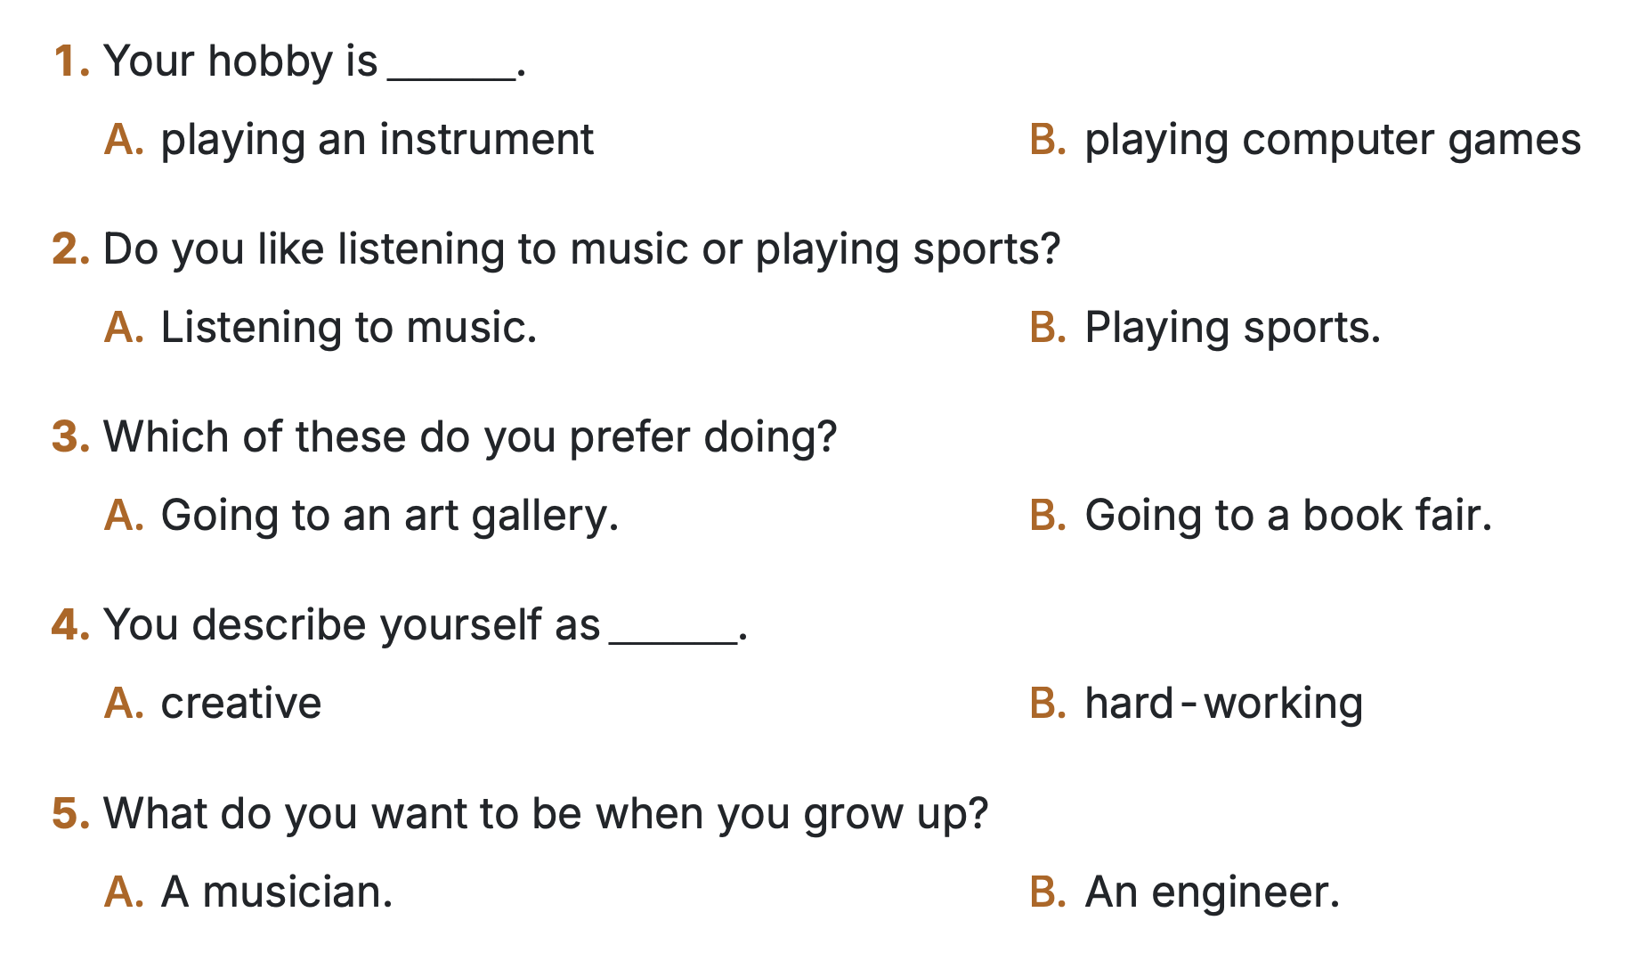
PRACTICE
4
Quiz “How artistic are you?”.

Slide 18
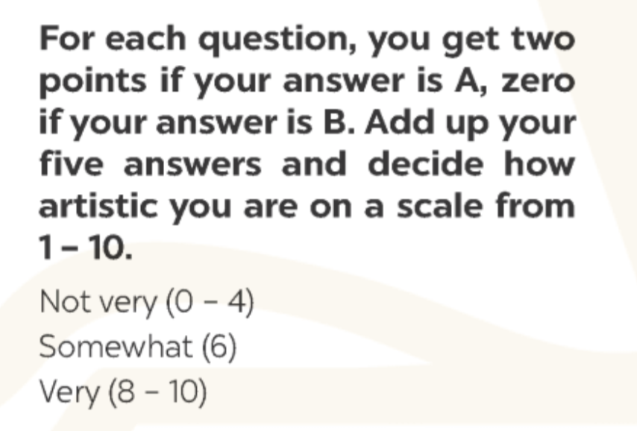
PRACTICE
4
Quiz “How artistic are you?”.

Slide 19
CONSOLIDATION
1
WRAP-UP
MUSIC AND ARTS
ABOUT MUSIC
ABOUT ARTS
Topic of the unit
Vocabulary

Slide 20



CONSOLIDATION
2
HOMEWORK
Prepare the vocabulary for the next lesson: A closer look 1.
Prepare for the Project lesson.

Slide 21
Thanks for your attendance!

