Slide 2
WARM-UP
“Simon says” game
Rules:
Students have to touch the body parts that teacher calls out.
Who does wrong actions is out of the game.
Simon says

Slide 3


Unit
3
MY FRIENDS
LESSON 2: A CLOSER LOOK 1
1

Slide 4
* Vocabulary
- hard-working /ˌhɑːd ˈwɜːkɪŋ/ (adj): chăm chỉ
- confident /ˈkɒnfɪdənt/ (adj.): tự tin, tin tưởng
- funny /ˈfʌni/ (adj): hài hước, khôi hài
- caring /ˈkeərɪŋ/ (adj):quan tâm
- active /ˈæktɪv/ (adj): hăng hái, năng động

Slide 5
* Vocabulary
- hard-working /ˌhɑːd ˈwɜːkɪŋ/ (adj):
- confident /ˈkɒnfɪdənt/ (adj.):
- funny /ˈfʌni/ (adj):
- caring /ˈkeərɪŋ/ (adj):
- active /ˈæktɪv/ (adj):

Slide 6
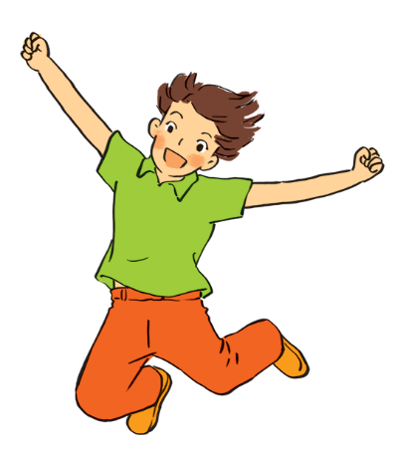
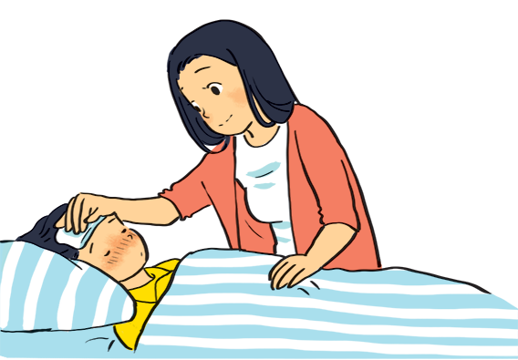
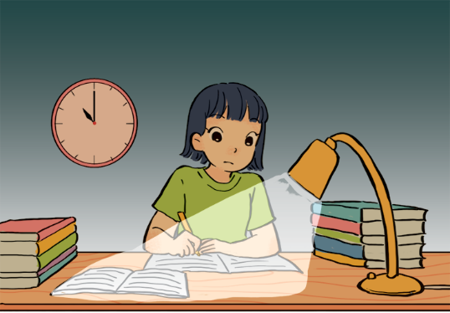
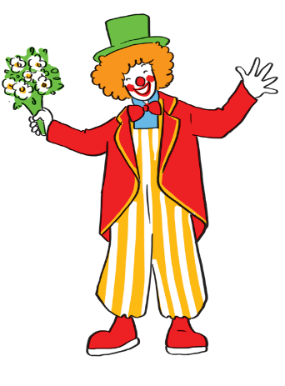
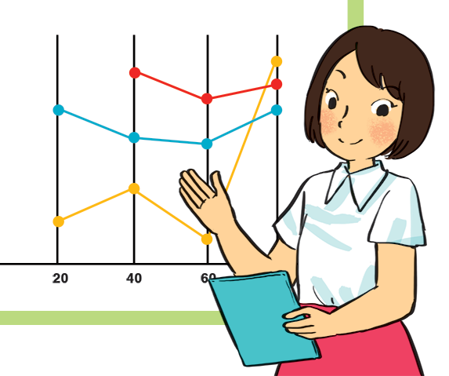
VOCABULARY
1
Match the adjectives to the pictures.
a
b
1. hard-working
2. confident
4. caring
5. active
4. caring
3. funny
5. active
c
d
e
1. hard-working
3. funny
2. confident

Slide 7


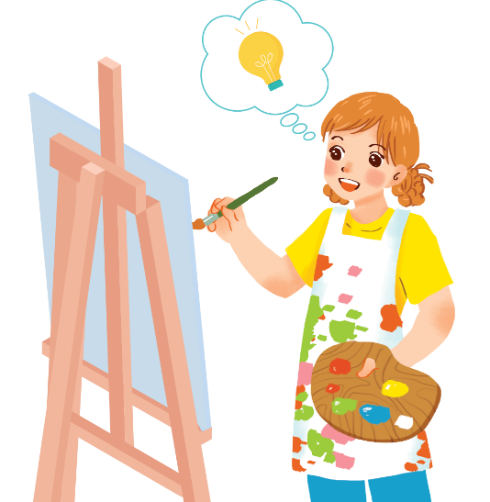
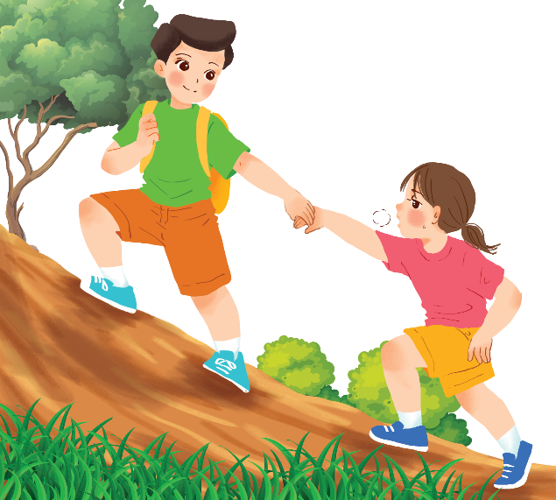
Use the adjectives in the box to complete the sentences.
Pay attention to the highlighted words / phrases.
careful
clever
shy
kind
creative
friendly
1.
Mina is very . She likes drawing pictures. She always has lots of new ideas.
creative
Nam is .
He likes helping his friends.
2.
kind

Slide 8
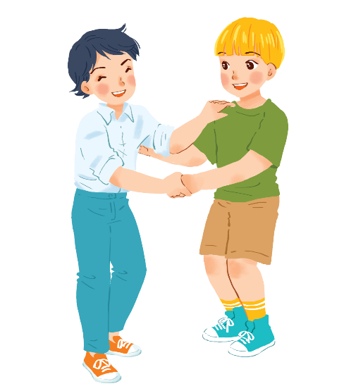
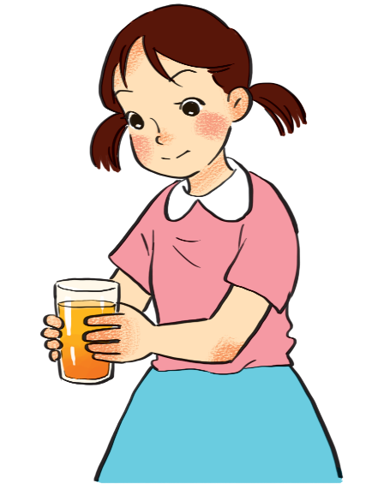
Use the adjectives in the box to complete the sentences.
Pay attention to the highlighted words / phrases.
careful
clever
shy
kind
creative
friendly
friendly.
3.
Minh Duc is
He likes meeting new people.
4.
Kim is very
She pays attention to what she’s doing.
careful.

Slide 9
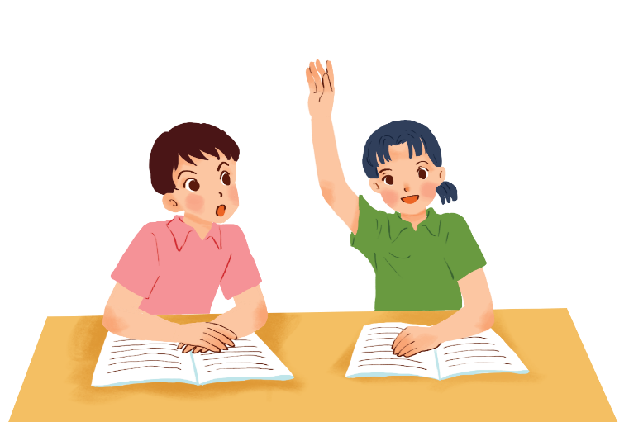
Use the adjectives in the box to complete the sentences.
Pay attention to the highlighted words / phrases.
careful
clever
shy
kind
creative
friendly
clever.
5.
Mai is
She things
learns
quickly and easily.

Slide 10
1.Mina is very creative
2. Nam is kind
3. Minh Duc is friendly.
4. Kim is very careful.
5. Mai is clever
.

Slide 11
* Cách miêu tả ngoại hình, tính cách
He is fat
They are friendly
FORM: S + am/is/are + adj
I / shy
I am shy
Nam / funny
Nam is funny

Slide 12
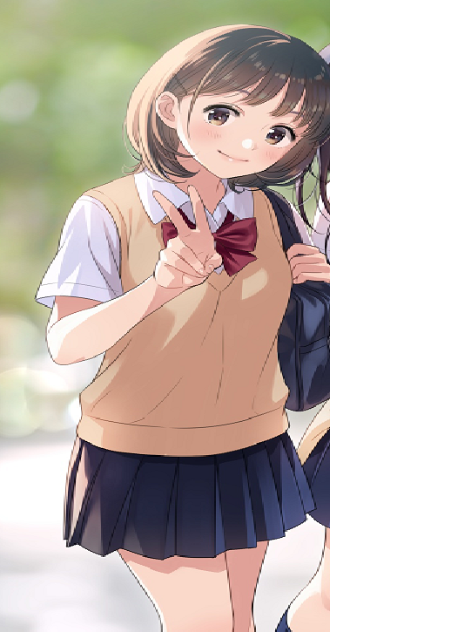
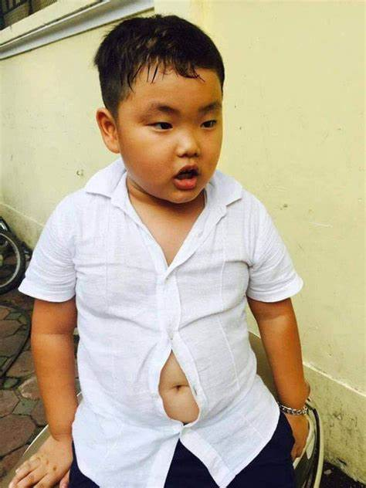
Describe body shape and personality about Nam and Lan using adjectives: short, fat, tall, thin , clever, active
Nam is short and fat but he is clever
Lan is tall and thin. She is active.
Nam
Lan

Slide 13


VOCABULARY
3
  Friendship ﬂower.
Work in groups of 4 . Write two personality adjectives for each group member.
Minh: kind funny

Slide 14

PRONUNCIATION
4
Listen and circle the words you hear. Then repeat.
 | /b/ | /p/
1. | big | pig
2. | bear | pear
3. | buy | pie
4. | robe | rope

Slide 15

PRONUNCIATION
5
Listen. Then practise the chant. Notice the rhyme.
We’re having a picnic
We’re having a picnic
Fun! Fun! Fun!
We’re bringing some biscuits
We’re bringing some biscuits
Yum! Yum! Yum!
We’re playing together
We’re playing together
Hurrah! Hurrah! Hurrah!

Slide 16

CONSOLIDATION
1
Wrap-up
What have we learnt in this lesson?
use lexical items related to body parts, appearance and personality
correctly pronounce the sound /p/ and /b/ in isolation and in context

Slide 17

CONSOLIDATION
2
Homework
Do the exercises in the workbook.

Slide 18






Website: hoclieu.vn
Fanpage: facebook.com/www.tienganhglobalsuccess.vn/

