Slide 1
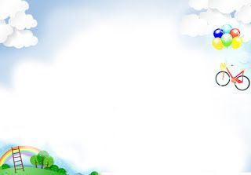

Class : 6B1
Teacher: Nguyen Bich Ngoc

Slide 2
I. Warm up – Brainstorming
Smart clock
Wireless TV
Electric cooker
appliances in the house
……….
dishwasher
fridge

Slide 3

UNIT 11: OUR GREENER WORLD
Period: 87 - Lesson 1: Getting started
Let’s go green!

Slide 4
UNIT 11: OUR GREENER WORLD
Lesson 1: Getting started
Let’s go green!

Slide 5



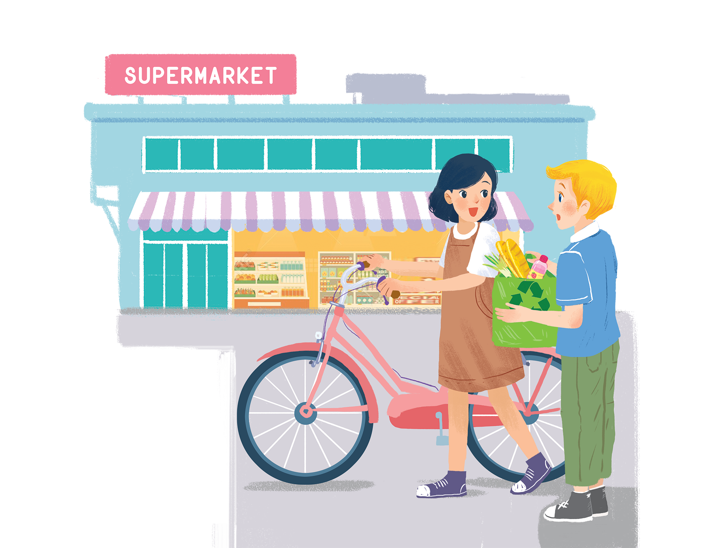
Listen and read.
Let’s go green!

Slide 6
Let’s go green!
Mi: Hi, Nick.
Nick: Hello, Mi.
Mi: You’ve bought a lot of things.
Nick: Yes. We’re going on a picnic tomorrow. What are you doing at the supermarket, Mi?
Mi: I’m buying some eggs. Hey, what’s this?
Nick: It’s a reusable shopping bag.
Mi: Do you always use it?
Nick: Yes. It’s better than a plastic one. If we all use this kind of bag, we will help the environment.
Mi: I see. I’ll buy one for my mum. Where can I buy one?
Nick: At the check-out. By the way, you’re also green. You’re cycling.
Mi: You’re right. If more people cycle, the air will be cleaner. Right?
Nick: Yes. Oh, it’s 5 o’clock already. I have to go now. See you later.
Mi: See you, Nick. Bye.

Slide 7
Let’s go green!
Mi: Hi, Nick.
Nick: Hello, Mi.
Mi: You’ve bought a lot of things.
Nick: Yes. We’re going on a picnic tomorrow. What are you doing at the supermarket, Mi?
Mi: I’m buying some eggs. Hey, what’s this?
Nick: It’s a reusable shopping bag.
Mi: Do you always use it?
Nick: Yes. It’s better than a plastic one. If we all use this kind of bag, we will help the environment.
Mi: I see. I’ll buy one for my mum. Where can I buy one?
Nick: At the check-out. By the way, you’re also green. You’re cycling.
Mi: You’re right. If more people cycle, the air will be cleaner. Right?
Nick: Yes. Oh, it’s 5 o’clock already. I have to go now. See you later.
Mi: See you, Nick. Bye.

Slide 8
New words:
words |  |  | meaning
reusable | (adj) | able to used again or more than one | có thể tái sử dụng
plastic | (n/adj) |  | nhựa/ (chất liệu) nhựa
check-out | (n) | the place in a shop where you pay the money | quầy thanh toán

Slide 9

Read the conversation again. Complete the following sentences. Use NO MORE THAN THREE words in each blank.
_______ tomorrow.
1.
Nick is going on
a picnic tomorrow.
?
2.
The green shopping bag is better than the
plastic one.
_______.
?
3.
People can buy green bags at
the check-out.
_______.
?
_______ bag for her mum.
4.
Mi wants to buy
a reusable bag for her mum.
?
5.
_______.
Nick thinks that Mi is green because
?
she’s cycling.

Slide 10
Let’s go green!
Mi: Hi, Nick.
Nick: Hello, Mi.
Mi: You’ve bought a lot of things.
Nick: Yes. We’re going on a picnic tomorrow. What are you doing at the supermarket, Mi?
Mi: I’m buying some eggs. Hey, what’s this?
Nick: It’s a reusable shopping bag.
Mi: Do you always use it?
Nick: Yes. It’s better than a plastic one. If we all use this kind of bag, we will help the environment.
Mi: I see. I’ll buy one for my mum. Where can I buy one?
Nick: At the check-out. By the way, you’re also green. You’re cycling.
Mi: You’re right. If more people cycle, the air will be cleaner. Right?
Nick: Yes. Oh, it’s 5 o’clock already. I have to go now. See you later.
Mi: See you, Nick. Bye.
1
2
4
5
3

Slide 11

Based on the ideas in the conversation, match the first half of the sentence in column A with its second half in column B.
A
1. Green bags are better
2. The air will be cleaner
3. If people use reusable bags for shopping.
B
a. they will help the environment.
b. than plastic bags.
c. if more people cycle.

Slide 12

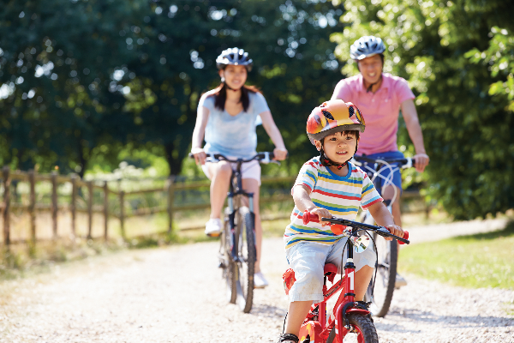
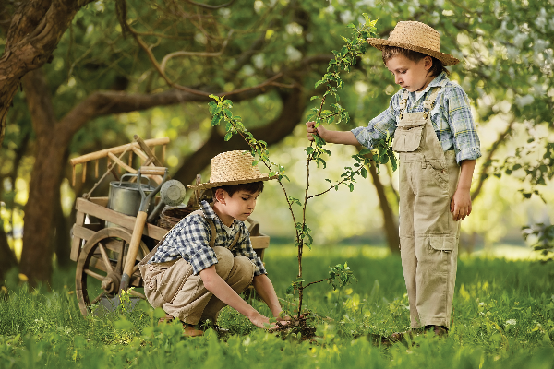
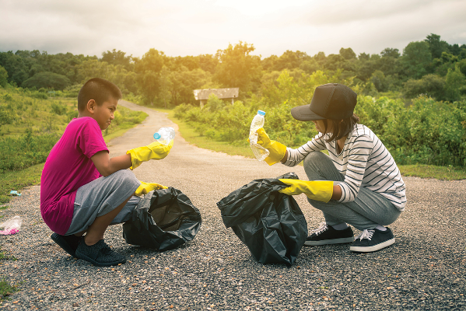
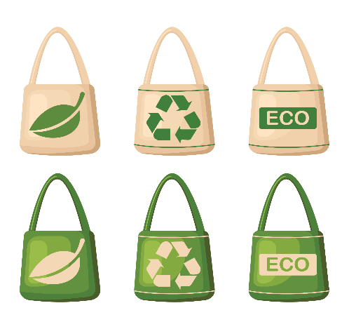
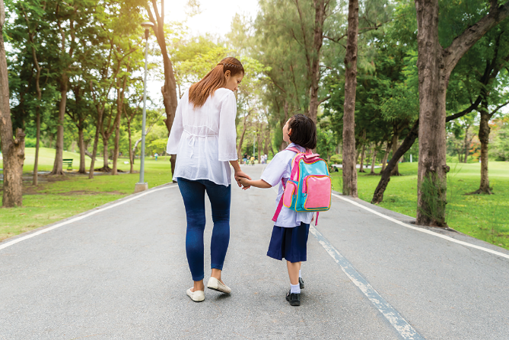
Match the pictures with the ways to help the environment.
a.
planting trees and flowers
b.
picking up rubbish
d.
walking to school
e.
using reusable bags when shopping
c.
cycling
1
2
3
4
5

Slide 13


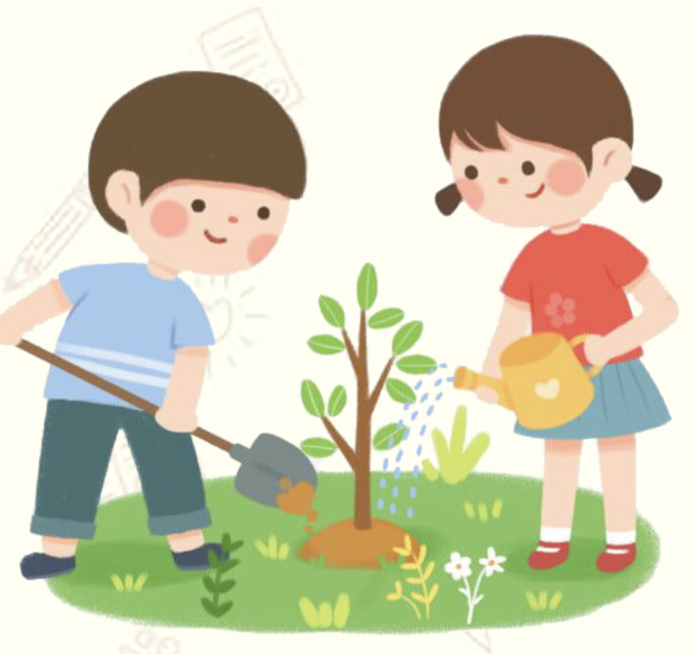
Find someone who ... Work in groups. Ask and answer to find someone who does the things in 4.
Example:
A: Do you plant trees?
B: No, I don’t.
A: Do you pick up rubbish?
B: Yes, I do.

Slide 14
Find someone who ... Work in groups. Ask and answer to find someone who does the things in 4.
Find someone who ... | Names
1. uses reusable bags when shopping
2. cycles
3. walks to school
4. picks up rubbish
5. plants trees and flowers
Example:
A: Do you plant trees?
B: No, I don’t.
A: Do you pick up rubbish?
B: Yes, I do.

Slide 15
- Lexical items related to the topic “Our greener world” - Some ways to help the environment
Wrap-up
Homework: - Practice the dialogue: “Let’s go green” - Prepare for the next lesson: Lesson 2 – A closer look 1

Slide 16


