Slide 1
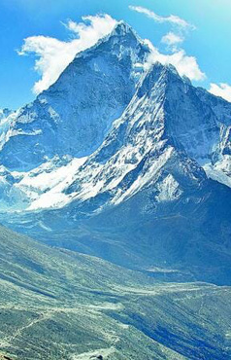
Unit 5:
Natural wonders of Viet Nam
Natural wonders of Viet Nam
Lesson 4: Communication

Slide 2
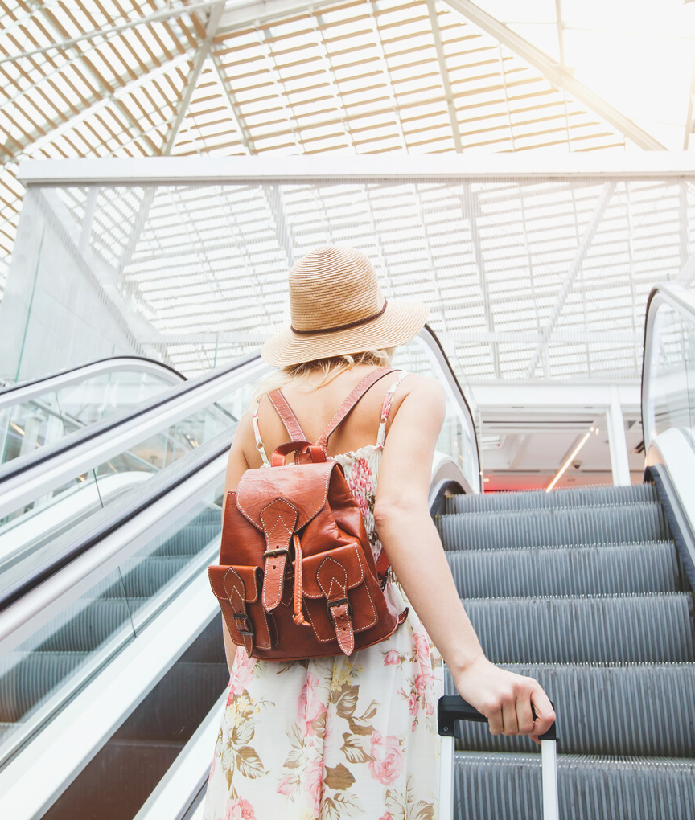
Everyday English
If you want to go out with your friends, what will you say to them?
How to make and accept appointments?
Let’s find out!

Slide 3

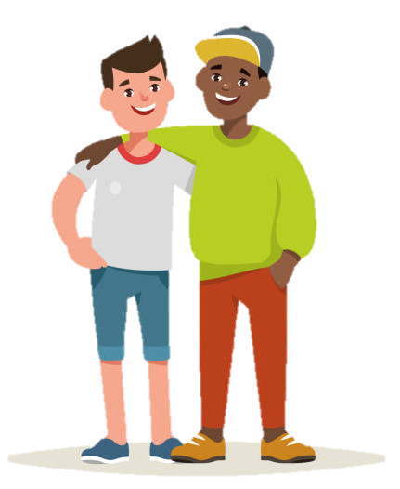
Making and accepting appointments
Ex 1. Listen to Duong and Steven. Highlight the ways to make and accept appointments.
Steven: Duong, let’s go for a picnic this Sunday.
Duong: That’s fine. What time can we meet?
Steven: How about 9 o’clock?
Duong: Sure. I’ll meet you at that time.
Making appointments
accepting
Making appointments
accepting
Practice in pairs!

Slide 4
Let’s + V-o
= Shall we + V-o?
= Why don’t we + V-o?
= Would you like + to V?
= How about + Ving?
= What about + Ving?

Slide 5
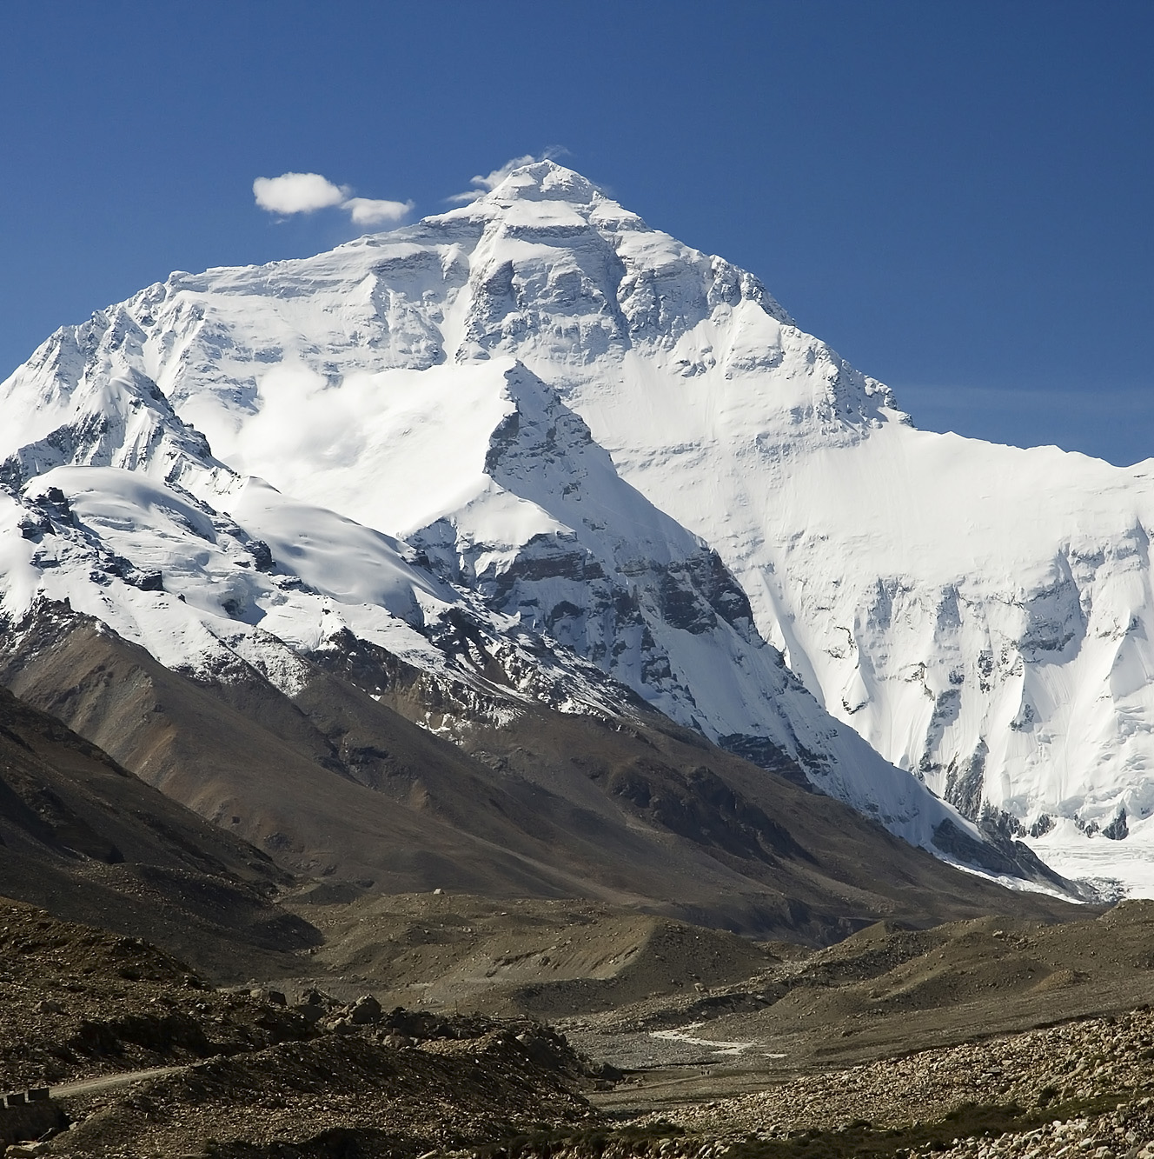
Let’s travel!
Let’s go to
Can you guess the place?
the Himalayas!
Notes:
Let’s travel to another place. Can you guess the place?

Slide 6
Do you know anything about the Himalayas?
Before we travel to a place that we don’t know, what should we do?
Read a travel guide

Slide 7
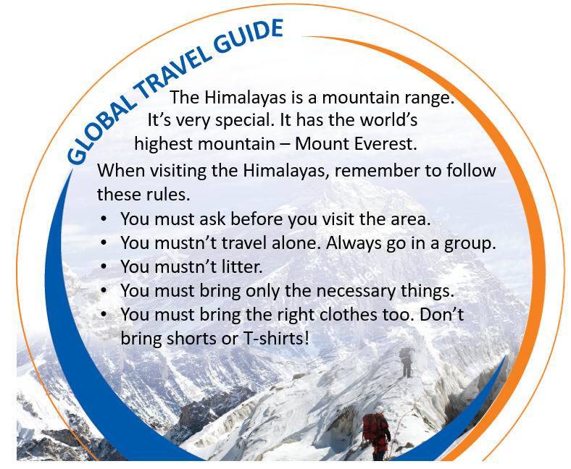
Ex 3. Read the travel guide entry.
2 minutes
Make a list of things you must and mustn’t do.
MUST | MUSTN’T
ask before you visit the area
travel alone
go in a group
litter
bring only the necessary things
bring shorts or T-shirts!
bring the right clothes

Slide 8
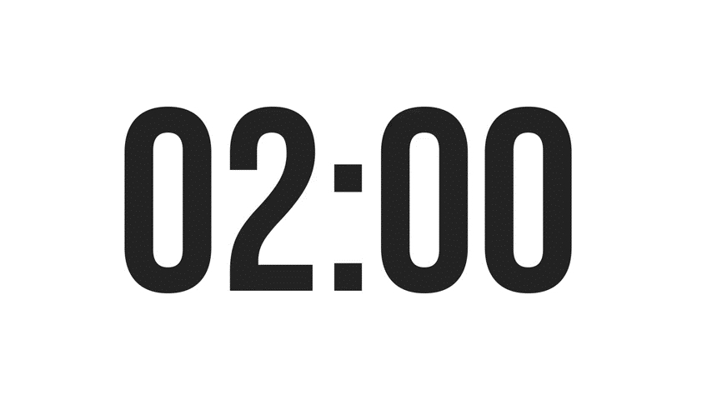
Ex 4. Make a list of the things you must bring to the Himalayas. Add things you mustn’t bring.
MUST | MUSTN’T
compass
bicycle
Type your answers in the chat box

Slide 9
Ex 4. Make a list of the things you must bring to the Himalayas. Add things you mustn’t bring.
Suggested answers
MUST BRING | MUSTN’T BRING
compass
bicycle
backpack, painkillers, map, plaster, sleeping bag, tent, waterproof coat, torch
…
T-shirts
shorts
computer
…

Slide 10
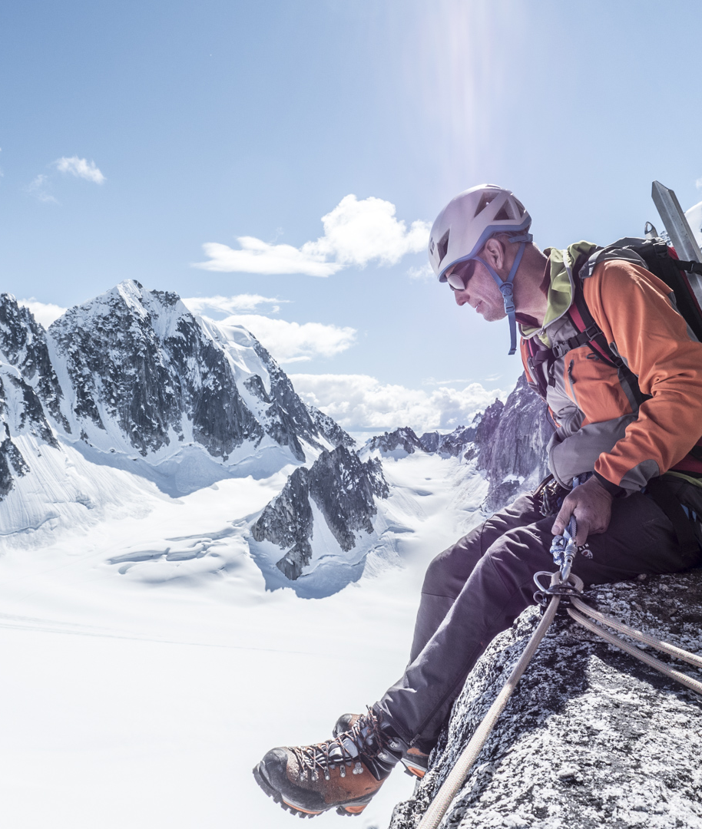
Ex 4. Role play
Work in pairs.
One is a tourist
One is a tour guide
Talk about what to prepare for the trip.
Think of a place to travel
Ask questions
Answer the questions
Give reasons
Example:
A: I’d like to go to the Himalayas next month.
B: OK. I think you must bring a waterproof coat. It’s cold and rainy there!
A: Yes. Anything else?
B: You must …, and you mustn’t …

Slide 11
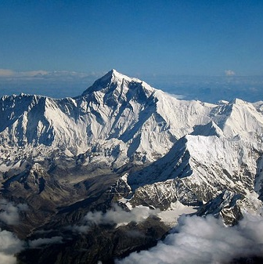
Thank you
Your ticket to utmost relaxation

