Slide 1



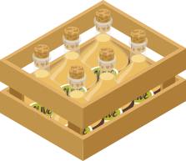




Unit 2 My HOUSE
Lesson 4: Communicaton

Slide 2

Objectives
After this lesson, students will be able to :
give suggestions
practice using some grammar points and vocabulary to describe a house

Slide 3




Elena and her mum are discussing how to decorate her bedroom. Listen and read the dialogue. Pay attention to the highlighted sentences.
How about putting a picture on the wall?
My bedroom isn’t nice.
Let’s go to the department store to buy one.
Great idea, Mum.

Slide 4
Giving suggestions
How about
putting
a picture on the wall?
How about
+ V-ing
Let’s
go
to the department store to buy one.
Let’s
+ V

Slide 5
What about + V-ing ?
Shall we + V ?
Why don’t we + V?
Would you like + to V?
=> Good idea/ Great/ Yes, Let’s

Slide 6

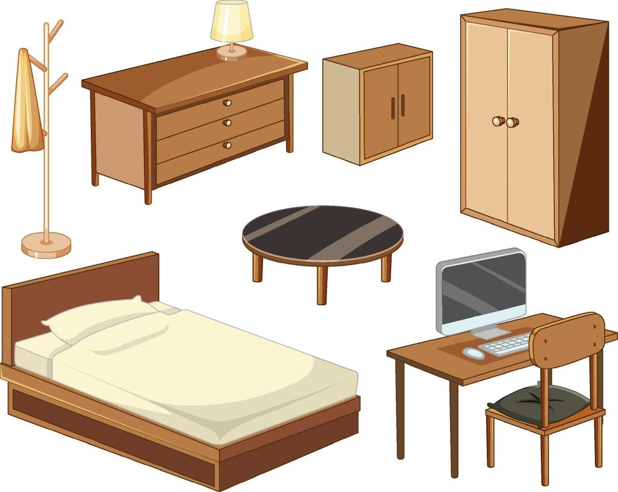
In group, make dialogues, using the structures:
How about + V-ing?
Let's + V.
Situation 1
Situation 2
A is going to buy a new house
B gives suggestions to buy some new furniture for the house
A & B is going camping together
B gives suggestions to buy some food and drinks

Slide 7
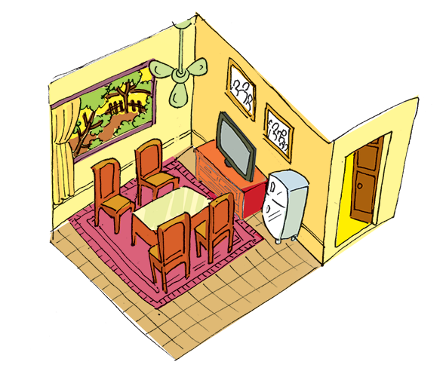
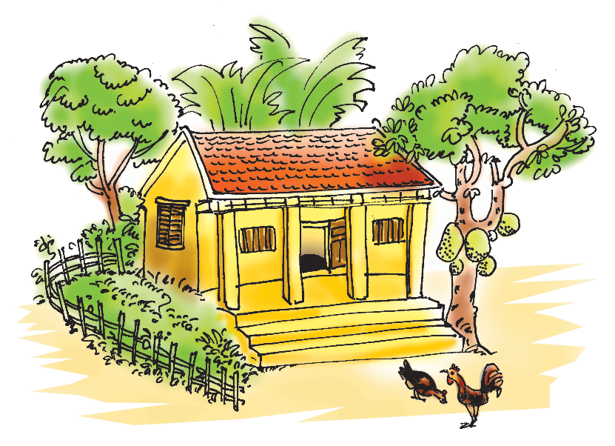
Living places
3. Mi tells Nick about her grandparents’ country house. Look at the pictures of her grandparents’ house and complete the sentences.
1. My grandparents live in a _________ house in Nam Dinh.
country
2. There _________ four rooms in the house and big garden.
3. I like the living room. There _________ a big window in this room.
4. There are four _________ and a table in the middle of the room.
5. There are two family photos _________ the wall.
are
is
chairs
on
Notes:
GV có thể brainstorm HS vậy để miêu tả về ngôi nhà của mình thì con có thể nói những cái gì, dùng những cấu trúc nào

Slide 8
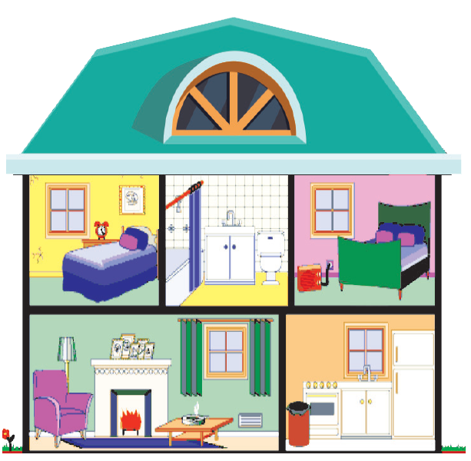
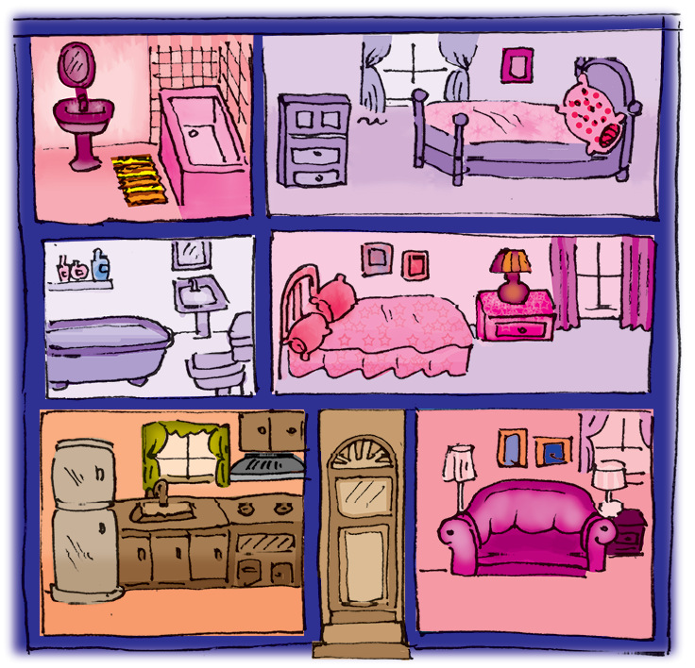

Work in pairs. Ask questions to find the differences between the two houses.
Example:
A: Where does Mi Live?
B: She lives in a town house.

Slide 9
- Work in groups of 4-5 students. - 5 minutes - Draw a picture of your dream house. + What kind of house is it? + How many rooms are there? + What are the things inside the house? + What do you like best? - Present in class. - The other students listen and give opinion.

Slide 10



Draw a picture of your dream house

Slide 11

Presentation time!

Slide 12

See you next time!

