Slide 1
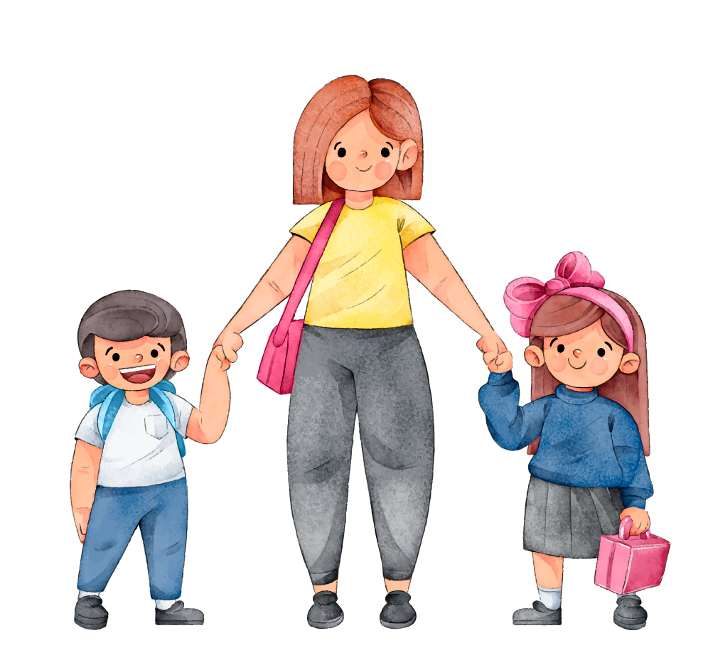
UNIT 3 MY FRIENDS
Lesson 4: Communication

Slide 2
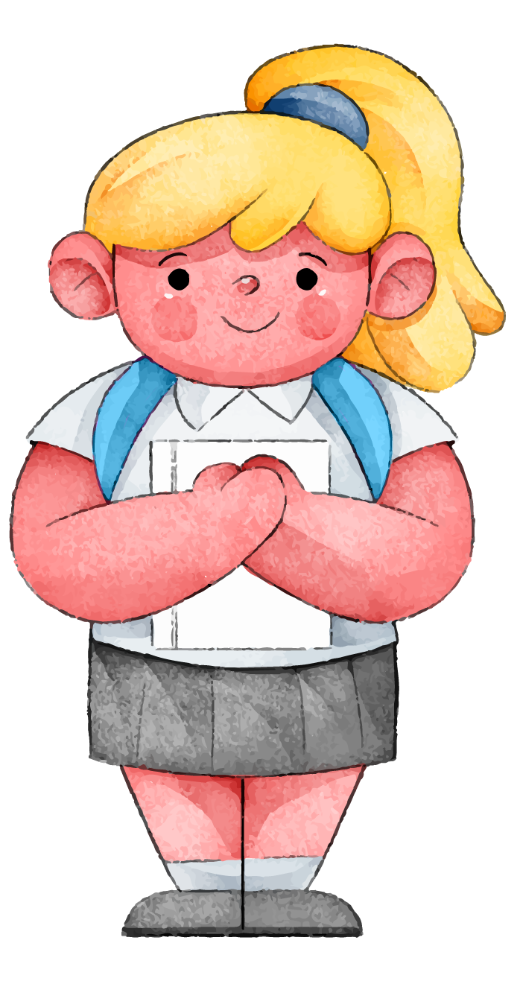

Find someone who
In 2 mins, look around the class and write the names.
.......... has curly hair.
……….. wears glasses.
……….. is very tall.
……….. is handsome.
……….. is creative.
………..is hard-working.
……….. is talkative.

Slide 3

OBJECTIVES
01
02
After this lesson, students will be able to:
Ask about appearance and personality
Compare the differences between the personalities according to the birth date and the real personalities

Slide 4
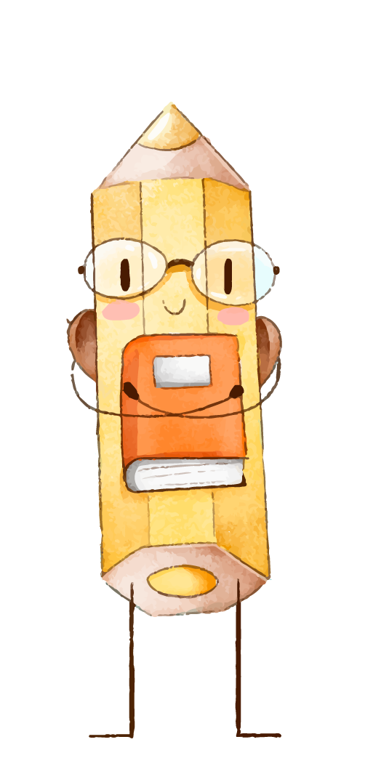
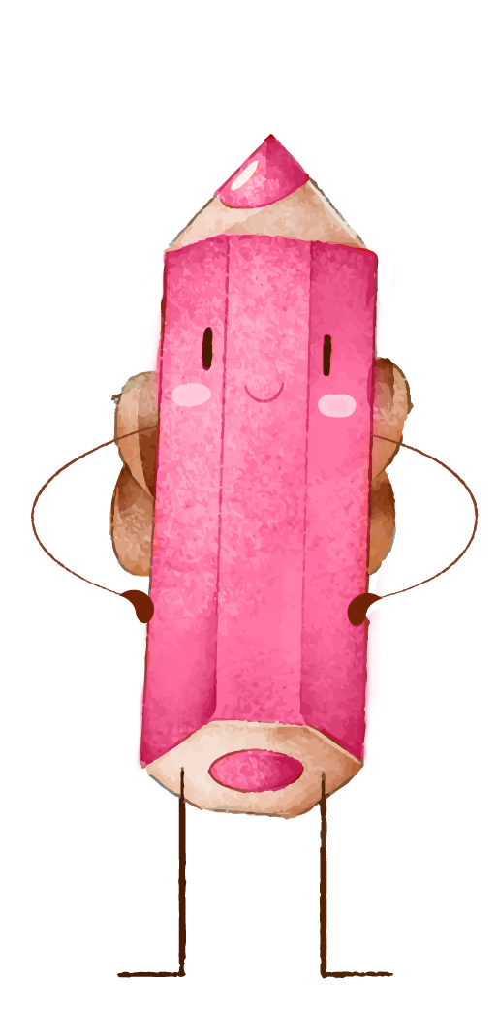
01
Everyday English

Slide 5

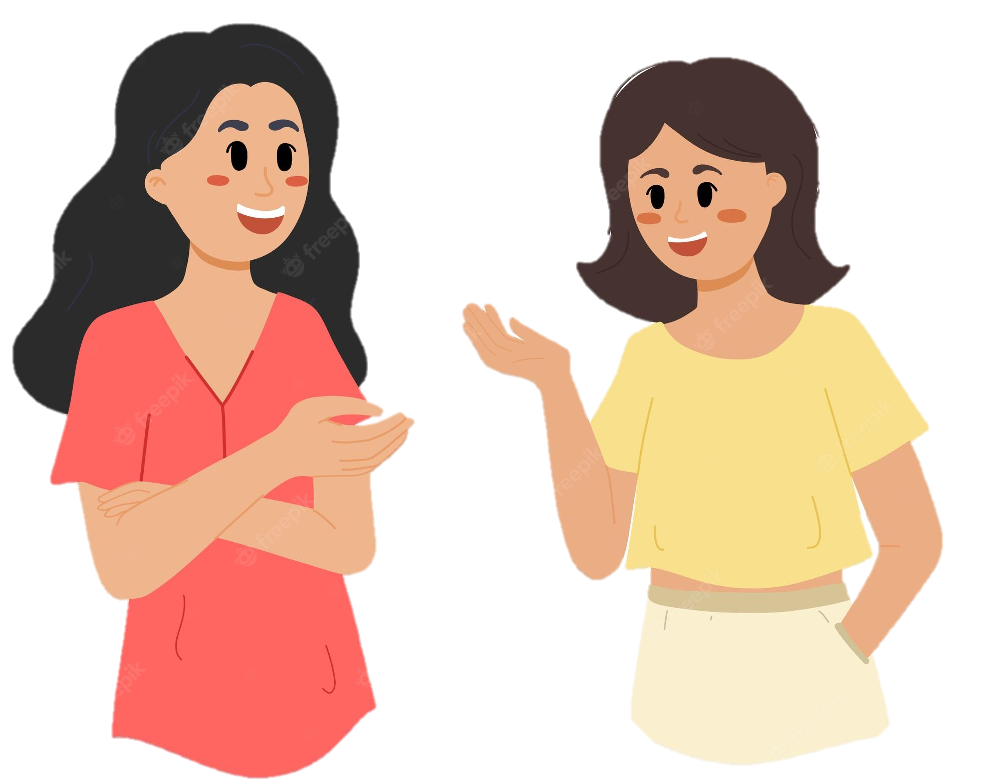
1. Listen and read the dialogue between Linda and Mi. Pay attention to the highlighted.
…
Linda: What does your best friend look like?
Mi: She’s short with long black hair. She has bright brown eyes.
Linda: What’s she like?
Mi: She’s very kind and creative.
…
Ask for appearance
Ask for personality
Linda
Mi

Slide 6
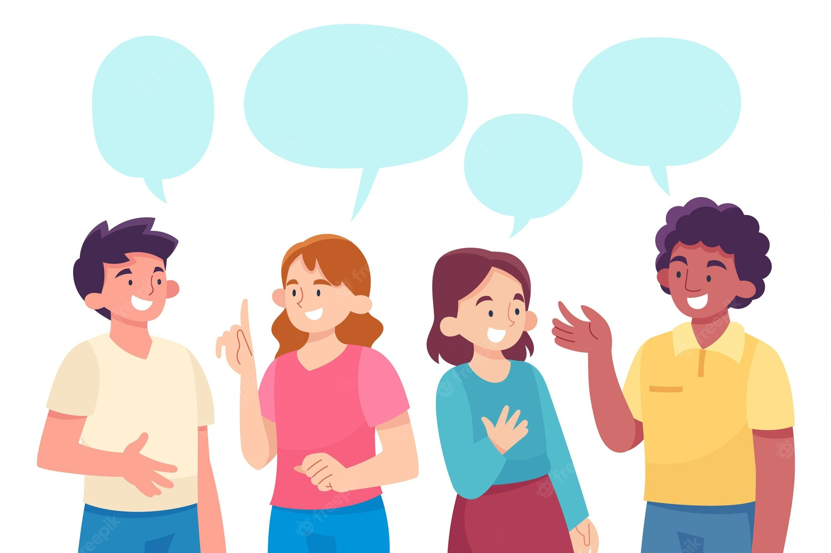
2. In pair, ask and answer about best friends using the 2 questions.
Ask for appearance
What does your best friend look like?
Ask for personality
What’s he/ she like?

Slide 7
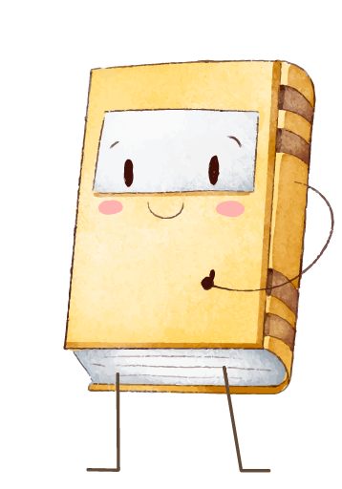
02
Date of birth and personality

Slide 8
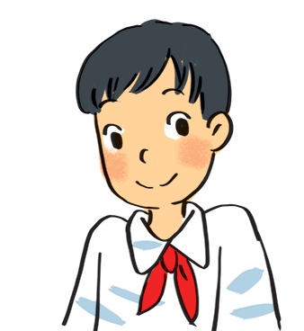
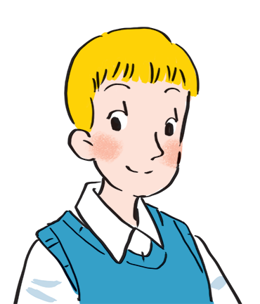
3. Read about these students in 4Teen magazine. Use one or two adjectives to describe them.
clever
I live in Da Nang. At home, I can do my homework without my parents’ help. At school, I like speaking English. I’m going to an English club now.
hard-working
active
…
I come from Cambridge. In my free time, I draw pictures and play the piano. I also help some old people near my house. I usually read to them at the weekend. Now I’m drawing in my garden.
creative
kind
helpful
…

Slide 9
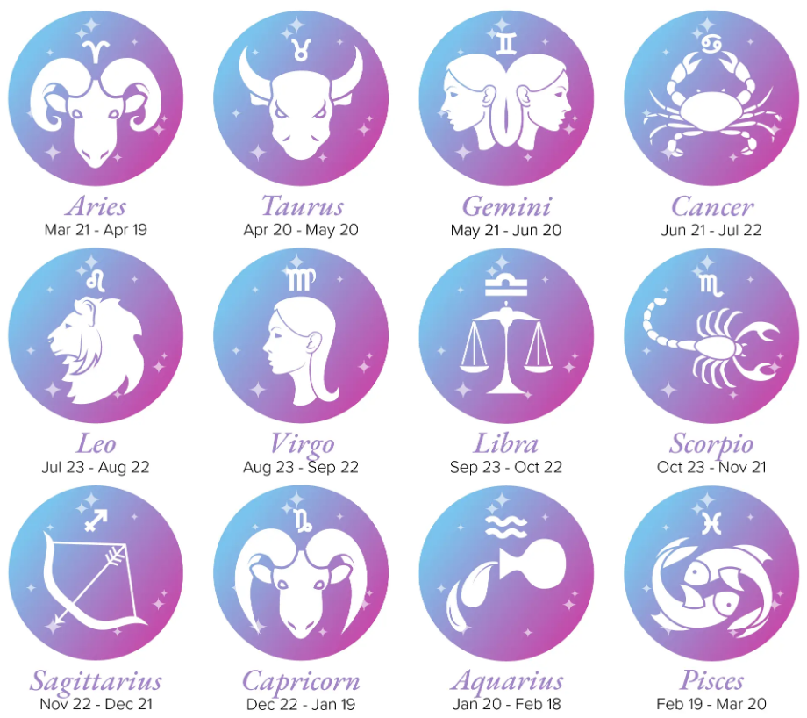
We may have different personalities because we have different birthdays.
21/3 – 19/4 | confident, active
20/4 – 20/5 | loving, hard-working
21/5 – 21/6 | active, friendly
22/6 – 22/7 | caring, clever
23/7 – 22/8 | confident, creative
23/8 – 22/9 | careful, hard-working
23/9 – 23/10 | creative, friendly
24/10 – 21/11 | careful, funny
22/11 – 21/12 | clever, confident
22/12 – 19/1 | careful, hard-working
20/1 – 18/2 | friendly, clever
19/2 – 20/3 | kind, creative

Slide 10


4. Find the personalities of Vinh and John, according to their birth date.
21/3 – 19/4 | confident, active
20/4 – 20/5 | loving, hard-working
21/5 – 21/6 | active, friendly
22/6 – 22/7 | caring, clever
23/7 – 22/8 | confident, creative
23/8 – 22/9 | careful, hard-working
23/9 – 23/10 | creative, friendly
24/10 – 21/11 | careful, funny
22/11 – 21/12 | clever, confident
22/12 – 19/1 | careful, hard-working
20/1 – 18/2 | friendly, clever
19/2 – 20/3 | kind, creative
Do you think they match the friends in ex 3?
Vinh (birthday 7/12)
22/11 – 21/12 | clever, confident
19/2 – 20/3 | kind, creative
John (birthday 26/2)

Slide 11
WHAT ABOUT YOU?
21/3 – 19/4 | confident, active
20/4 – 20/5 | loving, hard-working
21/5 – 21/6 | active, friendly
22/6 – 22/7 | caring, clever
23/7 – 22/8 | confident, creative
23/8 – 22/9 | careful, hard-working
23/9 – 23/10 | creative, friendly
24/10 – 21/11 | careful, funny
22/11 – 21/12 | clever, confident
22/12 – 19/1 | careful, hard-working
20/1 – 18/2 | friendly, clever
19/2 – 20/3 | kind, creative
5. Find the personalities according to your birth date.

Slide 12

WHAT ABOUT YOU?
21/3 – 19/4 | confident, active
20/4 – 20/5 | loving, hard-working
21/5 – 21/6 | active, friendly
22/6 – 22/7 | caring, clever
23/7 – 22/8 | confident, creative
23/8 – 22/9 | careful, hard-working
23/9 – 23/10 | creative, friendly
24/10 – 21/11 | careful, funny
22/11 – 21/12 | clever, confident
22/12 – 19/1 | careful, hard-working
20/1 – 18/2 | friendly, clever
19/2 – 20/3 | kind, creative
In 3 minutes, share your opinion with your group.
For example:
My birthday is …
It’s true that …
It isn’t true that …

Slide 13
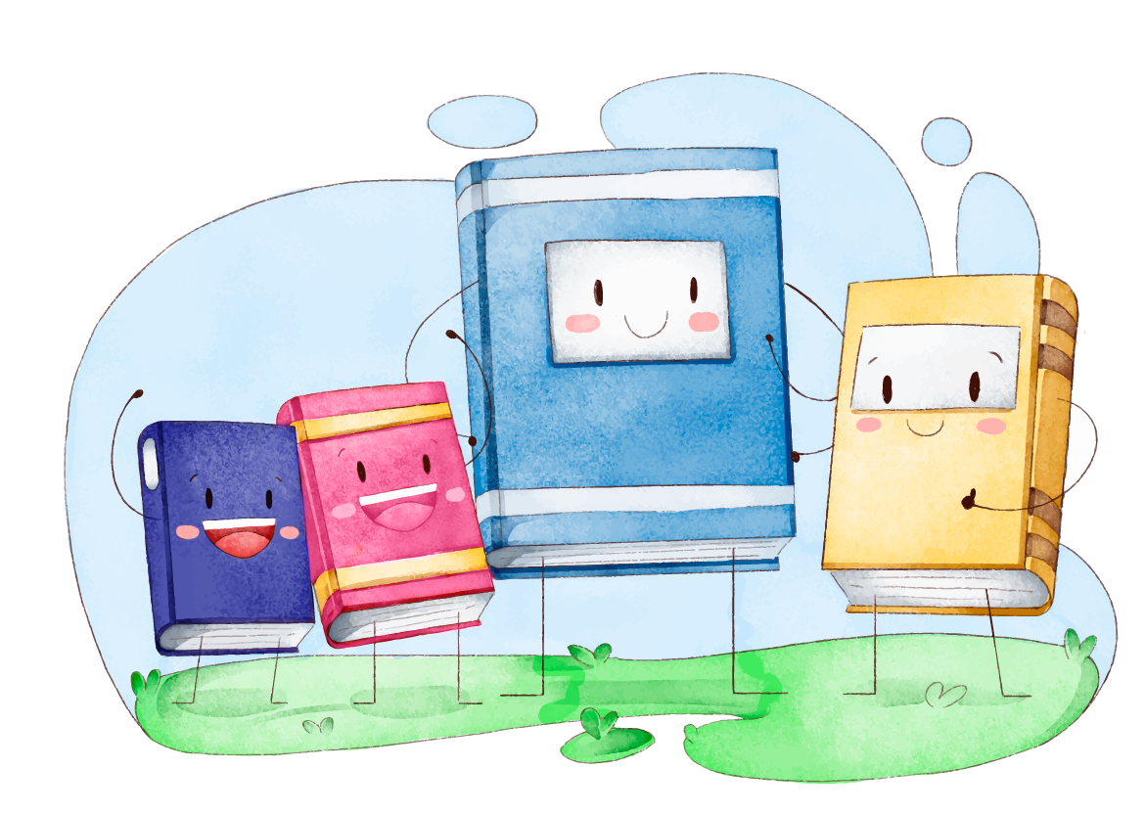
Wrap-up
In this lesson, students have:
Asked about appearance and personality
01
Compared the differences between the personalities according to the birth date and the real personalities
02

Slide 14
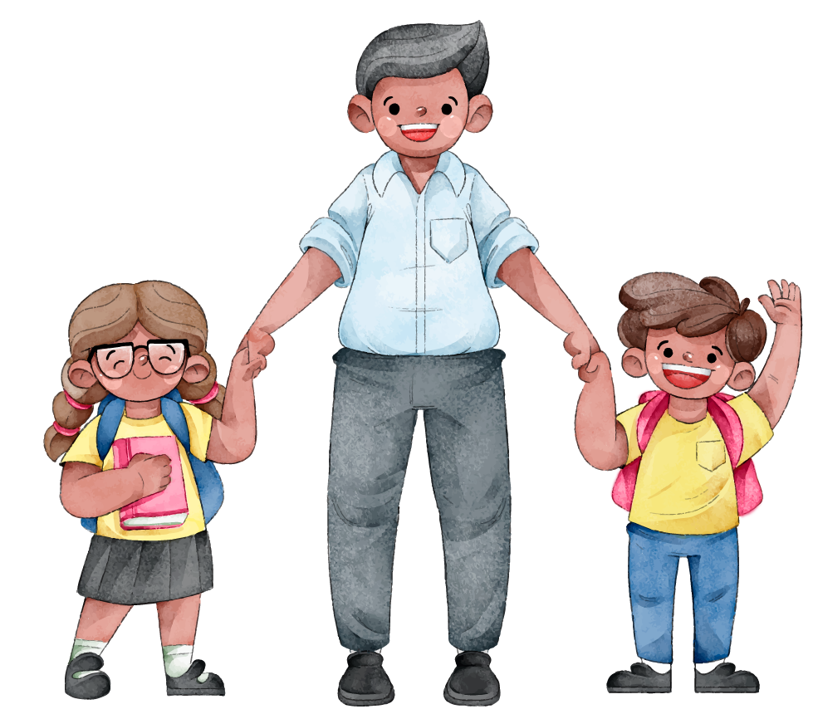
Thanks for your attention!

