Slide 1
UNIT 4: MY NEIGHBOURHOOD
Lesson 3: A closer look 2

Slide 2
This lesson, we will …
Use comparative adjectives to compare two people or things

Slide 3
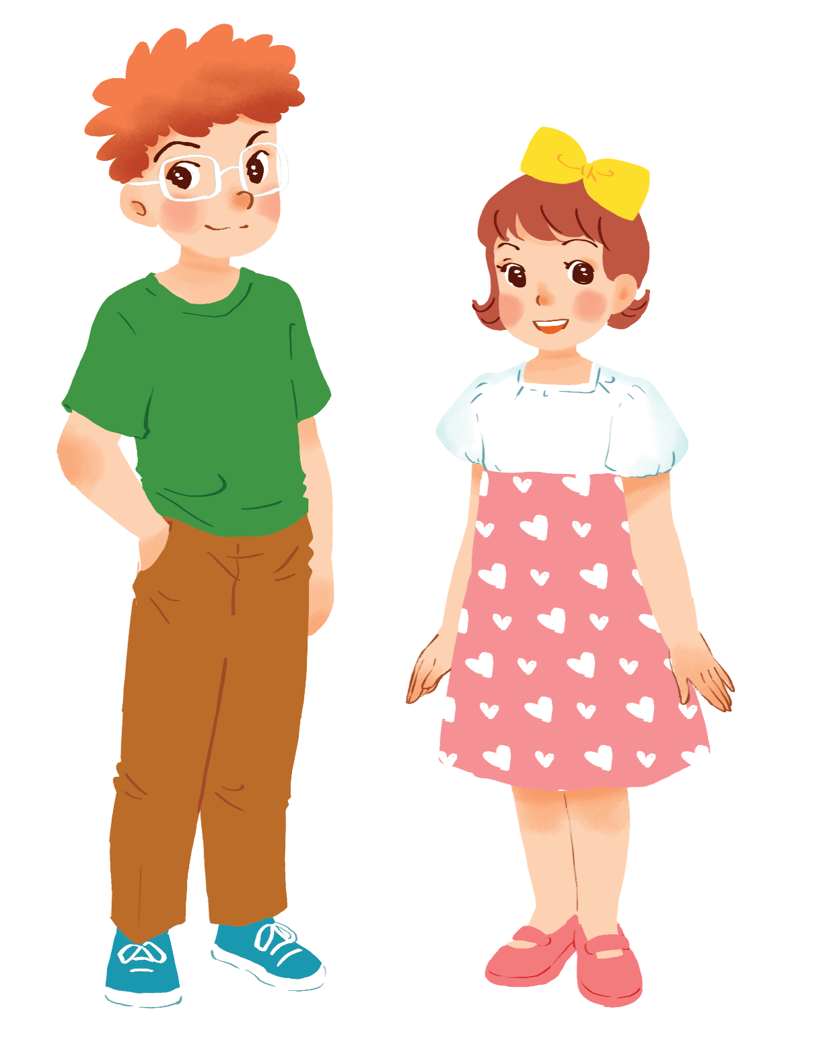
Compare 2 people
tall
Tom
is
taller
than
Mary
short adjective
one syllable
tall + er
Short adjective + er
Comparative adjective
Tom
Mary

Slide 4
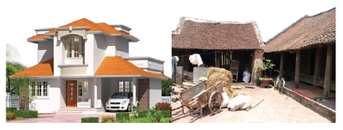
Compare 2 things
expensive
House in the city
House in the countryside
A house in the city
is
more expensive
than
a house in the countryside
more + long adj
more expensive
Three syllables
long adjective
Comparative adjective

Slide 5
Compare TWO people or things
NOTE: | Adj | Comparative adj
large
larger
one syllable
big
bigger
more than TWO syllables
modern
more modern
expensive
more expensive

Slide 6
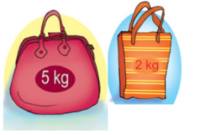
Compare 2 things
My bag
is
heavier
than
yours
two syllables
heavy + er
your bag
my bag
Special situations
y => ier
heavy

Slide 7
NOTE: | Adj | Comparative adj
One syllable
heavy
heavier
noisy
noisier
busy
busier

Slide 8
Special situations
NOTE: | Positive | Comparative adj
narrow
narrower / more narrow
two syllables
clever
cleverer / more clever
gentle
gentler / more gentle
quiet
quieter / more quiet
friendly
friendlier / more friendly

Slide 9
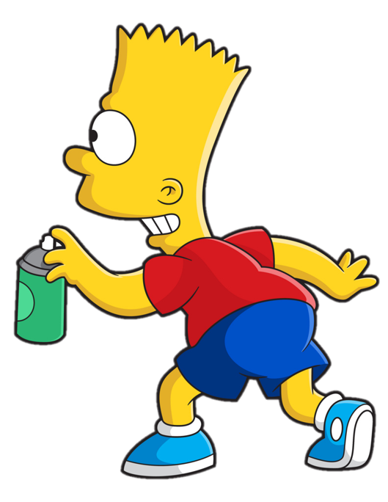


COMPARATIVES

Slide 10

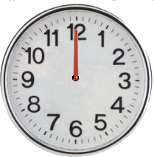
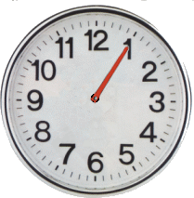
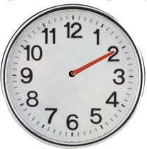
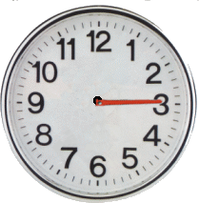
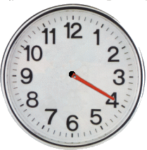
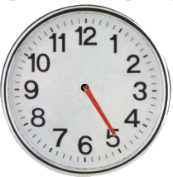
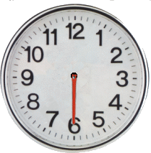
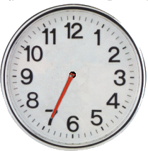
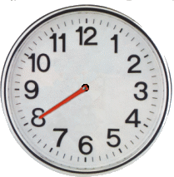
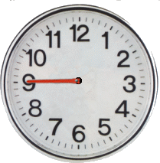
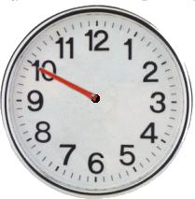
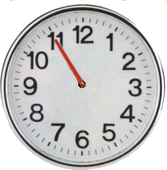
Comparatives
> Bart has deleted some words.
> Guess the deleted adjective within the time limit (12 seconds).

Slide 11
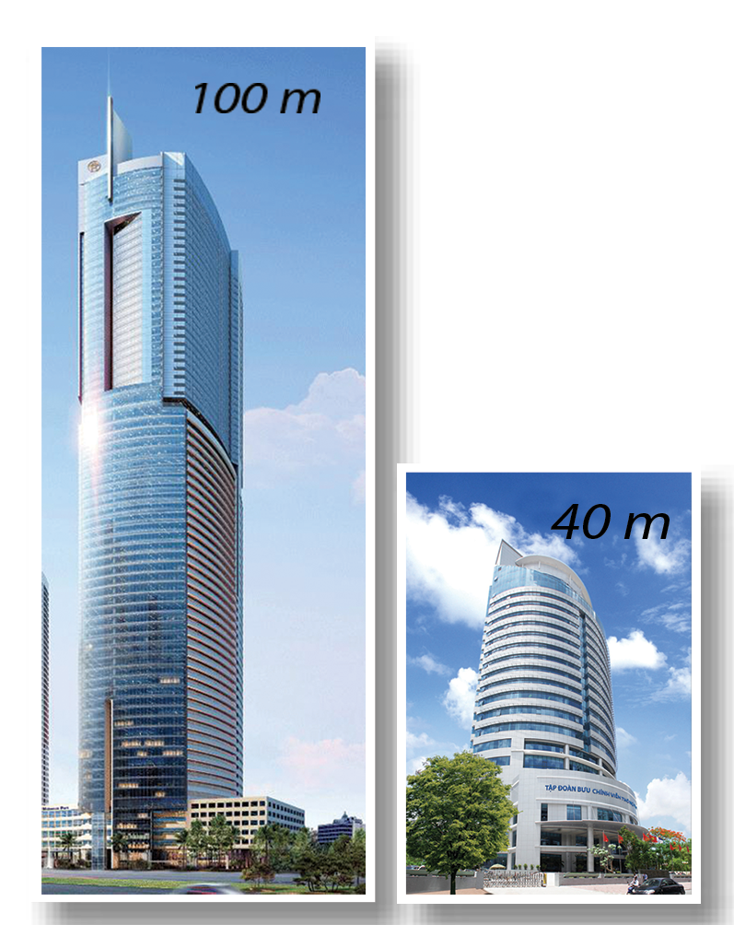
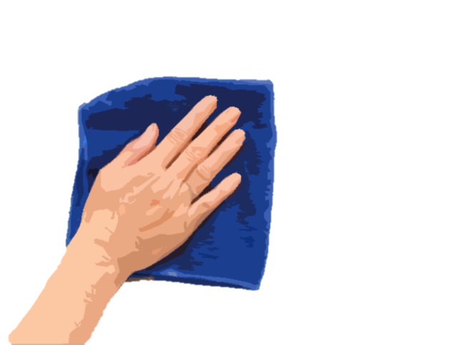
1/5
Comparatives
This building is taller than that building.
CHECK

Slide 12
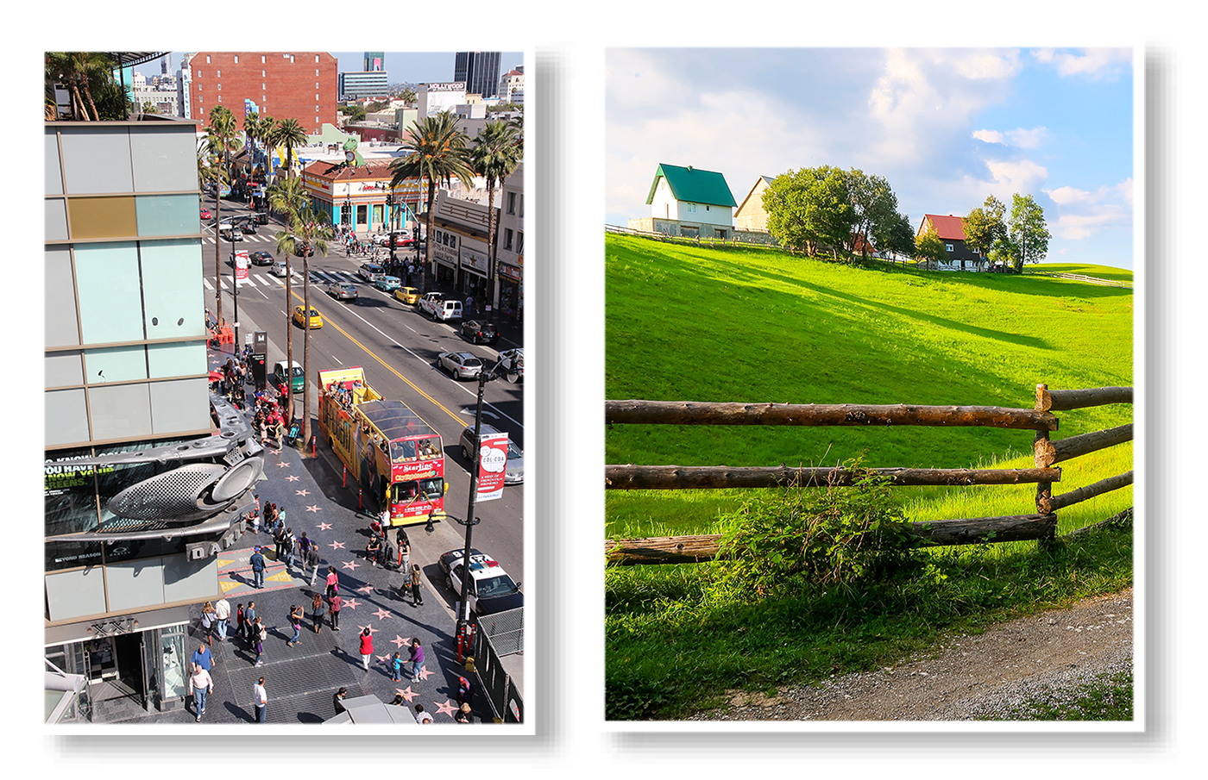
2/5
Comparatives
My neighbourhood is noisier than your neighbourhood. (noisy)
CHECK

Slide 13
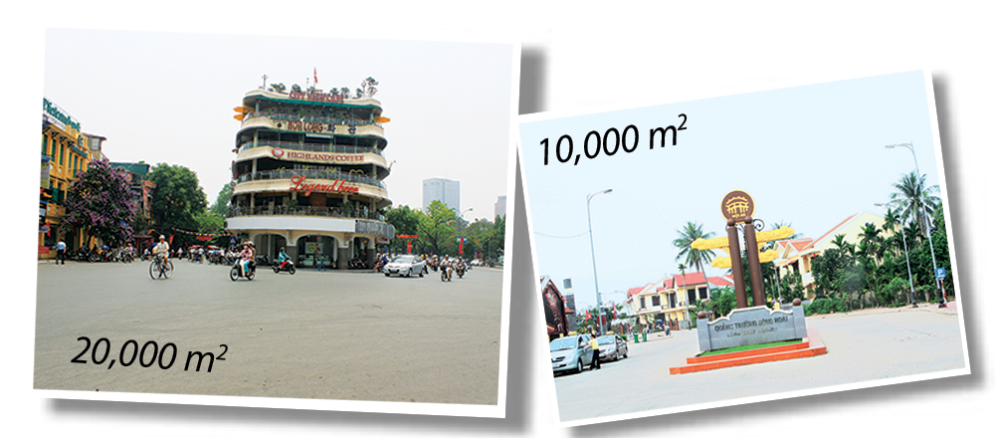
3/5
Comparatives
The square in Hanoi is bigger than the square in Hoi An. (big)
CHECK

Slide 14
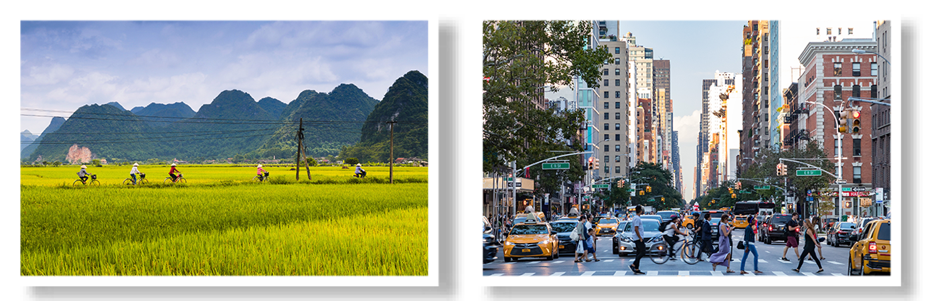
4/5
Comparatives
Living in the countryside is more peaceful an living in the city. (peaceful)
CHECK

Slide 15
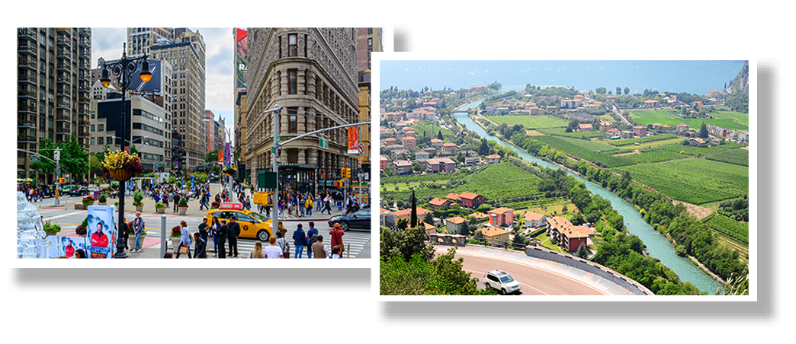
4/5
Comparatives
Is living in the city more exciting than living in the countryside? (exciting)
CHECK

Slide 16
Exercise 1: Complete the sentences
1. This building is taller than that building (tall)
noisier
2. My neighbourhood is ____________ than your neighbourhood. (noisy)
bigger
3. The square in Hanoi is ____________ than the square in Hoi An. (big)
more peaceful
4. Living in the countryside is ____________ than living in the city. (peaceful)
more exciting
5. Is living in the city ____________ than living in the countryside. (exciting)
Notes:
Khi chữa, nói them trường hợp đặc biệt

Slide 17
Ex 2. Use the correct form of the words in brackets to complete the sentences.
Dear Nick,
How are you?
Ha Noi is beautiful but it is too busy for me. I’m having a great time at Cua Lo Beach now. The weather is (1. hot) ________ than that in Ha Noi. The houses and the buildings are (2. small) ________ and (3. old) ________ than those in Ha Noi.
The streets are (4. wide) ________ with less traffic. The seafood here is (5. delicious) ___________ and (6. cheap) __________ than the seafood in Ha Noi.
See you soon,
Vy
Compare 2 things
Comparative adjective
hotter
smaller
older
wider
more delicious
cheaper

Slide 18
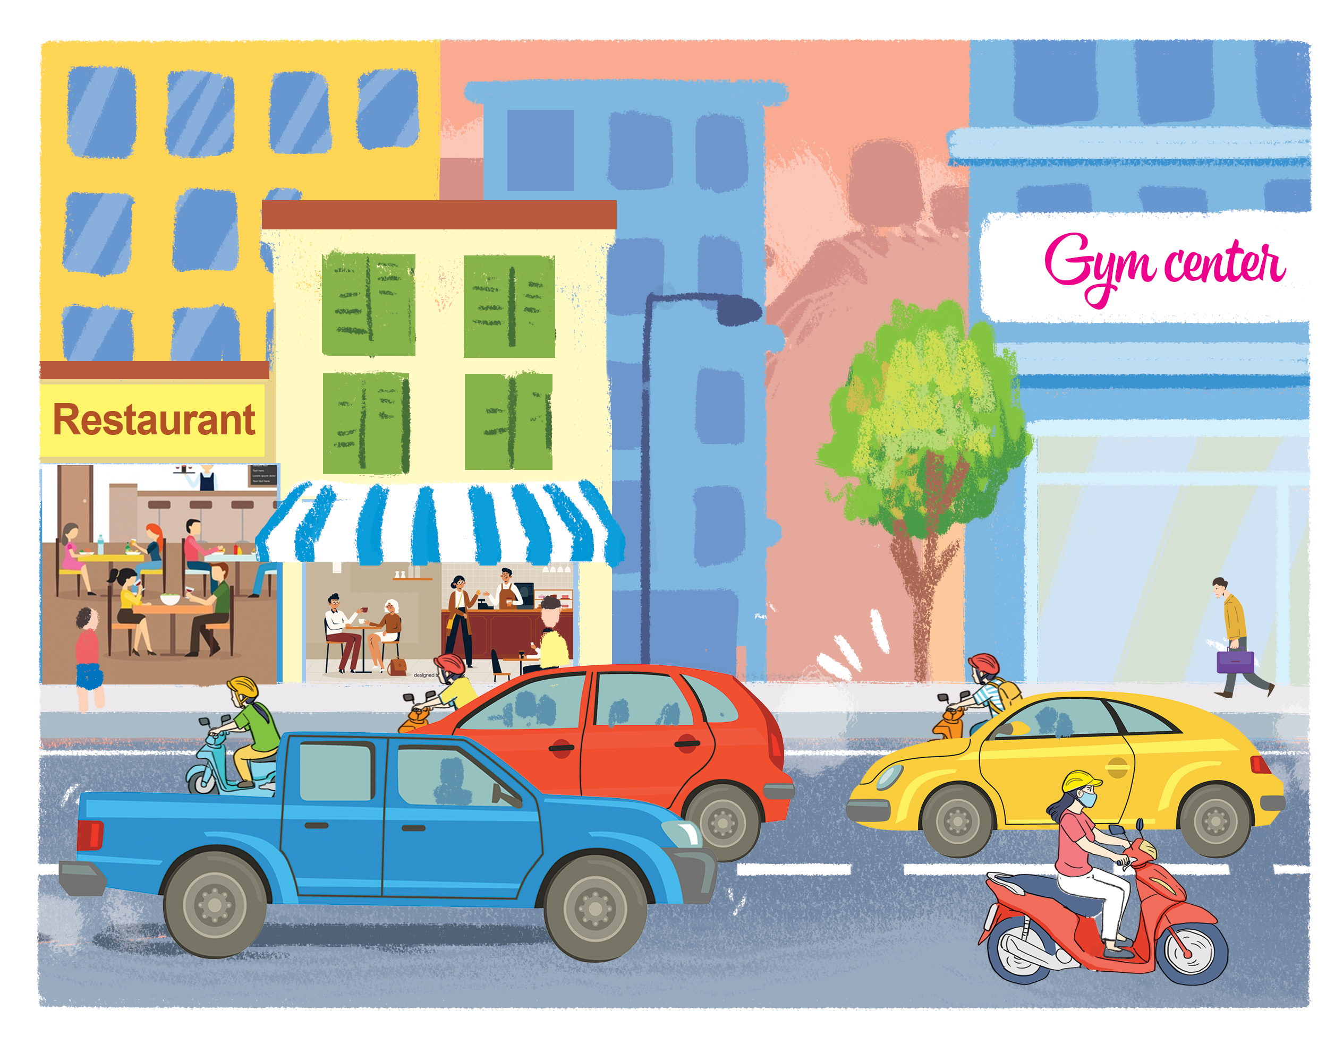
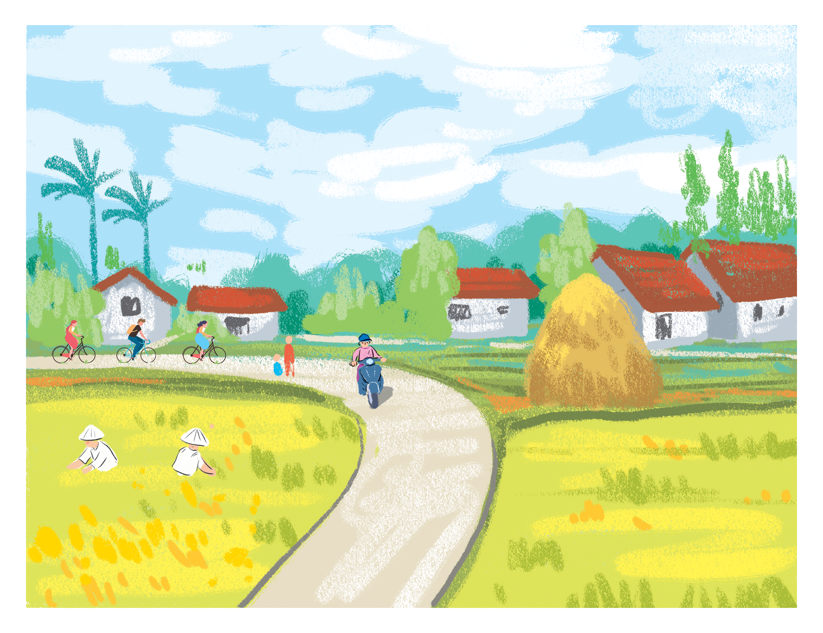
Ex 3: Compare 2 neighbourhoods. Write full sentences.
noisy crowded quiet peaceful modern busy boring
Binh Minh
Long Son
Example: Binh Minh is noisier than Long Son.

Slide 19
Ex 4: Work in pairs. Ask and answer.
Binh Minh
Long Son
Example: 1. A: Is Binh Minh noisier than Long Son?
B: Yes, it is.
2. A: Is Long Son more modern than Binh Minh?
B: No, it isn’t. Binh Minh is more modern than Long Son.

Slide 20

Activity: Mine is more …
Work in pairs
2 minutes
Describe your neighbourhoods

Slide 21
Activity: Mine is more …
COMPARE
2 minutes
Compare 2 neighbourhoods.
Use comparative adjectives.
REPORT

Slide 22
Complete the tables.
Wrap up
COMPARATIVE FORM OF ADJECTIVES
 | Positive | Comparative | Rule
One syllable | fast
 | large
Two syllables | noisy
 | modern
Three or more syllables | expensive
 | beautiful
faster
+ er
larger
+ er
noisier
y → ier
more modern
more expensive
more + ADJ
more beautiful

Slide 23
