Slide 1
UNIT 4:
My neighbourhood
Lesson 4: Communication

Slide 2
How can you identify places and give directions in a city?
Notes:
How can you identify places and give directions in a city?

Slide 3



This lesson, we will...
Ask for and give directions to places
identify places and give directions in a city
use first, then, after that and finally
make an audio guide
Notes:
Michelle to introduce the lesson aims

Slide 4
Asking for and giving directions

Slide 5

1. Listen and read.
A: Excuse me. Could you tell me the way to the cinema, please?
B: Go along this street. It’s on your left.
Excuse me.
Could you tell me the way to
please?
A: Excuse me. Where’s the nearest post office, please?
B: Go out of the station. Take the first turning on the right.
Excuse me.
Where’s
please?
Notes:
To

Slide 6



?
BY HERBER

Slide 7


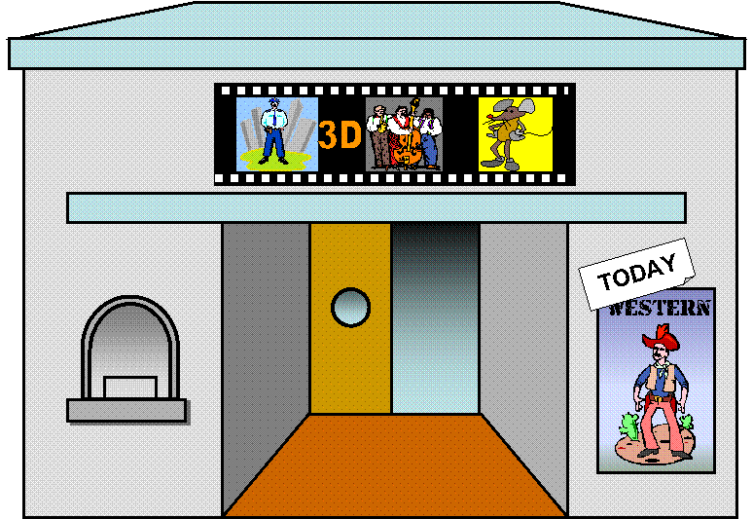
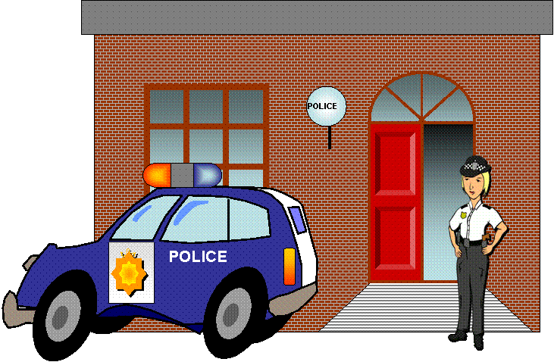

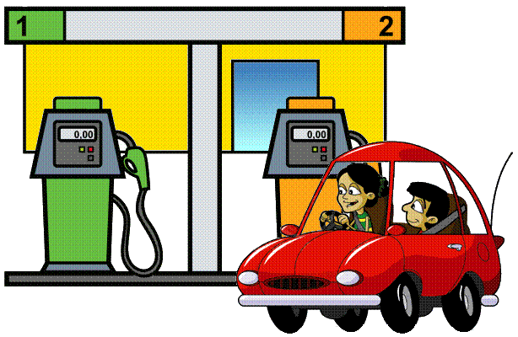




How do I get to the police station?

Slide 8


1. Go two blocks
2. Turn on the right
3. Go one block
4. It’s on the left

Slide 9

How do I get to the hospital?
Park Avenue
Oak Street

Slide 10
1. Go to the corner
2. Turn right
3. Go straight on
4. It’s at the corner of Park Ave. and Oak St.
Park Avenue
Oak Street

Slide 11
How do I get to the stadium?
Park Avenue
Oak Street

Slide 12
1. Go to the corner
2. Turn right
3. Go two blocks
4. It’s on the right opposite the gas station
Park Avenue
Oak Street

Slide 13
How do I get to the garage?
Park Avenue
Oak Street

Slide 14
1. Go two blocks
2. Turn left
4. It’s on the right across from the park
Park Avenue
Oak Street

Slide 15
THANK YOU FOR YOUR HELP!
YOU’RE WELCOME!

Slide 16



2. Asking for and giving directions
Work in pairs.
3 mins
Choose a place around your school.
Ask for and give directions to the place.
Student A
Ask
take turns
Student B
Give directions

Slide 17
An audio guide to a place

Slide 18
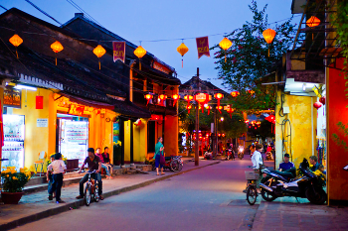
Where is he?
Nick
in Hoi An
Notes:
Nick is listen to an audio guide to Hoi An

Slide 19

3. Listen and fill
Let's start our tour in Hoi An. We are in Tran Phu Street now. First, go to Ong Pagoda. To get there, go (1) ___________along the street for five minutes. It's on your left. Next, go to the Museum of Sa Huynh Culture. Take the (2) ___________ turning on your left. Turn (3) ___________ and it's on your right. Finally, go to Hoa Nhap Workshop to buy some presents. Turn left and then right. It's (4) ___________Tan Ky House.
straight
second
right
next to

Slide 20
Summary
Let's start our tour in Hoi An. We are in Tran Phu Street now. First, go to Ong Pagoda. To get there, go (1) ___________along the street for five minutes. It's on your left. Next, go to the Museum of Sa Huynh Culture. Take the (2) ___________ turning on your left. Turn (3) ___________ and it's on your right. Finally, go to Hoa Nhap Workshop to buy some presents. Turn left and then right. It's (4) ___________Tan Ky House.
1. Where exactly are you in Hoi An?
Tran Phu Street.
straight
2. Are there any beautiful places and restaurants near you?
Yes, there are Ong Pagoda, Museum of Sa Huynh Culture, Hoa Nhap Workshop and Tan Ky House.
second
right
next to
3. Do you give directions to these places?
Yes.
Notes:
What do you use when you want to link the instructions

Slide 21
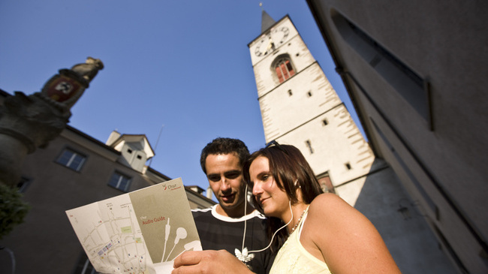
Let’s make an audio guide!

Slide 22
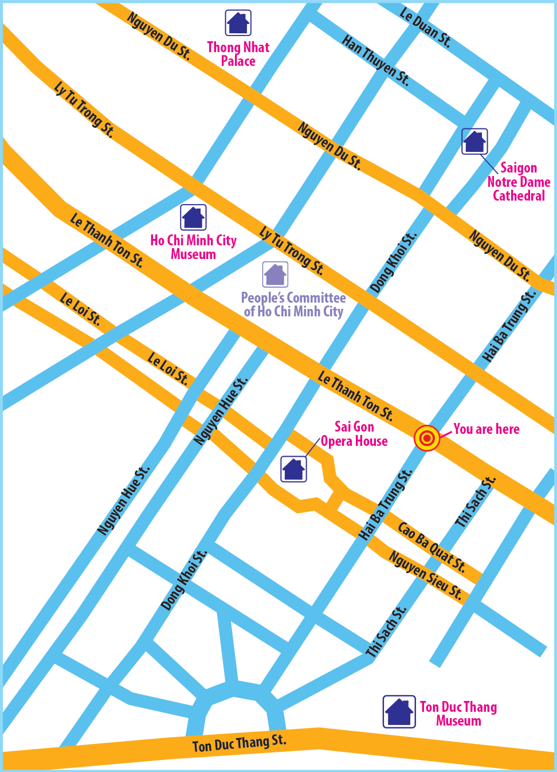
Answer three questions
1. Where exactly are you in Ho Chi Minh City?
2. Are there any beautiful places and restaurants near you?
3. Can you give directions to these places?

Slide 23
Let’s start our tour in Ho Chi Minh City. We are in Hai Ba Trung street now. First, go to

Slide 24
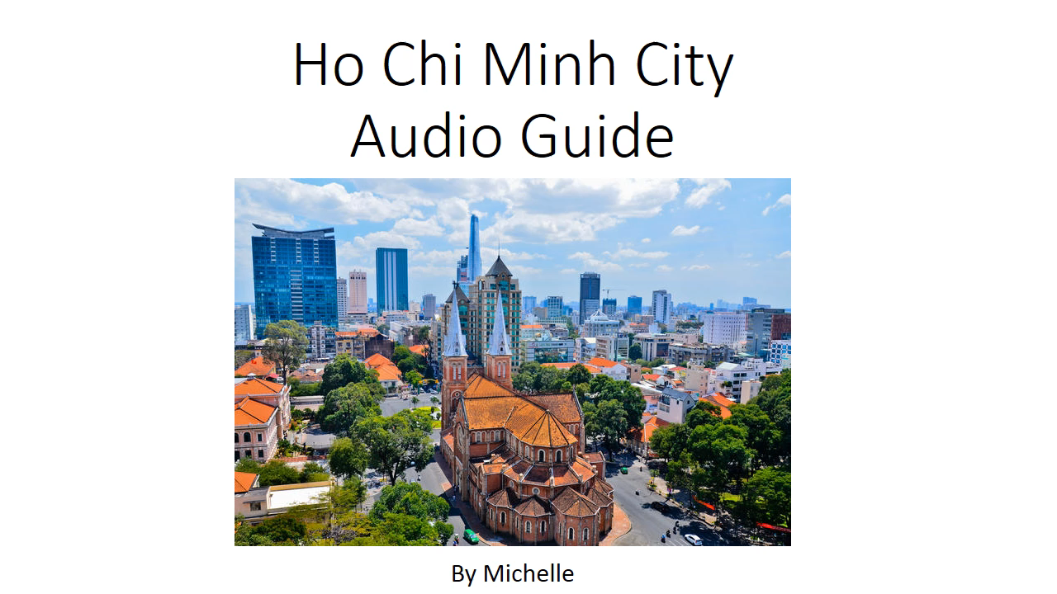
YOUR TURN!

Slide 25

Make an audio guide
Groups of 3
Leader?
Idea thinker(s)?
Script writer(s)?
Guider(s)?
5 mins
choose at least three different places
give directions
use first, then, after that and finally
Notes:
give directions to at least three different places;
use first, then, after that and finally to link your directions.

Slide 26
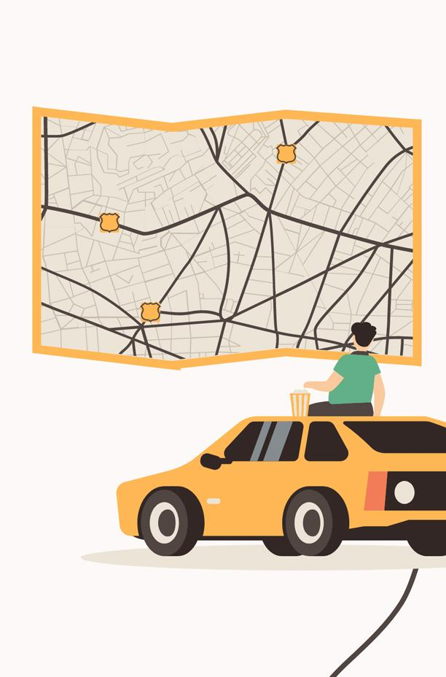
Time to record
A group records/ presents
Other groups listen
Talk  - 1 point

Slide 27

Giving feedback

Slide 28
THANKS!
Do you have any questions?
Please, keep this slide for attribution

Slide 29
ALTERNATIVE RESOURCES

