Slide 1
Warm up
Work in pair.
Look and guess what the word is

Slide 2

Question 1
P R T I A O R T
PORTRAIT

Slide 3

Question 2
S S C A T E R
ACTRESS

Slide 4
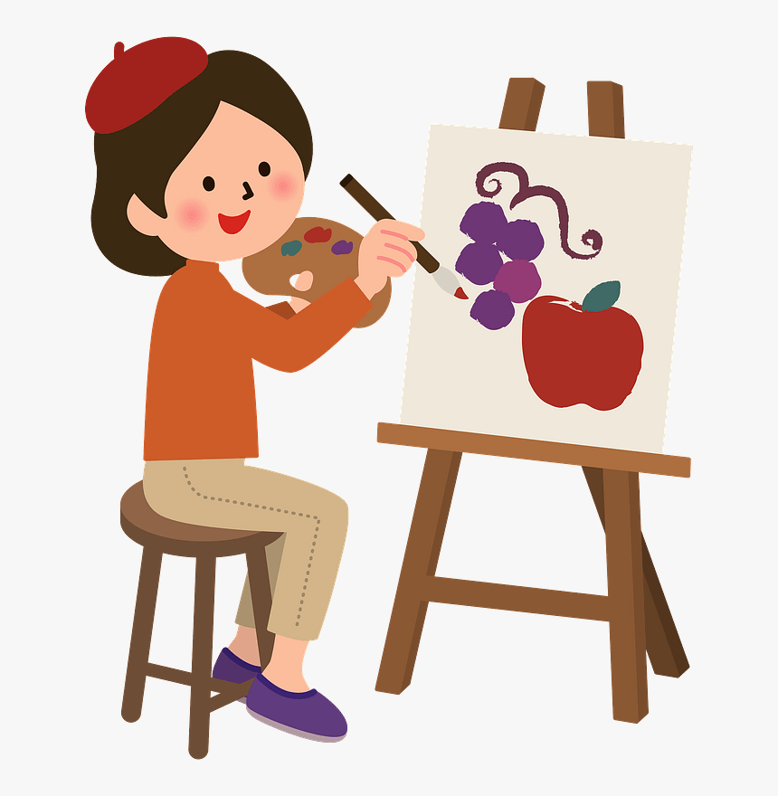
Question 3
N P A I E R T
PAINTER

Slide 5
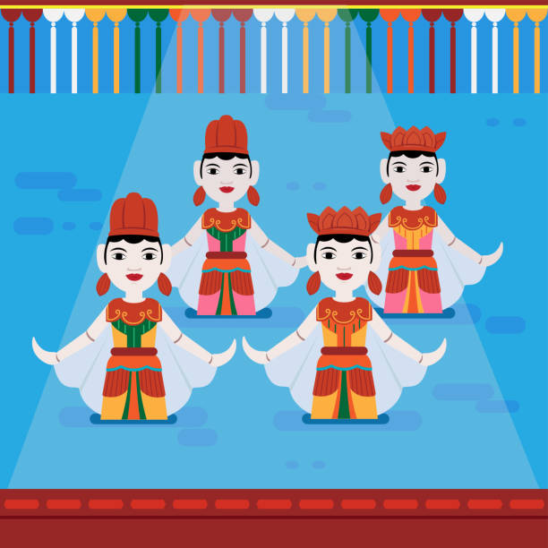
Question 4
T E P P U P
PUPPET

Slide 6
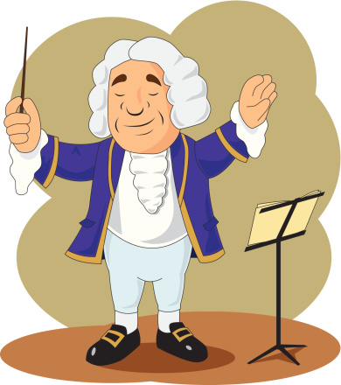
Question 5
O O M C S E R P
COMPOSER

Slide 7
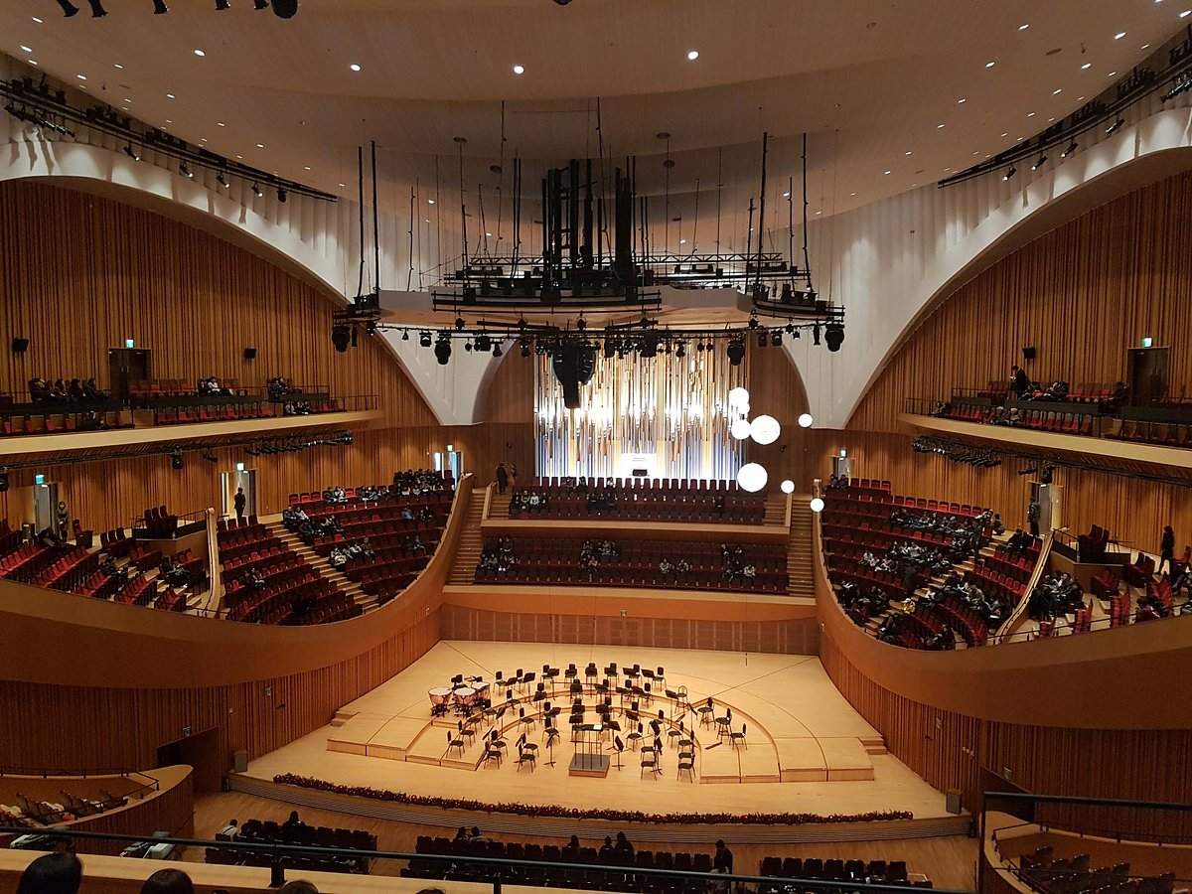
Question 6
O C N E R C T
A L H L
CONCERT
HALL

Slide 8

Question 7
L E N D S C E P A
LANDSCAPE

Slide 9
Unit 4 | Music and Arts
Lesson 4: Communication
English 7

Slide 10

Objectives
By the end of the lesson, students will be able to:
learn how to express preferences
practise using some grammar points and vocabulary related to the topic

Slide 11




Ex1. Listen and read the dialogue (p.45)
Which do you prefer, pop or folk music?
I prefer folk music. It has a better beat.
And which do you like better, modern art or folk art?
I like modern art better.
Nick
Nam

Slide 12

To express references
  - prefer sth
  - like sth better
  I prefer folk music.
  I like modern art better.

Slide 13





Ex 2. Work in pairs. Make similar conversation (p. 45)

Slide 14


Ex 2. Work in pairs. Make similar conversation (p. 45)

Slide 15

Who is fastest?
Groups of 4
In 1 minute
Answer the questions
Do exercise 3 - page 45

Slide 16


Check the answer
1. Who is the composer of Viet Nam's national anthem "Tien Quan Ca"?
A. Pham Tuyen. B. Van Cao. C. An Thuyen.
2. Where in Viet Nam did water puppetry originate?
A. In the North.
B. In the central region.
C. In the South.
3. What is Bac Ninh famous for?
A. Quan Ho singing. B. Vi Dam singing. C. Cai Luong opera.
4. Mozart is one of the world's greatest
A. singers B. composers C. poets

Slide 17
Ex 4. Read and underline the words related to the topic of arts and music. (pg.45)
Hi. My name is Susie. I’m from Australia. I’m in grade 7. My school teaches arts and music to all the students. Some forms of art such as painting, or drama are optional: you can choose to learn them if you like. Music and dancing are compulsory: all of us must study them every week. The school even has a choir, and they perform every month. There are also different art clubs, and you can join any of them.

Slide 18


Ex 5. Work in groups. Talk about how you learn music and arts. Compare Susie’s school with your school.
Groups of 4
3 minutes
Compare at least 3 things about your school and Susie’s school.

Slide 19
Recap
What structure do you use to express references?
A. I prefer A to B.
B. I like A better than B.
C. I would prefer A than B.

Slide 20
Homework
Prepare for the next lesson
Do Part C – Exercise 1,2,3 – Workbook

Slide 21
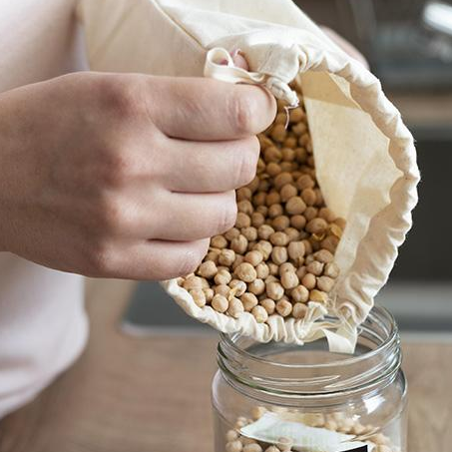
Thank you!

