Slide 1
Unit 5. Food and Drink
Lesson 4. Communication

Slide 2

Objectives
By the end of this lesson, Ss will be able to:
Use lexical items related to the favourite food and drink in everyday life.
Understand and use ways to ask and answer about prices in English.

Slide 3

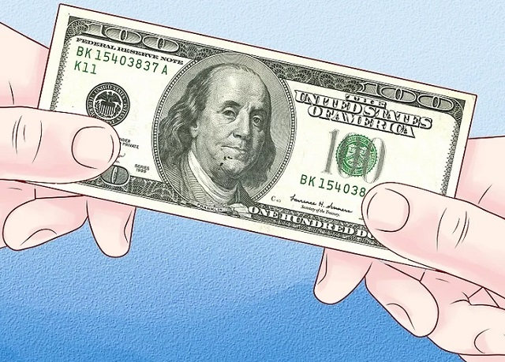
Game: Going out for a meal.
Step 1
Step 2
Rule:
Imagine your family going to restaurant.
Choose the suitable dishes for the amount of money that you have.

Slide 4
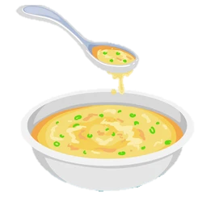
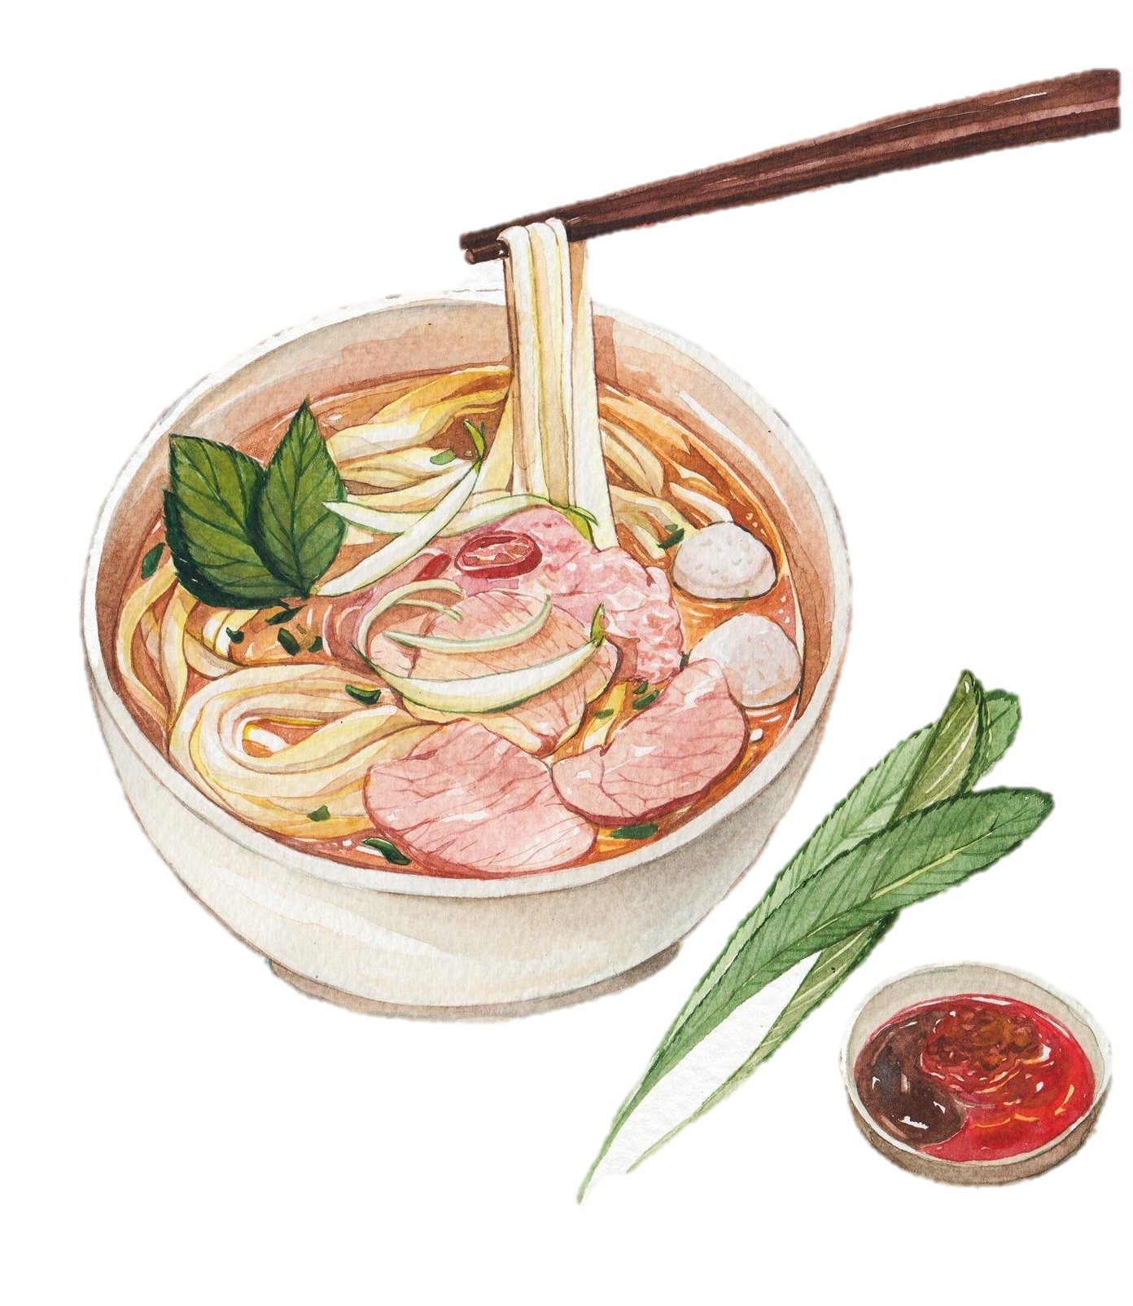
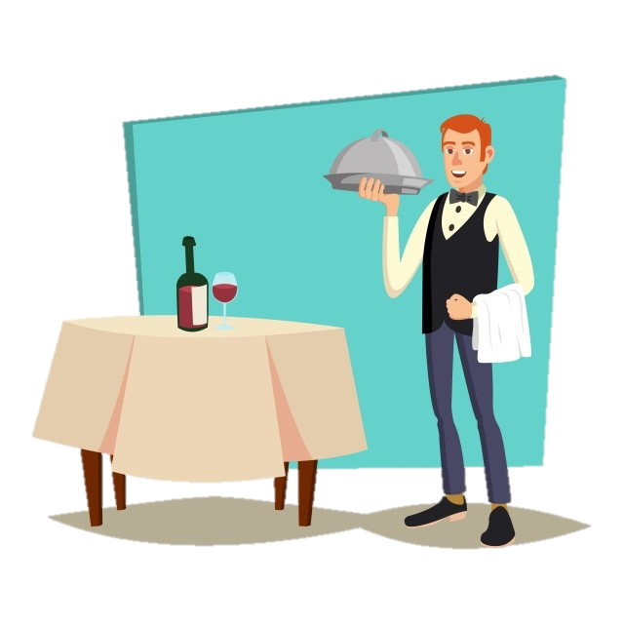
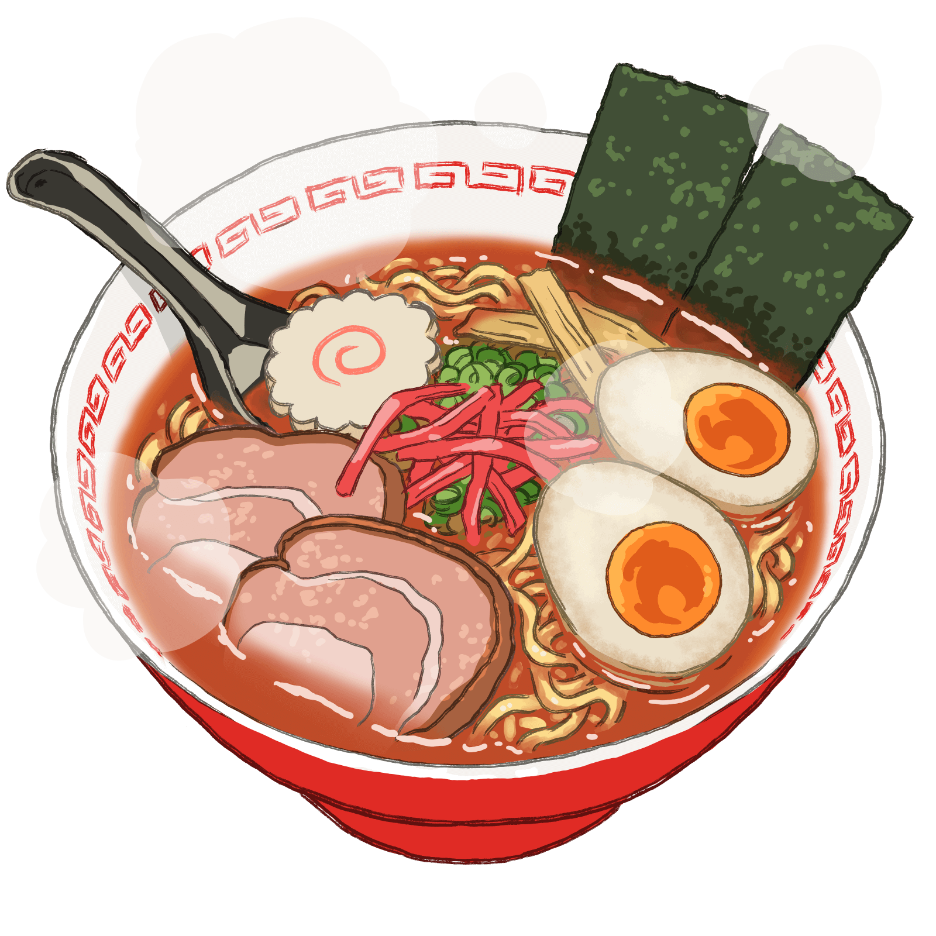
What food do you choose?
5$
Yes! It’s 9$
Yes! It’s 5$
Yes! It’s 7$
7$
9$

Slide 5
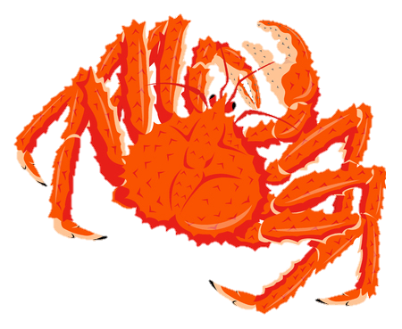
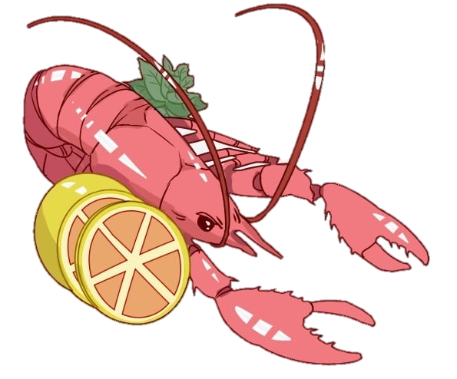
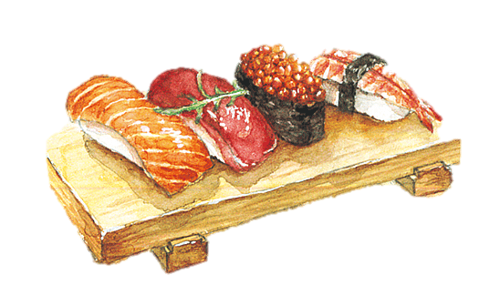
What food do you choose?
50$
Yes! It’s 25$
Yes! It’s 50$
Yes! It’s 15$
25$
15$

Slide 6

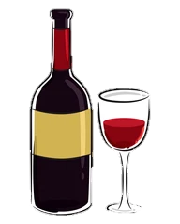

What food do you choose?
2$
Yes! It’s 3$
Yes! It’s 2$
Yes! It’s 20$
3$
20$

Slide 7
Do you know the price of each food and drink in the game?
Let’s study!!!
How do you ask about the price of each food and drink?

Slide 8
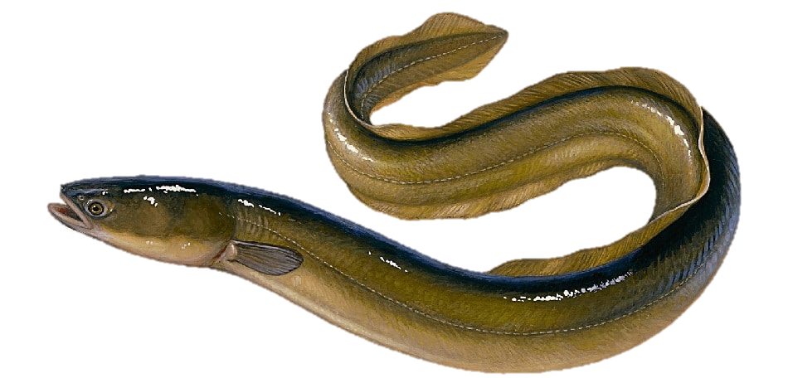
Vocabulary
eel (n)
/iːl/
con lươn

Slide 9

Vocabulary
Example:
What food do you want to try?
try (v)
/traɪ/
thử

Slide 10
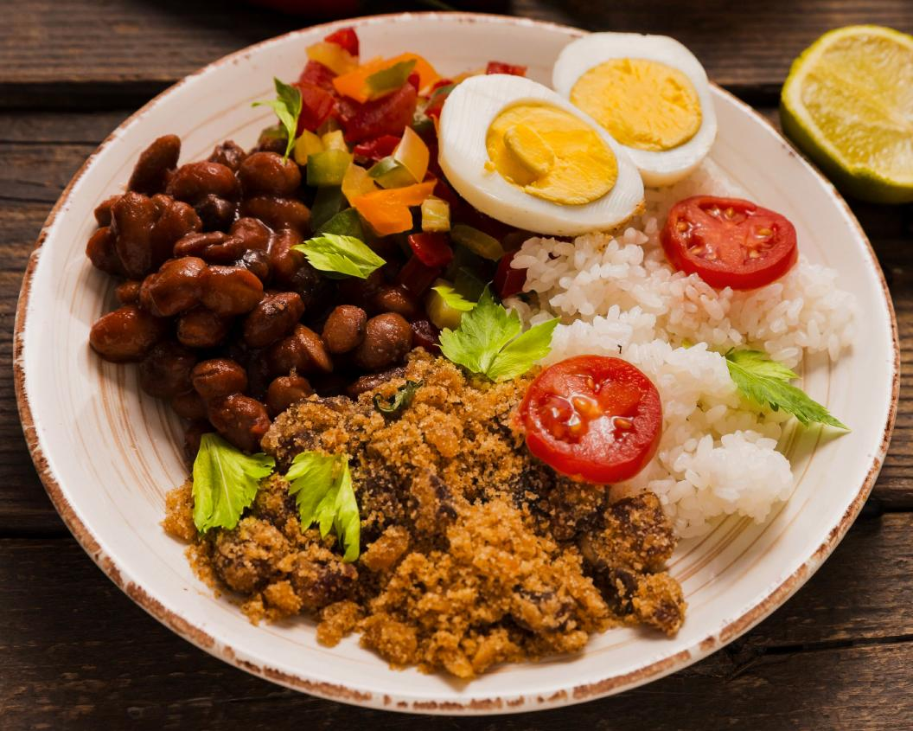
Everyday English
Asking and answering about the prices.

Slide 11

Ex 1. (p 55) Listen and read the conversation.
Ex 1. (p 55) Pay attention to the questions and answers.
Can you mark the question word and answer way about price?
Mark: How much is a bottle of mineral water?
Mi: It's 5,000 dong.
Mark: And how much are two kilos of apples?
Mi: They're 50,000 dong.
Mark: How much is a bottle of mineral water?
Mi: It's 5,000 dong.
Mark: And how much are two kilos of apples?
Mi: They're 50,000 dong.

Slide 12
Ex 2. (p 55). Work in pairs. Ask and answer about the prices of the food and drink on the menu.
LY'S RESTAURANT Breakfast Menu
Food
bowl of beef noodle soup | 30,000 dong
bowl of eel soup | 35,000 dong
toast | 20,000 dong
Drink
glass of milk | 9,000 dong
bottle of mineral water | 8,000 dong
cup of green tea | 5,000 dong
Example:
A: How much is a bowl of beef noodle soup?
B: It’s 30,000 dong.

Slide 13
Do you have any favorite food or drink?

Slide 14
Ex 3. (p 55) Listen to the conversation and answer the following questions.
Ex 3. (p 55) Underline the keywords.
1
What's Nam's favourite food?
What's Nam's favourite food?
2
What's his favourite drink?
What's his favourite drink?
3
What foreign food does he like?
What foreign food does he like?
4
What food does he want to try?
What food does he want to try?
5
What food can he cook?
What food can he cook?

Slide 15
Ex 3. (p 55) Listen to the conversation and answer the following questions.
1
What's Nam's favourite food?
What's Nam's favourite food?
Peter: What's your favourite food, Nam?
Nam: It's spring rolls.
Answer: Spring rolls

Slide 16
Ex 3. (p 55) Listen to the conversation and answer the following questions.
2
What's his favourite drink?
What's his favourite drink?
Peter: What's your favourite drink?
Nam: I like lemonade.
Answer: Lemonade

Slide 17
Ex 3. (p 55) Listen to the conversation and answer the following questions.
3
What foreign food does he like?
What foreign food does he like?
Peter: Interesting. What foreign food do you like?
Nam: Mmm, I like apple pie and pancakes.
Answer: Apple pie and pancakes

Slide 18
Ex 3. (p 55) Listen to the conversation and answer the following questions.
4
What food does he want to try?
What food does he want to try?
Peter: How about new food? Is there anything that you've never had, but would like to try?
Nam: Certainly. I'd love to try hu tieu in Ho Chi Minh City.
Answer: Hu tieu (in HCM city)

Slide 19
Ex 3. (p 55) Listen to the conversation and answer the following questions.
5
What food can he cook?
What food can he cook?
Peter: I'd like to give it a try too. What can you cook?
Nam: Let me think... I cook omelettes, rice, and spring rolls.
Answer: Omelettes, rice, and spring rolls

Slide 20
Ex 3. (p 55) Listen to the conversation and answer the following questions.
1
Spring rolls
What's Nam's favourite food?
What's Nam's favourite food?
2
Lemonade
What's his favourite drink?
What's his favourite drink?
3
Apple pie and pancakes
What foreign food does he like?
What foreign food does he like?
4
Hu tieu
(in HCM city)
What food does he want to try?
What food does he want to try?
Omelettes, rice, and spring rolls
5
What food can he cook?
What food can he cook?

Slide 21
Ex 4. (p 55) Work in groups. Interview two of your friends aout their favourite food and drink.
Questions | Student 1 | Student 2
1. What's your favourite food?
2. What's your favourite drink?
3. What food or drink do you want to try?
4. What foreign food or drink do you like?
5. What can you cook?

Slide 22
Ex 4. (p 55) Work in groups. Interview two of your friends aout their favourite food and drink.
Now report your results to the class.
Example:
I interviewed Minh about his favourite food and drink. Minh's favourite food is beef noodles soup. His favourite drink is fruit juice. He wants to try spaghetti. His favourite foreign food is Korea Kimbap. He can cook omelette and noodles.

Slide 23

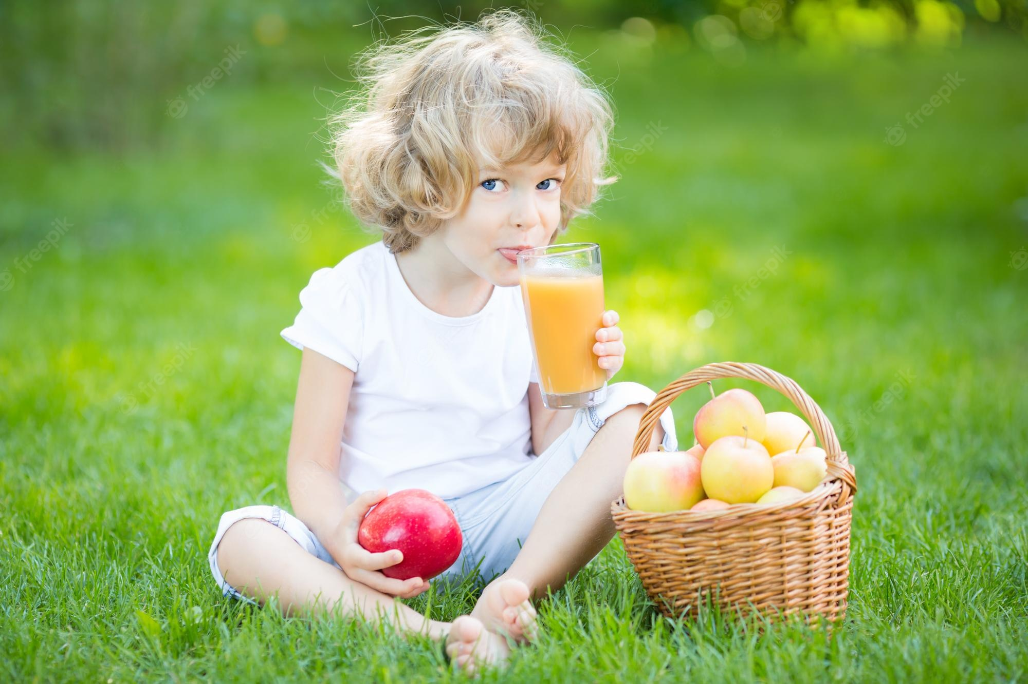
RECAP
Circle the best answer.
1. What is the price of a kilo of beef?
A. How much is a kilo of beef?
B. How many is a kilo of beef?
C. How much are a kilo of beef?
2. What’s her favourite drink?
A. I like lemonade.
B. She likes apple juice.
C. She likes coke.
1. What is the price of a kilo of beef?

Slide 24
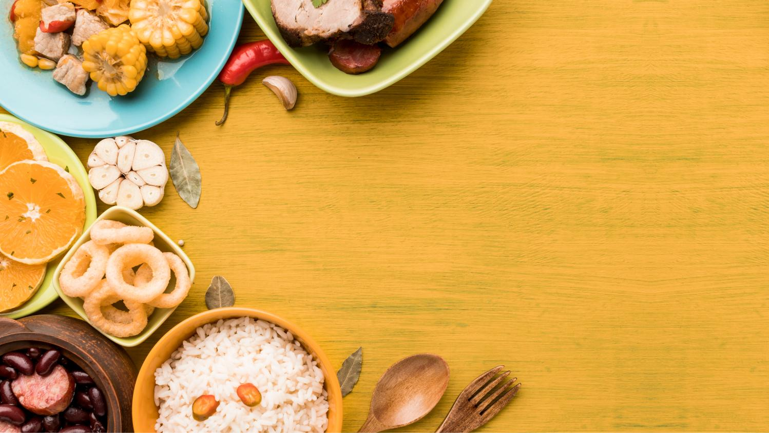
Thank you!

