Slide 1
Unit 6.
A visit to a school
Lesson 4. Communication
GREEN

Slide 2
Objectives
By the end of the lesson, students will be able to
ask for details and talk about their school.

Slide 3






Pull out carrot

Slide 4




Do you dare to try?
Yes. If you answer correctly these questions.
Now I'll let you pull up the carrots yourself.
I’m hungry. Can you give me a carrot?
Yes, I’m ready.

Slide 5





I like going to the beach ______ the summer.
A. in
B. on
C. at
A B C

Slide 6

Let's meet ______ 4:30 this afternoon.
A. in
B. on
C. at
A B C

Slide 7
I'll see you ______ May.
A. on
B. in
C. at
A B C

Slide 8

It was stormy ______ my 13th birthday.
A. at
B. in
C. on
A B C

Slide 9
He put the books ______ the table.
A. in
B. on
C. at
A B C

Slide 10
Rule for teacher:
- Students choose which answer, please click on the carrot according to that answer.
- The rabbit will go to pick the carrot by itself and will know the right and wrong answer.
- Finally, clicking on the farmer will give the correct answer.
- Click the screen over the slide containing the next question.

Slide 11
EVERYDAY ENGLSIH
ASKING FOR DETAILS

Slide 12
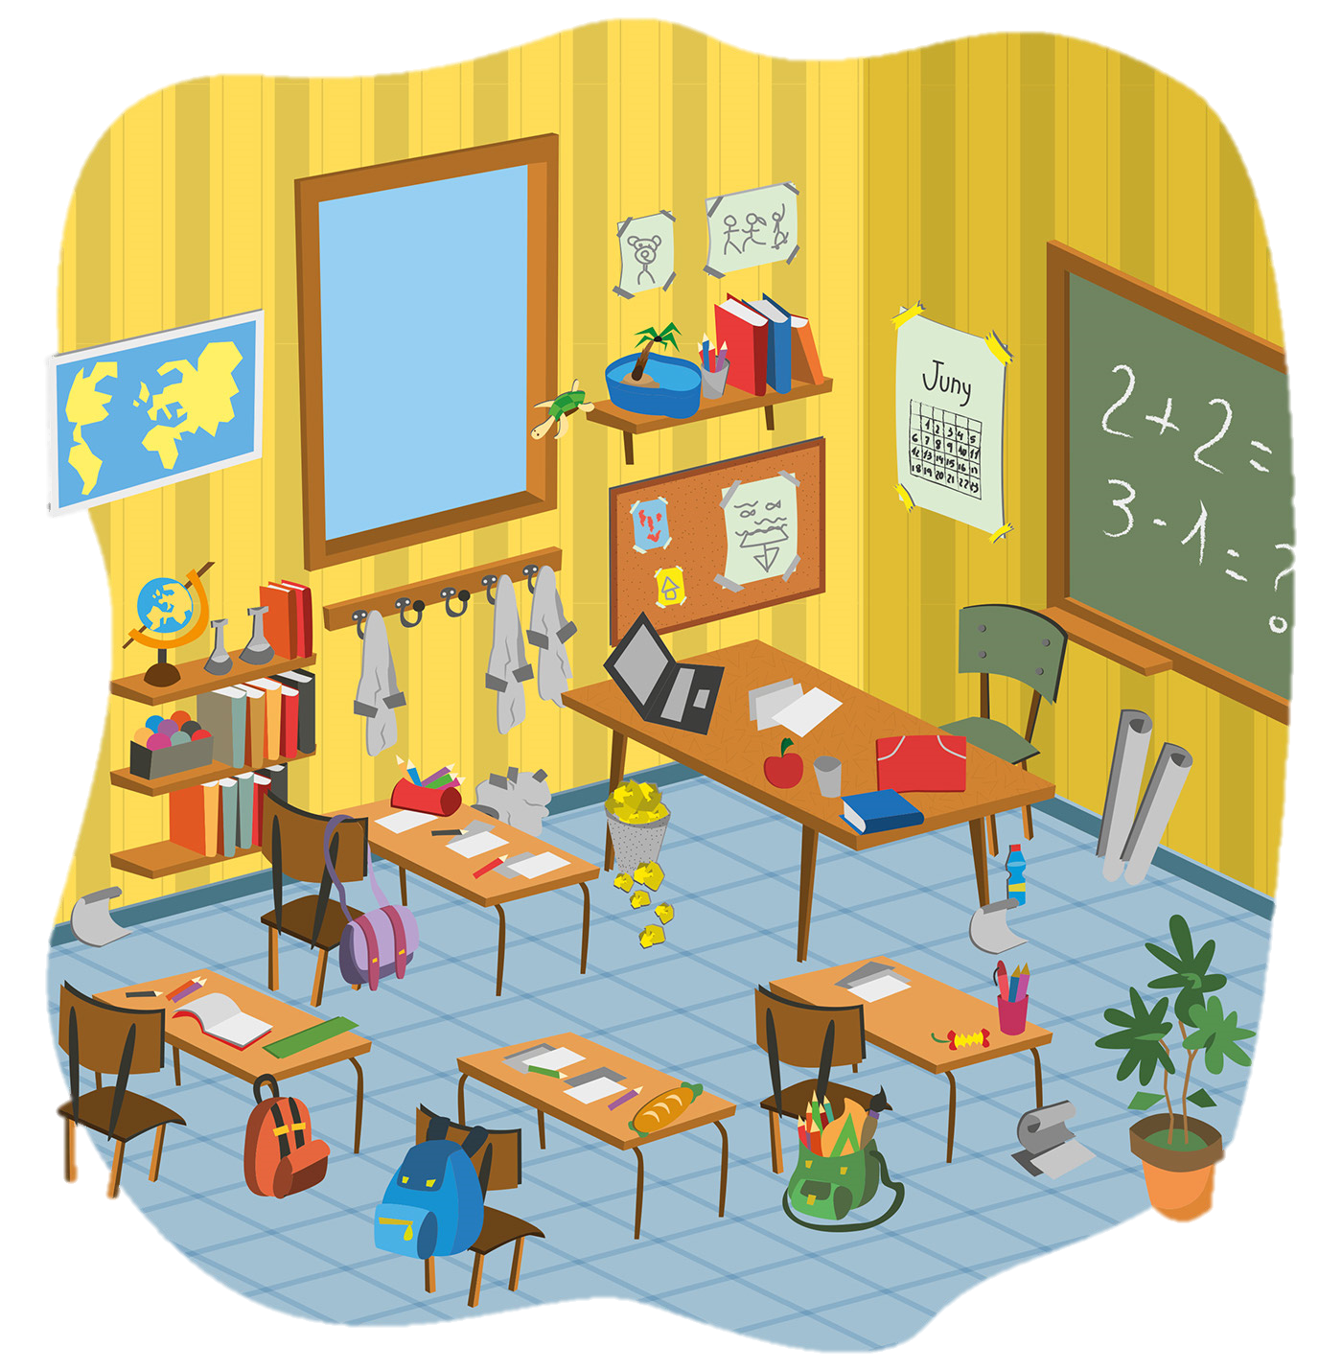
Ex 1. (p 64) Listen and read the conversation.
Ex 1. (p 64) Pay attention to the highlighted sentence.
Mi: Are you doing anything this Sunday?
Phong: Not really.
Mi: Would you like to go with us to Binh Minh Lower Secondary School?
Phong: Sounds great! Can you tell me more?
Mi: We’ll leave at 7 a.m. My friends David and Nick are coming too.

Slide 13
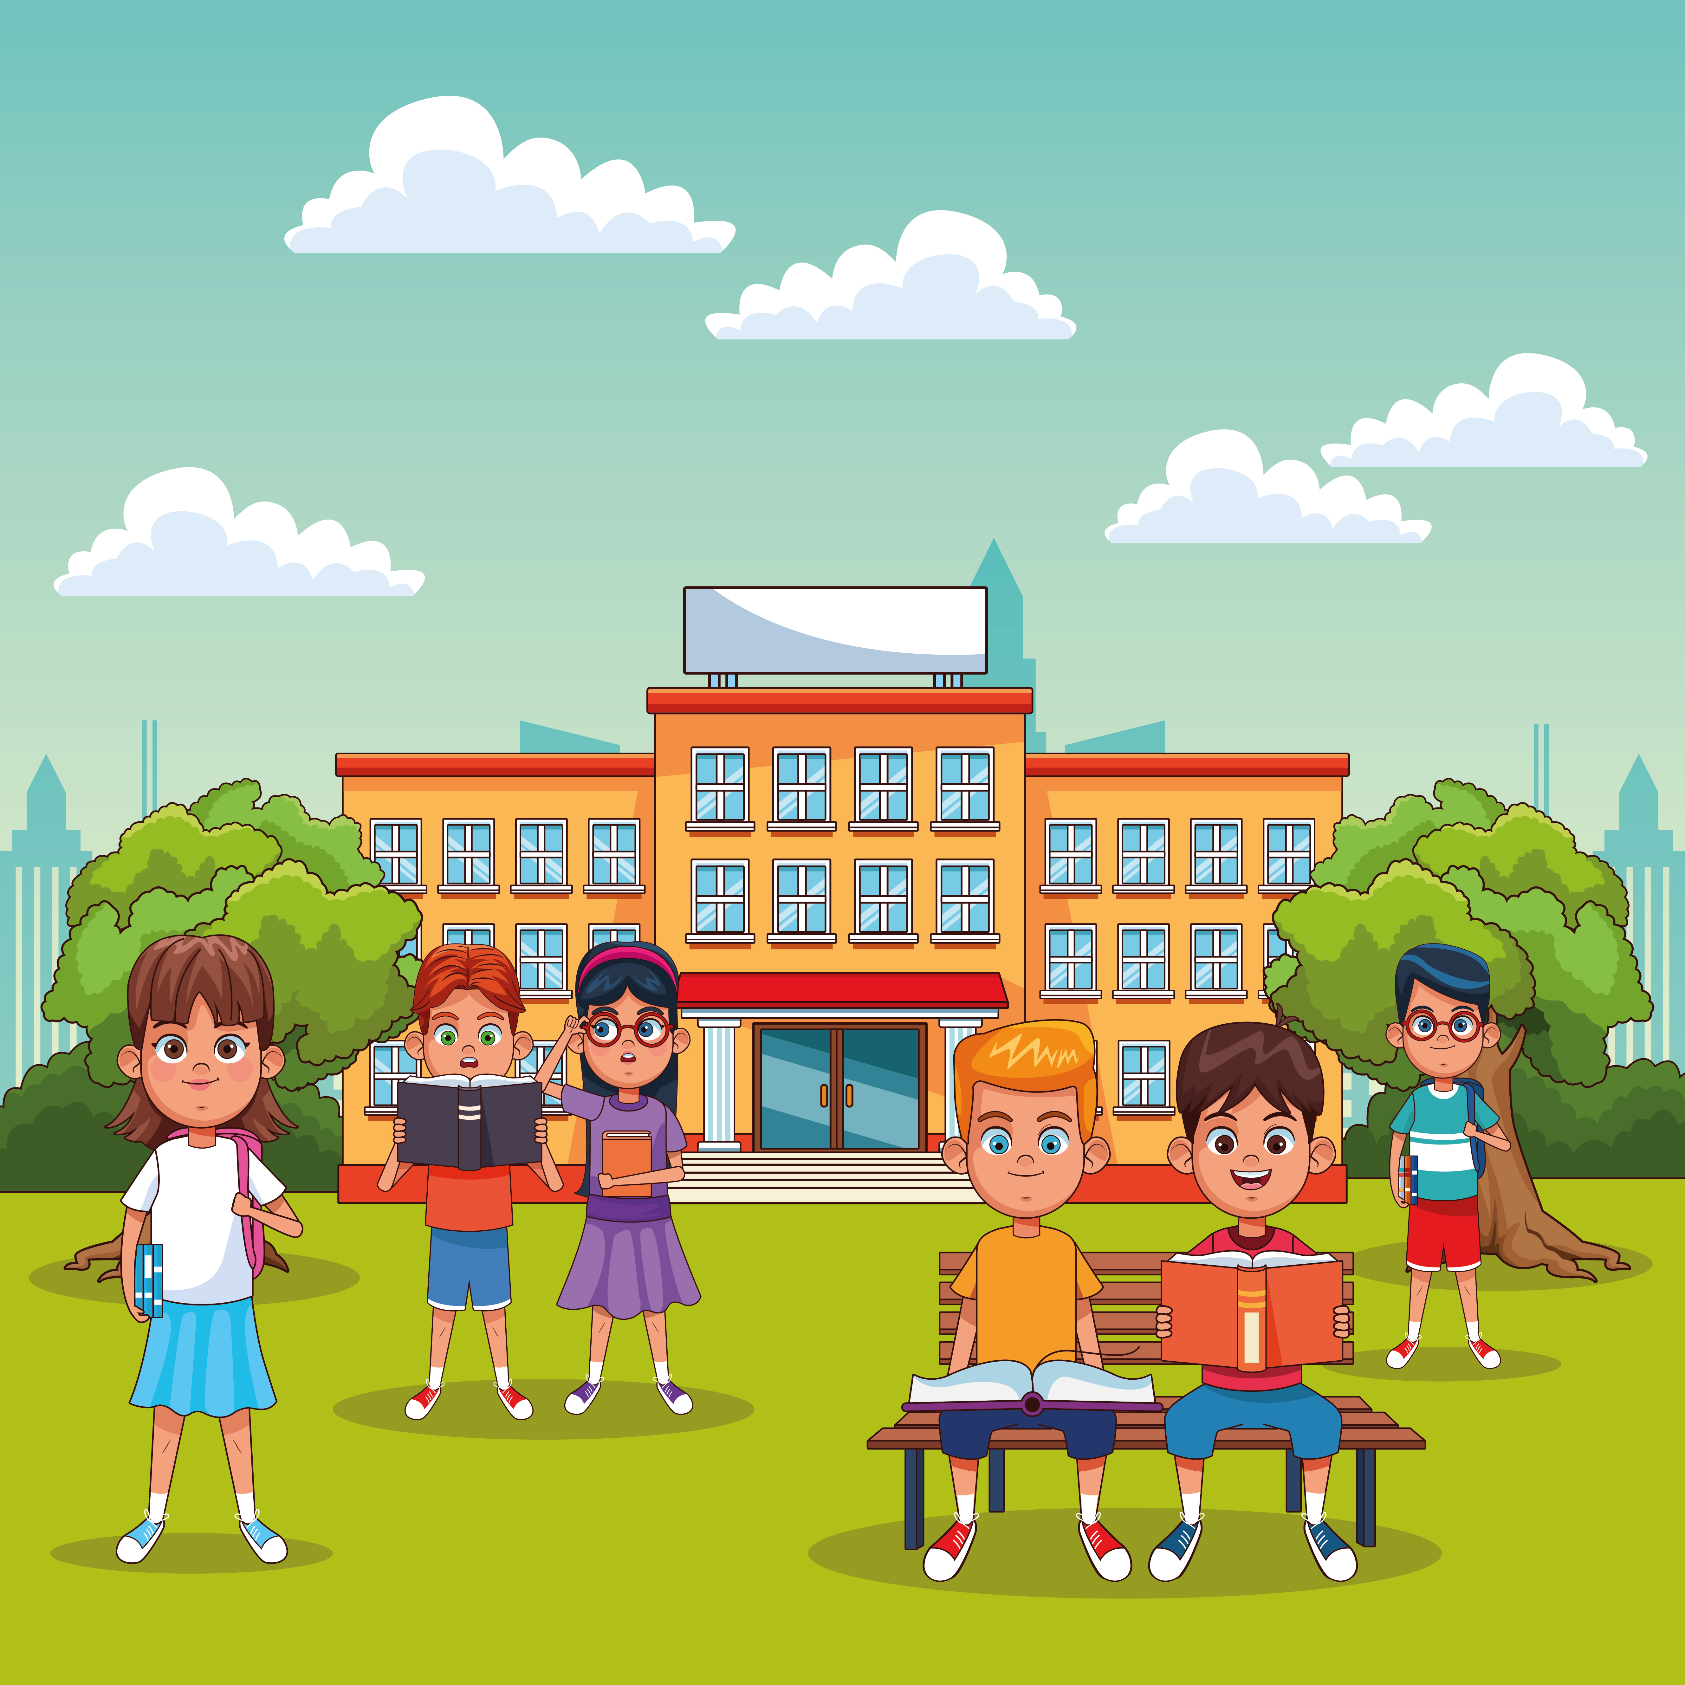
Ex 2. (p 64) Work in pairs. Ask and answer questions about your visit to a famous school.
Can you tell me more?
Can you tell me why?
Can you tell me how?

Slide 14
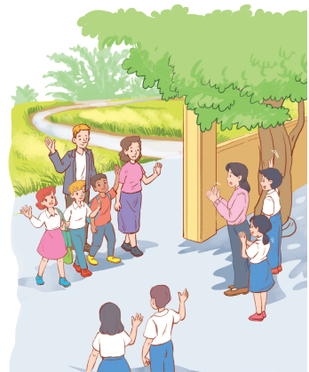
Welcome to our school!
What will you introduce about your school to your oversea friends?

Slide 15

Ex 3. (p 65) Make a list of what you want to show about your school to your overseas friends.
Work in pairs. Ask and answer questions about your plan.
Example:
A: I’m going to show them the school library.
B: Sounds good. Can you tell me why?
A: I want them to see our learning resources. I think they’re very modern.
Hello
Friends

Slide 16
Ex 4. (p 65) Work in groups. Read the passage and complete the table.
Wilson High School is for students aged 11 -16 in London. It has about 1,000 students and 100 teachers. The school has some modern science laboratories, computer rooms, a large library, a sports hall, and an activity studio.
The students study many different subjects such as English, literature, maths, science, etc. They also study extra subjects and get involved in projects, use school resources and take part in a number of outdoor activities and school trips.
 | Wilson High School
Number of students and teachers
Subjects
School facilities
1000 students and 100 teachers
English, literature, maths, science, etc.
Science laboratories, computer rooms, a large library, a sports hall, and an activity studio.

Slide 17
Ex 4. (p 65) Work in groups. Discuss and fill in the information about your school.
 | Wilson High School | Your school
Number of students and teachers
Subjects
School facilities
Example:
There are about 1,000 students in Wilson High School. They are between 11 and 16 years old.
Our school has about 900 students. We are between 11 and 14 years old.
1000 students and 100 teachers
English, literature, maths, science, etc.
Science laboratories, computer rooms, a large library, a sports hall, and an activity studio.

Slide 18
RECAP
What have you learnt today?
What are these questions in Communication for?
A. Communication
B. Skill 2
C. A closer look 2
A. Contents
B. Details
C. Ideas

Slide 19
THANK YOU!
BYE!

