Slide 1
UNIT 9: FESTIVALS AROUND THE WORLD
Lesson 4: Communication

Slide 2
Objectives
1
2
Express disappointment
Understand and talk about the concept of festival symbols and their meanings

Slide 3
Unjumble the words
DIPMSAIPONNET
DISAPPOINTMENT
Notes:
T lead to the next part: today we will learn how to express disappointment.

Slide 4
01
Every day English
Expressing Dissapointment

Slide 5

Ex 1: Listen and read the conversation. Pay attention to the highlighted sentences.
Mi: How was the music festival last Sunday?
Mark: It was disappointing!
Mi: Why?
Mark: The band was late.
Trang: And the singers weren’t very good either. It was a big disappointment.
What phrases did they use to express disappointment?
Can you add more?
Notes:
Suggestion: That’s too bad!, What a disaster!; That’s so disappointing!, what a bummer!, That’s a pity!, What a shame!, that's a real downer. ...

Slide 6
Ex 2: Work in groups. Make a similar conversation for each situation below.
1
2
Your friend went to a film festival for teenagers, but there were not many films he / she liked.
Your friend went to the market to buy decorations for the Mid-Autumn Festival. But there were not many decorations to choose from.

Slide 7
Present time!!

Slide 8
02
Festival Symbols

Slide 9

Ex 1: Listen and read the conversation. Pay attention to the highlighted sentences.
1. A symbol is an image we use or think of when celebrating a festival.
2. A symbol usually has a special meaning.
3. The Christmas tree is the symbol of a long life.
4. Santa Claus is the symbol of joy and happiness.
Notes:
Suggestion: what a bummer!, That’s a pity!, What a shame!, That’s too bad, that's a real downer. ...

Slide 10

Guess the festival
- Work in 4 teams
- One correct answer = 1 point
- You will be given some festival symbols and you will have to guess the festivals they are representing and their meanings.
Notes:
Teacher divide the class into 4 teams

Slide 11
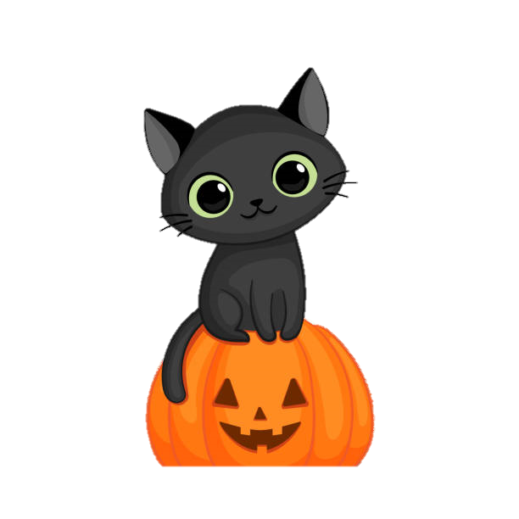
Halloween
It’s the symbol of bad luck

Slide 12
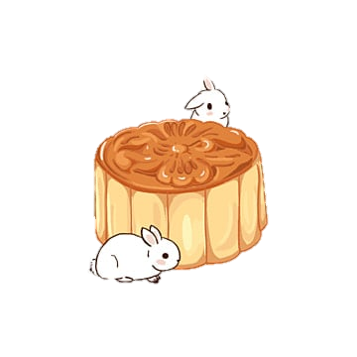
Mid-autumn Festival
It’s the symbol of the moon, prosperity and family reunion.

Slide 13

Cannes Film Festival
It’s the symbol of the winner’s prize.

Slide 14
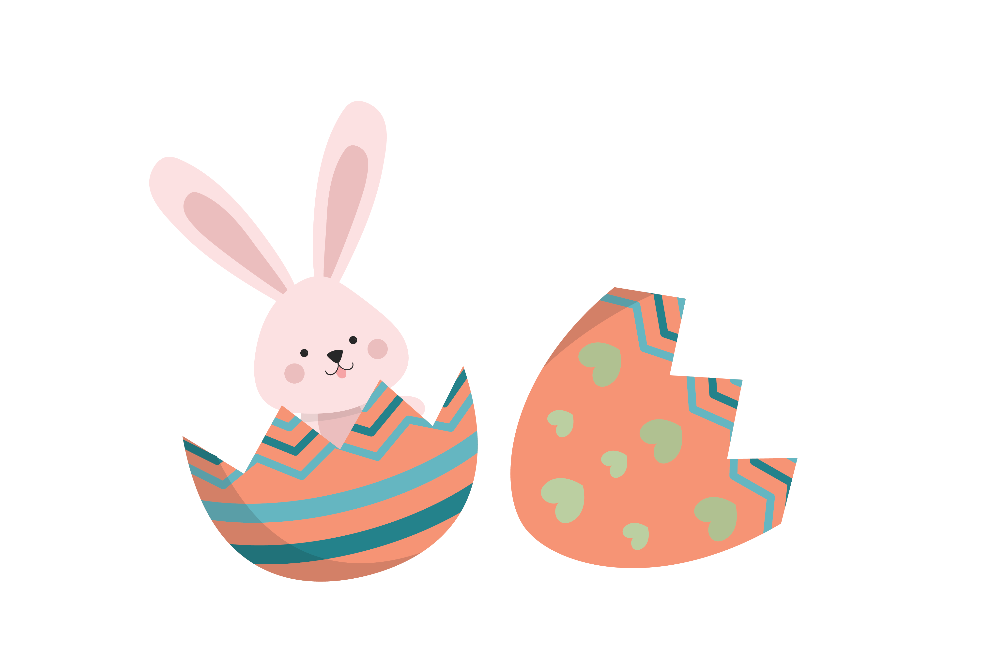
Easter
It’s the symbol of a new life because it has a lot of babies

Slide 15
Ex 4: Match each festival with its symbol and meaning.
Mid-autumn Festival
Halloween
Easter
Cannes Film Festival
It’s the symbol of bad luck
It’s the symbol of the moon, prosperity and family reunion.
It’s the symbol of a new life because it has a lot of babies
It’s the symbol of the winner’s prize.

Slide 16
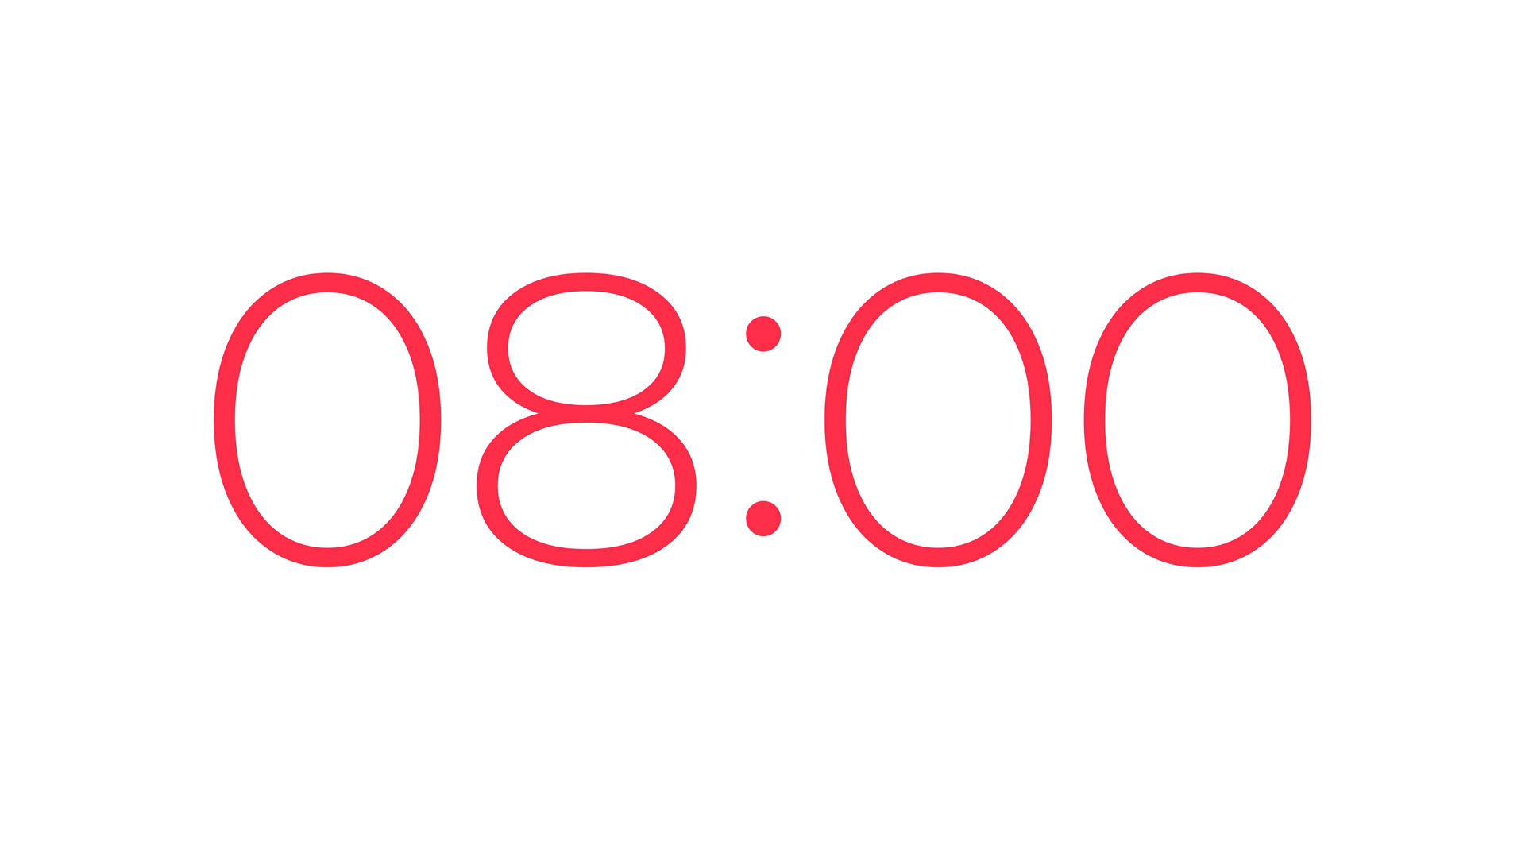
Ex 5: Work in groups. Choose a festival and talk about its symbol(s) and meaning.
Work in group of 6 in 5 minutes
Choose a festival and talk about its symbols
Present to the class in 2 minutes
Example: When we talk about Christmas, we think of the Christmas tree. It is the symbol of a long life.

Slide 17
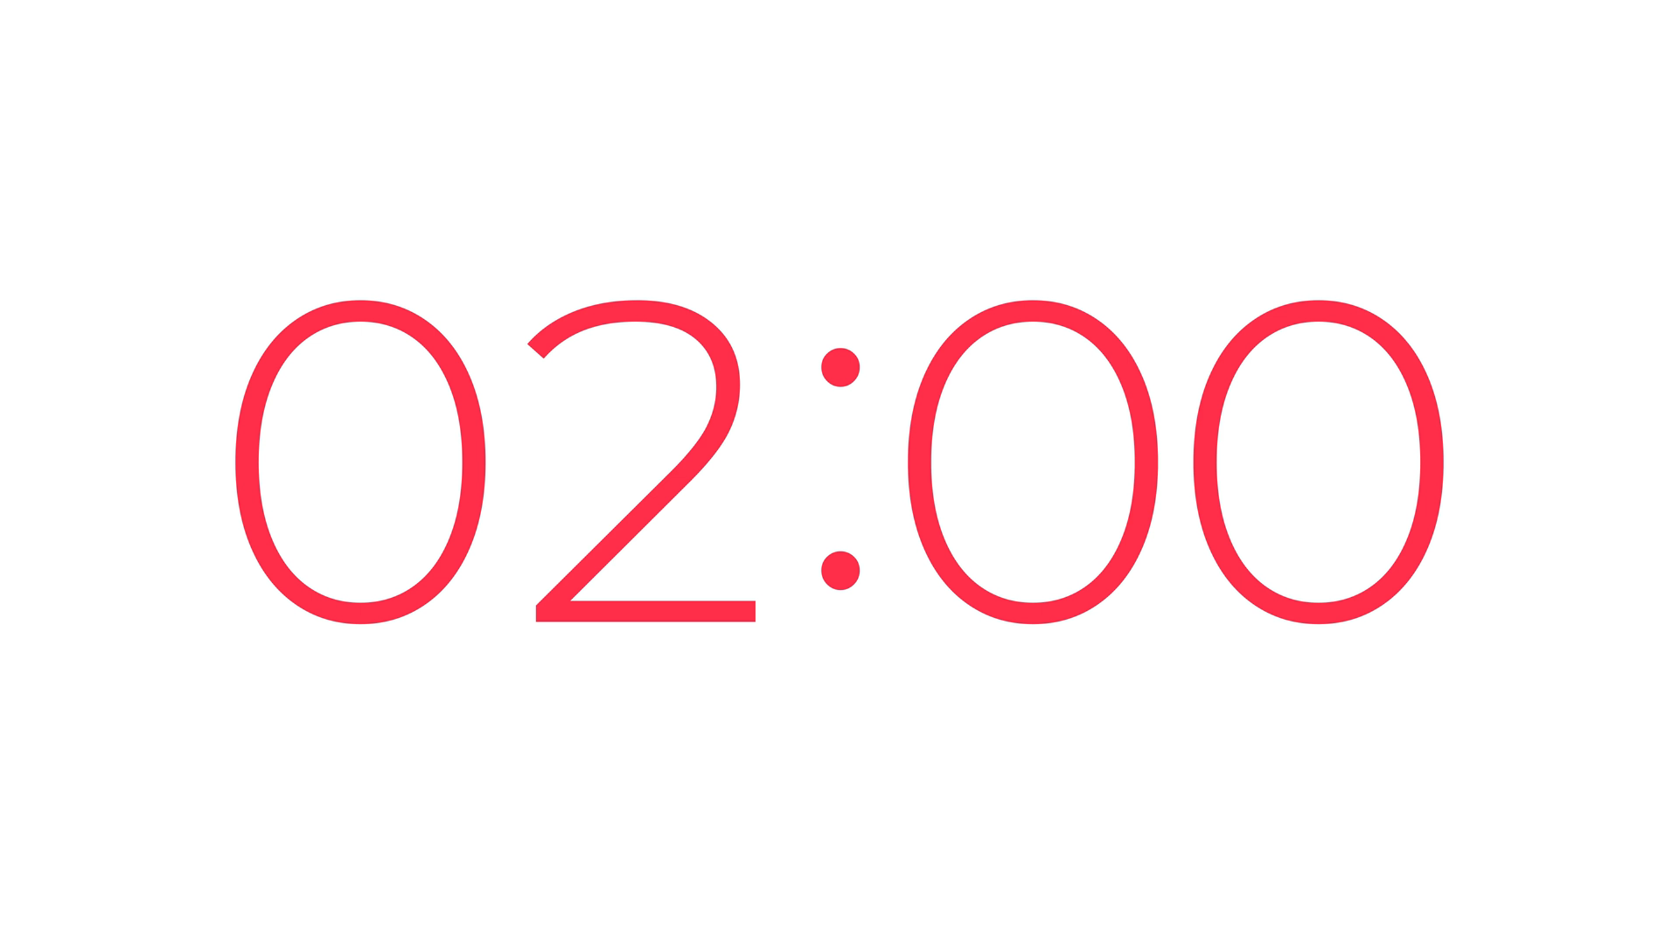
Present time!!

Slide 18
03
Let’s recap
What have you learnt today?

Slide 19
What have you learnt today?
1
2
Express disappointment
festival symbols and their meanings

Slide 20
Thanks for listening!
Homework:
Finish your talk about festival and their symbols.
Prepare for the next lesson.

