Slide 1
UNIT 3
TEENAGERS
Lesson 4: Communication

Slide 2
OBJECTIVES
After this lesson, students will be able to:
Everyday English
Social media popular among teens
Make requests
Ask and answer about what social media the teens use, why, and how often they use them

Slide 3
01
Everyday English Making requests

Slide 4

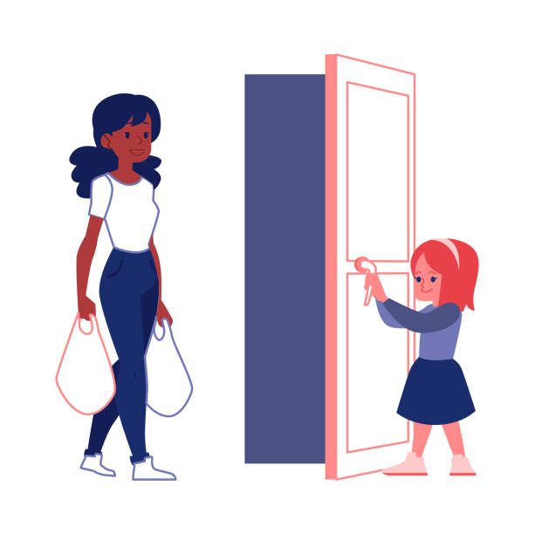
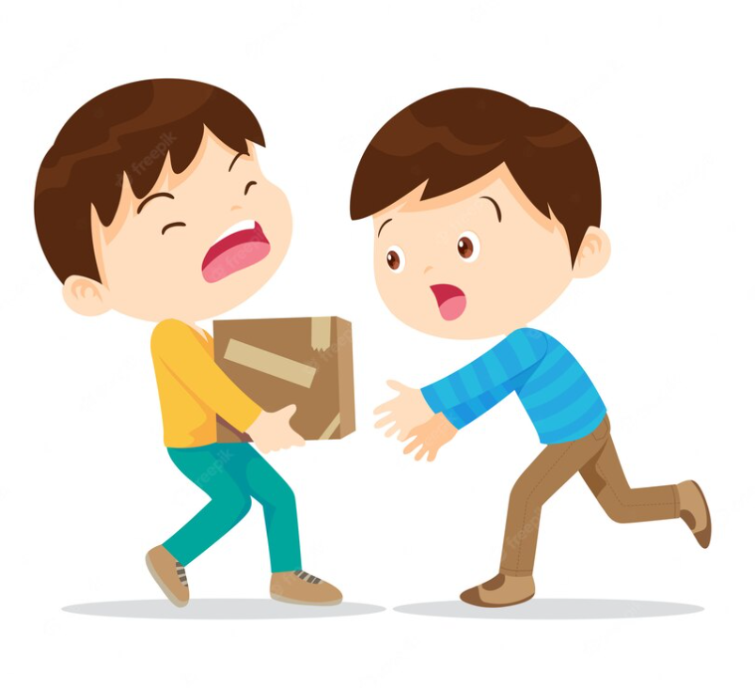
What would you say when you want somebody
tell me the time
open the door
help me carry the boxes
Making requests

Slide 5

1 (p.32) Listen and read the dialogues below. Pay attention to the highlighted sentences.
1. Student: Can you tell me more about the music club, please?
School club leader: Certainly. It meets on Mondays and Thursdays.
2. Student: Could you tell me the time it meets?
School club leader: Yes, it’s after school, from 5:00 p.m. to 6:30 p.m.
Can you…, please?
Making requests
Could you…(, please)?

Slide 6
2 (p.32) Work in pairs. Make similar conversations, using the cues below.
Can you…, please?
Making requests
Could you…(, please)?
1. Ask to borrow a book from your classmate.
Can you lend me your book that you finished reading, please?
…
2. Request some advice on how to do your science project.
Could you tell me how to start a science project?
…

Slide 7
02
Social media popular among teens

Slide 8
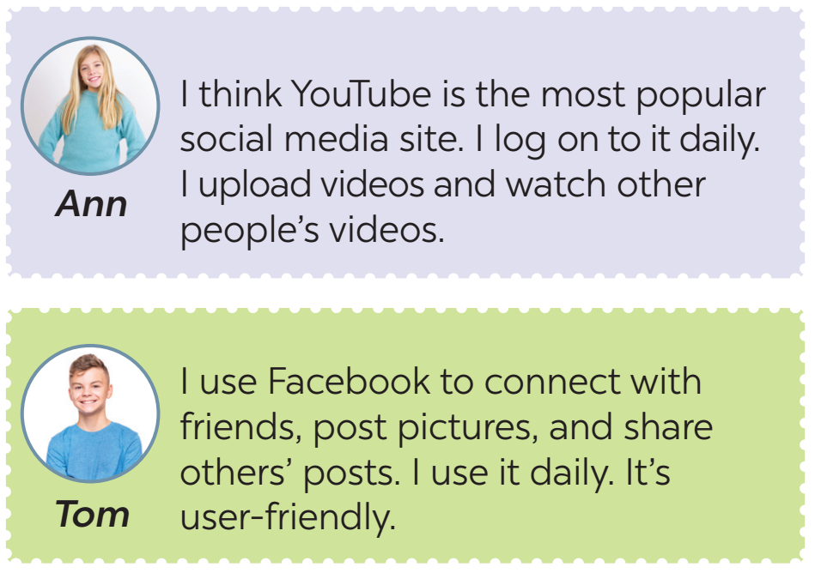
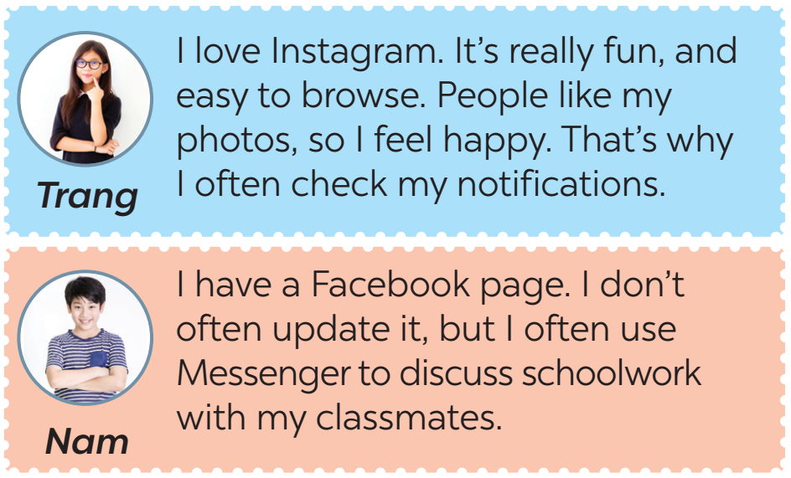
3 (p.32) Read some posts on a forum about different social media and match the names of the posters with their activities.
I think YouTube is the most popular social media site. I log on to it daily. I upload videos and watch other people's videos.
1. checks notifications regularly
2. watches videos on YouTube
I use Facebook to connect with friends, post pictures, and share others' posts. I use it daily. It's user-friendly.
3. uses Facebook Messenger to discuss schoolwork
I love Instagram. It's really fun, and easy to browse. People like my photos, so I feel happy. That's why I often check my notifications.
4. thinks Facebook is user-friendly
I have a Facebook page. I don't often update it, but I often use Messenger to discuss schoolwork with my classmates.
5. connects with friends on Facebook

Slide 9

4 (p.32) Work in pairs. Ask and answer questions about what social media the teens in 3 use, why, and how often they use.
I think YouTube is the most popular social media site. I log on to it daily. I upload videos and watch other people's videos.
2. watches videos on YouTube
What social media does Ann use?
She uses YouTube.
What does she use it for?
She uploads her videos and watch other people’s videos.
How often does she use it?
Every day.

Slide 10
4 (p.32) Work in groups. Discuss the following questions:
What social media do you use?
How often do you use it?
What do you use it for?
Report your group’s results to the class.

Slide 11
WRAP UP
What would you say when you want somebody “tell you the time”?
A. Can you tell me the time, please?
B. Could you tell me the time?
C. I want to know the time.
What information have you talked about social media?
A. What social media you use
B. How often you use it
C. Who you use it with
D. What you use it for

Slide 12
Thanks for your attention

Slide 13
Fonts & colors used
This presentation has been made using the following fonts:
Raleway
(https://fonts.google.com/specimen/Raleway)
Archivo
(https://fonts.google.com/specimen/Archivo)
#191919
#fff5f4
#6d9eeb
#d32f53
#ff8b84
#6f3663
#fdc450
#ffffff
#241a5b
#b2bc4b

