Slide 1
Unit 4.
Ethnic groups of Vietnam
Lesson 4. Communication

Slide 2

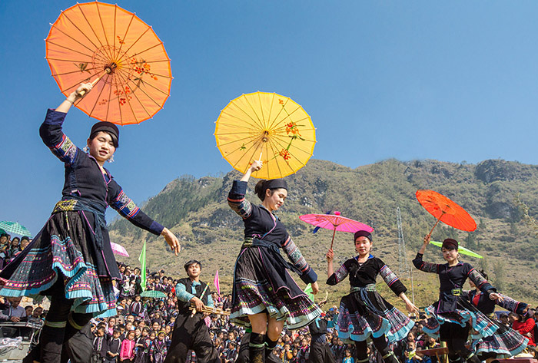
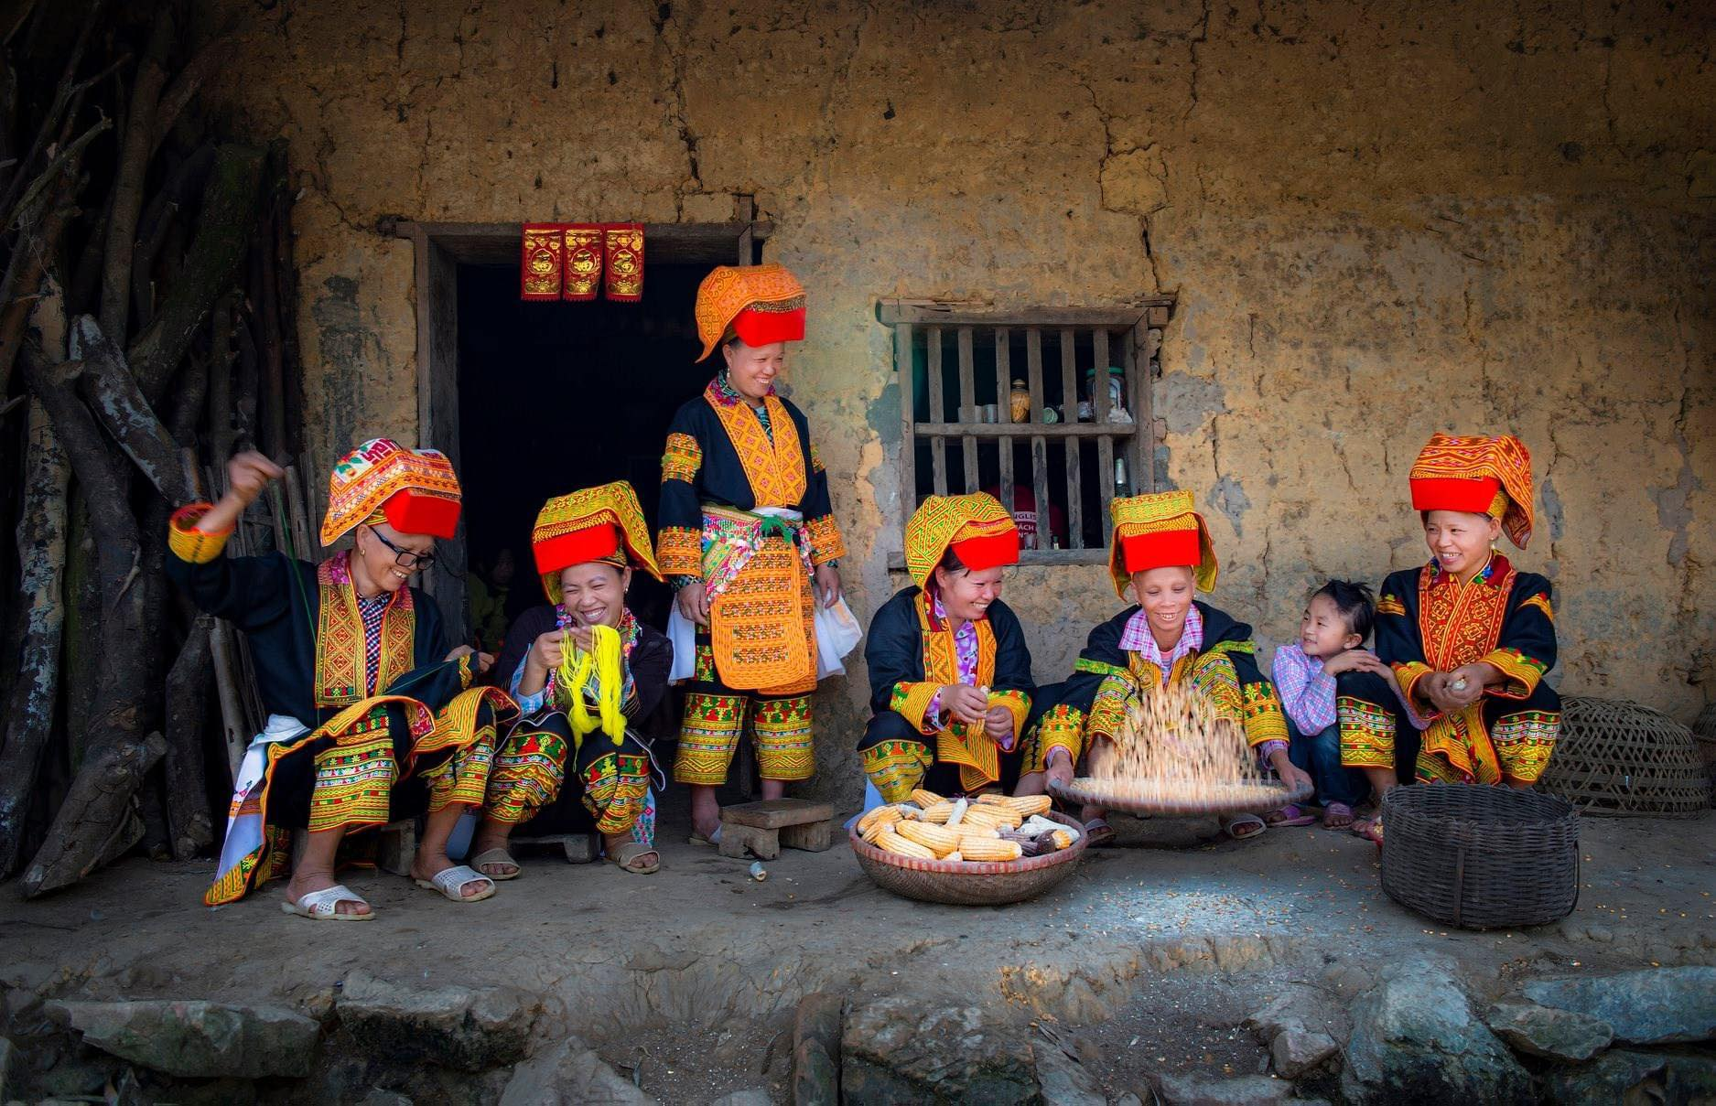
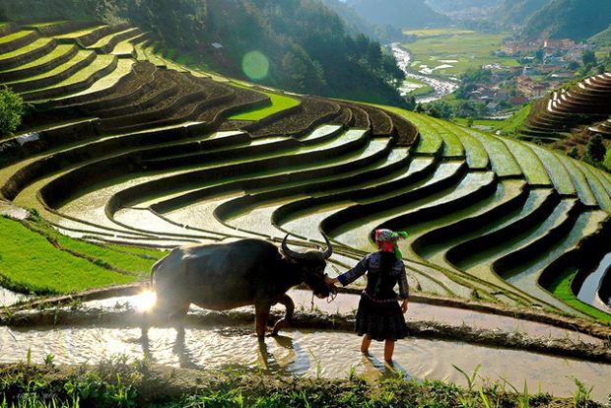
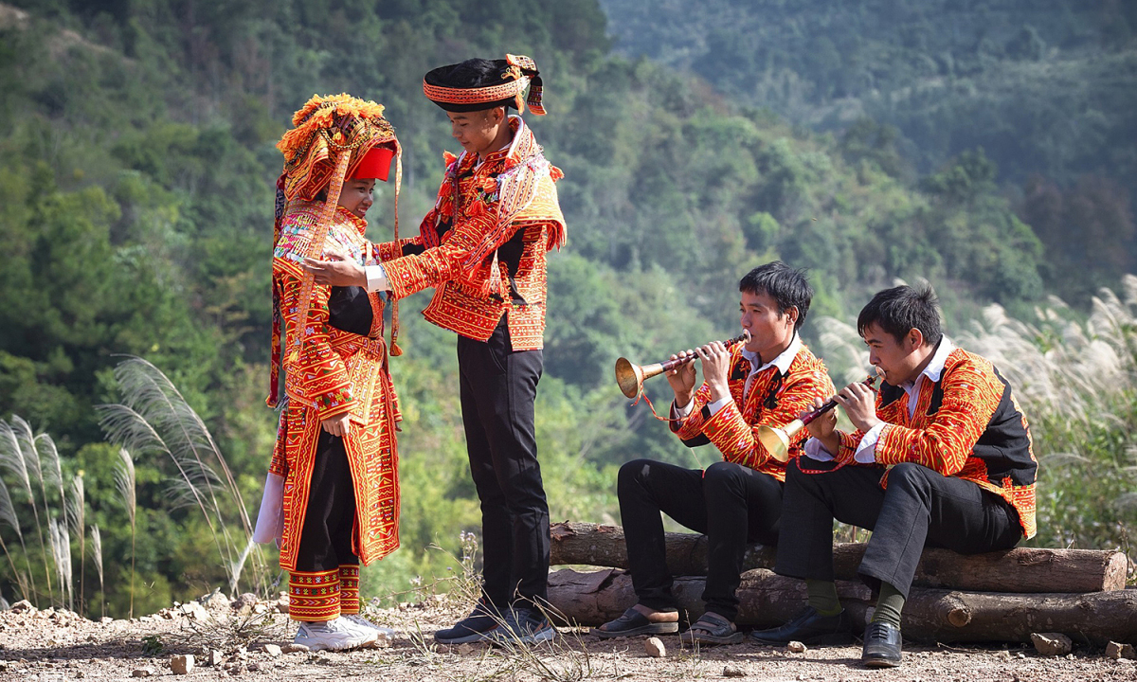
4 Pics 1 Word
L
I
F
E
S
T
Y
L
E
Y
U
S
O
M
E
D
I
A
L
F
R
W
T
U
O
M
D
A
R
W
Notes:
This game gives you four pictures that have something in common, and you have to guess what it is.

Slide 3
Objectives
01
02
03
By the end of this lesson, students will be able to gain:
Use the lexical items related to the life of the ethnic people.
Give opinions about the lifestyle of ethnic minority groups.
Ask and answer about the Jrai people.

Slide 4
Everyday
English
Giving opinions

Slide 5

Ex 1 (p 44). Listen and read the conversations.
Pay attention to the highlighted parts.
Structures giving opinions
What do you think about life in the mountains?
01
I think…
I think it’s very interesting. People in the mountains live close to nature.
02
To my way of thinking…
What about you, Mai? What do you think?
To my way of thinking, there are better services in the city.

Slide 6

Ex 2 (p 44). Work in pairs in 5 minutes. One asks the questions and the other gives opinions about these topics.
Topics
Playing traditional games
Living close to nature
A: What do you think about playing traditional games?
B: I think it's very interesting. Children always love playing traditional games. And What about you, A? What do you think?
A: I think playing traditional games will bring people together.
A: What do you think about living close to nature?
B: That sounds great. We can learn how to protect our planet. What about you, A? What do you think?
A: To my way of thinking you are right. Additionally, living close to nature will improves our mental health.

Slide 7
Lifestyle of the ethnic minority group
How much do you know about ethnic groups in Viet Nam?

Slide 8


5
1
2
6
3
4
LUCKY STAR
START
Notes:
ẤN VÀO MÓN QUÀ ĐỂ CHUYỂN SLIDE

Slide 9



Star 1 : Ethnic minority groups form about ______ of the total population of Viet Nam.
You are given 3 candies
A. 7%
B. 13%
C. 25%
GO HOME

Slide 10
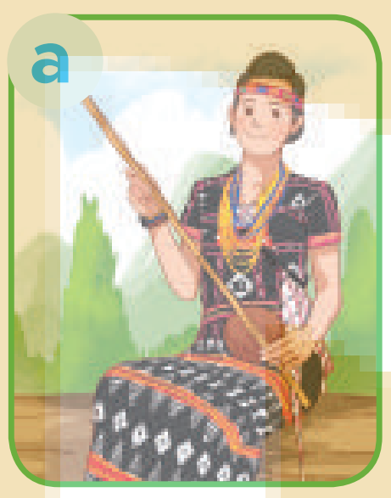
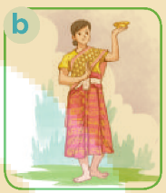
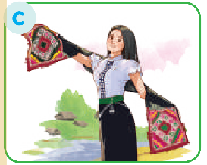
Star 2 : Picture ______ shows a Thai woman's costume.
You are given 1 candies
GO HOME

Slide 11
Star 3 : The Khmer mostly earn their living from weaving and ______.
You are given 5 candies
A. farming
B. hunting
C. fishing
GO HOME

Slide 12
Star 4 : There are ______ethnic groups in Viet Nam.
You are given 8 candies
A. 63
B. 45
C. 54
GO HOME

Slide 13
Star 5 : The Jrai decorate houses for the dead with a lot of _______.
You are given 10 candies
A. wood statues
B. flowers
C. colourful pictures
GO HOME

Slide 14
Star 6 : They mainly live ______.
You are given 2 candies
A. in the lowlands
B. in the mountains
C. in the Mekong Delta
GO HOME

Slide 15
Ex 4 (p 44). Work in pairs. Read the information below about the Jrai. Take turns to ask and answer about the information.
QUESTIONS
How many population in Jrai?
1
Is Jrai the largest minority group in the Central Highlands?
2
Where is the Jrai living?
3
What kind of house does Jrai live in?
4
Who plays the dominant role in the family?
5
What are they traditional culture?
6

Slide 16
Ex 5 (p 44). Work in groups. Share with your group the information about the Jrai people you find interesting in Ex 4.
You may start sharing your opinion with:
I like ______ because ______
I think that ______
In my opinion
01
I like the way the use bamboo trees to make the stilt house because it’s very environmental friendly.
I think that women play the dominant role in the Jarai family is a radical thought.
02

Slide 17

What have you learnt today?
01
Studied about the lifestyle of the peoples of the world.
Gotten to know Jrai’s information.
02
Practiced giving opinions.
03

Slide 18
THANKS!
HOMEWORK:
Learn by heart all the new words.
Do exercises in the workbook.
Prepare for Lesson 5 – Skills 1.

