Slide 1
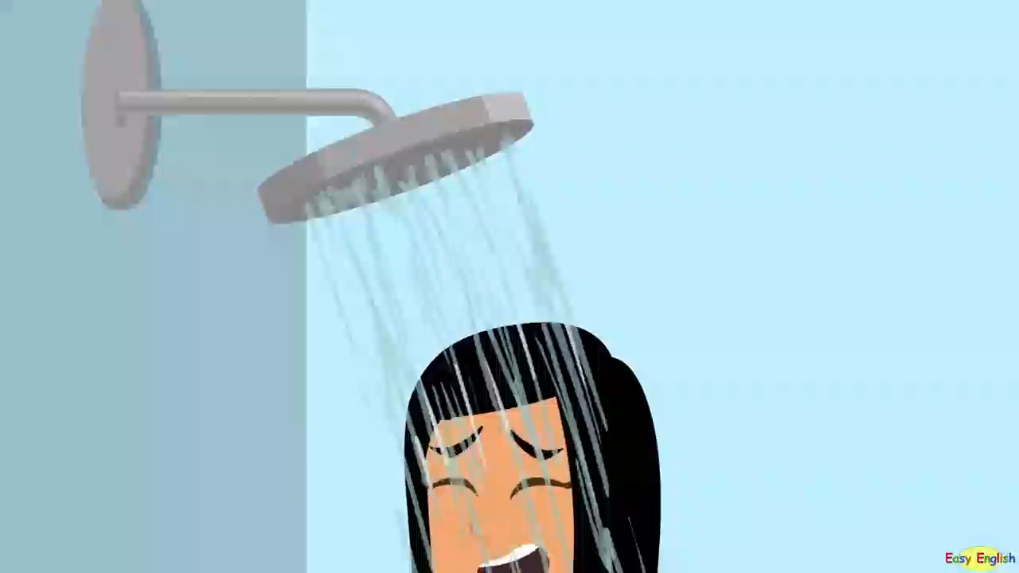
Watch and answer: What is the girl doing?

Slide 2
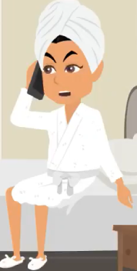
What is the girl doing?
She is making a complaint.
How does she make a complaint?
This is Anita Martin from room 101. I’d like to make a complaint. There is no hot water in my room, so I had to take a cold shower...
Can you add more ways to make complaints?

Slide 3
UNIT 8: SHOPPING
LESSON 4: COMMUNICATION

Slide 4
OBJECTIVES
By the end of the lesson, students will be able to:
make complaints in English.
listen and talk about favourite shopping place.

Slide 5
01
EVERYDAY ENGLISH
Making complaints

Slide 6

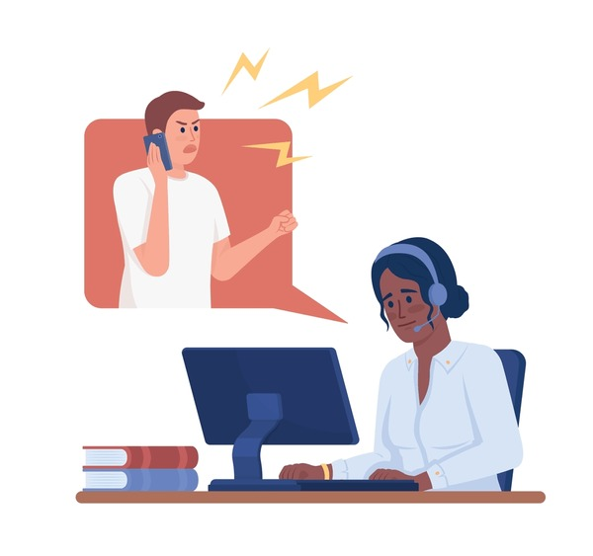
Ex 1. Listen and read the conversation. Pay attention to the highlighted parts.
Tom: I’m calling to make a complaint about the SMART backpack I ordered from you last week. I got it this morning, and it’s smaller than the one you advertised online.
Trang: Well … Let me check it.
Tom: And I’m not happy with the colour, either. In your picture, it’s dark brown, and this one is yellowish brown.
Trang: I’m sorry about that. I’ll send you another one.

Slide 7

Making complaints
I’m calling to make a complaint about…
I’m not happy with …
I’d like to make a complaint about …

Slide 8
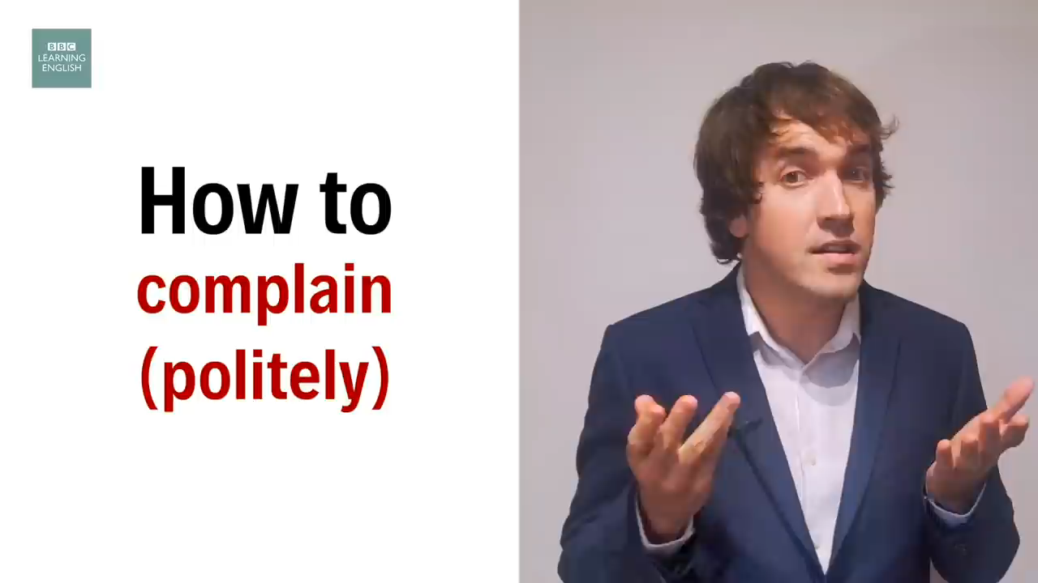
Other structures
Notes:
Optional

Slide 9
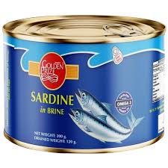
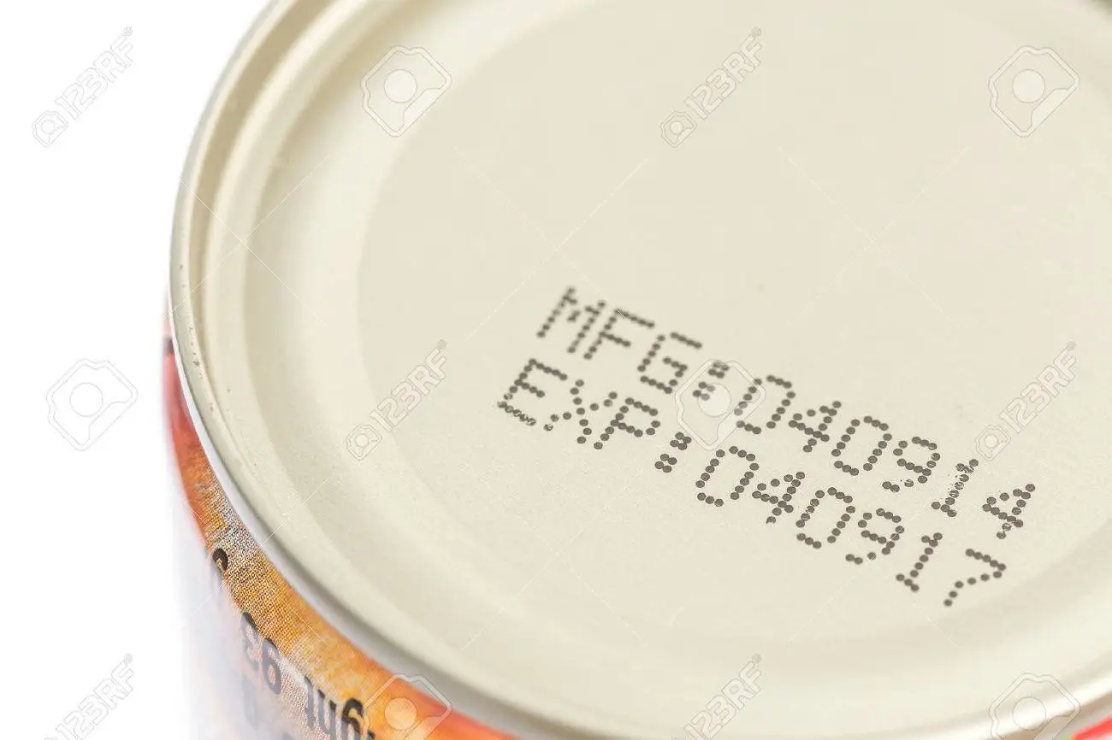
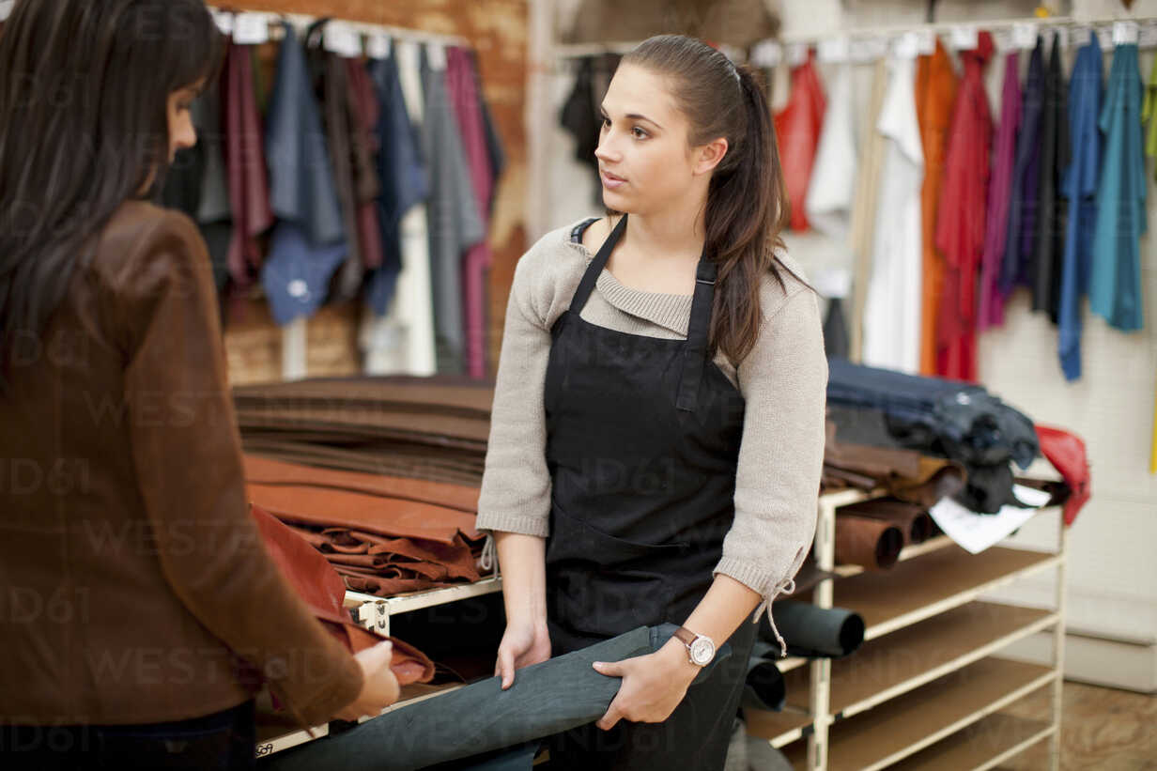
Ex 2. Work in pairs. In turn, make complaints about the situations below.
1. The cans of fish you bought at the shop expired five days ago.
2. An assistant at the shop was not very helpful.
Example:
Customer: I'd like to make a complaint about some cans of fish I bought from your store yesterday.

Slide 10
Have you ever made complaints when you shop?
Do you usually go shopping?
What is your favourite shopping place?

Slide 11
02
MY FAVOURITE SHOPPING PLACE

Slide 12
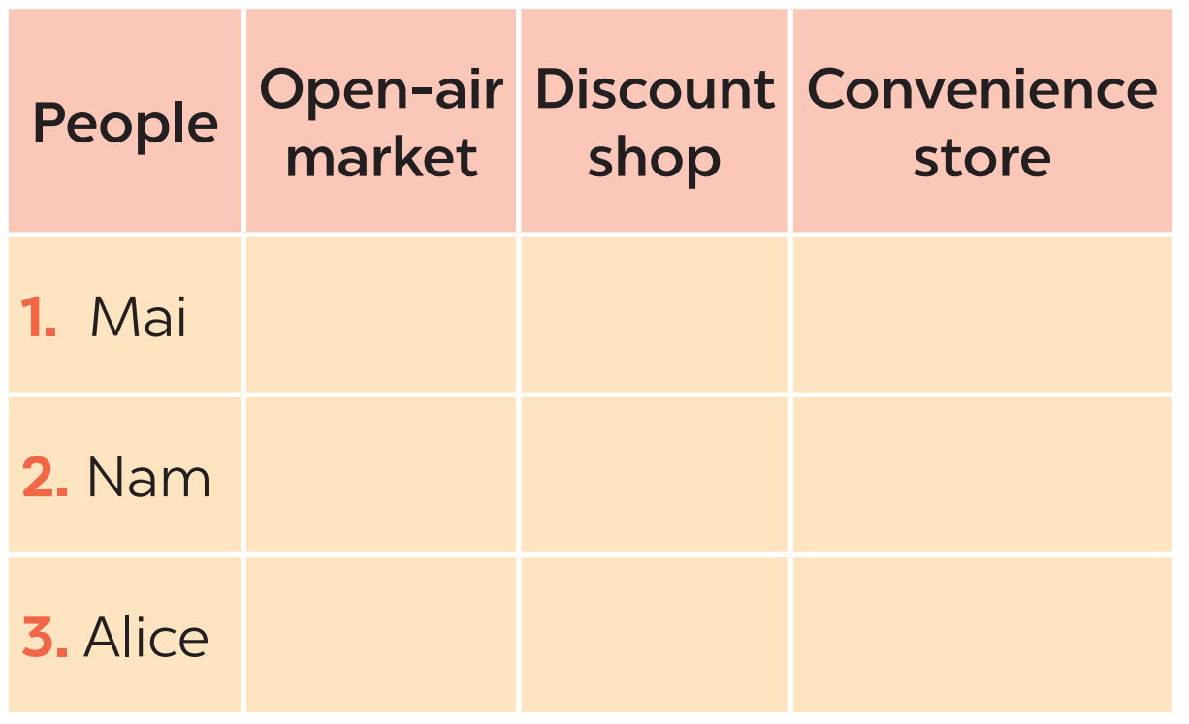
Ex 3. Listen to three people talking about their favourite shopping places and tick the place they mention.
Mai: I often go to the open-air market in my village. Most of the products there are home-grown or home-made. The market goers know one another and they chat happily while selling and buying.

Nam: When I need something, I go to a convenience store. They are easy to find because they are all over the place. The prices may be a bit higher than in supermarkets but they can save your time.


Alice: I love shopping at discount shops. There is a wide range of goods there, and everything is cheaper than at other places. Yesterday I bought a Christmas dress for half the price of one in a speciality shop.

Slide 13
Mai: I often go to the open-air market in my village. Most of the products there are home-grown or home-made. The market goers know one another and they chat happily while selling and buying.

Slide 14
Nam: When I need something, I go to a convenience store. They are easy to find because they are all over the place. The prices may be a bit higher than in supermarkets but they can save your time.

Slide 15
Alice: I love shopping at discount shops. There is a wide range of goods there, and everything is cheaper than at other places. Yesterday I bought a Christmas dress for half the price of one in a speciality shop.

Slide 16

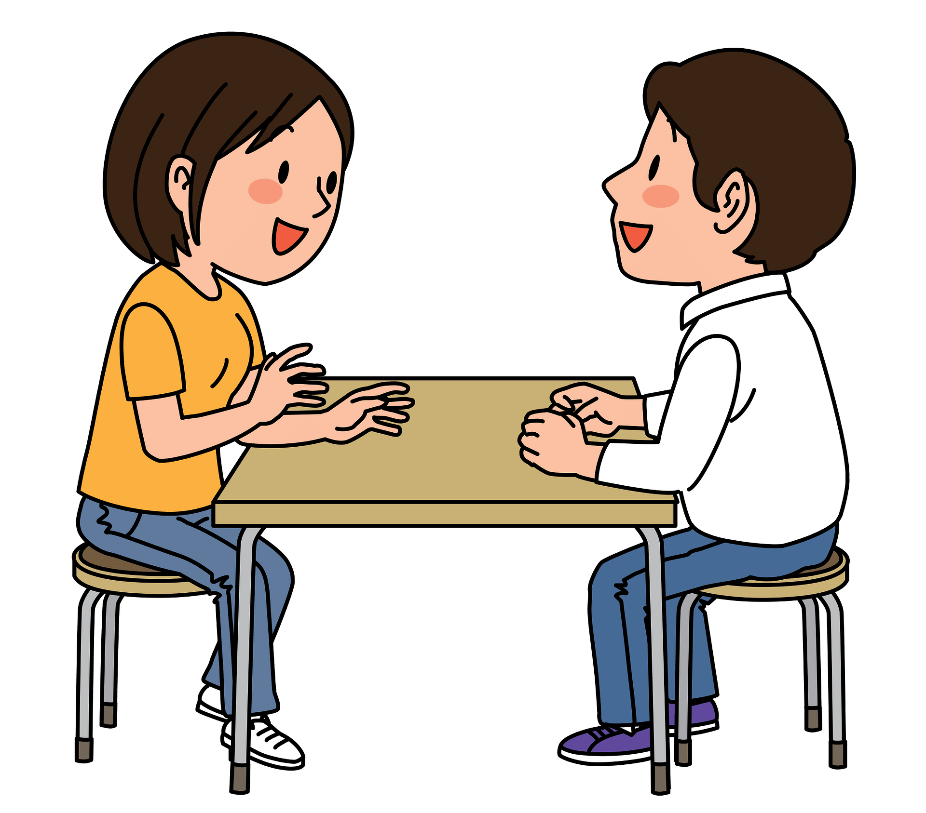
Ex 4. Work in pairs. Take turns to ask and answer what each person in 3 likes about their shopping place.
1. Mai
2. Nam
3. Alice
It saves him time.
Example:
A: What does Nam like about shopping at a convenience store?
B: It saves him time.

Slide 17
Ex 5. Work in groups. Share your favourite shopping place with your group.
You can include:
The name of the place
The reason(s) why you like it
Suggested answer:
Hello, my name is Linh. My favourite place to shop is the convenience store near my apartment. It's called 'Quick Mart'. There are many reasons why I like shopping there. First, they have a wide range of products available. From fresh produce to household items, I can find almost everything I need there. Second, the store is open 24/7. This is incredibly useful, especially when I need to buy something late at night or early in the morning. I don't have to worry about finding another store that's open during odd hours. Lastly, the staff at Quick Mart is friendly and helpful. They greet me with a smile and are always ready to assist if I can't find something. Their excellent customer service definitely adds to the pleasant shopping experience. That’s why I love shopping at convenience stores.

Slide 18
WRAP-UP
01
02
What have you learnt in this lesson?
Making complaints
Some favourite shopping places

Slide 19
Thanks!
Do you have any questions?

