Slide 1
Unit 3:
HEALTHY LIVING FOR TEENS
Lesson 4: Communication

Slide 2
Objectives
01
02
By the end of the lesson, students will be able to:
Everyday English
Asking for repetition and responding
Tips for being happy on school days
Learn about tips to make students feel happy on school days.

Slide 3
01
Everyday English
Asking for repetition and responding

Slide 4

Ex 1: Listen and read the dialogues below.
Pay attention to the highlighted sentences.
1. Mai: Can you open the door, Tom?
Tom: Sorry?
Mai: Can you open the door, please?
2. Nick: Excuse me. Would you mind showing me the way to the post office?
Woman: I beg your pardon.
Nick: Would you mind showing me the way to the post office?

Slide 5
Asking for repetition and responding
ASKING FOR REPETITION | RESPONDING
Sorry? | Repeat/Simplify what you have said
I beg your pardon.
I'm sorry, I didn't quite catch that.
Could you say that again?
One more time?
Look! I can't hear a word you're saying.

Slide 6
Ex 2: Work in pairs. Make similar conversations for the following situations.
Situation 1: You ask your friend to pass the book, but he / she can’t hear what you say.
Situation 2: A stranger asks you the way to the nearest bus station, but you can’t hear what he / she says.

Slide 7
Ex 2: Work in pairs. Make similar conversations for the following situations.
Situation 1: You ask your friend to pass the book, but he / she can’t hear what you say.
Suggested answer:
A: Can you pass me the book?
B: Sorry?
A: Can you pass me the book, please?

Slide 8
Ex 2: Work in pairs. Make similar conversations for the following situations.
Situation 2: A stranger asks you the way to the nearest bus station, but you can’t hear what he / she says.
Suggested answer:
A: Excuse me. Could you tell me the way to the nearest bus station, please?
B: I beg your pardon.
A: Could you tell me the way to the nearest bus station, please?

Slide 9
02
Tips for being happy on school days

Slide 10
Vocabulary

Slide 11


praise (v)
khen, ca ngợi
/preɪz/

Slide 12

overcome (v)
đánh bại, vượt qua
/ˌəʊvəˈkʌm/

Slide 13
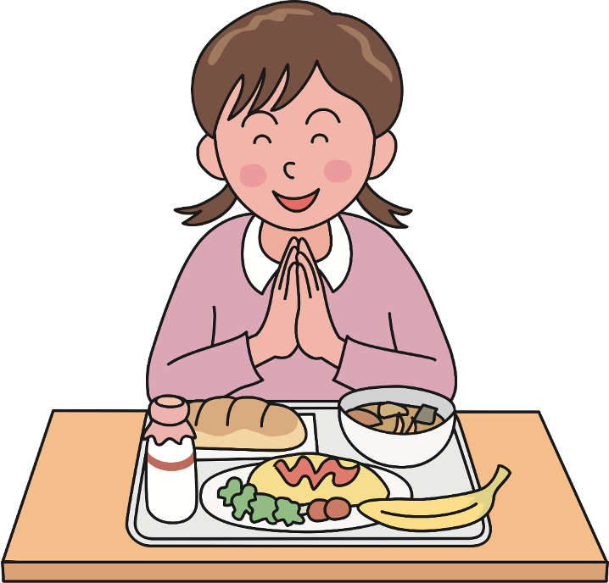
thankful (adj)
biết ơn
/ˈθæŋk.fəl/

Slide 14
Ex 3: Read the text and complete each sentence that follows with a suitable word.
Do nice things to others
Praise or encourage your classmates for a fun activity. Thank your teacher for his or her interesting lesson. Making other people feel happy can bring you great happiness.
Take care of yourself
Get enough sleep and eat healthy food. Do exercise regularly and do some activities you like. Taking care of yourself can bring you good health and happiness.
Don’t delay
When you complete your homework or assignment ahead of time, you will feel less worried about it. Don’t wait to study until the night before a test. Instead, study one or two hours regularly a day.
Be optimistic
There will always be bad things and difficulties to overcome at school, but they don’t last long. If you have an unhappy day, you should try to get through it!

Slide 15
Ex 3: Read the text and complete each sentence that follows with a suitable word.
1. You should make others feel ______ by giving them encouragement or being thankful to them.
2. You shouldn’t ______ doing your homework or assignment or preparing for a test. This will reduce your stress.
3. Getting enough sleep, eating healthy food, and doing what you like can bring you good health and ___________.
4. You should always be expecting good things to happen and try to ____________ difficulties.
Do nice things to others
Praise or encourage your classmates for a fun activity. Thank your teacher for his or her interesting lesson. Making other people feel happy can bring you great happiness.
Take care of yourself
Get enough sleep and eat healthy food. Do exercise regularly and do some activities you like. Taking care of yourself can bring you good health and happiness.
Don’t delay
When you complete your homework or assignment ahead of time, you will feel less worried about it. Don’t wait to study until the night before a test. Instead, study one or two hours regularly a day.
Be optimistic
There will always be bad things and difficulties to overcome at school, but they don’t last long. If you have an unhappy day, you should try to get through it!

Slide 16
Ex 3: Read the text and complete each sentence that follows with a suitable word.
1. You should make others feel ______ by giving them encouragement or being thankful to them.
happy
Do nice things to others
Praise or encourage your classmates for a fun activity. Thank your teacher for his or her interesting lesson. Making other people feel happy can bring you great happiness.

Slide 17
Ex 3: Read the text and complete each sentence that follows with a suitable word.
2. You shouldn’t ______ doing your homework or assignment or preparing for a test. This will reduce your stress.
delay
Don’t delay
When you complete your homework or assignment ahead of time, you will feel less worried about it. Don’t wait to study until the night before a test. Instead, study one or two hours regularly a day.

Slide 18
Ex 3: Read the text and complete each sentence that follows with a suitable word.
3. Getting enough sleep, eating healthy food, and doing what you like can bring you good health and _______.
happiness
Take care of yourself
Get enough sleep and eat healthy food. Do exercise regularly and do some activities you like. Taking care of yourself can bring you good health and happiness.

Slide 19
Ex 3: Read the text and complete each sentence that follows with a suitable word.
4. You should always be expecting good things to happen and try to ______ difficulties.
overcome
Be optimistic
There will always be bad things and difficulties to overcome at school, but they don’t last long. If you have an unhappy day, you should try to get through it!
get through it
=
overcome

Slide 20
Ex 4: Work in groups.
Write tips for one of the following situations.
Situation 1: A friend of yours cannot get a good night’s sleep.
Situation 2: A friend of yours does not feel very well.
Situation 3: A friend of yours cannot remember the words he / she learnt.

Slide 21
Present your tips to the class.

Slide 22
Ex 4: Work in groups.
Write tips for one of the following situations.
Situation 1: A friend of yours cannot get a good night’s sleep.
Suggested answers:
You should try to go to bed and wake up at the same time every day, even on weekends. This helps regulate your body's internal clock and improve the quality of your sleep.

Slide 23
Ex 4: Work in groups.
Write tips for one of the following situations.
Situation 2: A friend of yours does not feel very well.
Suggested answers:
You should pay attention to your symptoms and their progression. If they become severe or unusual, you should seek medical attention.

Slide 24
Ex 4: Work in groups.
Write tips for one of the following situations.
Situation 3: A friend of yours cannot remember the words he / she learnt.
Suggested answers:
You should try using the words you've learned in sentences or conversations.

Slide 25
Wrap-up
What have you learnt in this lesson?
01. Asking for repetition and responding
02. Learn about tips to make students feel happy on school days.

Slide 26
HOMEWORK
01
02
03
04

Slide 27
THANKS!
Does anyone have any questions?

