Slide 1
Unit 4:
REMEMBERING THE PAST
LESSON 4: COMMUNICATION

Slide 2
OBJECTIVES
By the end of the lesson, students will be able to:
✓ Know how to thank and respond.
✓ Talk how to keep traditions alive

Slide 3
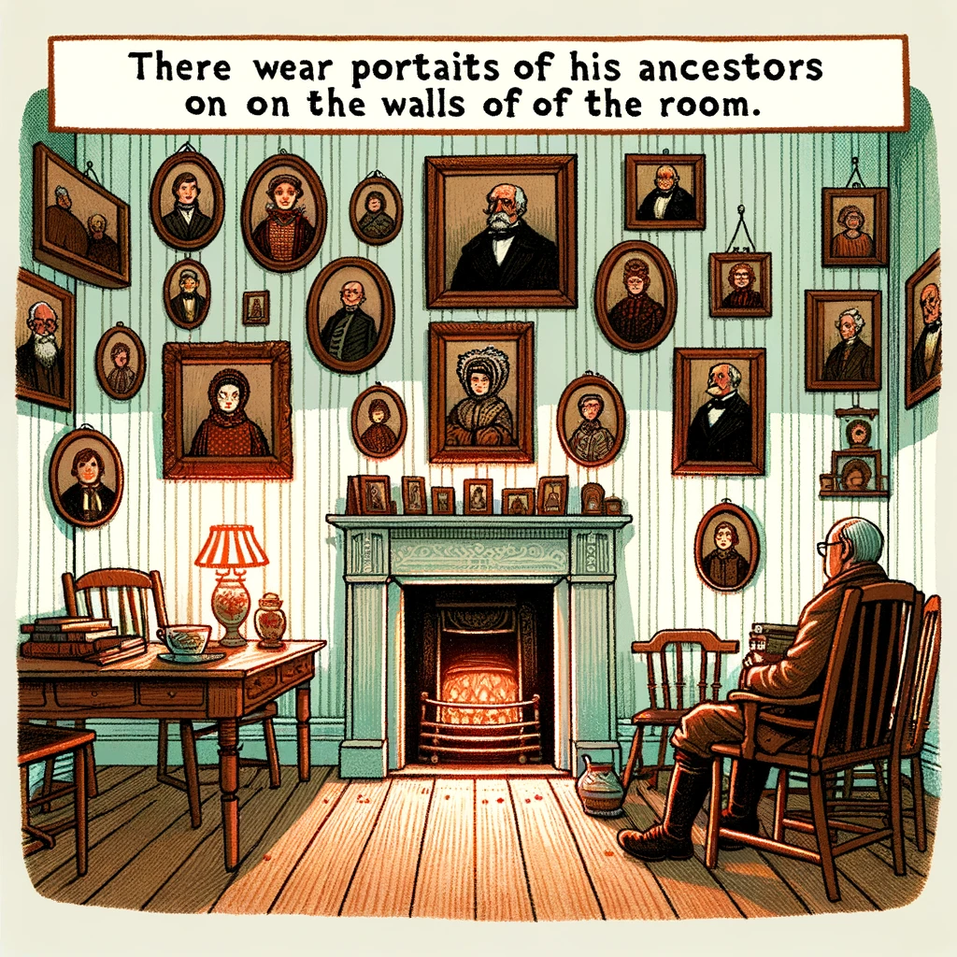

NEW WORDS
Ancestor (n)
/ˈæn.ses.tər/
tổ tiên

Slide 4
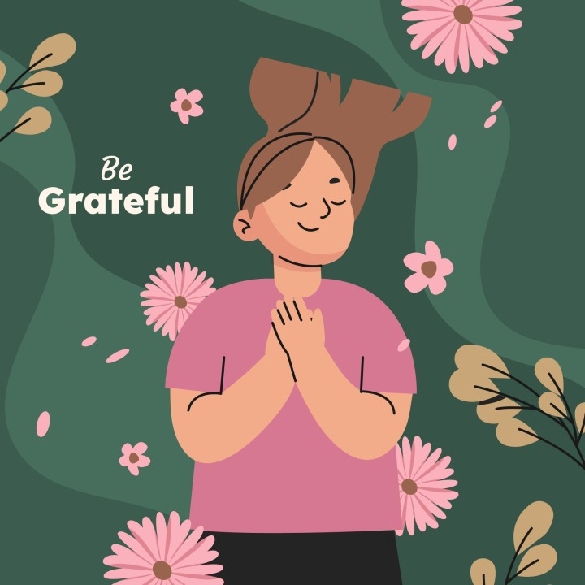
NEW WORDS
Gratitude (n)
/ˈɡræt.ɪ.tʃuːd/
lòng biết ơn

Slide 5
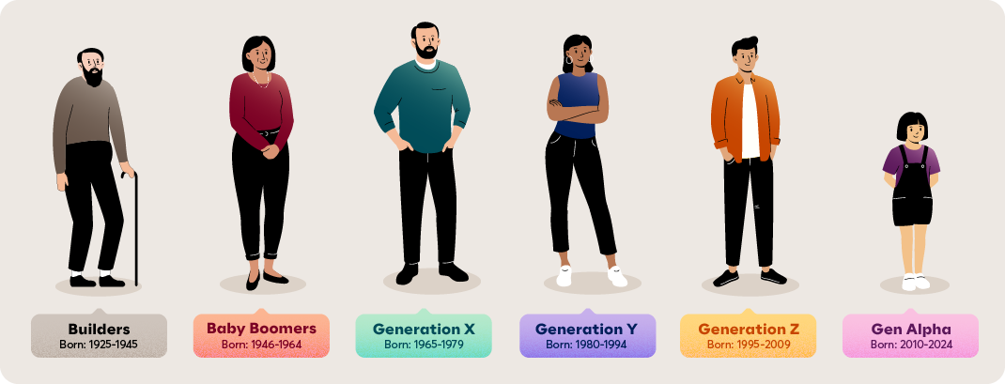
NEW WORDS
Generation (n)
/ˌdʒen.əˈreɪ.ʃən/
thế hệ

Slide 6
NEW WORDS
death anniversaries (n)
ngày giỗ

Slide 7

NEW WORDS
Words | Pronunciation | Meanings
 |  | tổ tiên
 |  | lòng biết ơn
 |  | thế hệ
Ancestor(n) | /ˈæn.ses.tər/
Gratitude (n) | /ˈɡræt.ɪ.tʃuːd/
Generation (n) | /ˌdʒen.əˈreɪ.ʃən/

Slide 8
Ex1: Listen and read the conversations below. Pay attention to the highlighted parts.
Kate: Thank you very much for showing us around Angkor Wat.
Guide: You’re welcome.
Alice: Thanks a lot for telling us about life in the countryside.
Mi: No problem.
THANKING | RESPONDING
Thank you very much for showing us around Angkor Wat.
You’re welcome.
Thanks a lot for telling us about life in the countryside.
No problem.

Slide 9
Ex2: Work in pairs. Make similar conversations to express thanks and respond in the following situations.
Work in pairs to make similar dialogues, using the language you have learnt.
1. You thank the village head for showing you around the craft workshop.
2. You thank your friend for lending you an interesting book.

Slide 10
Ex2: Work in pairs. Make similar conversations to express thanks and respond in the following situations.
1. You thank the village head for showing you around the craft workshop.
You: Thank you very much for showing me / us around the craft workshop.
Friend: You’re welcome.

Slide 11
Ex2: Work in pairs. Make similar conversations to express thanks and respond in the following situations.
2. You thank your friend for lending you an interesting book.
You: Thanks a lot for lending me your history book.
Friend: No problem.

Slide 12
Ex3: Read the passage and complete the table.
Most of Vietnamese families have customs and traditions that they have observed for many generations. Firstly, they worship their ancestors, and they celebrate their death anniversaries every year. That’s the way they show their gratitude to their ancestors and teach their young children about traditions. Secondly, they take part in many national and regional festivals, for example the Mid-Autumn Festival and the New Harvest Festival. Thirdly, they celebrate many holidays during the year such as Tet and National Day. In this way, they keep their traditions alive and pass them down to the next generation.

Slide 13
Ex3: Read the passage and complete the table.
Anniversaries | Festivals | Holidays
1. _____________ anniversaries | 2. _____________ Festival 3. _____________ Festival | 4. ___________ 5. ___________
death
Firstly, they worship their ancestors, and they celebrate their death anniversaries every year.

Slide 14
Ex3: Read the passage and complete the table.
Anniversaries | Festivals | Holidays
1. _____________ anniversaries | 2. _____________ Festival 3. _____________ Festival | 4. ___________ 5. ___________
death
Mid-Autumn
New Harvest
Secondly, they take part in many national and regional festivals, for example the Mid-Autumn Festival and the New Harvest Festival.

Slide 15
Ex3: Read the passage and complete the table.
Anniversaries | Festivals | Holidays
1. _____________ anniversaries | 2. _____________ Festival 3. _____________ Festival | 4. ___________ 5. ___________
death
Mid-Autumn
Tet holiday
National Day
New Harvest
Thirdly, they celebrate many holidays during the year such as Tet and National Day.

Slide 16
Ex4: Work in pairs. Ask and answer about how your family observes customs and traditions
Work in pairs
Look at the examples
Examples:
A: What festival(s) does your family celebrate every year?
B: We celebrate Hung Kings’ Temple Festival.

Slide 17
Ex4: Work in pairs. Ask and answer about how your family observes customs and traditions
Examples:
A: Does your family have any traditions for Lunar New Year?
B: Yes, we make Banh Chung and give lucky money to children.
A: What are your New Year's Eve traditions?
B: We write wishes for the new year and set off fireworks.
A: What does your family do for Christmas?
B: We decorate a Christmas tree and exchange gifts.

Slide 18
Ex5: Work in groups. Give a short talk about one of the things in 4 that you and your family do to preserve traditions.
Look at the cues
Work in groups, taking turns to choose one of the things in 3 and talk about what your families do to preserve your family traditions, for example celebrating family members’ birthdays.

Slide 19
Ex5: Work in groups. Give a short talk about one of the things in 4 that you and your family do to preserve traditions.
Cues:
You can begin your talk like this:
We celebrate each family member’s birthday every year. When someone’s birthday is coming, all of us happily prepare for it. …

Slide 20
Ex5: Work in groups. Give a short talk about one of the things in 4 that you and your family do to preserve traditions.
Sample Answers:
We celebrate each family member's birthday every year. When someone's birthday is coming, all of us happily prepare for it. We gather around the kitchen table, rolling out dough and decorating cakes with colorful sprinkles and frosting. We share funny stories, create memories that will last a lifetime. These traditions are precious to us, connecting us to our past and shaping our future.

Slide 21
SWAP AND CHECK
Check for spelling:
Do the words spell correctly?
Check for ideas
Did your friend talk about one of the things in 4 that you and your family do to preserve traditions?
Check for comprehension
Does the writing make sense?
Check for grammar
Does the writing use the correct tenses and structures?

Slide 22
Wrap-up
What have we learnt in this lesson?
✓ Know how to thank and respond.
✓ Talk how to keep traditions alive

Slide 23
THANK YOU!

