Slide 1
Unit 7: Natural wonders of the world
LESSON 4: COMMUNICATION

Slide 2
OBJECTIVES
By the end of the lesson, students will be able to:
EVERYDAY ENGLISH
Know how to ask for permission and respond.
NATURAL WONDERS AND TOURISM
Talk about Natural wonders and tourism

Slide 3
01
EVERYDAY ENGLISH
Asking for permission and respond.

Slide 4

Ex1: Listen and read the conversations below. Pay attention to the highlighted parts.
Anne: Can I watch a horror film, Mum?
Anne’s Mum: No, dear, you can’t. It’s late now.
Tourist: May we come in and have a look around the temple?
Guard: Sure. But be careful. It’s very dark inside.

Slide 5
Ex1: Listen and read the conversations below. Pay attention to the highlighted parts.
Anne: Can I watch a horror film, Mum?
Anne’s Mum: No, dear, you can’t. It’s late now.
Ask for permission | Respond
Can I watch a horror film, Mum?
No, dear, you can’t. It’s late now.

Slide 6
Ex1: Listen and read the conversations below. Pay attention to the highlighted parts.
Tourist: May we come in and have a look around the temple?
Guard: Sure. But be careful. It’s very dark inside.
Ask for permission | Respond
May we come in and have a look around the temple?
Sure. But be careful. It’s very dark inside.

Slide 7
Structures:
Ask for permission
- Can I + bare V……………..?
- May we + bare V……………?
Respond
- No, dear, you can’t.
- Sure.

Slide 8
Ex 2: Work in pairs. Make similar conversations to ask for permission and respond in the following situations.
Study the instructions.
Work in pairs, one asks questions, and the other gives the answers.
Then, swap roles.

Slide 9
Ex 2: Work in pairs. Make similar conversations to ask for permission and respond in the following situations.
Situation:
1. You ask your friend for permission to borrow a book on the Galápagos Islands
2. You ask your teacher for permission to submit your project after the deadline.

Slide 10

Ex 2: Work in pairs. Make similar conversations to ask for permission and respond in the following situations.
1. You ask your friend for permission to borrow a book on the Galápagos Islands
Can I borrow you / Can you lend me a book on the Galapagos Islands?
Sure. But please look after it carefully.

Slide 11

Ex 2: Work in pairs. Make similar conversations to ask for permission and respond in the following situations.
2. You ask your teacher for permission to submit your project after the deadline.
May I submit my project after the deadline, Miss?
I’m afraid you can’t.

Slide 12
EXTRA ACTIVITY
Name some natural wonders / tourist attractions of our country.
Suggested answers:
Ha Long Bay, Cuc Phuong National Park, Dong Van Plateau, Ban Gioc Waterfall, Son Doong Cave, Cu Lao Cham Island, Con Dao Island, etc.
How you can ask for permission and respond when they want to enter one of these tourist attractions.

Slide 13
02
NATURAL WONDERS AND TOURISM
Talk about Natural wonders and tourism

Slide 14
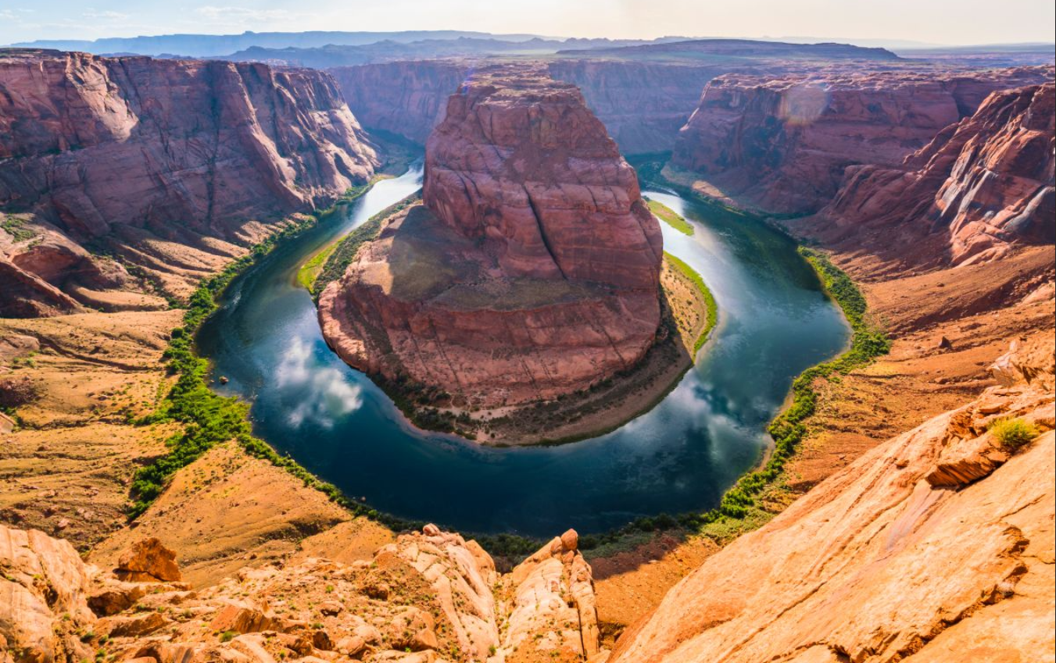
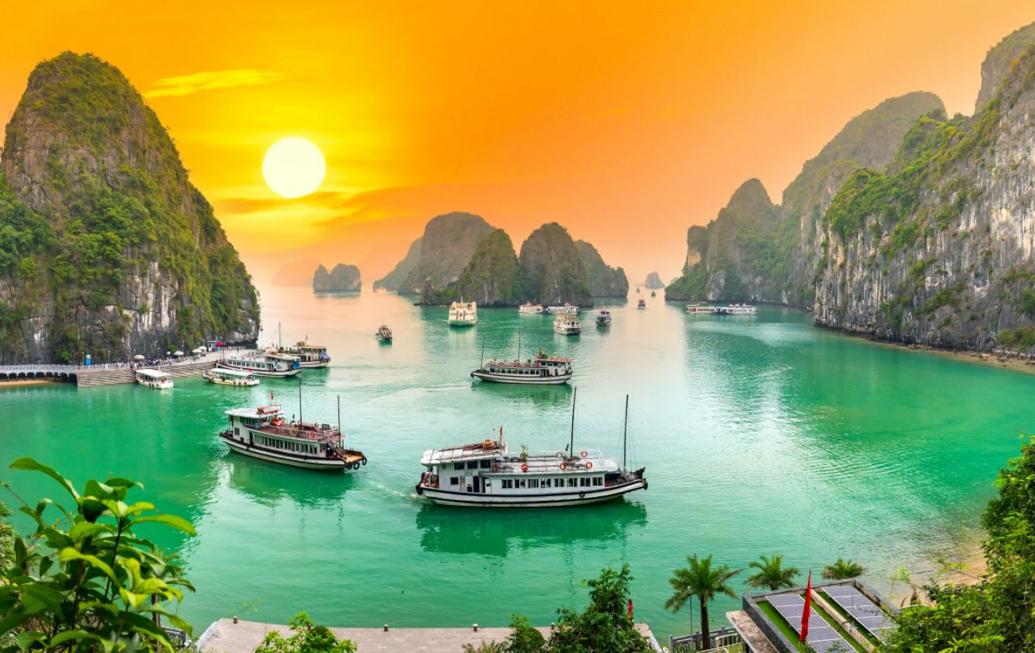
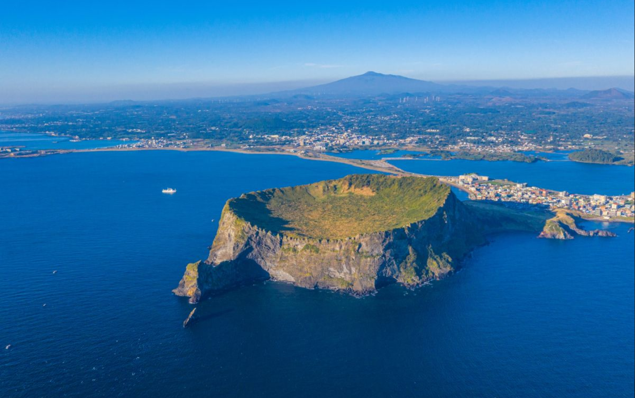
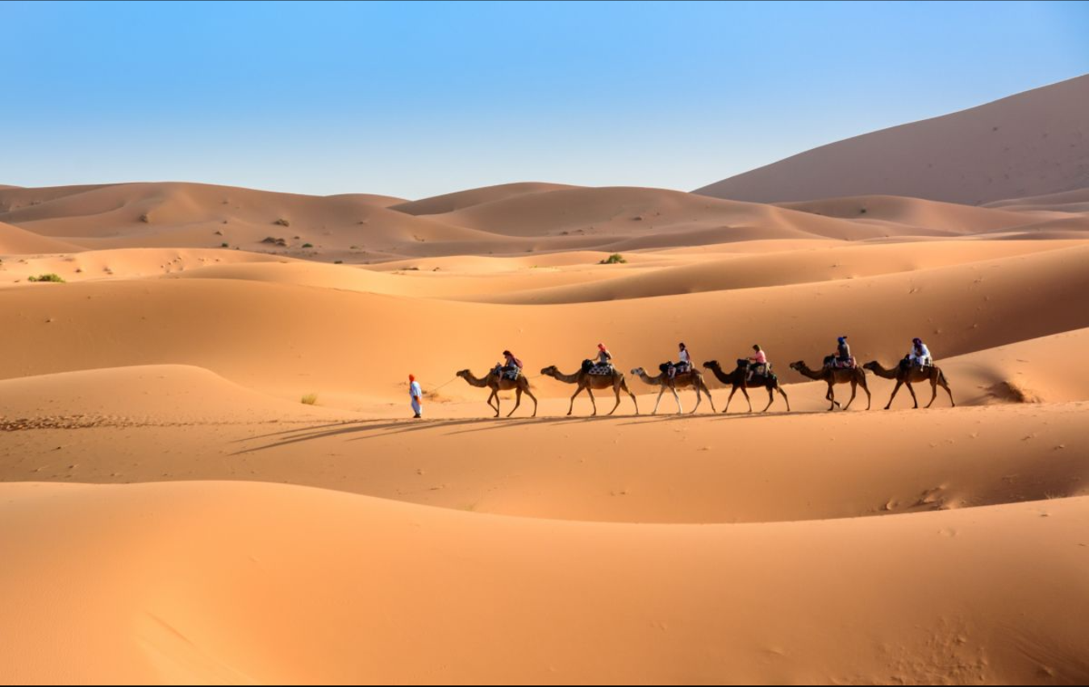
Ex3: Write each natural wonder under the correct picture.
Ha Long Bay
Jeju Island
Grand Canyon
The Sahara Desert

Slide 15
Ex3: Write each natural wonder under the correct picture.
Ha Long Bay
Jeju Island
Grand Canyon
The Sahara Desert

Slide 16
Ex3: Write each natural wonder under the correct picture.
Ha Long Bay
The Sahara Desert

Slide 17

Ex4: Mai, Phong and Mark are talking about the natural wonders they have visited. Read and decide which wonder in 3 each of them is talking about.
It’s an island located off the coast of South Korea. It was formed by the eruption of an underwater volcano about 2 million years ago. It ranks among the world’s seven natural wonders. Every year, it receives millions of tourists.
MAI
1.
Jeju Island

Slide 18

Ex4: Mai, Phong and Mark are talking about the natural wonders they have visited. Read and decide which wonder in 3 each of them is talking about.
Visiting this place is a wonderful experience for adventurers like me. It’s the largest desert on Earth, covering over 9 million square kilometres. You can see red sand and beautiful sand dunes everywhere. You can also see plant life and even nomadic men with their camels.
PHONG
2.
Sahara Desert

Slide 19

Ex4: Mai, Phong and Mark are talking about the natural wonders they have visited. Read and decide which wonder in 3 each of them is talking about.
It’s a UNESCO World Heritage Site and one of the greatest tourist attractions of the USA! It’s 446 kilometres long, up to 29 kilometres wide, and over 1,800 metres deep. Some people say that it’s the most magnificent landscape on Earth.
MARK
3.
Grand Canyon

Slide 20
Ex5: Work in groups. Discuss and decide which place in 3 and 4 your group wants to visit. Explain the reasons why you want to visit it. Plan the things you want to do there. Report your decision to the class.
Work in groups.
Discuss a decide on the place you want to visit.
Explain the reasons why they want to visit it.

Slide 21
FACTS
Ha Long Bay:
- Location: Quang Ninh Province
- World Natural Heritage site (1994)
- Main features: About 2,000 islands and islets, beautiful caves, blue water …
- Visitors’ activities: exploring floating villages, cruising the bay, kayaking, enjoying delicious sea food …
Jeju Island
- Location: Korea
- Created by a series of volcanic activities
- Contains a natural World Heritage Site: the Jeju Volcanic Island and Lava Tubes
- Contains Mount Hallasan, the tallest mountain in Korea

Slide 22
Sahara Desert
- Location: Africa
- Largest desert on Earth (9 million km²)
- Sand dunes of different colours
- Natural oases – diversified flora
Grand Canyon
- Location: Arizona, USA
- 446 km long, 29 km wide
- Carved by the Colorado River
- First national park in the USA

Slide 23
SAMPLE PARAGRAPH
Hey everyone, I’m super excited to tell you why I’m keen on visiting Ha Long Bay. It’s in Quang Ninh Province, and not only it’s beautiful but it’s also a World Natural Heritage site!
Imagine over 2,000 islands and islets rising from crystal-clear blue water, like giants in the sea. Caves filled with secrets and history await exploration.
There’s even more! Floating villages where people live their lives right on the water, and incredibly fresh seafood that practically jumps onto your plate.
Seriously, Ha Long Bay sounds like an adventure playground, and I can’t wait to experience it all for myself! Who’s with me?

Slide 24
WRAP – UP
What have we learnt in this lesson?
EVERYDAY ENGLISH
Know how to ask for permission and respond.
NATURAL WONDERS AND TOURISM
Talk about Natural wonders and tourism

Slide 25

THANK YOU!

