Slide 1
UNIT 8:
SPORTS AND GAMES
Lesson 3: A closer look 2

Slide 2
OBJECTIVES
By the end of the lesson, students will be able to:
use the past simple tense and imperatives correctly in context and real situation.

Slide 3
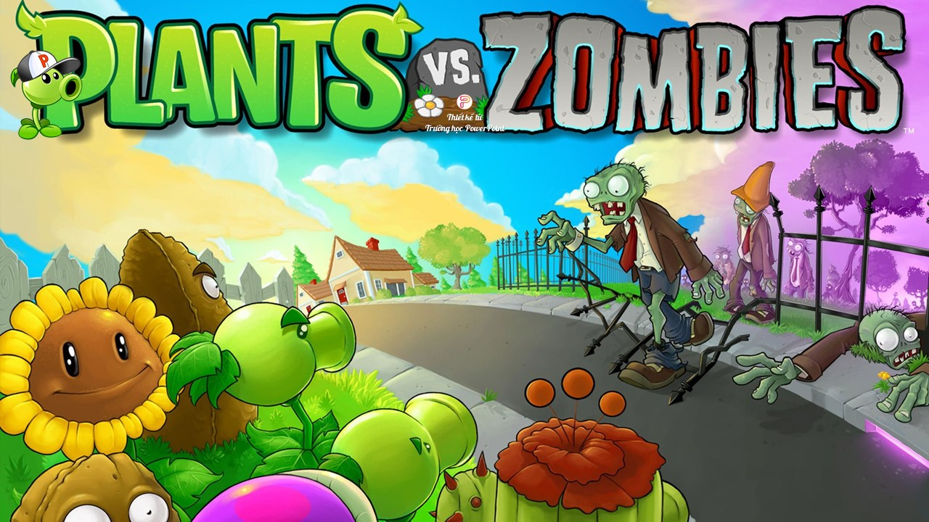



Slide 4
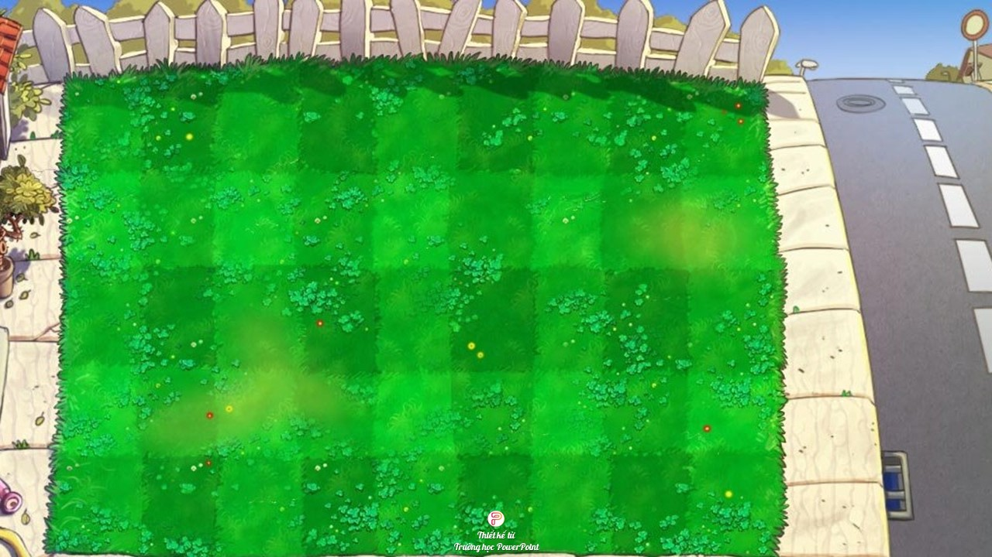

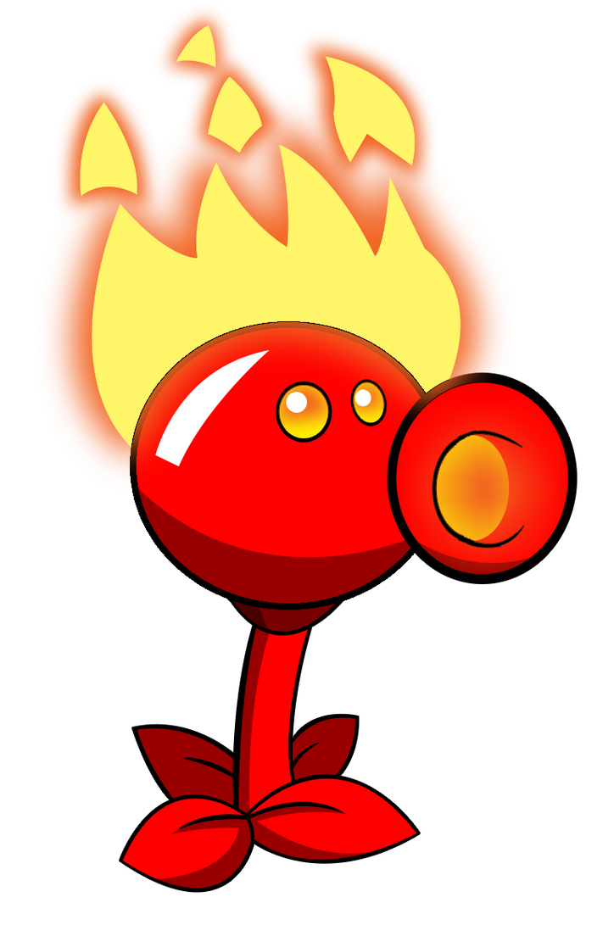
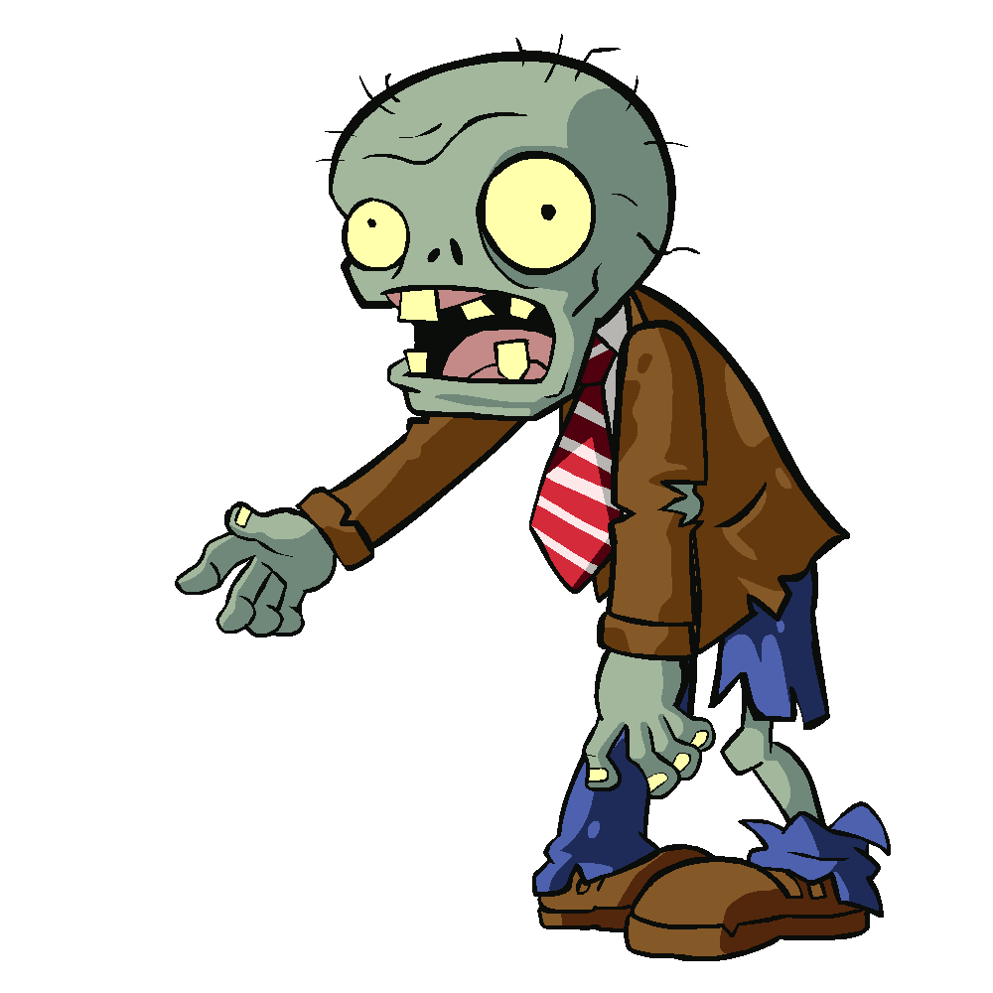










Slide 5
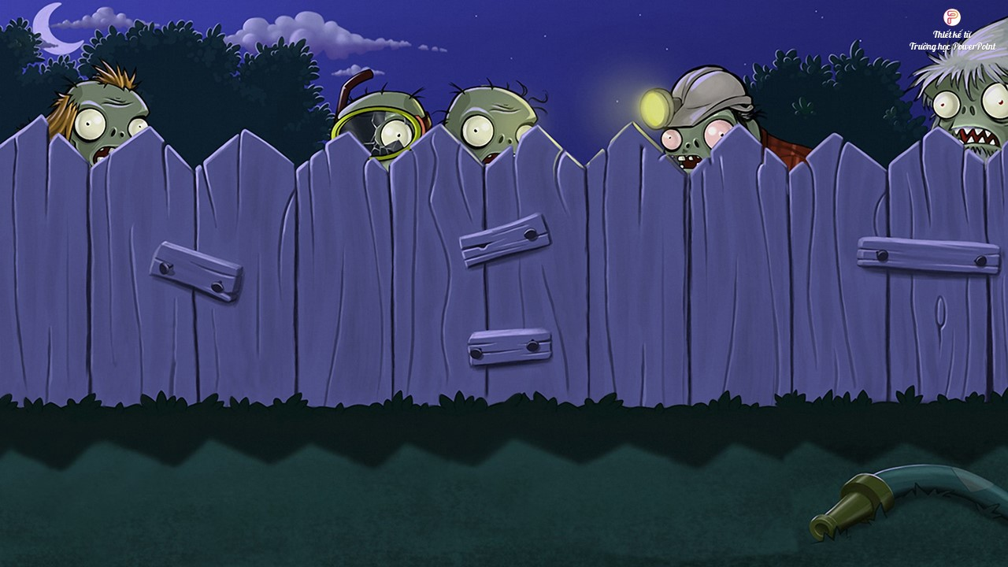


Question 1
There __________ an interesting match on TV last night.
A. is
B. were
C. was

Slide 6
Question 2
My dad __________ a lot of tennis some years ago.
A. plays
B. played
C. is playing

Slide 7
Question 3
I was at the gym last Sunday, but I __________ you there.
A. not saw
B. don’t see
C. didn’t see

Slide 8
Question 4
The teacher __________ us about our homework this morning.
A. didn’t ask
B. not asking
C. doesn’t ask

Slide 9
Question 5
__________ sleep well last night?
A. Do you
B. Did you
C. Were you

Slide 10
There was an interesting match on TV last night.
My dad played a lot of tennis some years ago.
I was at the gym last Sunday, but I didn’t see you there.
The teacher didn’t ask us about our homework this morning.
Did you sleep well last night?
These activities happened in ___.
A. the future
B. the past
C. the present
last night.
some years ago.
last Sunday,
Past simple
this morning.
last night?

Slide 11
Past simple
was
an interesting match
There
an interesting match on TV last night.
singular
→ be: was
To be:
I/ he/ she/ it
+
was
you/ we/ they
+
were

Slide 12
Past simple
My dad
played
a lot of tennis some years ago.
play + ed
→ V + ed
Positive (+)
S
+
Ved/ Irregular verb

Slide 13
Past simple
I
didn’t see
you there.
I was at the gym last Sunday, but I
didn’t + see
→ didn’t/ did not + V
The teacher
didn’t ask
The teacher
us about our homework this morning.
didn’t + ask
→ didn’t/ did not + V
Negative (-)
S
+
didn’t/ did not + V

Slide 14
Past simple
Did you
sleep well last night?
Did … sleep
→ Did … V
Question (?)
Did
+
S
+
V
…?

Slide 15
Ex 2 (p.19) Write the correct form of the verbs to complete the conversation.
Nick: Hi, there.
Sonny: Hello, Nick. Did you have a nice weekend?
Nick: Yeah, it was OK. On Sunday, I (1. go) ______ fishing with my dad. How about you?
Sonny: Oh, I (2. have) ______ a good weekend, too.
Nick: Really? What ______ you (3. do) ______ ?
Sonny: I (4. visit) ______ the museum with my family, then we (5. eat) ______ at my favourite restaurant.
Nick: Did you watch football last Sunday?
Sonny: Oh, yeah! My favourite team (6. score) ______ a fantastic goal!
went
Irregular verb
had
Irregular verb
did
do
visited
Regular verb (Ved)
ate
Irregular verb
scored
Regular verb (Ved)

Slide 16


Ex 3 (p.19)
- 3 minutes
- Ask and answer questions about your last weekend.
Did you do any sport last weekend?
Oh yes, and I was exhausted. What did you do?
A
B
C

Slide 17
Ex 3 (p.19)
- 3 minutes
- Groups of 6.
- Ask and answer questions about your last weekend.
Did you do any sport last weekend?
Oh yes, and I was exhausted.
Really? What did you do?
A
B
C

Slide 18
OBJECTIVES
By the end of the lesson, students will be able to:
use the past simple tense and imperatives correctly in context and real situation.

Slide 19
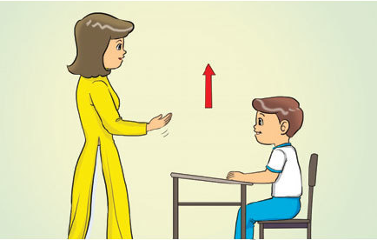
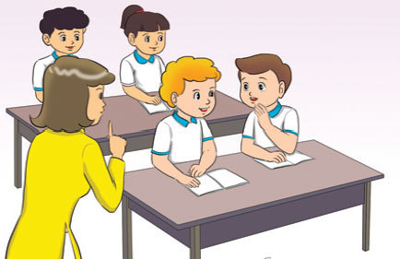
Imperatives
Stand up.
Stand up.
(+)
V
Don’t talk.
Don’t talk.
(-)
Don’t
+
V
Notes:
We use imperatives to tell someone to do something, or to give a direct order.

Slide 20


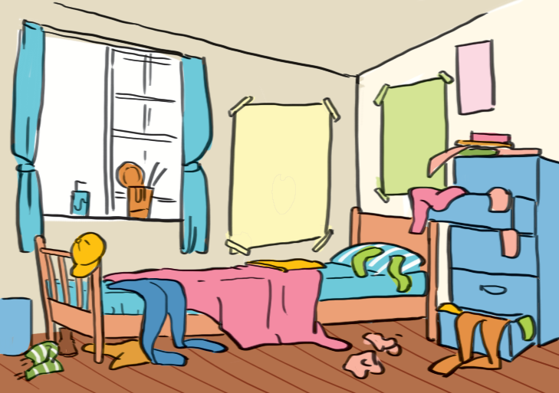
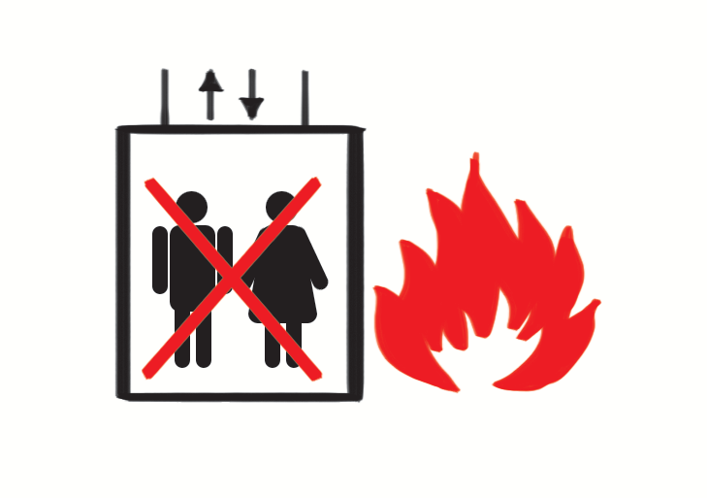
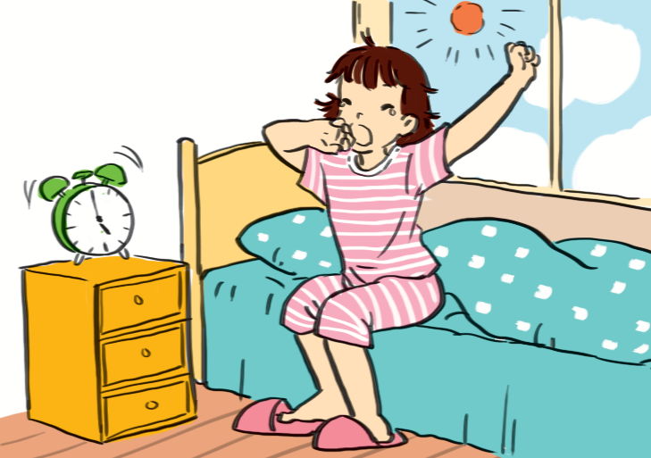
Ex 4 (p.20) Look at each picture and choose the correct answer.
1. (Park / Don't park) here.
2. (Close / Open) the window. It's windy outside.
3. (Tidy up / Don't tidy up) your room.
4. (Use / Don't use) the lift when there is fire.
5. (Try / Don't try) to get up early to do some exercise.

Slide 21
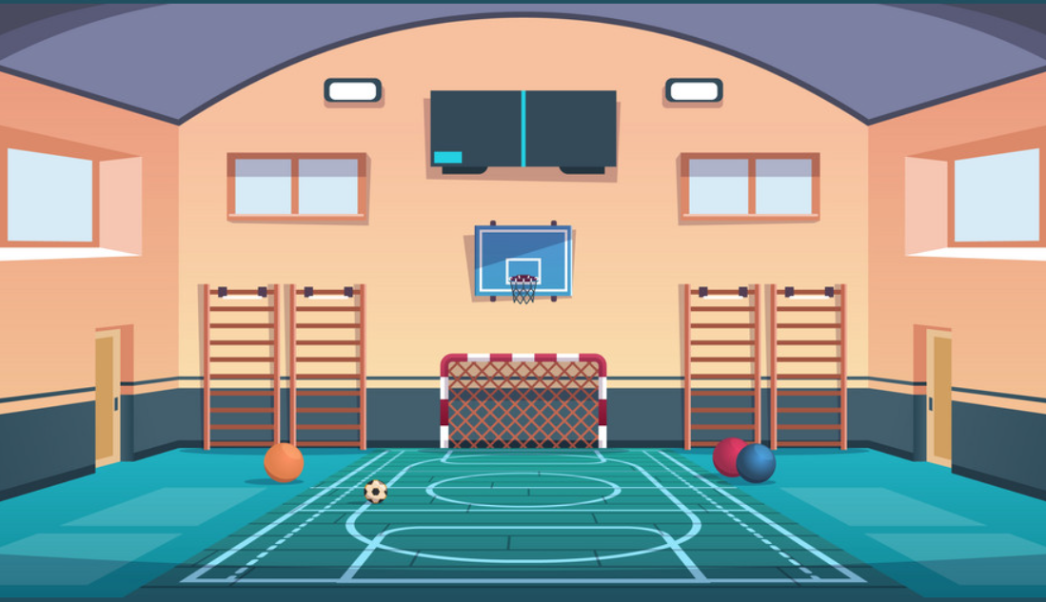
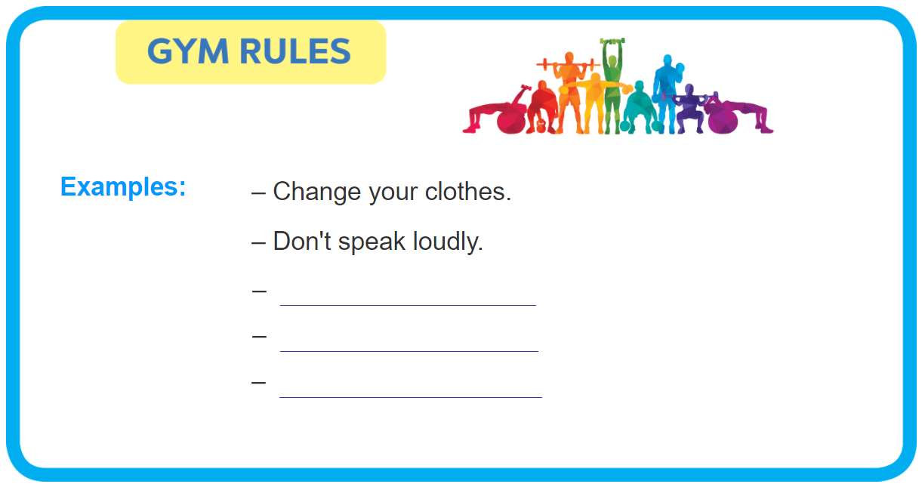
Ex 5 (p.20)
2 minutes
Group of 3
Brainstorm the rules at TV’s gym.
Lien Ninh’s gym

Slide 22
Fonts & colors used
This presentation has been made using the following fonts:
Vidaloka
(https://fonts.google.com/specimen/Vidaloka)
Lato
(https://fonts.google.com/specimen/Montserrat)
#3f3533
#000000
#f5f2ee

