Slide 1
GAME GUESS THE SPORTS
- 5 seconds
- Look at the hints.
- Guess the sports.

Slide 2

GUESS THE SPORTS.

Slide 3
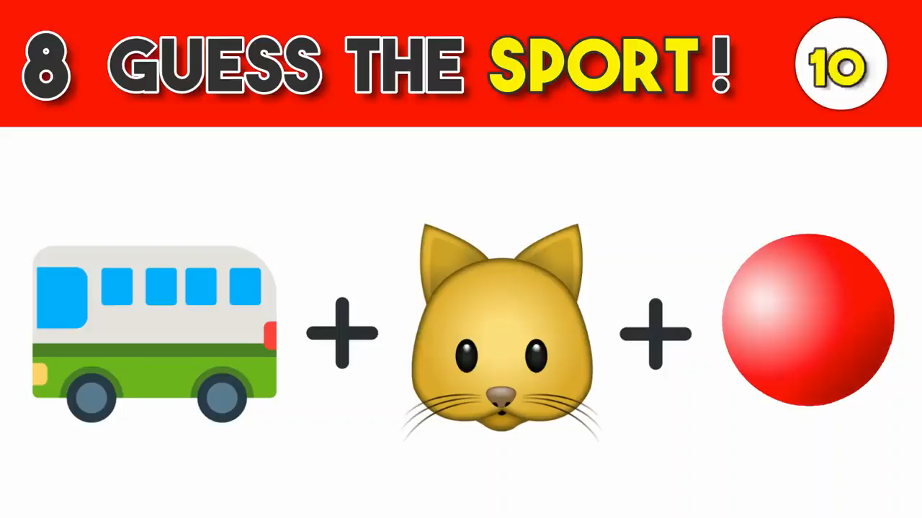
GUESS THE SPORTS.

Slide 4
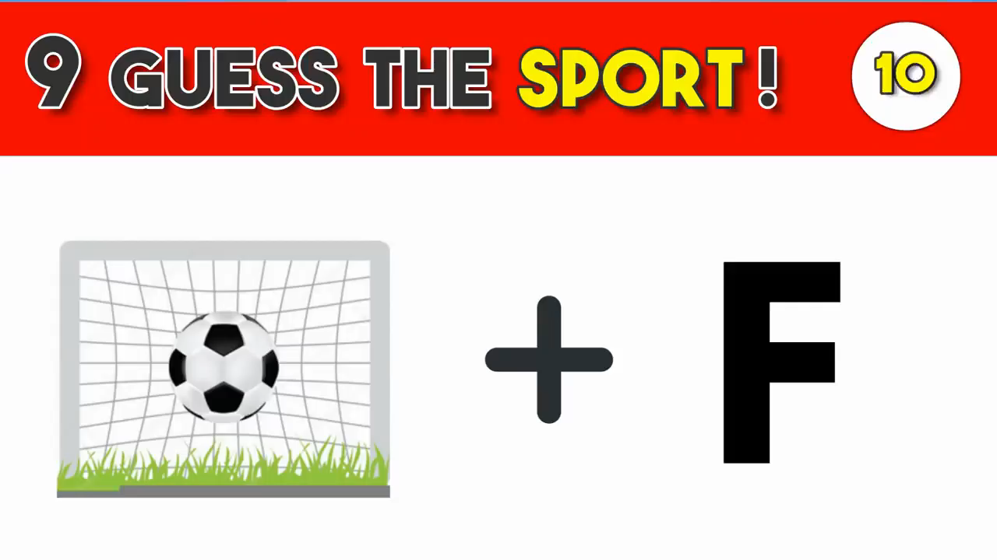
GUESS THE SPORTS.

Slide 5
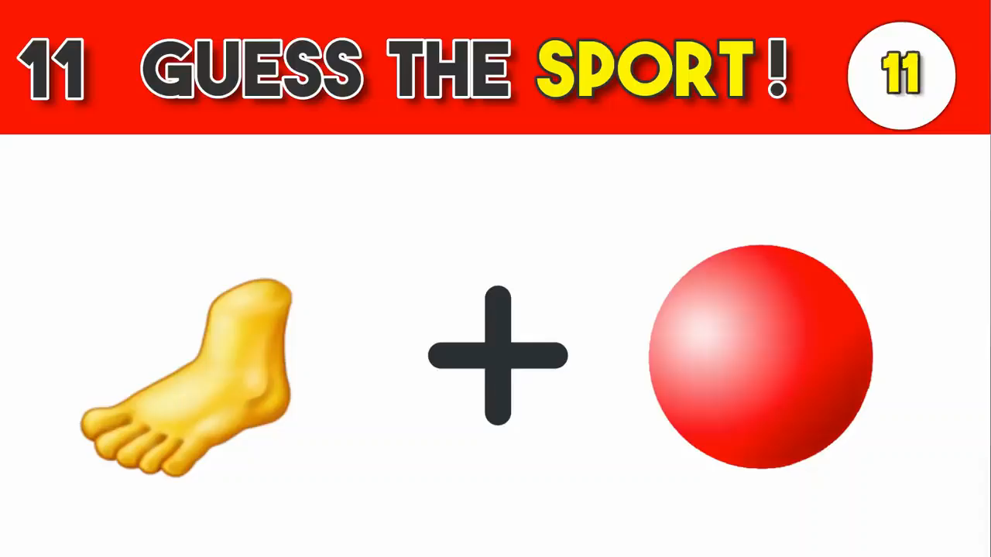
GUESS THE SPORTS.

Slide 6
UNIT 8 Sports and games
Lesson 1: Getting started

Slide 7
OBJECTIVES
By the end of the lesson, students will be able to:
□ have an overview of the topic: Sports and games
□ use the vocabulary and talk about sports and games

Slide 8


Extra vocabulary
equipment
/ɪˈkwɪpmənt/
trang thiết bị

Slide 9
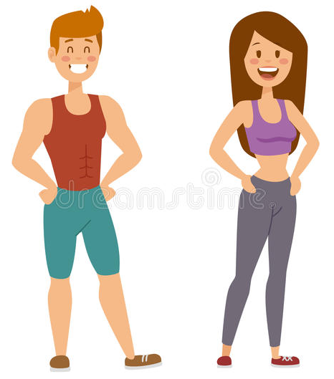
Extra vocabulary
fit /fɪt/
khỏe mạnh, cân đối

Slide 10
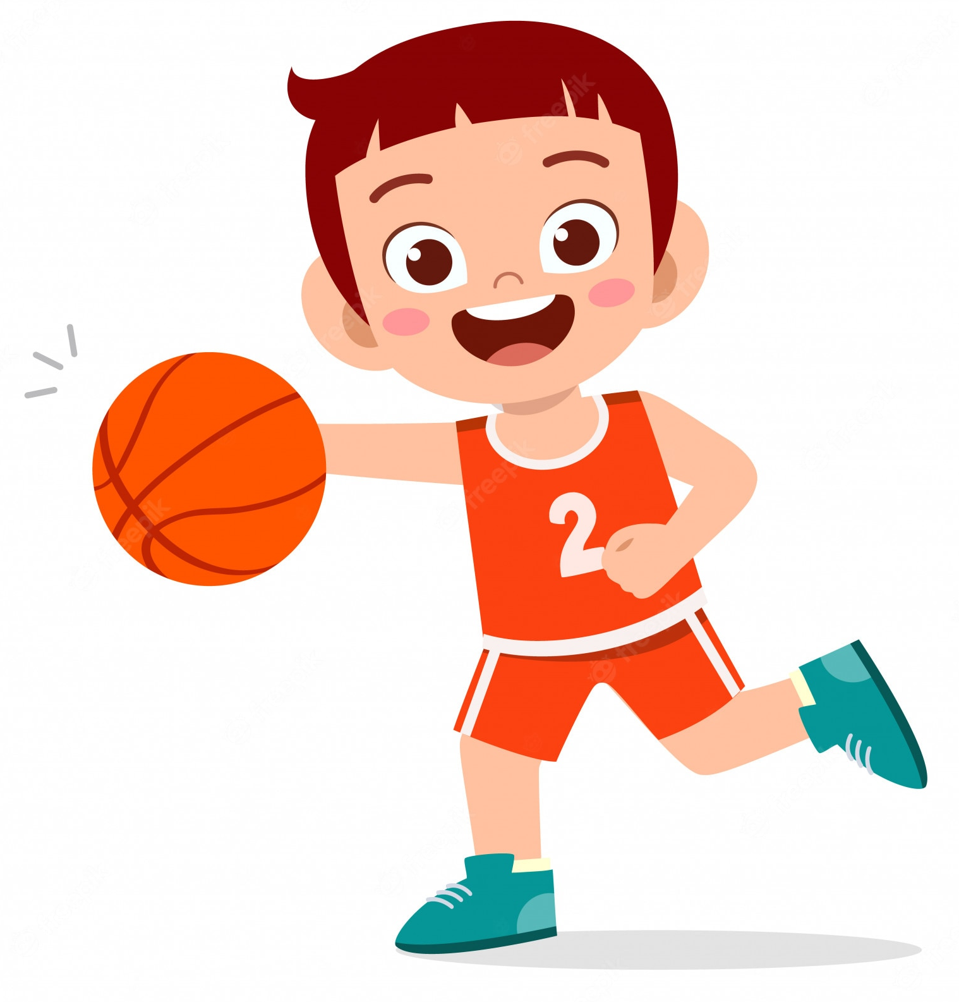
Extra vocabulary
He is good at playing basketball.
He can play basketball very well.
be good at doing sth
giỏi làm việc gì đó

Slide 11
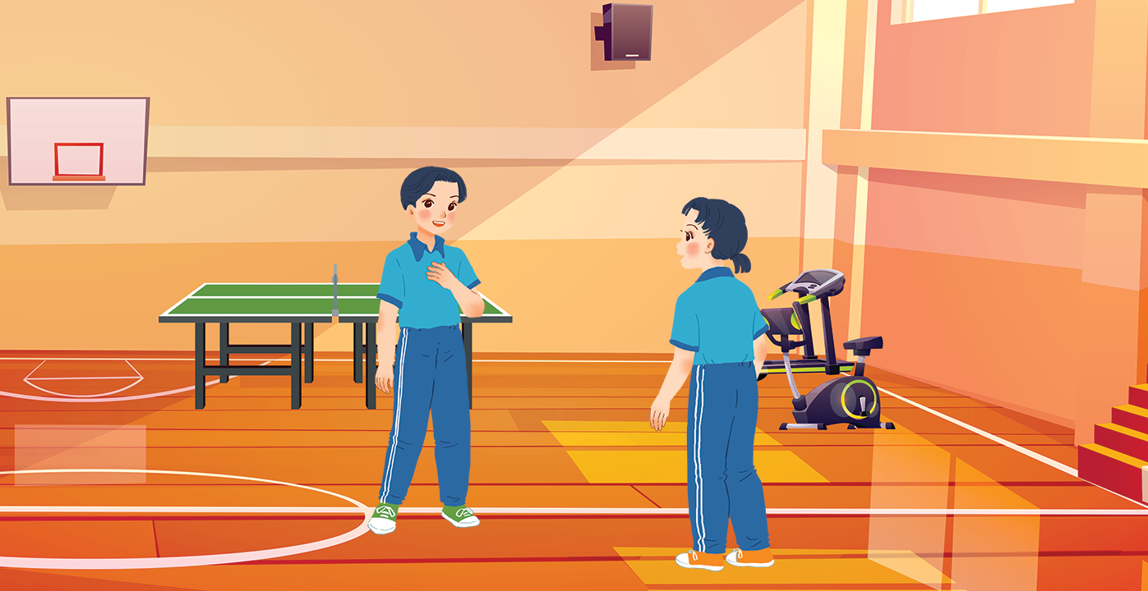
Where are the two kids?
What do you think they’re talking about?
School clubs/ Sports and games
At the gym.
Listen and check
Well, I do karate, and I play table tennis.
What sports do you do, Duong?
…you can go to the karate club with me.

Slide 12
Duong: Wow! This gym is big!
Mai: Yeah. The equipment is great. What sports do you do, Duong?
Duong: Well, I do karate, and I play table tennis. Yesterday I played with Duy, and I won!
Mai: Congratulations! You look f it! I’m not good at sports.
Duong: I have an idea – you can go to the karate club with me.
Mai: No, I can’t do karate.
Duong: But you can learn! You’ll love it.
Mai: Well ... OK.
Duong: Great! I’ll meet you there at 10 a.m. on Sunday.
Mai: Where’s the club?
Duong: It’s Superfit Club, in Pham Hung Road. You can cycle there.
Mai: OK. See you then.
Ex 2 (p.17) Read. Put A WORD from the conversation in EACH GAP.
1. Duong looks _____________. He often does karate.
2. Mai likes coming to the _____________. The equipment there is great.
3. Duong played _____________ with Duy yesterday, and he won.
4. Mai and Duong will meet at Superfit _____________ on Sunday.
5. Mai will _____________ to Superfit Club.

Slide 13
Ex 2 (p.17) Read. Put A WORD from the conversation in EACH GAP.
1. Duong looks _____________. He often does karate.
2. Mai likes coming to the _____________. The equipment there is great.
3. Duong played _____________ with Duy yesterday, and he won.
4. Mai and Duong will meet at Superfit _____________ on Sunday.
5. Mai will _____________ to Superfit Club.
fit
Duong: Well, I do karate, and I play table tennis. Yesterday I played with Duy, and I won!
Mai: Congratulations! You look fit! I'm not good at sports.
fit

Slide 14
Ex 2 (p.17) Read. Put A WORD from the conversation in EACH GAP.
1. Duong looks _____________. He often does karate.
2. Mai likes coming to the _____________. The equipment there is great.
3. Duong played _____________ with Duy yesterday, and he won.
4. Mai and Duong will meet at Superfit _____________ on Sunday.
5. Mai will _____________ to Superfit Club.
fit
gym
Duong: Wow! This gym is big!
Mai: Yeah. The equipment is great. What sports do you do, Duong?
gym

Slide 15
Ex 2 (p.17) Read. Put A WORD from the conversation in EACH GAP.
1. Duong looks _____________. He often does karate.
2. Mai likes coming to the _____________. The equipment there is great.
3. Duong played _____________ with Duy yesterday, and he won.
4. Mai and Duong will meet at Superfit _____________ on Sunday.
5. Mai will _____________ to Superfit Club.
fit
gym
table tennis
Duong: Well, I do karate, and I play table tennis. Yesterday I played with Duy, and I won!
table tennis

Slide 16
Ex 2 (p.17) Read. Put A WORD from the conversation in EACH GAP.
1. Duong looks _____________. He often does karate.
2. Mai likes coming to the _____________. The equipment there is great.
3. Duong played _____________ with Duy yesterday, and he won.
4. Mai and Duong will meet at Superfit _____________ on Sunday.
5. Mai will _____________ to Superfit Club.
fit
gym
table tennis
Club
Duong: Great! I'll meet you there at 10 a.m. on Sunday.
Mai: Where's the club?
Duong: It's Superfit Club, in Pham Hung Road. You can cycle there.
Club

Slide 17
Ex 2 (p.17) Read. Put A WORD from the conversation in EACH GAP.
1. Duong looks _____________. He often does karate.
2. Mai likes coming to the _____________. The equipment there is great.
3. Duong played _____________ with Duy yesterday, and he won.
4. Mai and Duong will meet at Superfit _____________ on Sunday.
5. Mai will _____________ to Superfit Club.
fit
gym
table tennis
Club
cycle
Mai: Where's the club?
Duong: It's Superfit Club, in Pham Hung Road. You can cycle there.
Mai: OK. See you then.
cycle

Slide 18


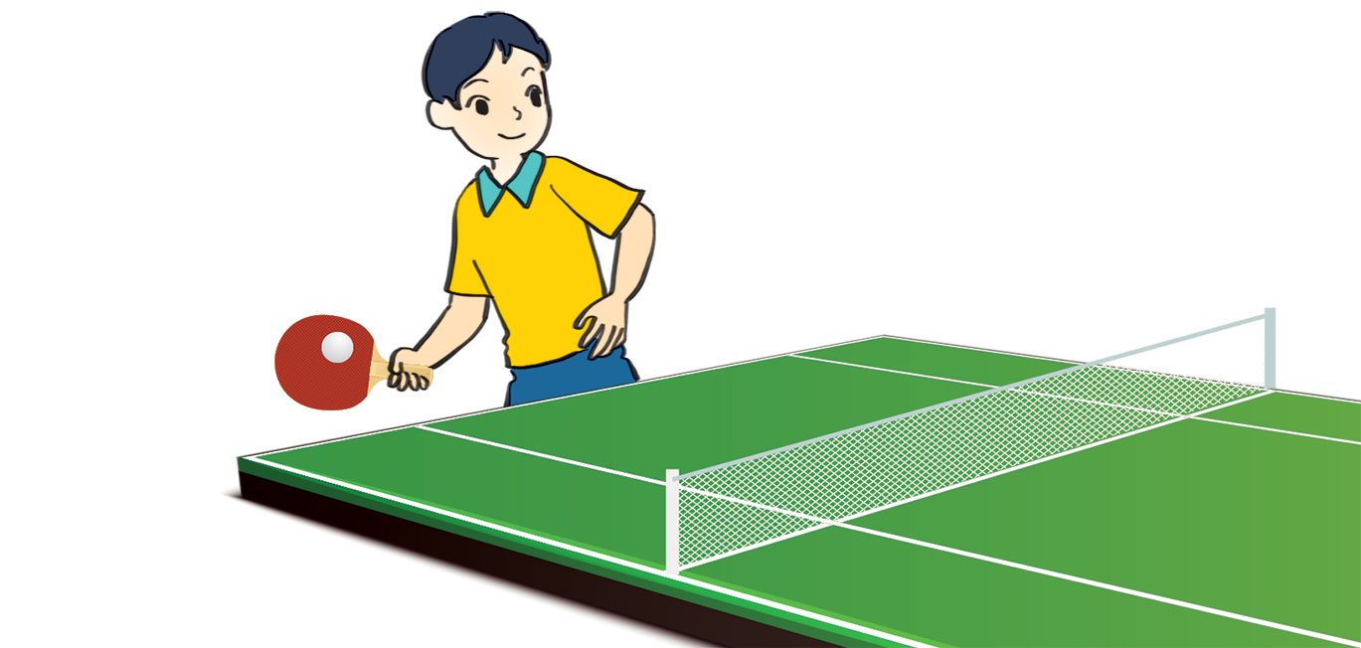
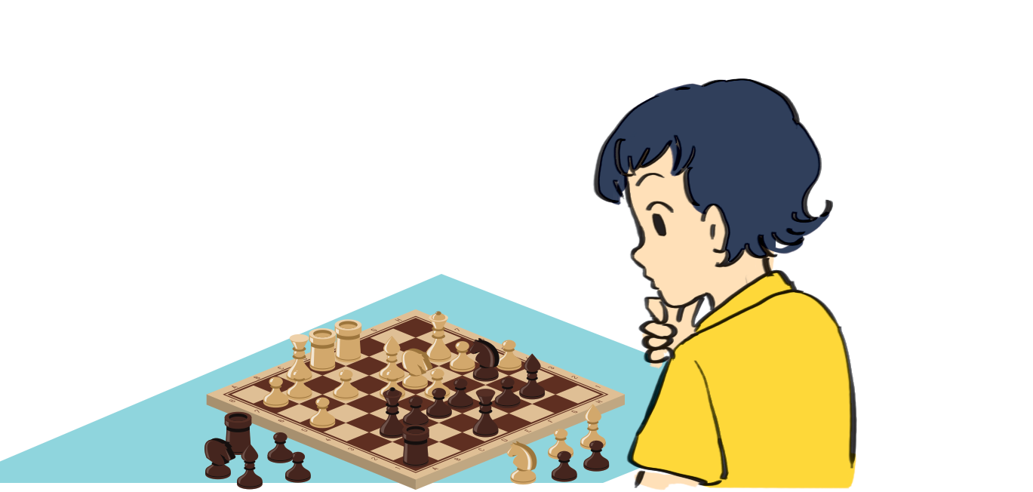

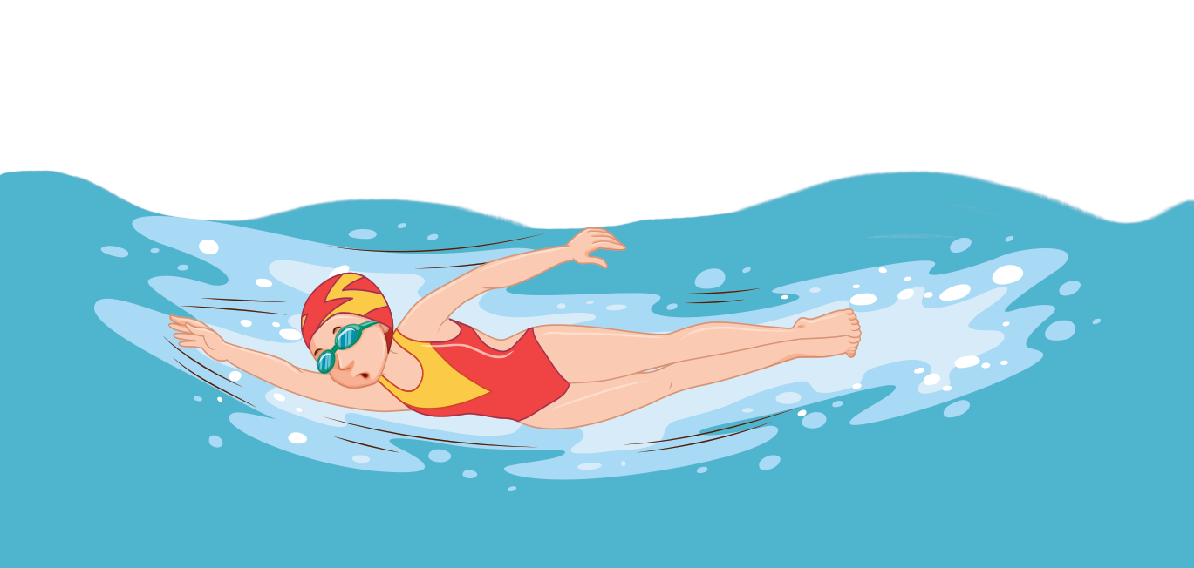
Ex 3 (p.17): Match
chess aerobics table tennis cycling swimming volleyball
cycling
aerobics
table tennis
1. ______________
2. ______________
3. ______________
swimming
chess
volleyball
4. ______________
5. ______________
6. ______________

Slide 19
Which are sports and which are games?
1. cycling
sports
2. aerobics
sports
3. table tennis
games
4. swimming
sports
5. chess
games
6. volleyball
games
A sport: an activity that you do for pleasure and needs physical exercise.
A game: an activity or a sport with rules in which people or teams compete against each other.
Notes:
What is the different between sports and game?
Can you add more example?

Slide 20
Duong and Mai, who is sporty?
Duong
What about you?

Slide 21


Class survey: How sporty are you?
Work in pairs.
Ask 2 classmates.
3 minutes
 | … | ….
1. Can you swim? | A. Yes/ B. No | A. Yes/ B. No
2. Do you play outdoors every day? | A. Yes/ B. No | A. Yes/ B. No
3. Do you usually do morning exercise? | A. Yes/ B. No | A. Yes/ B. No
4. What do you usually do at break time at school? | A. Play in the schoolyard. B. Sit in the classroom. | A. Play in the schoolyard. B. Sit in the classroom.
5. What do you think of sports and games? | A. Very good. B. Not useful. | A. Very good. B. Not useful.

Slide 22
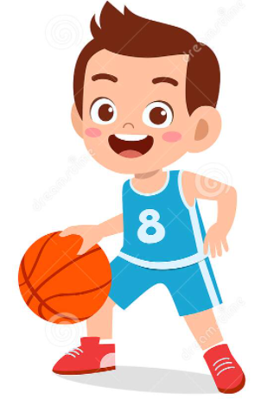



Class survey: How sporty are you?
Share.
Mostly A 🡪 Sporty
Mostly B 🡪 Do more sport and try to be more active.
 | … | ….
1. Can you swim? | A. Yes/ B. No | A. Yes/ B. No
2. Do you play outdoors every day? | A. Yes/ B. No | A. Yes/ B. No
3. Do you usually do morning exercise? | A. Yes/ B. No | A. Yes/ B. No
4. What do you usually do at break time at school? | A. Play in the schoolyard. B. Sit in the classroom. | A. Play in the schoolyard. B. Sit in the classroom.
5. What do you think of sports and games? | A. Very good. B. Not useful. | A. Very good. B. Not useful.

Slide 23
Wrap up
By the end of the lesson, students have been able to:
🗹 have an overview of the topic: Sports and games
🗹 use the vocabulary and talk about sports and games

