Slide 1
UNIT 3 MY FRIENDS
Lesson 2: A closer look 1

Slide 2
OBJECTIVES
After this lesson, students will be able to:
Vocabulary
use the words about personality
Pronunciation
pronounce the sounds /b/ and /p/ correctly

Slide 3
01
VOCABULARY

Slide 4
Look at the pictures and guess the personality
HIDDEN PICTURES

Slide 5
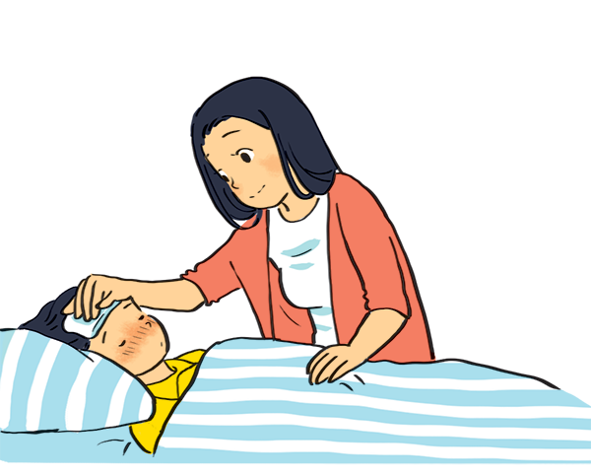
CARING
SHOW

Slide 6
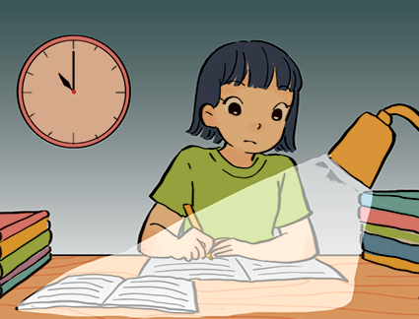
HARD WORKING
SHOW

Slide 7
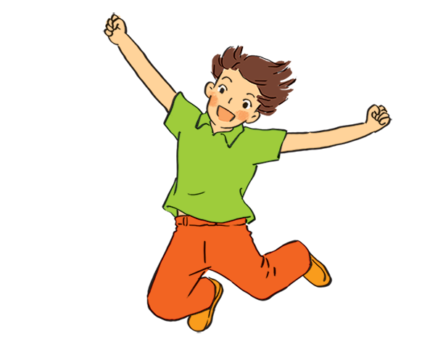
ACTIVE
SHOW

Slide 8
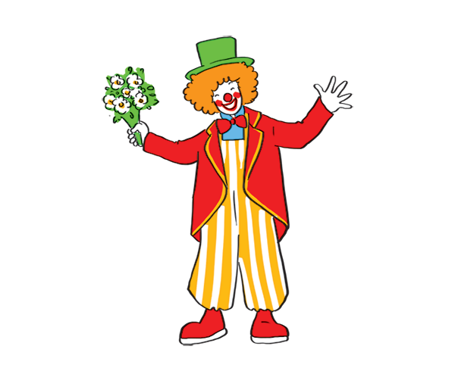
FUNNY
SHOW

Slide 9
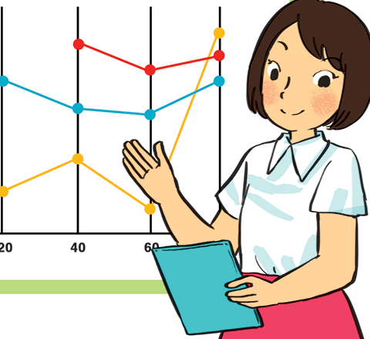
CONFIDENT
SHOW

Slide 10
2. Use the adjectives in the box to complete the sentences.
careful shy creative clever kind friendly
1. Mina is very __________. She likes drawing pictures. She always has lots of new ideas.
2. Nam is __________. He likes helping his friends.
3. Minh Duc is __________. He likes meeting new people.
4. Kim is very __________. She pays attention to what she's doing.
5. Mai is __________. She learns things quickly and easily.

Slide 11
2. Use the adjectives in the box to complete the sentences.
careful shy creative clever kind friendly
1. Mina is very __________. She likes drawing pictures. She always has lots of new ideas.
2. Nam is __________. He likes helping his friends.
3. Minh Duc is __________. He likes meeting new people.
4. Kim is very __________. She pays attention to what she's doing.
5. Mai is __________. She learns things quickly and easily.
creative
kind
friendly
careful
clever

Slide 12

How well do you know your friends?
Groups of 5-6
Write 2 adjectives for each group member
(Example: Minh - friendly & clever)
3 mins

Slide 13
PRONUNCIATION
02

Slide 14
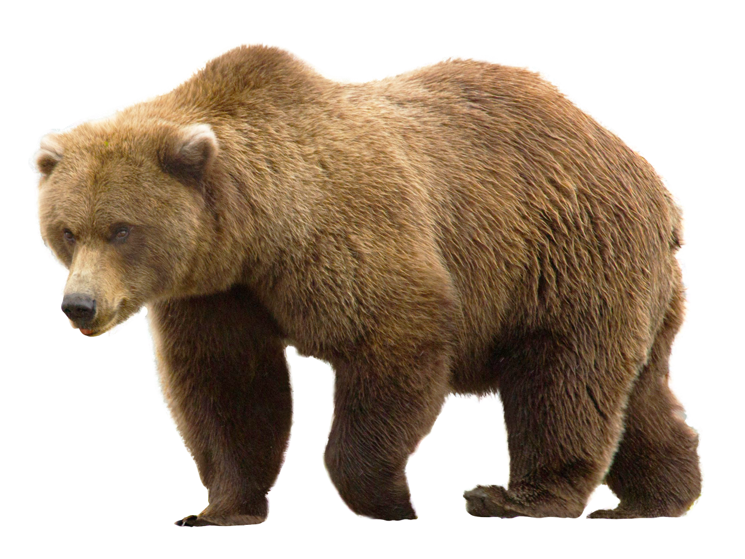
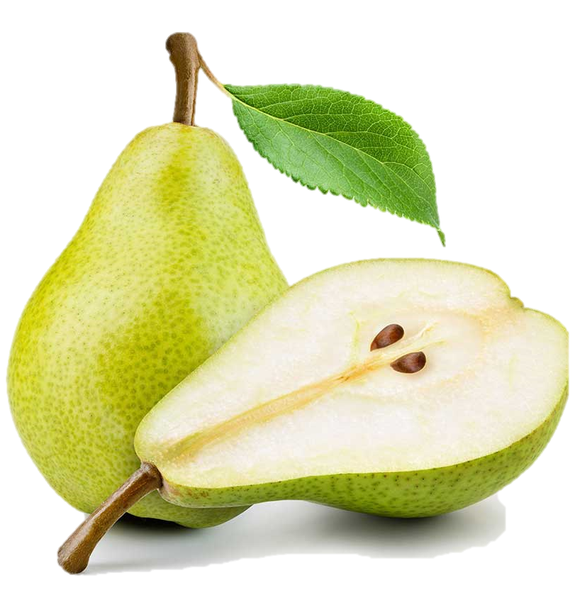

bear
pear
/b/
/p/

Slide 15


Slide 16
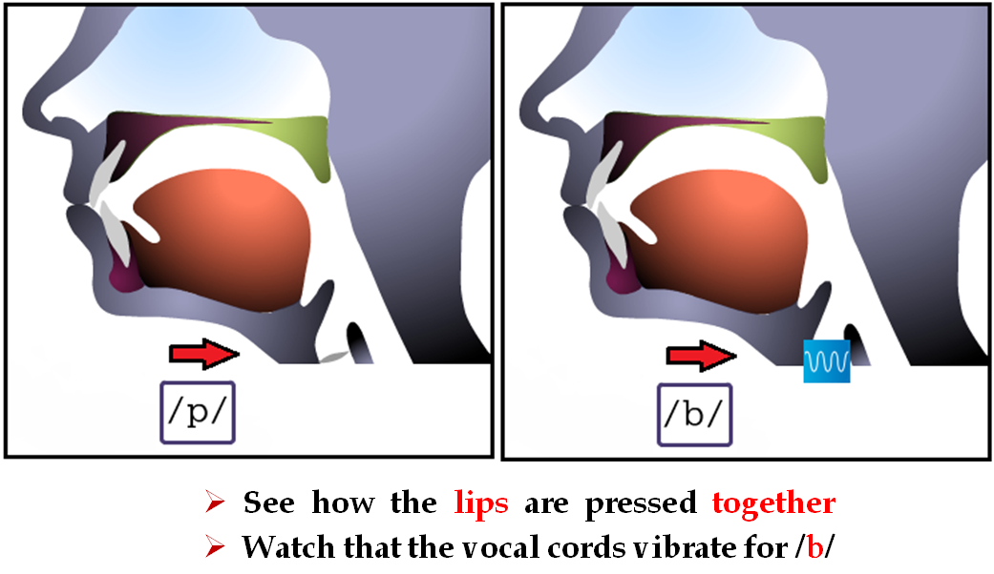

Slide 17
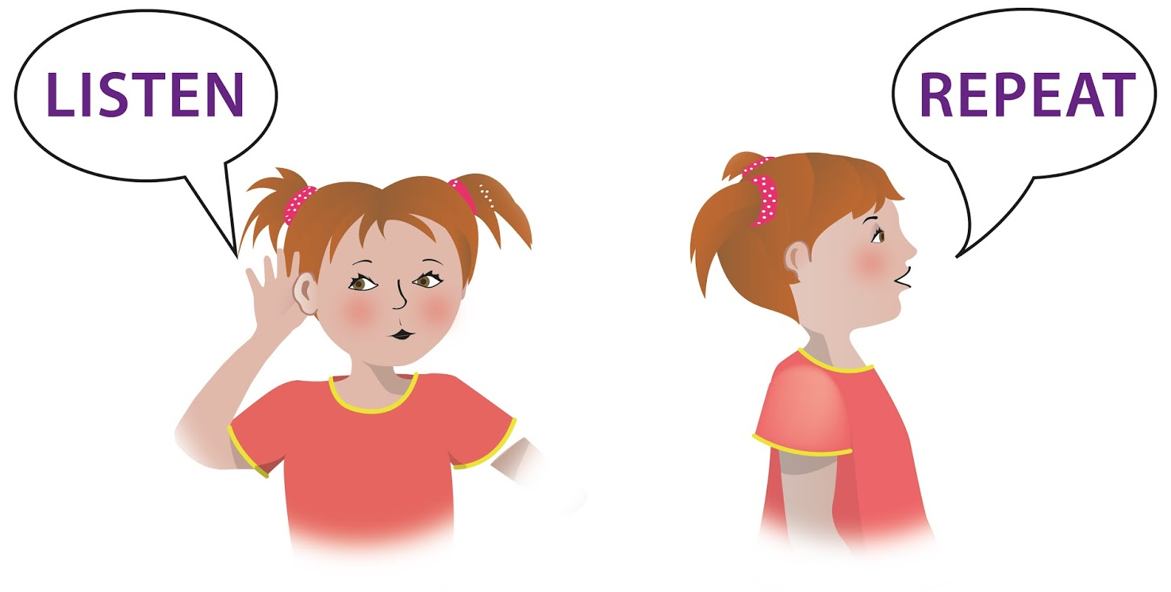
Listen and repeat.
picnic
biscuits
blonde
black
big
patient
Notes:
Cho học sinh listen trước- sau đó mới repeat.
Repeat xong thì cho hs nhận biết. Show cái voiceless và cái voiced.
/p/ raise right hand
/b/ raise left hand.

Slide 18
4. Listen and circle.
/b/ | /p/
big | pig
bear | pear
buy | pie
robe | rope

Slide 19
5. Listen. Then practise the chant. Notice the rhyme.
We're having a picnic
We're having a picnic
Fun! Fun! Fun!
We're bringing some biscuits
We're bringing some biscuits
Yum! Yum! Yum!
We're playing together
We're playing together
Hurrah! Hurrah! Hurrah!

Slide 20
WRAP-UP
What we have learnt today?
Reading about best friends
Adjectives about personality
Body parts
□ Sounds /b/ and /p/
✓
✓

Slide 21
THANKS FOR YOUR ATTENTION!

