Slide 1
UNIT 3
MY FRIENDS
Lesson 3: A closer look 2

Slide 2
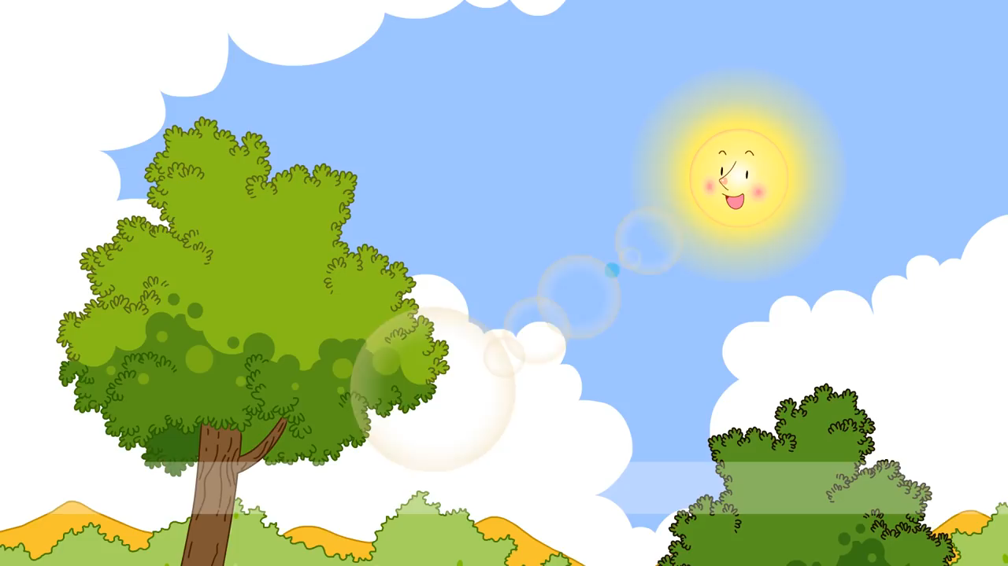
What tense is it in the video clip?
Present Continuous

Slide 3
OBJECTIVES
After this lesson, students will be able to
use the Present continuous to talk about things happening now

Slide 4
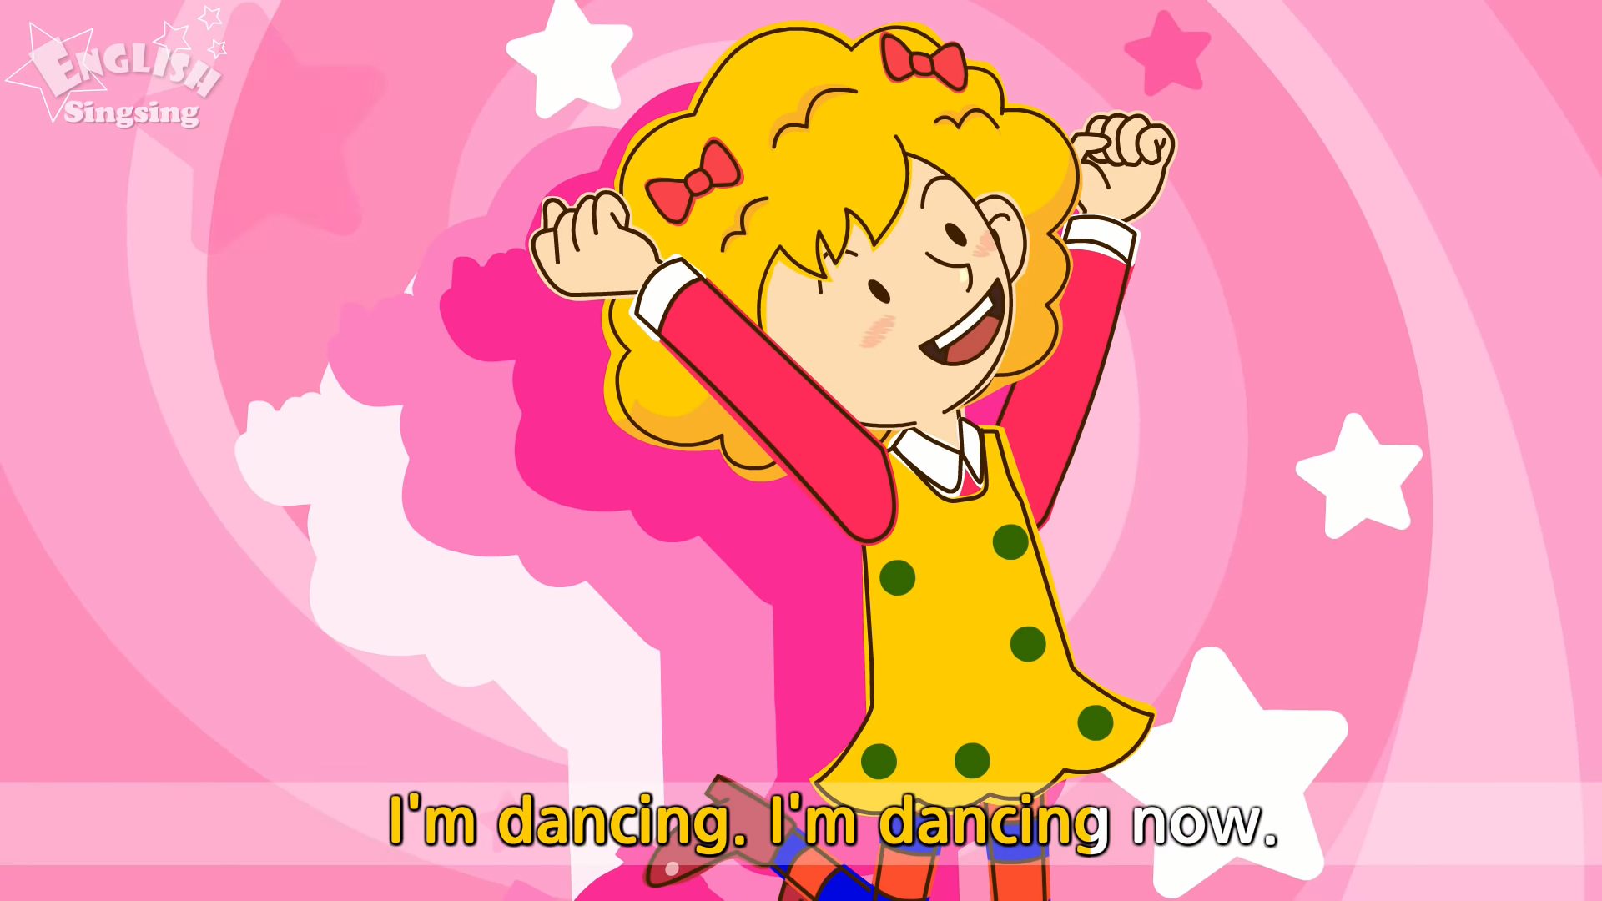
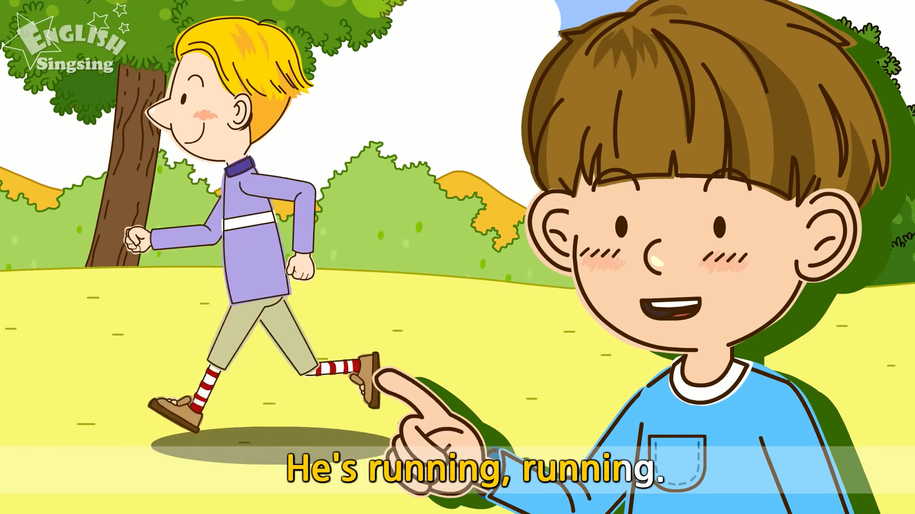
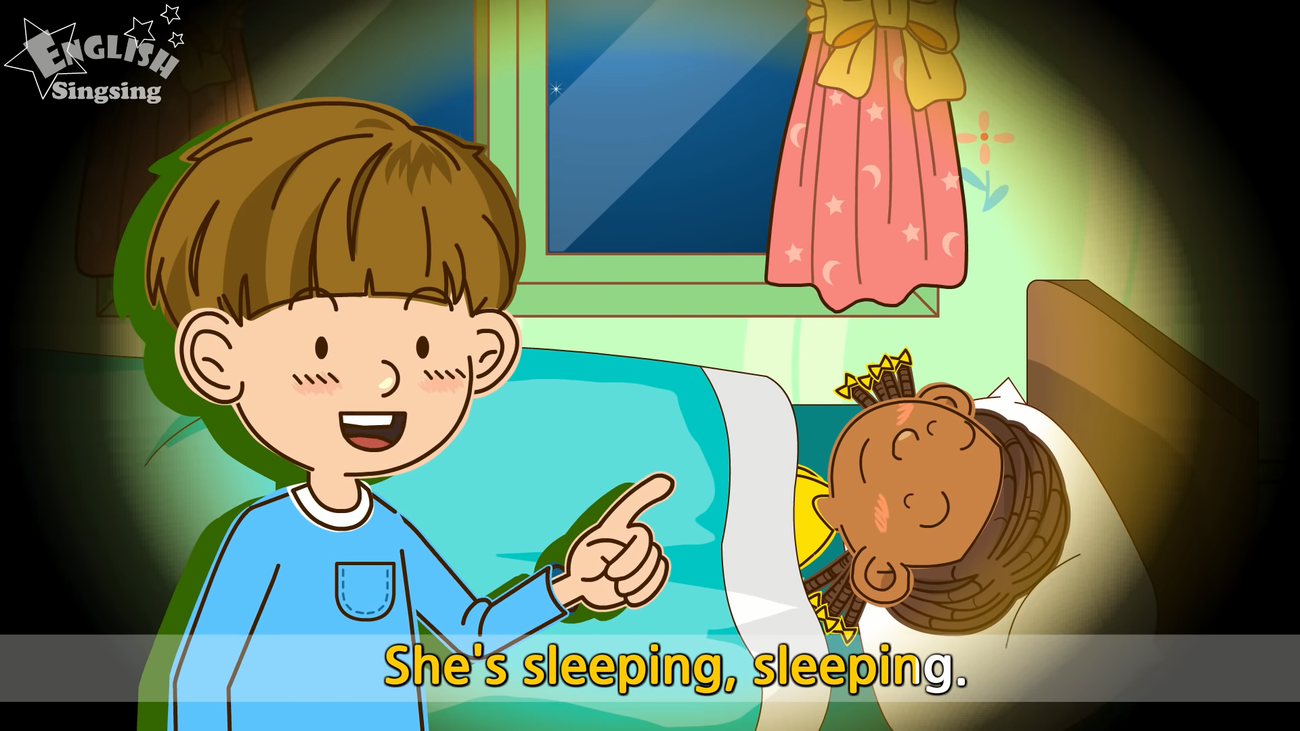
Present continuous
I’m dancing now.
I’m dancing now.
He’s running.
She’s sleeping.
We use the present continuous for actions happening now.
We can use the present continuous with now, at present, or at the moment.

Slide 5
Present continuous
Positive
I’m dancing now.
I + am Ving.
He’s running.
He/ She/ It + is Ving.
They’re talking.
You/ We/ They + are Ving.

Slide 6
Present continuous
Negative
I’m not dancing now.
I + am not Ving.
He’s not running.
He/ She/ It + is not Ving.
They’re not talking.
You/ We/ They + are not Ving.

Slide 7
Present continuous
Question
Am I dancing now?
Am + I + Ving?
Is he dancing?
Is + he/ she/ it + Ving?
Are they dancing now?
Are + you/ we/ they + Ving?
What are you doing?
What + am/is/are + S + Ving?

Slide 8
Present continuous
Positive
I + am Ving.
He/ She/ It + is Ving.
You/ We/ They + are Ving.
I + am not Ving.
Negative
He/ She/ It + is not Ving.
You/ We/ They + are not Ving.
Am + I + Ving?
Question
Is + he/ she/ it + Ving?
Are + you/ we/ they + Ving?
What + am/is/are + S + Ving?

Slide 9
Ex 1: Put the verbs in brackets in the present continuous.
is reading
He/ She/ It + is Ving.
1. Nam (read) _______________ a book now.
2. They (play) _________________ football at the moment.
3. My sister (not make) ___________________ a sandwich at present.
4. I (go) _________________ to the supermarket at the moment.
5. _______ they (talk) _________ about their new friends?
are playing
You/ We/ They + are Ving.
isn’t making
He/ She/ It + is Ving.
am going
I + am Ving.
Are
talking
Are + you/ we/ they + Ving?

Slide 10



TRÒ CHƠI
ĐÀO VÀNG
BẮT ĐẦU

Slide 11

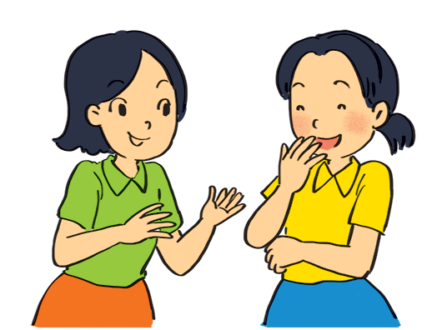

Write sentences using positive or negative present continuous verbs.
She _____________ to Mai. (talk)
is talking

Slide 12
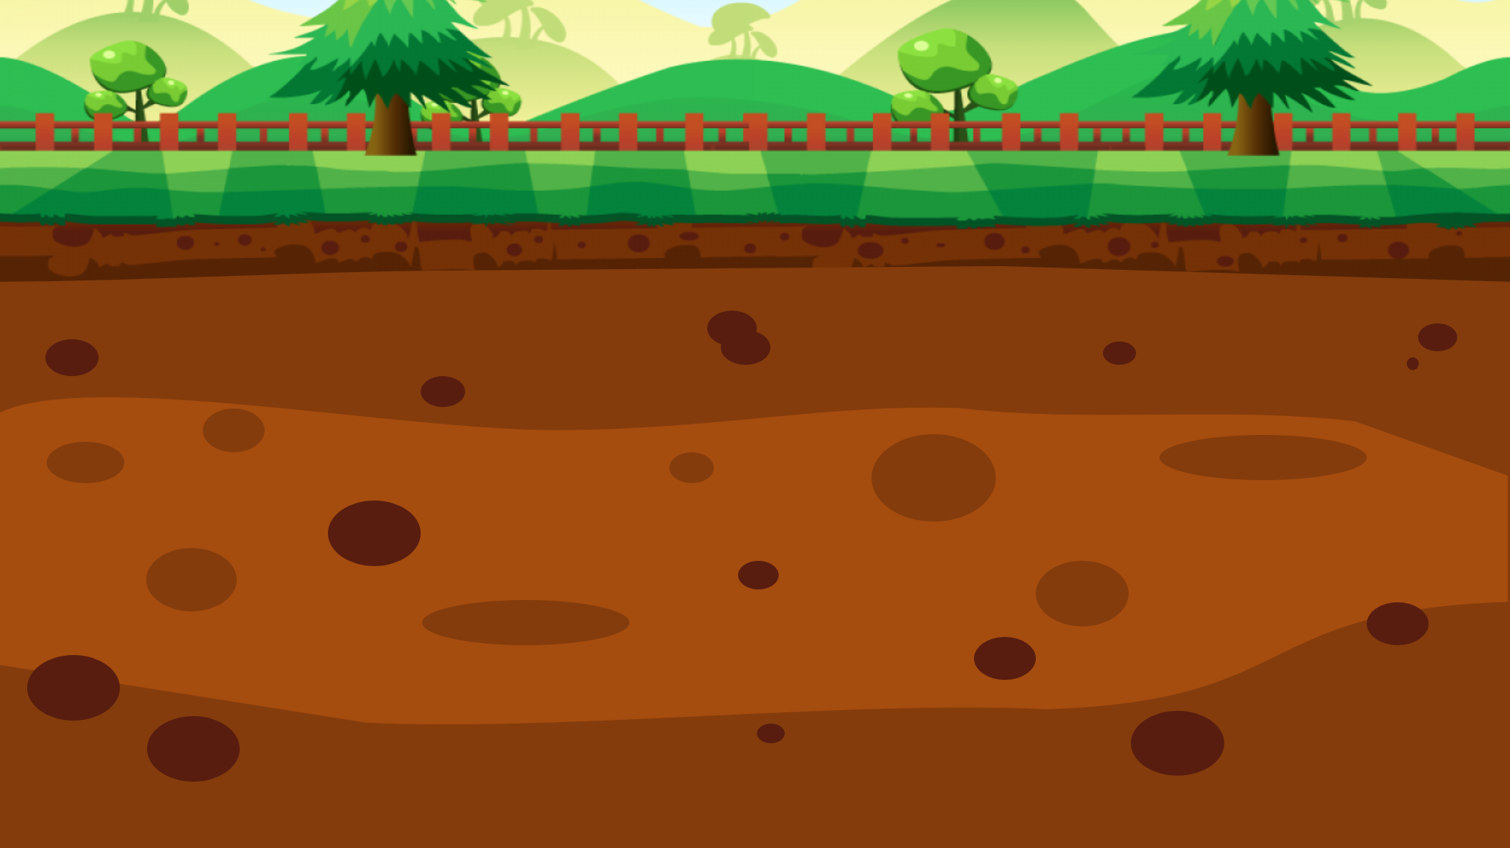



100$
150$
50$
20$
10$
100$
10$
20$
150$
50$

Slide 13
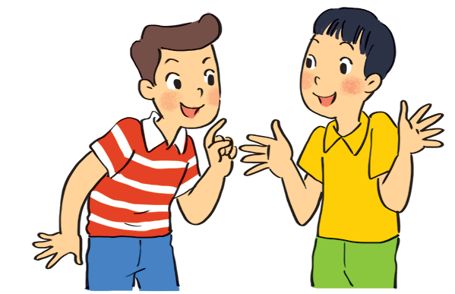
Write sentences using positive or negative present continuous verbs.
Nam and Ba ____________________________. (eat ice cream)
are not eating ice cream

Slide 14
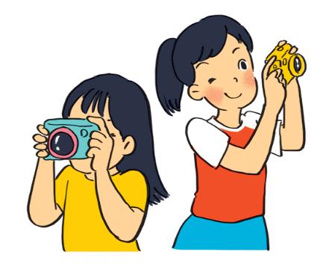
Write sentences using positive or negative present continuous verbs.
Lan and Trang ____________________________. (take photos)
are taking photos

Slide 15
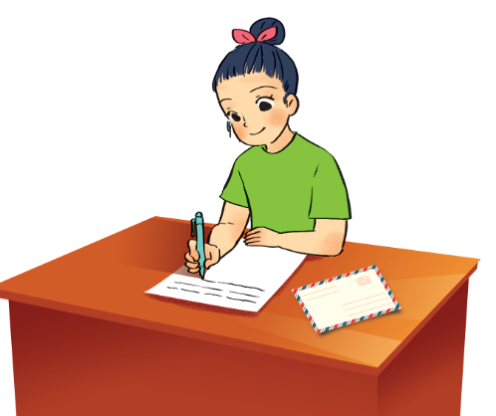
Write sentences using positive or negative present continuous verbs.
Ha ____________________________.
(write a letter)
is writing a letter

Slide 16
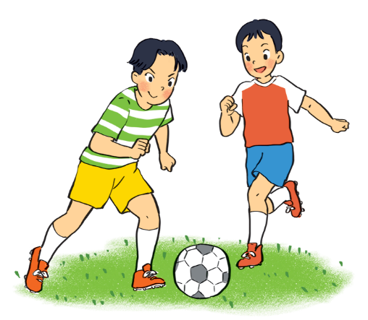
Write sentences using positive or negative present continuous verbs.
Duong and Hung __________________
_________________. (play badminton)
are not playing
badminton

Slide 17
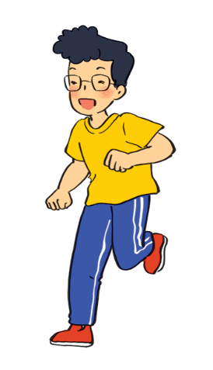
Write sentences using positive or negative present continuous verbs.
Phong ____________________________.
(draw a picture)
is not drawing a picture

Slide 18
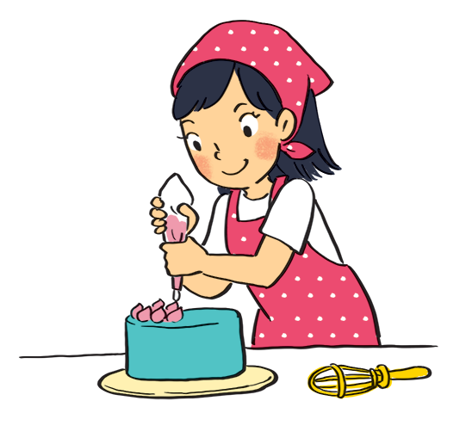
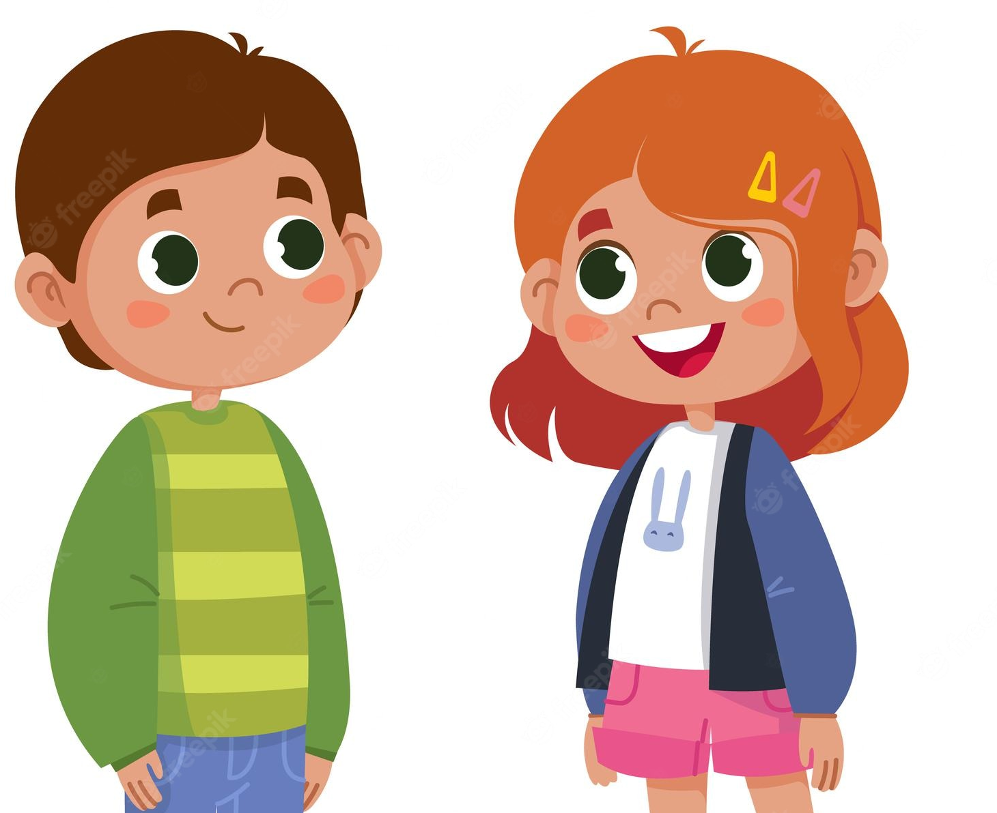
Ex 3: Work in pairs. Ask and answer.
Example:
Is your sister making a cake?
Yes, she is.
A: your sister / make a cake?
Is + he/ she/ it + Ving?

Slide 19
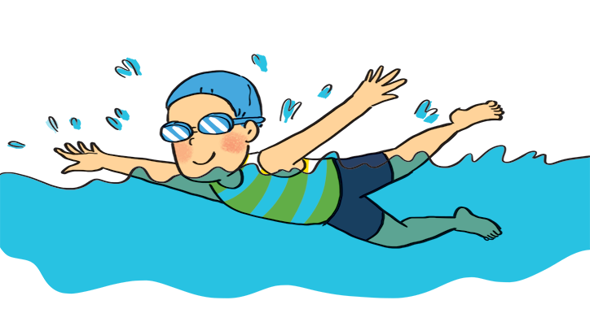
Ex 3: Work in pairs. Ask and answer.
Is your friend swimming?
1
Yes, he is.
A: your friend / swim?
Is + he/ she/ it + Ving?

Slide 20
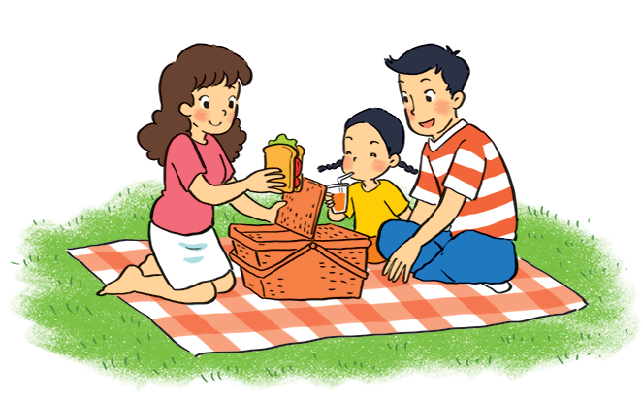
Ex 3: Work in pairs. Ask and answer.
Are they listening to music?
No, they aren’t. They’re having a picnic.
2
A: they / listen to music?
Are + you/ we/ they + Ving?

Slide 21
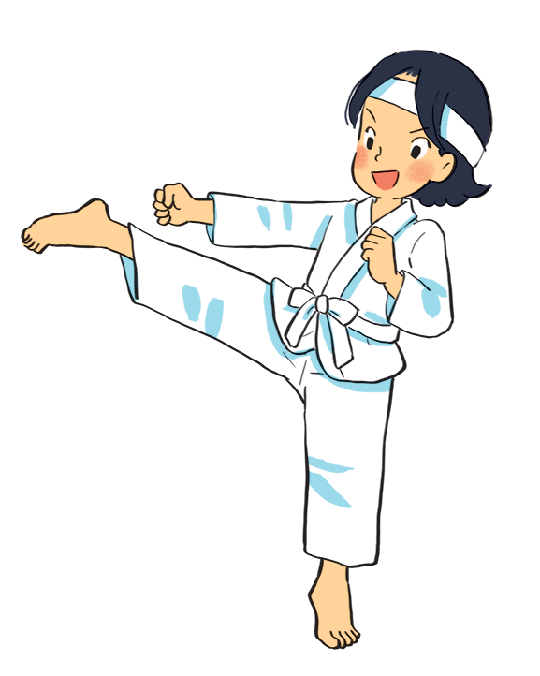
Ex 3: Work in pairs. Ask and answer.
Is Mi playing the piano?
No, she isn’t. She is doing karate.
3
A: Mi / play the piano?
Is + he/ she/ it + Ving?

Slide 22
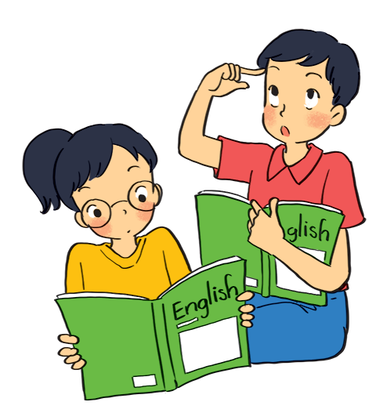
Ex 3: Work in pairs. Ask and answer.
Are they learning English?
4
Yes, they are.
A: they / learn English?
Are + you/ we/ they + Ving?

Slide 23
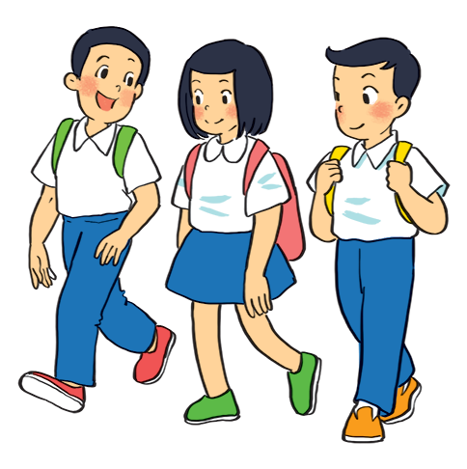
Ex 3: Work in pairs. Ask and answer.
Are your friends cycling to school?
No, they aren’t. They are walking to school.
5
A: your friends / cycle to school?
Are + you/ we/ they + Ving?

Slide 24
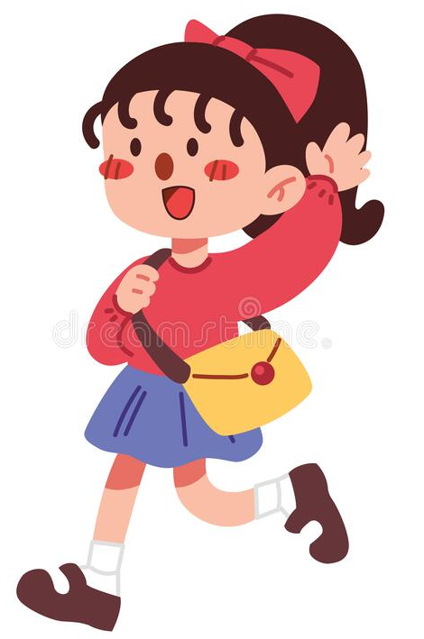
Present Simple & Present continuous
She walks to school from Mondays to Fridays.
She is walking to school now.
Mondays
→
Fridays
now
When something often happens or is fixed, we use the present simple.
When something is happening now, we use the present continuous.

Slide 25
Present Simple & Present continuous
POSITIVE
POSITIVE
I/ You/ We/ They + V
He/ She/ It + V(s/es)
I + am V-ing.
He/ She/ It + is V-ing.
You/ We/ They + are V-ing.
NEGATIVE
NEGATIVE
I/ You/ We/ They + don’t + V
He/ She/ It + doesn’t + V
I + am not V-ing.
He/ She/ It + is not V-ing.
You/ We/ They + are not V-ing.
QUESTIONS
QUESTIONS
Do + I/you/we/they + V?
➔ Yes, I do / No, I don’t
Does he/she/it + V?
➔ Yes, she/he/it does
➔ No, she/ he/it doesn’t
Am I + V-ing?
- Yes, I am./ No, I am not.
Is he/she/it + V-ing?
- Yes, he/she/it is. / No, he/she/it isn’t.
Are you/we/they + V-ing?
- Yes, you/we/they are./ No, you/we/they aren’t.

Slide 26
Ex 4: Put the verbs in brackets in the present simple or present continuous.
doesn’t walk
Present simple
(-) He/ She/ It + doesn’t V.
(+) He/ She/ It + Vs/es.
1. My best friend ________________ (not walk) to school every day. Sometimes she (cycle) __________ .
2. Look! What _________ he _________ (play) ?
3. ________ your friends and you ____________ (study) in the library every afternoon?
4. I _______________ (write) an email to my friend now.
5. He (not do) ______________ his homework now.
He (read) ______________ .
cycles
Present continuous
(?) What + is + he/ she/ it + Ving?
is
playing
Do
Present simple
(?) Do + you/we/they + V?
study
am writing
Present simple
(+) I + am + Ving.
isn’t doing
Present continuous
(-) He/ She/ It + is not Ving.
(+) He/ She/ It + is Ving.
is reading

Slide 27
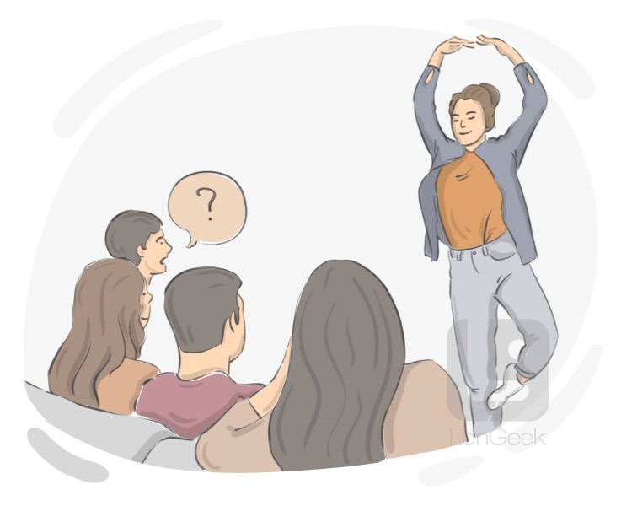
Charade
Work in group.
One member uses movements or gestures to express.
Other members ask and guess.
Are you dancing?
No, I’m not.
Are you looking for something?
Yes, I am.

Slide 28
Wrap-up
Choose the correct answers.
1. What tenses have we learnt and review?
A. Present Continuous B. Present simple
2. We use Present Continuous for
A. actions happening now
B. actions which often happens or is fixed
3. We can use the present continuous with
A. everyday B. now
C. At the moment D. at present

Slide 29
Thanks for your atttention!
Please keep this slide for attribution

