Slide 1










Lien Ninh Secondary School
English Class

Slide 2









Welcome, Students!

Slide 3





INTRODUCE YOURSELF
My name is ........../ I am .........
I’m ...11.... years old
I’m in class 6A5

Slide 4

GUESSING GAME
“Where is it?”
Look at the picture
Guess where it is

Slide 5

“Where is it?”
-> Big Ben Clock

Slide 6




What We Will Learn

Slide 7
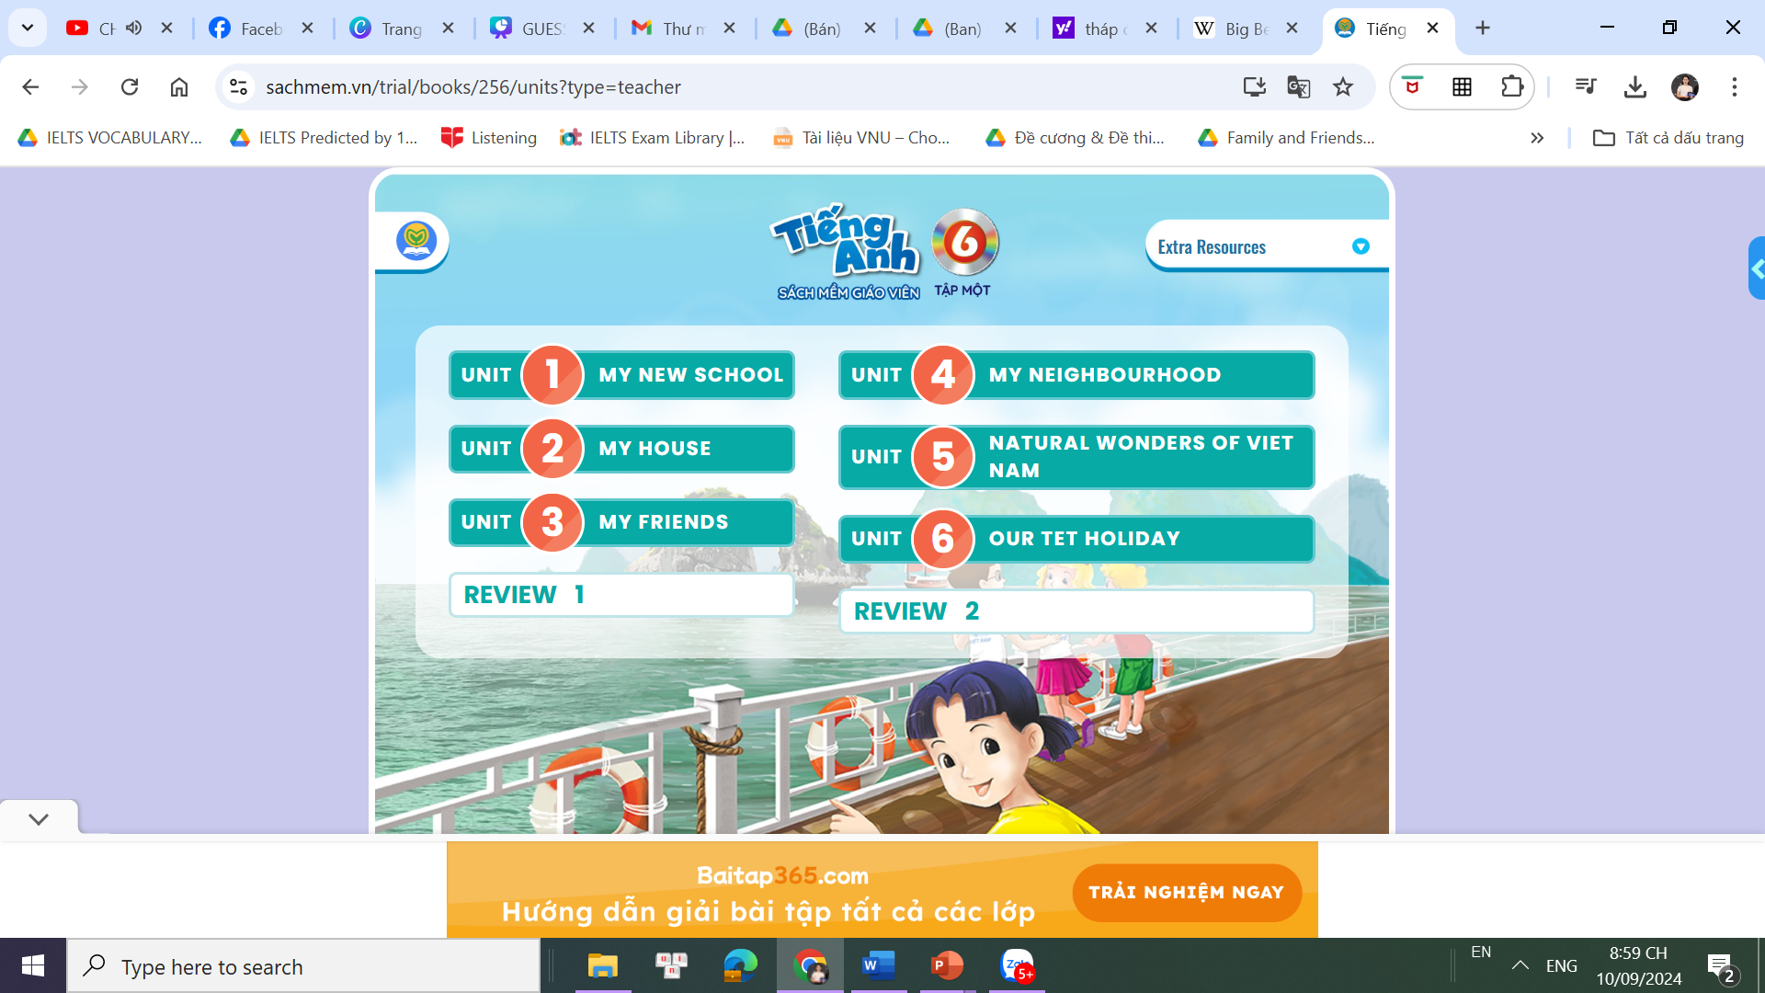
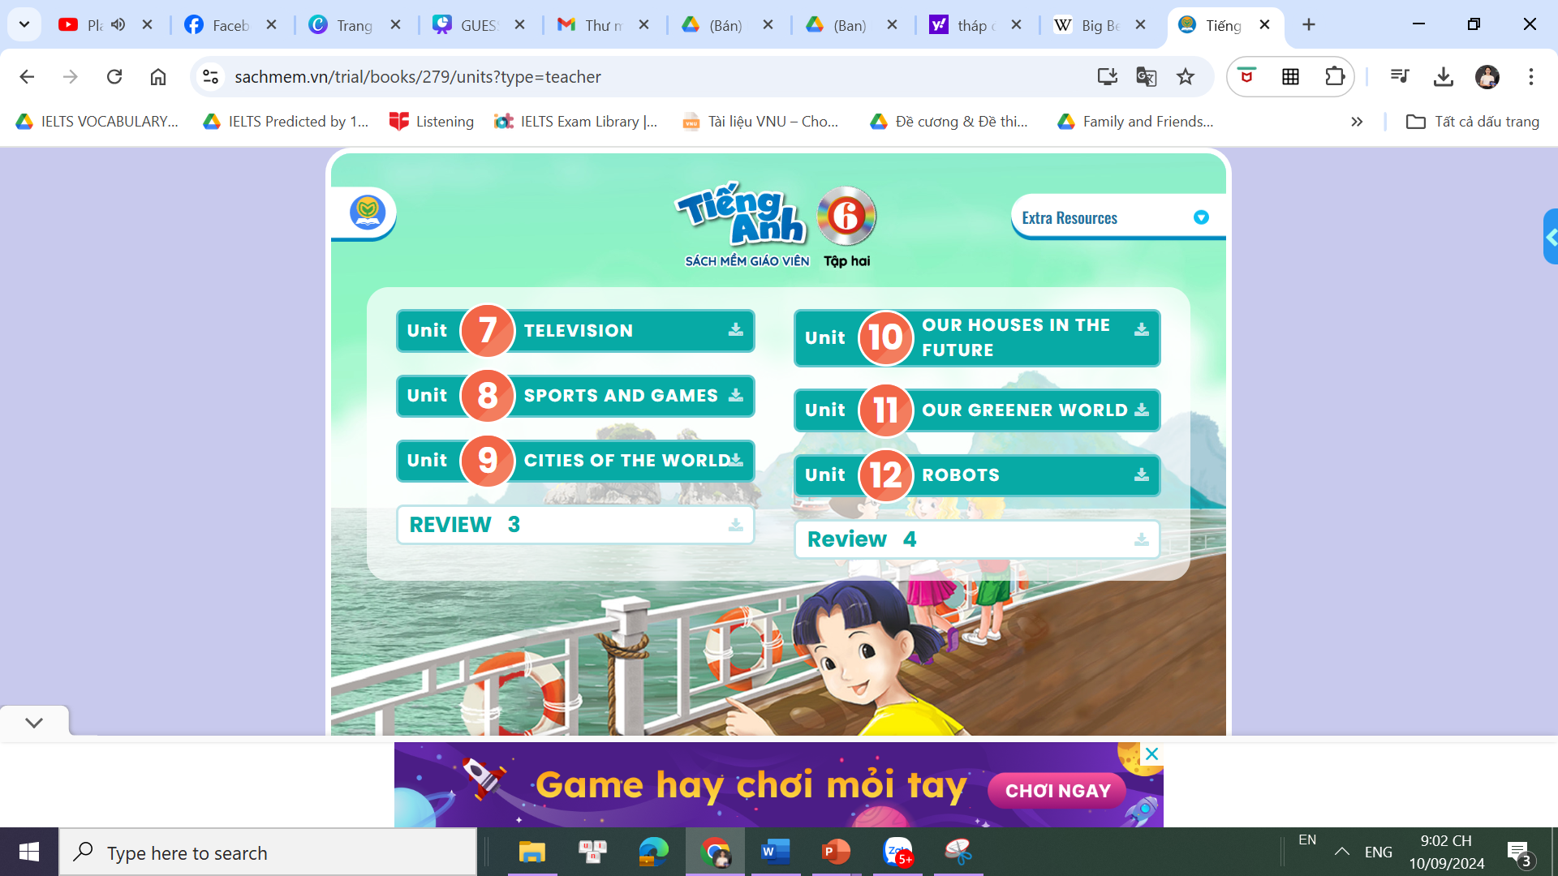
What We Will Learn

Slide 8






Each unit has 7 lessons.
+ Lesson 1: Getting started
+ Lesson 2: A closer look 1
+ Lesson 3: A closer look 2
+ Lesson 4: Communication
+ Lesson 5: Skills 1
+ Lesson 6: Skills 2
+ Lesson 7: Looking back and project

Slide 9




Tips to learn English
Learn by heart all vocabulary, grammar and their usage.
Review the lesson every day.
Learn English every day.

Slide 10




Homework Fun
Prepare Unit 1 (Getting started)

Slide 11





Thank You

