Slide 1
Unit 4 Ethnic groups of Viet Nam
Lesson 3. A closer look 2

Slide 2

Name 2 types of questions
Yes/No questions
Wh questions

Slide 3
Yes/ No questions
Do/ Does/ Did
Is/ Am/ Are
Have/ Has
Can/ Could/ May/ Will…
Rules for making question.
He is an ethnic minority.
S + V (s/es/ed) + O.
→ Is he an ethnic minority?
→ Do/ Does/ Did + S + V + O?
Kinh people live mainly in the plains.
S + have/ has + Ved/PII + O.
→ Do Kinh people live mainly in the plains?
→ Have/ Has + S + Ved/PII + O?
I have read this story twice.
S + can/ could/ may/ will… + V + O.
→ Have you read this story twice?
→ Can/ Could/ May/ Will… + S + V + O?

Slide 4
Wh - questions
Wh question words | Meaning | Usage
What | Cái gì | Information
When | Khi nào | Time/Occasion/Moment
Where | Ở đâu | Place/ Position
Why | Tại sao | Reason
Which | Cái nào | Choices
Whose | Của ai | Possession
How | Như thế nào | Process, Manner
Who | Ai | People (replace: he/she)
Whom | Ai | People (replace: him/her)
Can you list some
wh- question words?
Can you tell me the meaning of each word?
How to use each word?

Slide 5
Objectives
By the end of this lesson, students will be able to gain:
Vocabulary | The lexical items related to the life of the ethnic people.
Grammar | - Yes / No and WH-questions. - Countable and uncountable nouns.

Slide 6
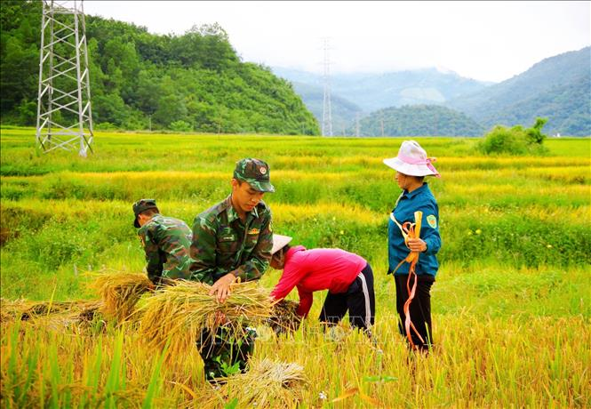

Vocabulary
harvest (v)
/ˈhɑːvɪst/
gặt hái,
thu hoạch

Slide 7
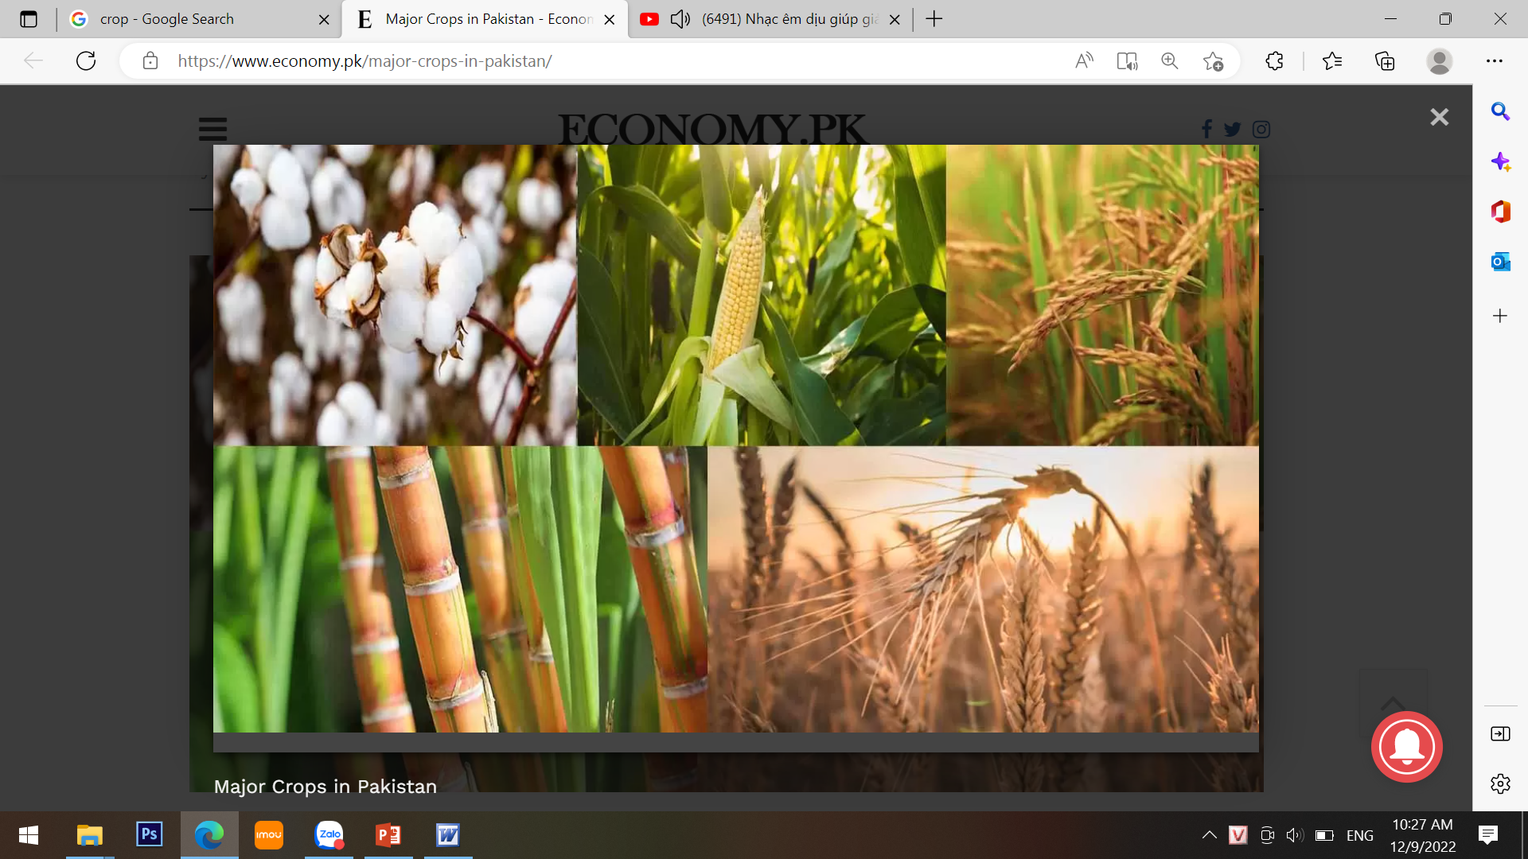
Vocabulary
crop (n)
/krɒp/
vụ mùa,
vụ trồng trọt

Slide 8
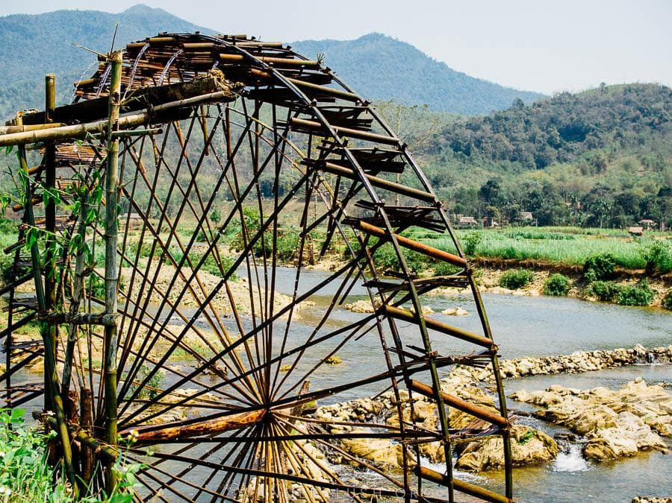
Vocabulary
waterwheel (n)
/ˈwɔːtəwiːl/
bánh xe nước

Slide 9
Ex 1 (p 43). Change the sentences into Yes / No questions.
Example:
The farmers are harvesting their crops in the fields.
S
tobe
→ Are
the farmers
harvesting their crops in the fields?

Slide 10
Ex 1 (p 43). Change the sentences into Yes / No questions.
01
02
03
Women play an important role in a Jrai family.
→ Do women play an important role in a Jrai family?
Mua sap is a popular folk dance of the Thai people.
→ Is mua sap a popular folk dance of the Thai people?
We didn't have boarding schools for minority students in 1950.
→ Did you/we have boarding schools for minority students in 1950?
I attended the Ban Flower Festival in Dien Bien last year.
02
→ Did you attend the Ban Flower Festival in Dien Bien last year?
We will watch a documentary about the Khmer.
03
→ Will you/we watch a documentary about the Khmer?

Slide 11

Ex 2 (p 43). Choose the correct question word for each question below
Questions | Question word | Explain
A: ___ do you like best about Sa Pa? B: I like its local markets best. | A. Why B. What
A: ___ can we find the most beautiful terraced fields? B: In Mu Cang Chai. | A. When B. Where
A: ___ is the Ban Flower Festival? B: It’s in spring. | A. When B. Why
A: ___ tall is an average stilt house? B: About 5 - 6 metres tall. | A. How B. What
A: ___ festival is more important for the Kinh: the Mid-Autumn or the Lunar New Year? B: The Lunar New Year. | A. What B. Which
1
B: I like + something + best
→ What
2
B: In Mu Cang Chai (place)
→ Where
3
B: in spring (season)
→ When
4
A: ___ tall
B: About 5 - 6 metres tall.
→ How
the Mid-Autumn or the Lunar New Year
→ Which N1 ….. N2 or N3?
5

Slide 12
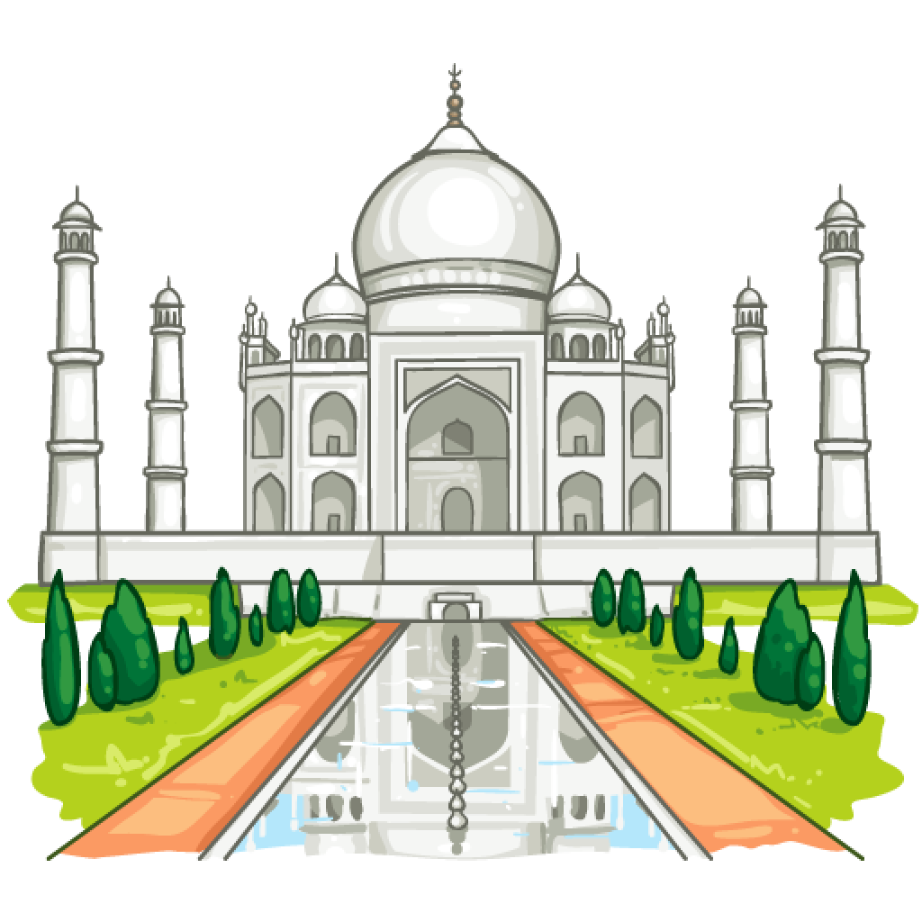

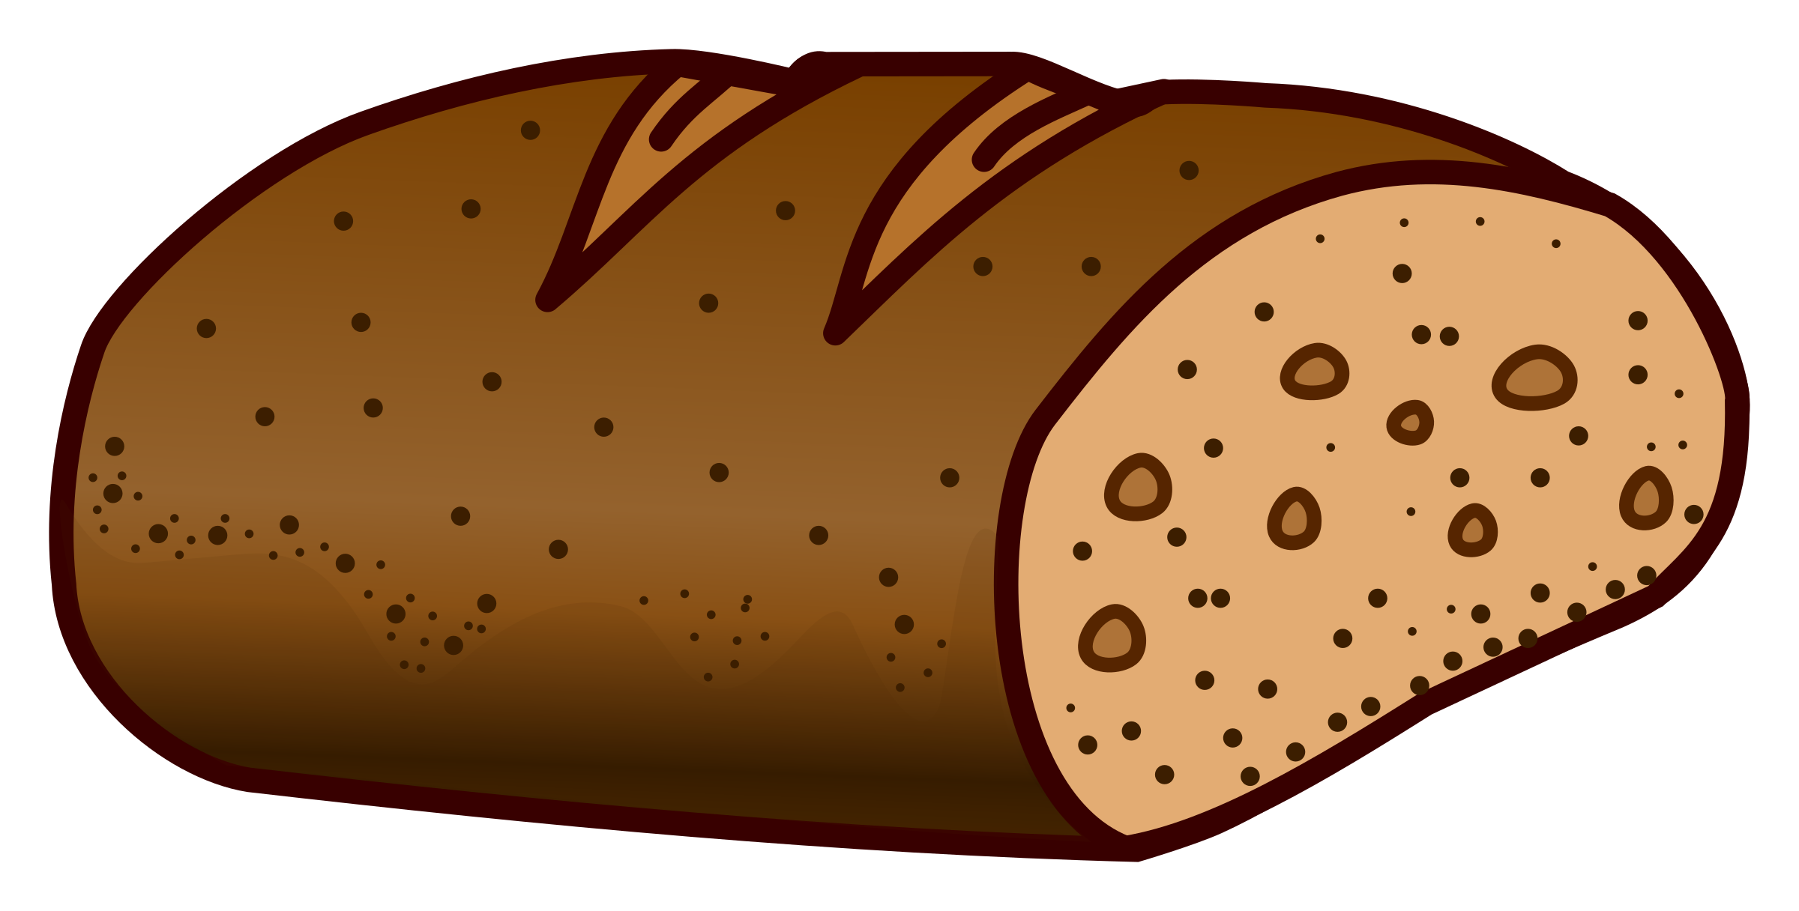
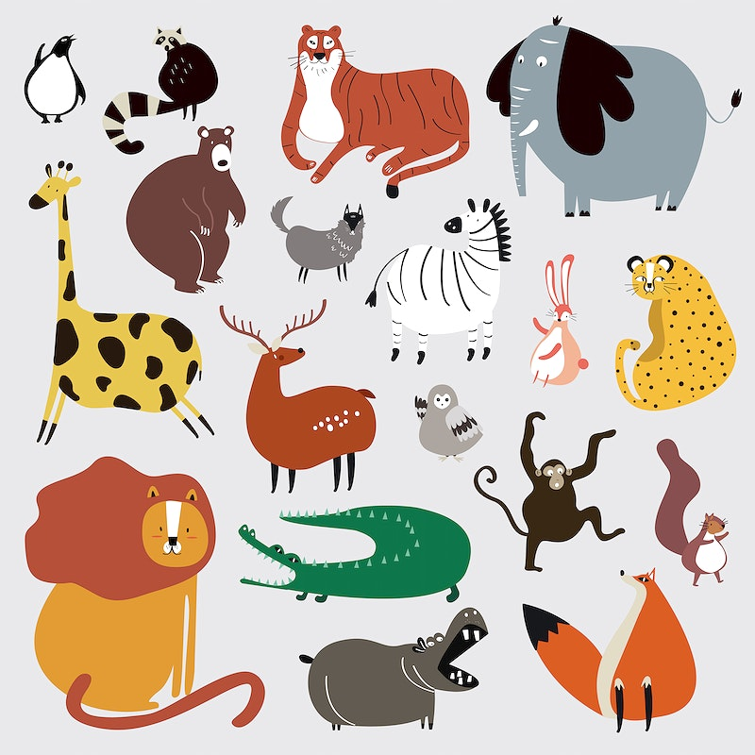


Matching
palace
knowledge
bread
bananas
animal
money
Countable noun
Uncountable noun
bananas
palace
knowledge
bread
money
animal

Slide 13
Definition
- They are individual people,
animals, places, things, or
ideas which can be counted.
- They can be singular or plural.
- They are substances, concepts
that we cannot divide into
separate elements, so they
cannot be counted.
- They are always singular.
Countable noun
Uncountable noun
bananas
palace
knowledge
bread
money
animal

Slide 14
Ex 3 (p 43). Write C (countable) or U (uncountable) for the underlined words.
Some minority (1) groups are farmers. They do not have much (2) land and they use simple farming techniques. After finding an (3) area for a garden, the men cut the (4) trees down and burn them. The (5) ash they collect helps enrich the soil. They then grow a few (6) crops like rice and corn. When the (7) soil becomes poor, they move to a new (8) place.
1.
2.
3.
4.
5.
6.
7.
8.
C
nhóm (thing, plural)
U
đất (substances, singular)
C
khu vực (place, singular)
C
cây (thing, plural)
U
tro (substances, singular)
C
vụ mùa (thing, plural)
U
đất (substances, singular)
C
địa điểm (place, singular)

Slide 15
Quantifiers
a
+ countable / singular noun – beginning consonant
Một
an
+ countable / singular noun – beginning vowel (u, e, o, a, i)
much
+ uncountable / singular noun
Nhiều
many
+ countable / plural noun
a little
+ uncountable / singular noun
Một chút, một ít, một vài
a few
+ countable / plural noun

Slide 16
Ex 4 (p 43). Fill in the blank with a, much, many, a little, or a few.
1. My uncle has _____coffee plantation in Kon Tum.
2. How _____ ethnic groups live on the Hoang Lien Son mountain range?
3. There are only _____ waterwheels left in my village.
4. You should add _____ more water to your noodles. It’s a bit dry.
5. How _____ information about the Van Kieu have you collected?
Đồn điền cà phê
(countable / singular noun)
a
many
Nhóm dân tộc thiểu số
(countable / plural noun)
a few
Bánh xe nước
(countable / plural noun)
a little
Nước (uncountable)
much
Thông tin (uncountable)
How much

Slide 17


Work in groups of two.
Leisure time | Tue | Living in the mountains | Thu
Countable | Uncountable | Countable | Uncountable
film | walking | stilt house | heat
Think of six nouns related to each of the topics
- 3 nouns are countable
- 3 nouns are uncountable
The group that comes up with the correct six words first wins.

Slide 18
CHOOSE THE BEST ANSWER
RECAP
1.
______pencil is this? Is it yours?
A. How
B. Which
C. Whom
D. Whose
2.
A: Have you got any money?
B: Yes,______. Do you want to borrow some?
A. many
B. a little
C. a few
D. much
3.
Which is uncountable noun?
A. mathematics
B. fish
C. waterwheel
D. boarding school
Môn toán
Cá/ đàn cá
Bánh xe nước
Trường nội trú

Slide 19
Thanks!
Do you have any questions?

Slide 20
Alternative resources
Here’s an assortment of alternative resources whose style fits that of this template:
Vectors
Sukkot frame template
Sukkot elements collection

