Slide 1
Unit 4.
Ethnic groups of Viet Nam
LESSON 6. SKILLS 2

Slide 2

Objectives
01
02
03
By the end of this lesson, students will be able to:
Use the lexical items related to the topic of the listening text.
Develop the skill of listening for specific information.
Write a paragraph about the things they do to help their family.

Slide 3

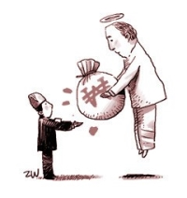
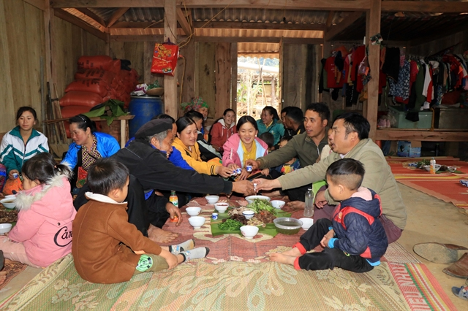

Vocabulary
Words | Pronunciation | Meaning | Vietnamese equivalent
1. gather (v)
/ˈɡæðər/
to come together in a group
tụ họp
2. pass on (v)
/pɑːs ɒn/
to pass down from generation to generation
để lại, truyền lại
3. legend (n)
/ˈledʒənd/
a very old story or set of stories from ancient times
truyền thuyết

Slide 4

Ex 1 (p 47). Match the phrases with the correct pictures.
1. catching fish
2. weaving clothing
3. growing crops

Slide 5


Ex 2 (p 47). Listen and tick ( ) the activities that minority children do to help their families.
They spend some of their time helping their parents inside and outside the house.
1. look after the house
2. weave clothing
Girls help look after the house, care for smaller children, weave clothing, and prepare food.
3. prepare food
4. build houses
Boys learn to do what their fathers do. They grow crops, raise the family's livestock, and catch fish.
5. grow crops
6. raise livestock

Slide 6

Ex 3 (p 47). Listen again and circle the correct answer A, B, or C.
1. Minority children usually learn to work at ______. A. twelve B. ten C. six 2. Girls ______. A. weave clothing B. do the gardening C. catch fish 3. Boys ______. A. prepare food B. raise livestock C. do housework 4. Children learn traditions through _____ A. work B. music C. stories 5. The number of minority children going to school is ______. A. going up B. going down C. staying the same

Slide 7
Ex 3 (p 47). Listen again and circle the correct answer A, B, or C.
1. Minority children usually learn to work at ______. A. twelve B. ten C. six 2. Girls ______. A. weave clothing B. do the gardening C. catch fish 3. Boys ______. A. prepare food B. raise livestock C. do housework
→ They learn to work from an early age, usually at six.
→ Girls help look after the house, care for smaller children, weave clothing, and prepare food.
→ Boys learn to do what their fathers do. They grow crops, raise the family's livestock, and catch fish.

Slide 8
Ex 3 (p 47). Listen again and circle the correct answer A, B, or C.
4. Children learn traditions through _____ A. work B. music C. stories 5. The number of minority children going to school is ______. A. going up B. going down C. staying the same
→ Children listen to stories or legends of heroes from their grandparents. They also listen to adults talk about their work. This is how the elders pass on traditions and knowledge to their children.
→ Nowadays, more and more minority children are going to school.

Slide 9
Writing
What do you do to help your parents?

Slide 10

Ex 4 (p 47). Serial Game.
1. Work individually in 2 minutes.
2. Note things you do to help your family as much as you can.
3. Take turn to show your answer but do not overlap with previous ones.

Slide 11

Ex 5 (p 47). Write a paragraph (80 - 100 words) about the things you do to help your family. Use the ideas in 4.
1
What are some of the daily tasks that you take care of to assist your family?
2
How do you show support to your family members?
Example:
Though I don’t have much time at home, I try my best to do something to help my family. I take out the garbage, dust the room, make my bed and pick up books and toys that are lying on the floor. I also help my mother with cooking dinner and my family likes my food so much. Sometimes I ask my family members if they need help. If I have more time stay at home, I would love to help my family with more housework.

Slide 12
Peer-checking
Does paragraph have enough ideas?
Does he/she use word phrases correctly?
Does he/she have spelling mistakes?
Do you have any other suggestions for the paragraph?

Slide 13
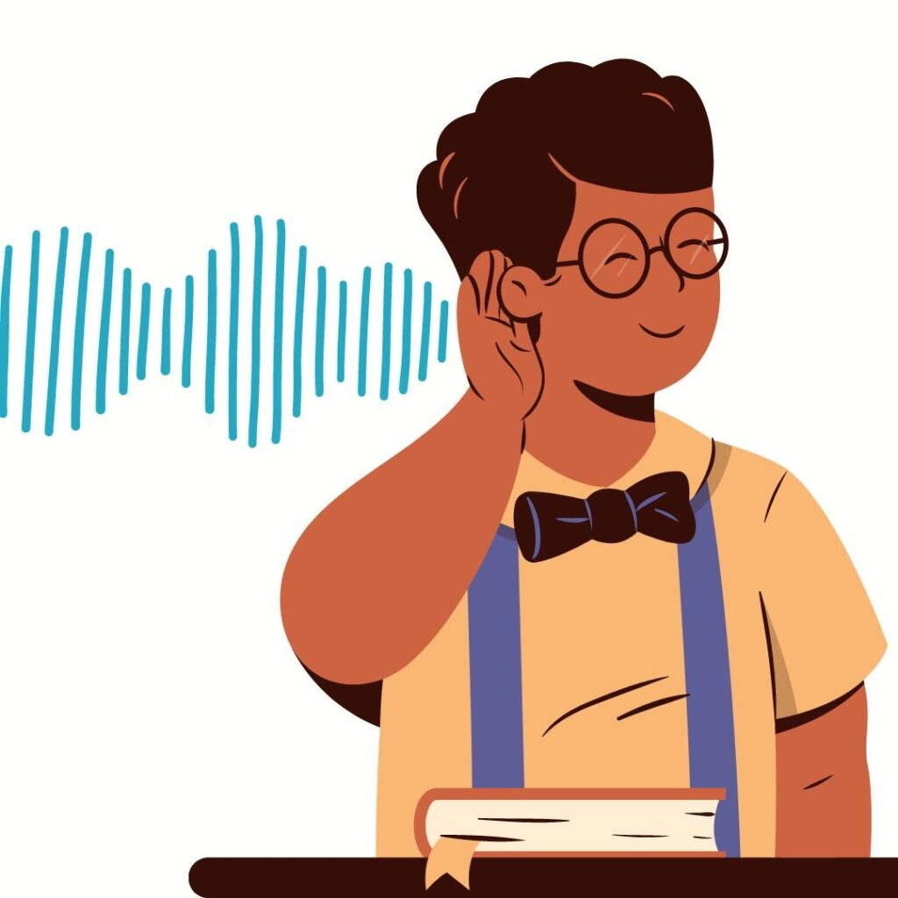

RECAP
LISTENING
WRITING
listen for general and special information about the things the children do to help their family.
write a paragraph about the things they do to help their family.

Slide 14
Thanks
Do you have any questions?

