Slide 1

Unit 7: NATURAL WONDERS OF THE WORLD
LESSON 5: SKILLS 1

Slide 2
OBJECTIVES
By the end of the lesson, students will be able to:
1. READING
Read for specific information about the Dolomites - a travel destination.
2. SPEAKING
Talk about the Great Barrier Reef.

Slide 3

NEW WORDS
majestic (adj)
= beautiful, powerful
/məˈdʒestɪk/
E.g. The majestic Montana scenery will leave you breathless.
uy nghi, tráng lệ

Slide 4
NEW WORDS
occur (v)
= happen (especially unexpected events)
/əˈkɜː/
E.g. I hope this never occurs again, but I'm prepared if it does.
xảy ra

Slide 5

NEW WORDS
New words | Pronunciation | Meaning
1. majestic (adj) | /məˈdʒestɪk/ | uy nghi, tráng lệ
2. occur (v) | /əˈkɜː/ | xảy ra

Slide 6
01
READING

Slide 7
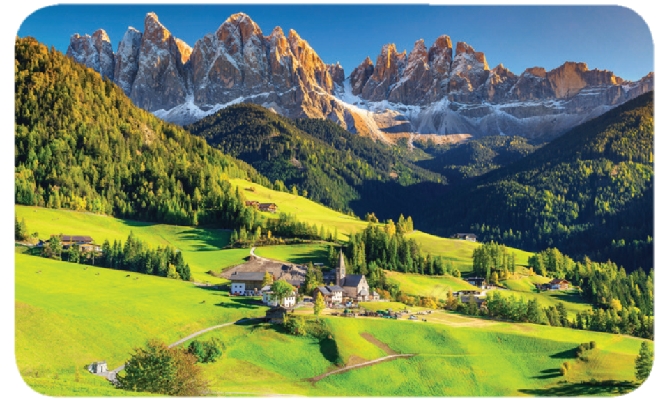
Ex1: Work in groups. Look at the picture and answer the questions.
1. What do you see in the picture?
2. What activities do you think visitors can do there?

Slide 8
Ex1: Work in groups. Look at the picture and answer the questions.
1. What do you see in the picture?
Beautiful nature: snow-covered mountains, forests, green grass, nice houses at the foot of the mountain, …

Slide 9
Ex1: Work in groups. Look at the picture and answer the questions.
2. What activities do you think visitors can do there?
Cycling, walking, climbing mountains, skiing, trekking, taking pictures, camping, …

Slide 10
The Dolomites – Paradise at Your Feet
Ex2: Read the text and match the highlighted words with their meanings or explanations
If you haven’t decided on where to travel this holiday, consider the Dolomites!
The Dolomites are a mountain range in Italy. It was recognised as a UNESCO World Heritage Site in 2009. The Dolomites are part of the Alps, stretching from the Adige River to the Piave River valley. This mountain range has a total area of about 141,900 hectares. It has 18 peaks over 3,000 metres high. It is easy to get access to most parts of the Dolomites.

Slide 11
The Dolomites are a majestic site. They are widely regarded as being among the most attractive mountain landscapes in the world. There are steep rocky cliffs, sharp peaks, narrow and deep valleys, and white snow on the mountain top. Their natural scenery attracts tourists from many parts of the world.
The Dolomites are a popular place for winter skiing, mountain climbing, hiking, and cycling any time of the year. An annual bicycle race covering seven mountain passes on the Dolomites occurs in the first week of July. So do not hesitate to book a tour to the Dolomites to see and do these things for yourself!

Slide 12
Ex2: Read the text and match the highlighted words with their meanings or explanations
1. consider
1 – c
a. impressive, magnificent
nghĩ về
2. peaks
2 – d
b. happens
đỉnh, đỉnh núi
c. to think about something carefully
3. majestic
3 – a
uy nghi tráng lệ
4. occurs
4 – b
d. pointed tops, mountains
xảy ra

Slide 13
Ex3: Read the text again and choose the correct answer to each question.
1. According to the text, the Dolomites are a ______.
River
Work of art
Mountain range
Valley
2. The word “hesitate” in the last sentence of the text is closest in meaning to ______
Be unhappy
Be indecisive
Hurry
Decide
The Dolomites are a mountain range in Italy.
Không vui
Không quyết đoán
Nhanh lên
Quyết định
Hesitate: do dự

Slide 14
Ex3: Read the text again and choose the correct answer to each question.
3. Which of the following is NOT true, according to the text?
A. The Dolomites are in Italy.
B. You can get access to the Dolomites easily.
C. The Dolomites are a World Heritage Site.
D. You can cycle in the Dolomites only in July.
4. This text is probably taken from ______.
A. a travel brochure
B. a science journal
C. a novel
D. an arts magazine
The Dolomites are a popular place for winter skiing, mountain climbing, hiking, and cycling any time of the year.
So do not hesitate to book a tour to the Dolomites to see and do these things for yourself!

Slide 15
02
SPEAKING

Slide 16
Ex4: Work in pairs. Ask and answer about the Great Barrier Reef, using the facts below. Then prepare a short talk about it.
- Work in pairs.
- One asks questions, and the other answers, then they swap roles.
World Heritage Site (1981)
Total area: about 334,400 km²
Location: the Coral Sea, Australia
Over 400 different types of corals
Tourists’ activities: coral watching, sailing, scuba diving

Slide 17

Ex4: Work in pairs. Ask and answer about the Great Barrier Reef, using the facts below. Then prepare a short talk about it.
Suggest answer:
When did the Great Barrier Reef become a World Heritage Site?
In 1981.
In the Coral Sea, Australia.
Where is it located?

Slide 18
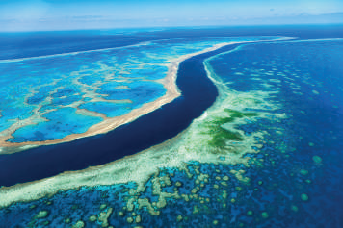
Ex5: Work in groups. Introduce the Great Barrier Reef to the class.
Look at the sentences given, and think how to continue the talk, and what to say.
Work in groups to use the answers in 4 and the vocabulary learnt in the unit to talk about the Great Barrier Reef.

Slide 19
Ex5: Work in groups. Introduce the Great Barrier Reef to the class.
Suggested answer:
The Great Barrier Reef is a World Heritage Site. It was recognised by UNESCO in 1981. It’s located in the Coral Sea, Australia. The total area of this reef is about 334,400 km². There are over 400 different types of corals living in the site. When you come here, you can take part in a lot of activities: coral watching, sailing, scuba diving, and so on. The Great Barrier Reef is the world's biggest single living structure. But this natural wonder is now in danger, and it needs much effort to protect it from damage.

Slide 20
Wrap – up
What have we learnt in this lesson?
Read for specific information about the Dolomites - a travel destination.
Talk about the Great Barrier Reef.

Slide 21
THANK YOU!

