Slide 1
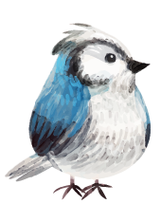


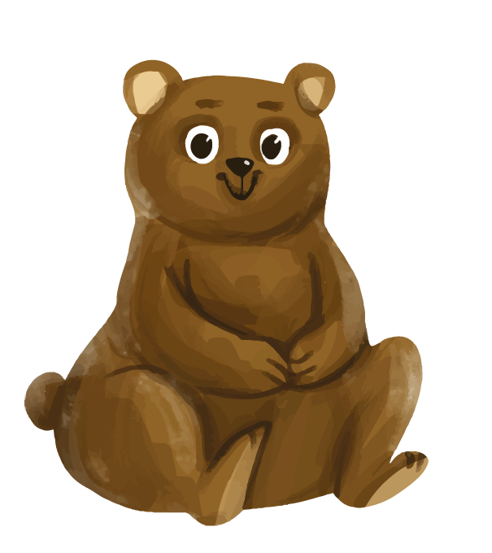
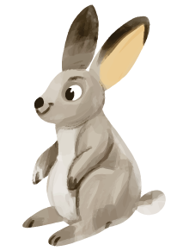
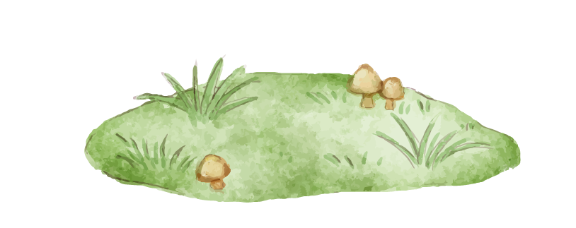


Unit 7: NATURAL WONDERS OF THE WORLD
LESSON 6: SKILLS 2

Slide 2
OBJECTIVES
In this lesson, students have learned to:
Listening
Listen for specific information about the Amazon Rainforest;
Writing
Write about a natural wonder / landscape in their area.

Slide 3

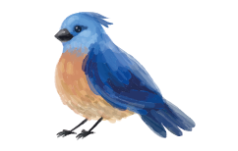


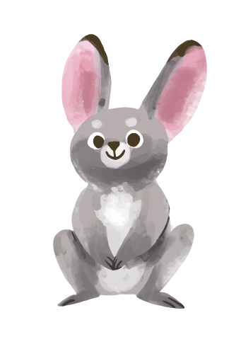
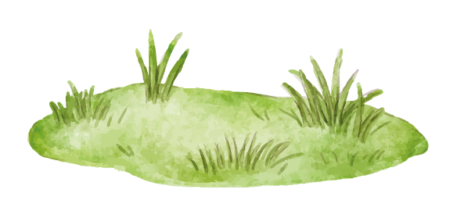

01
LISTENING
Listen for specific information about the Amazon Rainforest

Slide 4
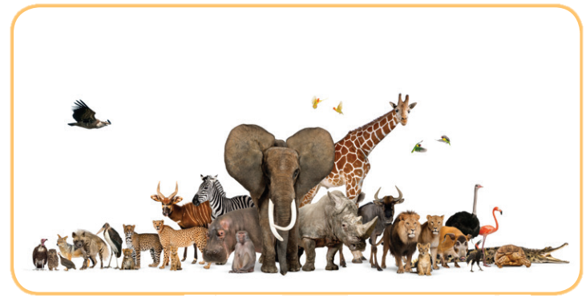
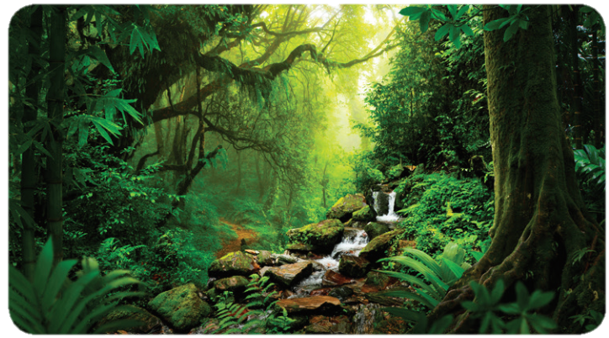
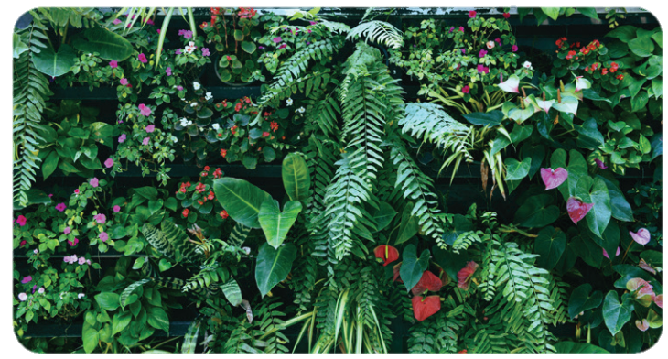
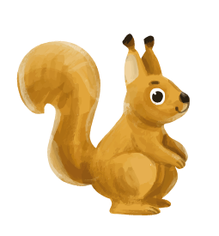
Ex1: Write a word from the box under the correct picture.
a. rainforest
b. flora
c. fauna

Slide 5
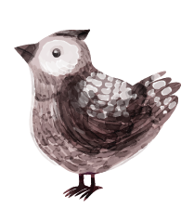

Ex2: Listen to the passage and tick the things you hear.
- Green lung of the world
- Causing climate change
- Threats to biodiversity
- Planting trees
- Exploring ecosystems
- Protecting wildlife

Slide 6
Ex2: Listen to the passage and tick the things you hear.
- Green lung of the world
- Causing climate change
- Threats to biodiversity
✓
✓
The Amazon Rainforest is home to the most biological diversity, serving as the green lung of the world.
The Amazon also helps to slow climate change.
Today, the biodiversity off this region is threatened.

Slide 7
Ex2: Listen to the passage and tick the things you hear.
- Planting trees
- Exploring ecosystems
- Protecting wildlife
✓
✓
They plant trees and establish parks to protect rainforests and wildlife.
Governments and the communities living in the area are doing a lot to restore damaged ecosystems.
They plant trees and establish parks to protect rainforests and wildlife.

Slide 8
Ex3: Listen again and choose the correct answers.
1. The Amazon Rainforest is rich in ______. A. rivers and forests
B. flora and fauna
C. climate change
2. The threats to biodiversity are deforestation, fires, and extinction of rare animal ______.
A. flora
B. fauna
C. species
3. Which activity can governments and communities do to restore damaged ecosystems? A. Punishing loggers.
B. Establishing parks.
C. Putting out fires.
4. Governments are encouraging people to live in a way that doesn’t hurt the ______.
A. environment
B. animals
C. marine life

Slide 9
Ex3: Listen again and choose the correct answers.
1. The Amazon Rainforest is rich in ______. A. rivers and forests
B. flora and fauna
C. climate change
2. The threats to biodiversity are deforestation, fires, and extinction of rare animal ______.
A. flora
B. fauna
C. species
The Amazon possesses more than half of our world’s tropical forest areas. It is very rich in flora and fauna.
These threats include illegal logging, deforestation, fires, and rare animal species extinction.

Slide 10
Ex3: Listen again and choose the correct answers.
3. Which activity can governments and communities do to restore damaged ecosystems? A. Punishing loggers.
B. Establishing parks.
C. Putting out fires.
4. Governments are encouraging people to live in a way that doesn’t hurt the ______.
A. environment
B. animals
C. marine life
Governments and the communities living in the area are doing a lot to restore damaged ecosystems. They plant trees and establish parks to protect rainforests and wildlife.
They also encourage people to live in a way that doesn’t hurt the environment.

Slide 11
Audio script
The Amazon Rainforest is a magnificent area. It is the largest tropical forest on earth. The Amazon possesses more than half of our world’s tropical forest areas. It is very rich in flora and fauna.
The Amazon Rainforest is home to the most biological diversity, serving as the green lung of the world. It contributes to the production of one – fifth of the oxygen in our atmosphere. The Amazon also helps to slow climate change. For these reasons, the Amazon ranks among seven natural wonders of the world. It has so many things which are especially important for our earth and our future.
Today, the biodiversity off this region is threatened. These threats include illegal logging, deforestation, fires, and rare animal species extinction. Protecting wild species and the wild place where they live is so urgent for us. Governments and the communities living in the area are doing a lot to restore damaged ecosystems. They plant trees and establish parks to protect rainforests and wildlife. They also encourage people to live in a way that doesn’t hurt the environment.

Slide 12
02
WRITING
Write about a natural wonder / landscape in their area.

Slide 13
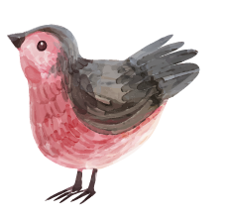
Ex4: Work in pairs. Brainstorm ideas about a natural wonder/beautiful landscape in your area. Ask and answer about it, using the following prompts.
- Think of a natural wonder / beauty spot / landscape in your area.
- Work in pairs. One asks questions and one answers, based on the following cues:
– Name of the natural wonder / beautiful landscape
– Location
– Natural features
– Activities
– Ways to protect it

Slide 14
Ex4: Work in pairs. Brainstorm ideas about a natural wonder/beautiful landscape in your area. Ask and answer about it, using the following prompts.
– Name of the natural wonder / beautiful landscape
– Location
– Natural features
– Activities
– Ways to protect it
What is it / is its name?
Where is it located?
What are its natural features?
What (activities) can visitors do there?
What are the ways to protect it?

Slide 15
Ex5: Write a paragraph (100 - 120 words) about the natural wonder/ beautiful landscape you have talked about in 4.
- Use the ideas in Activity 4 for your writing.
There is a beautiful ___________________________ near my home. __________________________________________________________________________________________________
____________________________________________________________________________________________________________________________________________________________________________________________________

Slide 16
Ex5: Write a paragraph (100 - 120 words) about the natural wonder/ beautiful landscape you have talked about in 4.
Suggested answer:
There is a beautiful river near my home. It is called Dong Son River. It is not very large, but it is nice and peaceful. On the right bank of the river near my village, there are rice fields and patches of green grass. There are also bushes and a lot of wild flowers. At weekends, a lot of people gather here for entertainment. Young people go camping and have a picnic. Old people may spend their time fishing or playing chess. Many swim in the river or row a boat on it. This place is becoming more and more popular, so it is more and more crowded. I think the authorities need to do something to protect this natural beauty.

Slide 17
SWAP AND CHECK
Check for spelling
Do the words spell correctly?
Check for ideas
Did your friend write about the natural wonder/ beautiful landscape your friend have talked about in 4?
Check for comprehension
Does the writing make sense?
Check for grammar
Does the writing use the correct tenses and structures?

Slide 18
WRAP – UP
What have we learnt in this lesson?
Listening
Listen for specific information about the Amazon Rainforest;
Writing
Write about a natural wonder / landscape in their area.

Slide 19
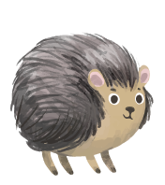

THANK YOU!

