Slide 2

Unit 9. Cities of the World
Lesson 6 – Skills 2 (page 33)

Slide 3
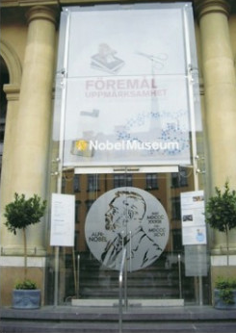
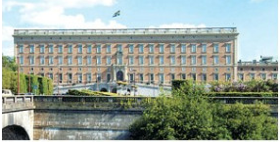
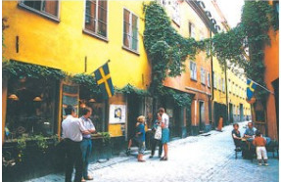
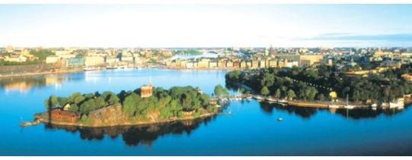
I. Listening
Activity 1 (page 33): Look at the pictures. What do you see?

Slide 4
Activity 2 (page 33): Listen and tick (✓) True (T) or False (F).
 | T | F
1. The Royal Palace is one of the largest palaces in Europe.
2. The biggest part of Stockholm is the Old Town.
3. Today, the Old Town doesn’t have any cafés, restaurants or shops.
4. The Nobel Peace Prize is awarded in Stockholm.
5. The Nobel Prize is presented by the Swedish Prime Minister.
✓
✓
oldest
✓
Today, the Old Town is a place with cafés, restaurant, shops and museums.
All Nobel Prizes, except for the Nobel Peace Prize, are awarded in Stockholm.
✓
✓
It is presented by the Swedish King.

Slide 5
Activity 3 (page 33): Listen again to the talk and fill in the gaps.
1. The city of Stockholm covers _____islands.
2. It has ____________ years of history.
3. There are about ____________ people living in the Old Town today.
4. Nobel prizewinners receive their awards on
____________.
5. The award consists of a Nobel diploma, a medal, and ____________ Swedish crowns.
14
700
3000
10th December
10 million

Slide 6
II. Writing
Activity 4 (page 33): Rearrange the words to make sentences.
Stockholm/fantastic/is/!
2. Da Lat/we’re/in/!
3. a good time/we’re/having/here/!
4. love/I/Disneyland/!
5. must/come/you/!
6. you/wish/I/were/here/!
Stockholm is fantastic!
We’re in Da Lat!
We’re having a good time here!
I love Disneyland!
You must come!
I wish you were here!

