Slide 1

Friday, February 21st 2025
UNIT 8: SPORTS AND GAMES
Period 62: LESSON1 : GETTING STARTED
At the gym

Slide 2
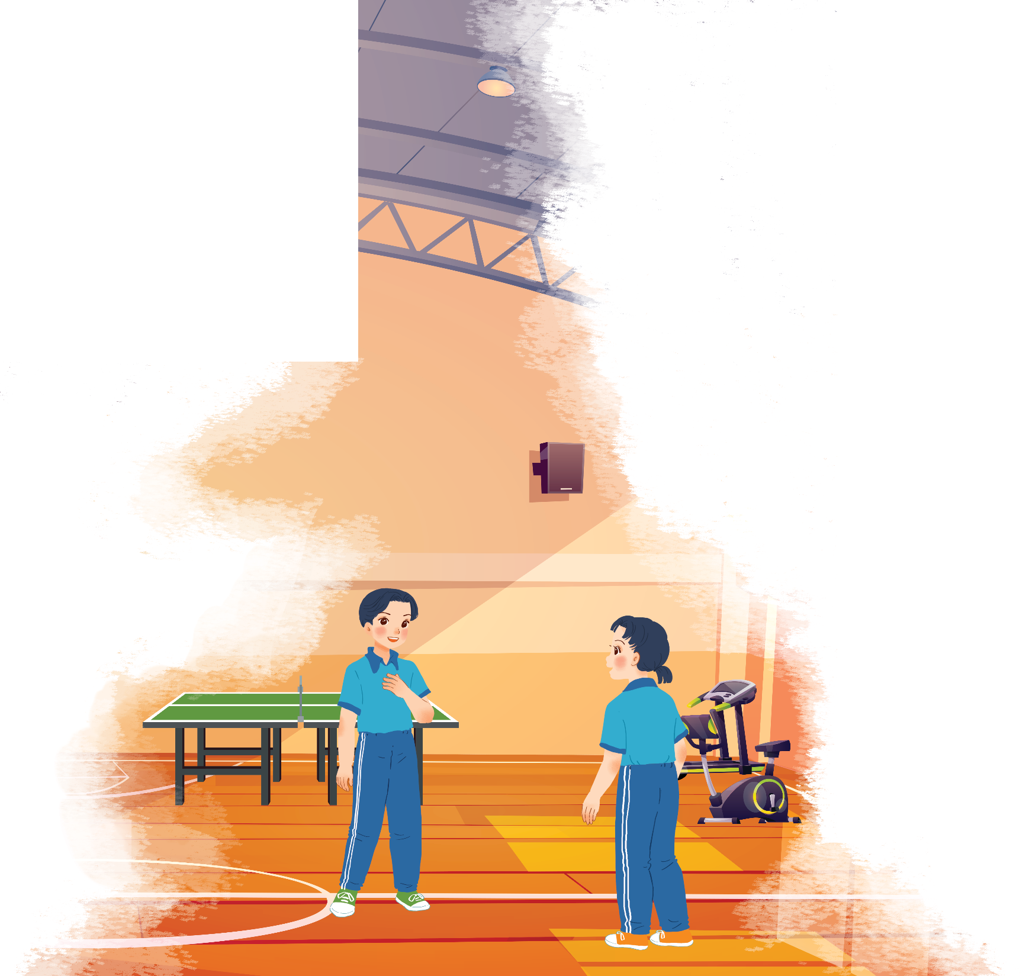


Listen and read.
At the gym
- Who are they in the picture ?
They are Duong and Mai.
- Where are they?
They are at the gym.
- What are they talking about?
They are talking about
some sports and games
Duong
Mai

Slide 3

Listen and read.
At the gym
Duong: Wow! This gym is big!
Mai: Yeah. The equipment is great. What sports do you do, Duong?
Duong: Well, I do karate, and I play table tennis. Yesterday I played with Duy, and I won!
Mai: Congratulations! You look fit! I’m not good at sports.
Duong: I have an idea – you can go to the karate club with me.
Mai: No, I can’t do karate.
Duong: But you can learn! You’ll love it.
Mai: Well ... OK.
Duong: Great! I’ll meet you there at 10 a.m on Sunday.
Mai: Where’s the club?
Duong: It’s Superfit Club, in Pham Hung Road. You can cycle there.
Mai: OK. See you then.

Slide 4

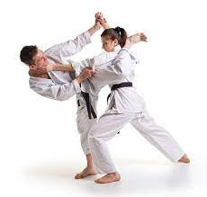
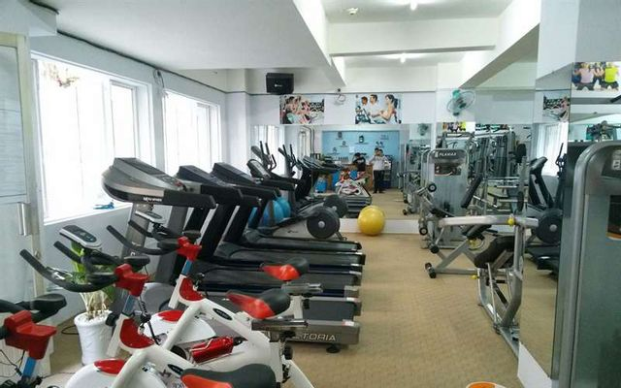
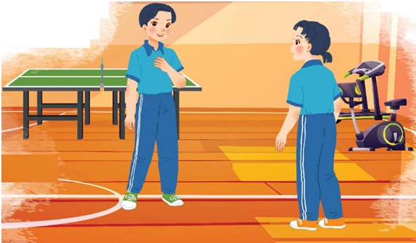
* Vocabulary
- gym (n)
/dʒɪm/
: phòng tập thể dục
- equipment (n)
/ɪˈkwɪpmənt/
:dụng cụ, thiết bị
- karate (n)
/kəˈrɑːti/
: môn võ karate
- fit (a)
/fit/
:khoẻ mạnh, cân đối

Slide 5
* Checking vocabulary : Matching

Slide 6
* Matching
1.gym
2.fit
3.equipment
4. karate
a
b
c

Slide 7
Listen and read.
At the gym
Duong: Wow! This gym is big!
Mai: Yeah. The equipment is great. What sports do you do, Duong?
Duong: Well, I do karate, and I play table tennis. Yesterday I played with Duy, and I won!
Mai: Congratulations! You look fit! I’m not good at sports.
Duong: I have an idea – you can go to the karate club with me.
Mai: No, I can’t do karate.
Duong: But you can learn! You’ll love it.
Mai: Well ... OK.
Duong: Great! I’ll meet you there at 10 a.m. on Sunday.
Mai: Where’s the club?
Duong: It’s Superfit Club, in Pham Hung Road. You can cycle there.
Mai: OK. See you then.

Slide 8



Put ONE word from the conversation in each gap.
1. Duong looks ................ He often does karate.
2. Mai likes going to the............... The equipment there is great
3. Duong played .................... with Duy yesterday,
and he won.
4. Mai and Duong are going to meet at Superfit ............... on Sunday.
5. Mai will…………to Superfit Club.

Slide 9




3
4
Lucky apple?
2
5
6
1
7

