Slide 1



WELCOME TO OUR CLASS!
7
LESSON 3: A CLOSER LOOK 2

Slide 2
REVISION
- Tell me the use of “who, which and whose”.
Eg: The teacher who is sitting over there is very creative.
-> who
-> which
-> whose
: refers to people.
Eg: She is living in the house which has beautiful yard.
: refers to things or animals.
Eg: She is the teacher whose children are intelligent.
: indicates possession for people or things.

Slide 3
What do you call the underlined parts in the sentences?
They are relative clauses.
Eg: The teacher who is sitting over there is very creative.
Eg: She is living in the house which has beautiful yard.
Eg: She is the teacher whose children are intelligent.

Slide 4

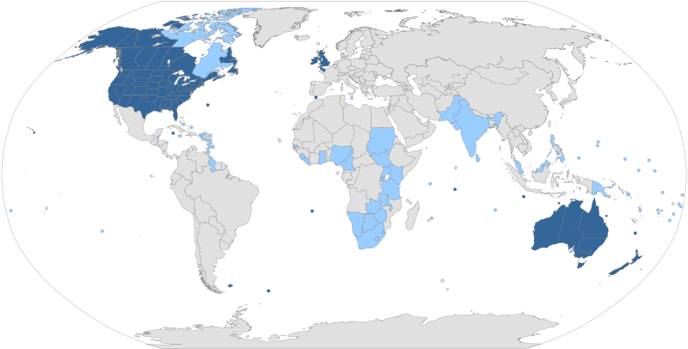
UNIT 9: WORLD ENGLISHES
LESSON 3: A CLOSER LOOK 2

Slide 5
GRAMMAR: DEFINING RELATIVE CLAUSES
- Look at the sentence:
“She is living in the house which has a beautiful yard.”
+ What does a relative clause tell us?
-> A relative clause tells us more about people and things.
+ What does it usually start with?
->It usually starts with a relative pronoun.
+ Why are defining relative clauses important?
-> Defining relative clauses give us essential information.
Without this information, people are not clear which person(s) or thing(s) we are talking about.
- Answer the questions:

Slide 6

1
A relative clause tells us more about people and things. It usually starts with a relative pronoun.
Defining relative clauses give us essential information. Without this information, people are not clear which person(s) or thing(s) we are talking about.
Example:
– The teacher who taught me my first words in English is Mr Vinh.
– He gave me the dictionary which you suggested.

Slide 7
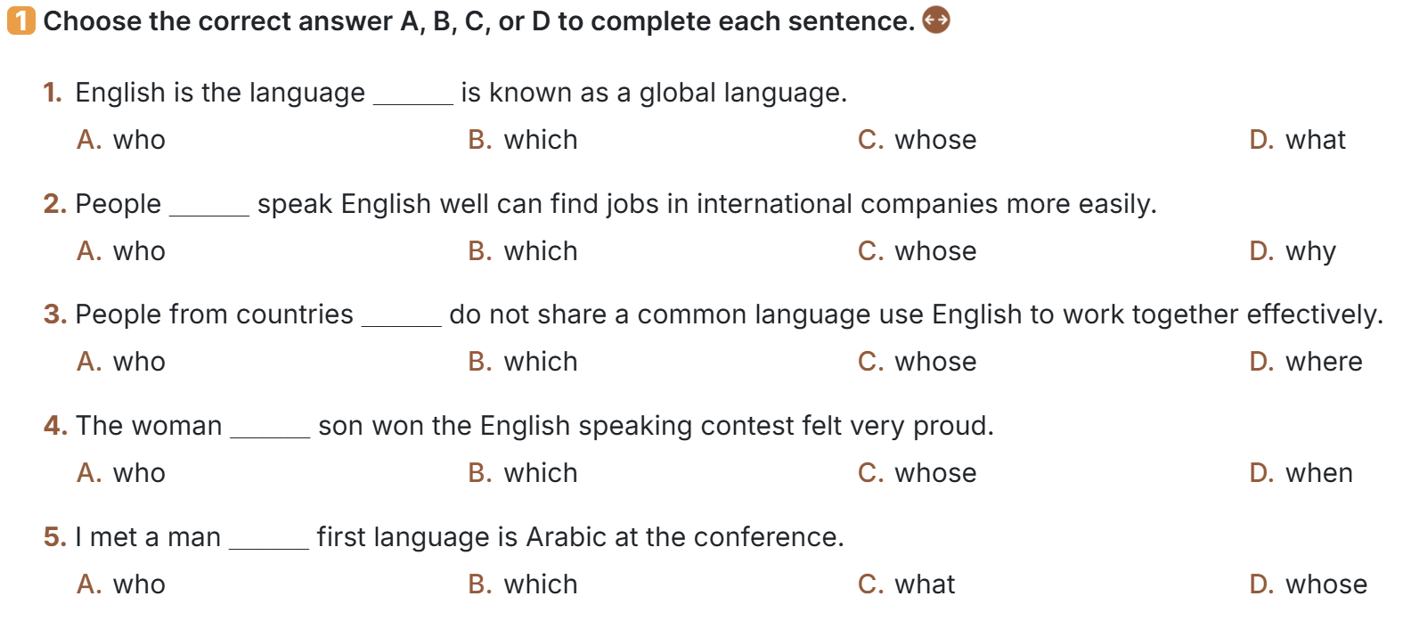

Slide 8
1
Choose the correct answer A, B, C, or D to complete each sentence.
1. English is the language ______ is known as a global language.
A. who
C. whose
B. which
D. that
(refers to a thing)
2. People ______ speak English well can find jobs in international companies more easily.
A. who
C. whose
B. which
D. why
(refers to people)

Slide 9
1
Choose the correct answer A, B, C, or D to complete each sentence.
3. People from countries ______ do not share a common language use English to work together effectively.
A. who
C. whose
B. which
D. where
(refers to things)
4. The woman ______ son won the English speaking contest felt very proud.
A. who
C. whose
B. which
D. when
(refers to possession)

Slide 10
PRACTICE
1
Choose the correct answer A, B, C, or D to complete each sentence.
5. I met a man ______ first language is Arabic at the conference.
A. who
C. what
B. which
D. whose
(refers to possession)

Slide 11
2
The relative pronoun who or which can be the subject or the object of the relative clause. We must use it when it is the subject of the relative clause. We can omit it if it is the object.
Example:
– The man who is talking to the girl is bilingual in English and French.
V →must use who
– The man who you met this morning is bilingual in English and French. S V
→can omit who
S
O

Slide 12
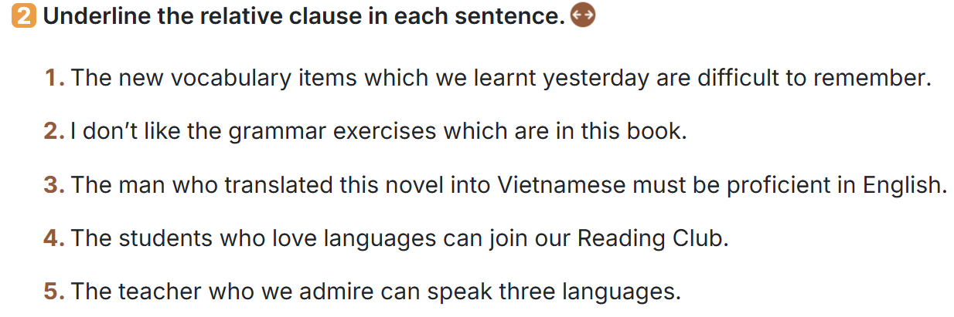
a. Underline the relative clause in each sentence.

Slide 13
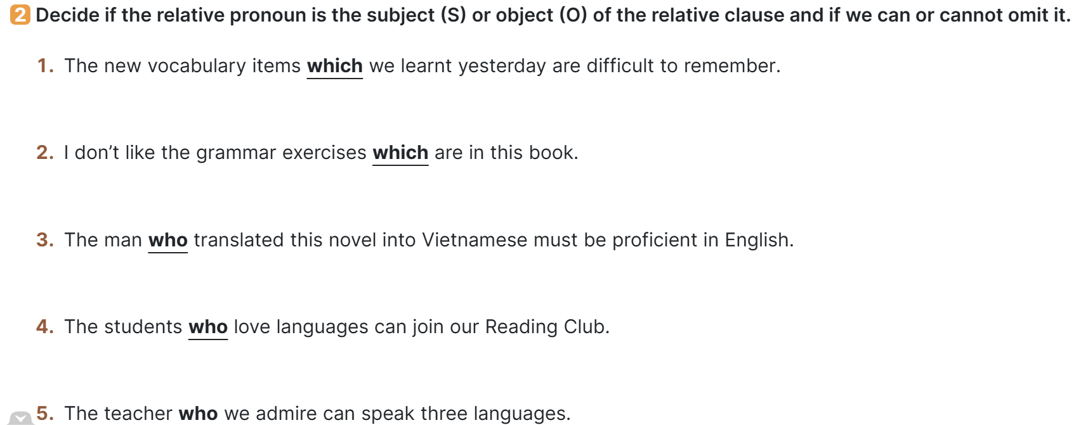
2 b. Decide if the relative pronoun is the subject (S) or
object (O) of the relative clause and if we can or cannot omit it.

Slide 14
PRACTICE
2
b. Decide if the relative pronoun is the subject (S) or
object (O) of the relative clause and if we can or cannot omit it.
1. The new vocabulary items which we learnt yesterday are difficult to remember.
O -> can omit
2. I don’t like the grammar exercises which are in this book.
S -> must use
3. The man who translated this novel into Vietnamese must be proficient in English.
S -> must use

Slide 15
PRACTICE
2
b. Decide if the relative pronoun is the subject (S) or
object (O) of the relative clause and if we can or cannot omit it.
4. The students who love languages can join our Reading Club.
S -> must use
5. The teacher who we admire can speak three languages.
O -> can omit

Slide 16
PRACTICE
3
Are these sentences right or wrong? Correct them if necessary.
E.g.
x
1. My sister doesn’t like films have unhappy endings.
S
V
-> My sister doesn’t like films which have unhappy endings.

Slide 17

PRACTICE
3
Are these sentences right or wrong? Correct them if necessary.
2. What is the name of the man who is the director of the language centre?
refers to a person
3. One of the four official languages people use in Singapore is English.
= One of the four official languages which people use in Singapore is English.
refers to things
S V

Slide 18
PRACTICE
3
Are these sentences right or wrong? Correct them if necessary.
4. I like the English lesson which Ms Oanh taught yesterday.
S V
refers to a thing
5. Students who grades are high can compete in this contest.
-> whose (refers to possession)

Slide 19
PRACTICE
4
Combine the two sentences into one, using a relative pronoun.
1. The guide said to them: “Is it your first time here?”
1. I met a woman. Her husband is a famous linguist
=>
______________________________________________________________________________________________________.
I met a woman whose husband is a famous linguist.
2. Olivia asked the guide: “Do the people live on fishing?”
2. My friend’s father gave us the tickets. He owns a travel agency.
=>
______________________________________________________________________________________________________.
My friend's father, who owns a travel agency, gave us the tickets.

Slide 20
PRACTICE
4
Combine the two sentences into one, using a relative pronoun.
3. The grammar exercise was very complicated. Nobody could do it.
1. The guide said to them: “Is it your first time here?”
The grammar exercise (which) nobody could do was very complicated.
______________________________________________________________________________________________________.
=>
2. Olivia asked the guide: “Do the people live on fishing?”
4. I study English in a language school. It is in the centre of the city.
______________________________________________________________________________________________________.
I study English in a language school which is in the centre of the city.
=>

Slide 21
PRACTICE
4
Combine the two sentences into one, using a relative pronoun.
5. The student completed the quiz the fastest. The teacher praised him.
1. The guide said to them: “Is it your first time here?”
The student (who) the teacher praised completed the quiz the fastest.
______________________________________________________________________________________________________.
=>
2. Olivia asked the guide: “Do the people live on fishing?”
______________________________________________________________________________________________________.

Slide 22


PRODUCTION
5
Game: Clues for you. Work in two teams. A student from each team gives clues about an object or a person in class, using a relative clause. Students from the other team guess which object or person it is.
- Work in teams.
- A student from each team gives clues about an object or a person in class, using relative clauses.
- Students from the other team guess which object or person it is.

Slide 23
EXTRA ACTIVITY
Example:
bilingual (n)
Definition: A bilingual is a person who can speak two languages equally well.

Slide 24

CONSOLIDATION
1
Wrap-up
What have we learnt in this lesson?
-> Defining relative clauses.

Slide 25

2
Homework
- Write “Remember” – p95 in your notebook, translate them into Vietnamese and learn them by heart.
- Make 5 sentences using defining relative clauses.

Slide 26
EXTRA ACTIVITY
Relative clauses challenge
- Work in groups.
- Each group is given some words related to places, animals, things, etc.
- Write definitions of the words.
- Read out their definitions and vote for the best one(s) (you can’t vote for your own definition).

Slide 27
PRODUCTION
5
Example:
This is something which we write with.
Is it a pen?
Yes, it is.

Slide 28
Website: hoclieu.vn
Fanpage: facebook.com/tienganhglobalsuccess.vn/

