Slide 1
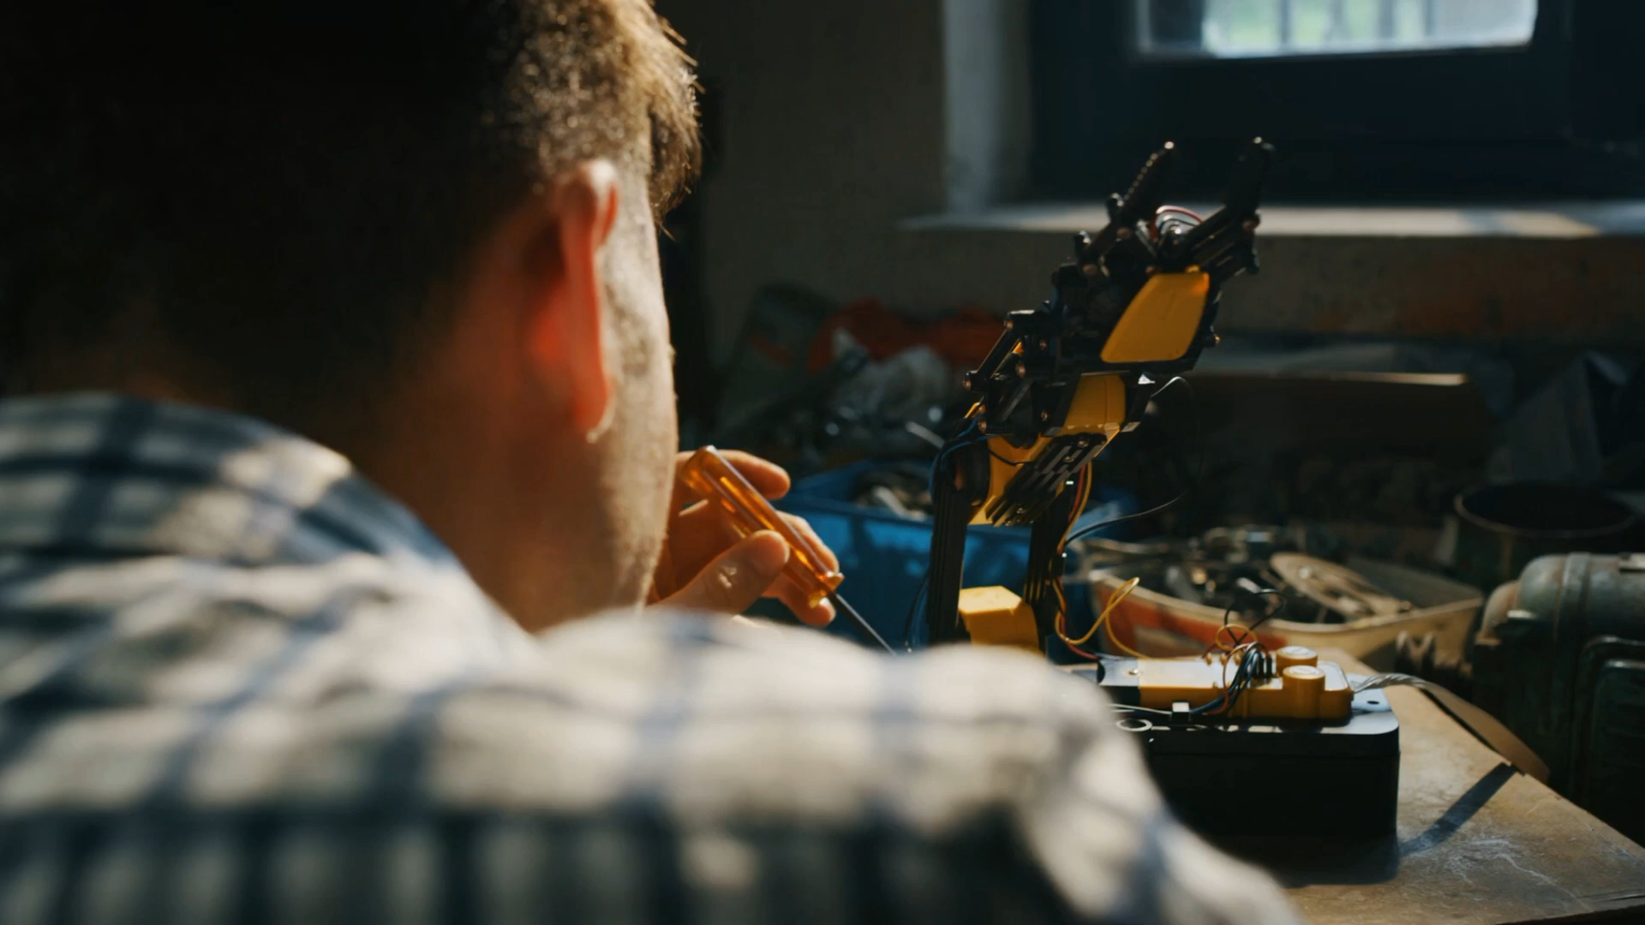
What is the clip about?

Slide 2
Unit 11
Science and Technolody
Lesson 1. Getting started

Slide 3
Objectives
By the end of this lesson, Ss will be able to gain:
01.
02.
An overview about the topic Science and technology
Vocabulary to talk about Science and technology

Slide 4
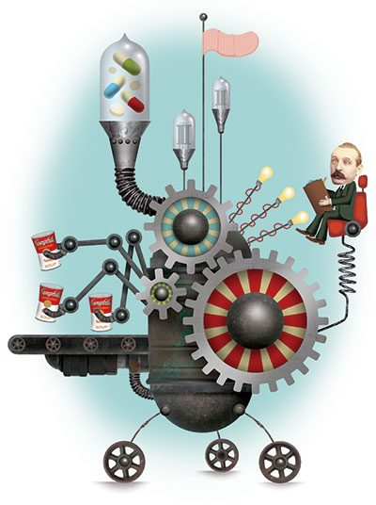
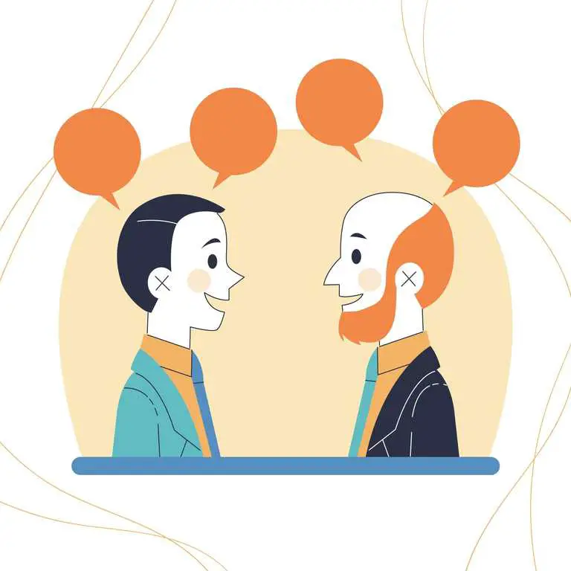
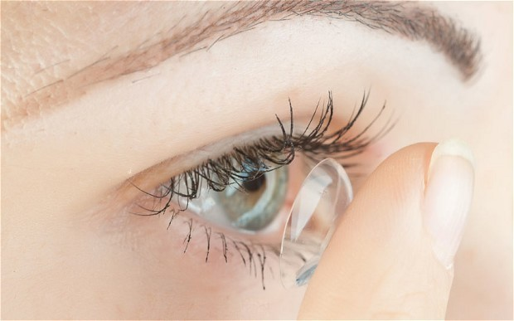
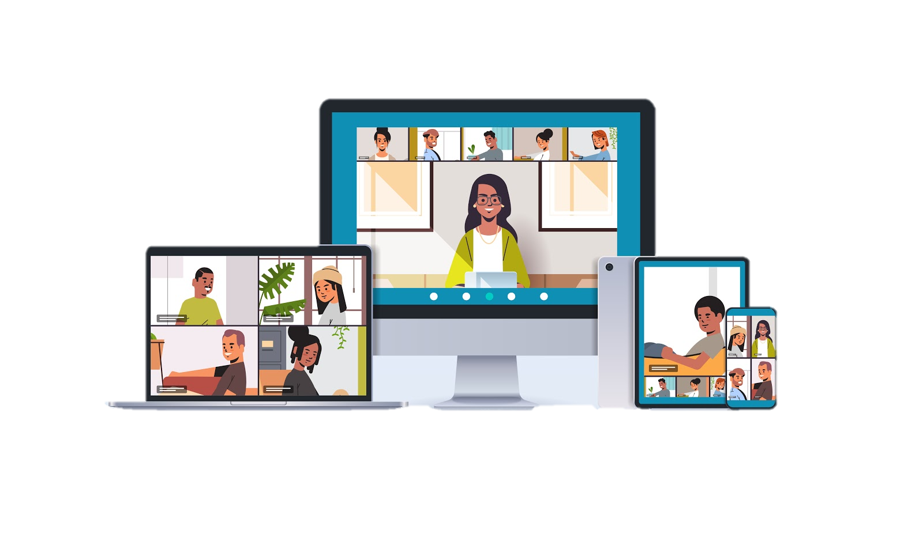
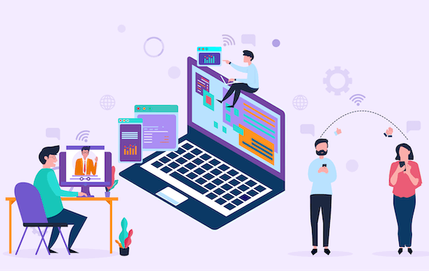


Vocabulary
Form | Pronunciation | Vietnamese equivalent
 | /tekˈnɒlədʒi/
 | /ˌfeɪs tə ˈfeɪs/
 | /ˌepɪˈdemɪk/
 | /ˈkɒntækt lenz/
 | /ˈbreɪkaʊt ruːm /
 | /ɪnˈvenʃn/
1. technology(n)
công nghệ
2. face-to-face (adj)
trực tiếp, mặt đối mặt
3. epidemic (n)
đại dịch
4. contact lens (n)
kính áp tròng
5. breakout room (n)
phòng học chia nhỏ, chia nhóm
6. invention (n)
sự phát minh, sáng chế

Slide 5
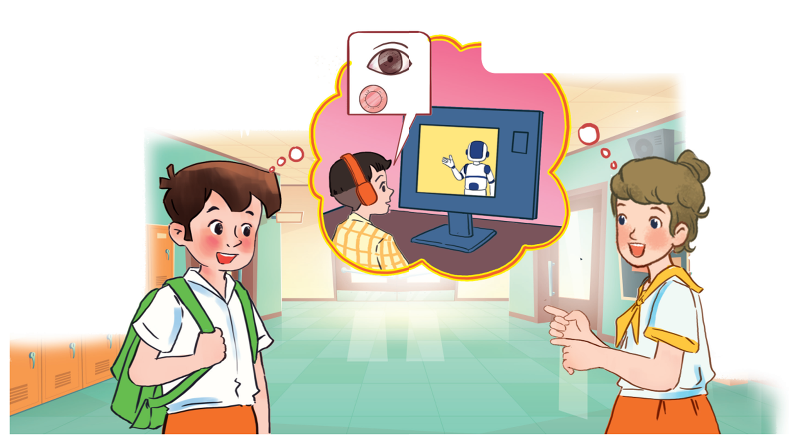
1. Where do you think they are?
Great news for students
2. What might they be taking about?
3. What can you see in the bubble?

Slide 6

Ex 1. Listen and read
Minh: I really liked yesterday’s online lesson. What about you, Ann?
Ann: I prefer having face-to-face classes. I like to interact with my classmates during the lessons.
Minh: I think online classes are convenient during bad weather or epidemics. Also, students can still interact when they are in breakout rooms.
Ann: But the Internet connection doesn’t always work well enough to learn online. And my eyes get tired when I work in front of the computer screen for a long time.
Minh: I know what you mean. But there’s some great news for us. 3D contact lenses will soon be available. With them, our eyes won’t get tired when looking at a computer screen all day long.
Ann: Wow, that’s brilliant!
Minh: Another helpful invention is robot teachers. They will teach us when our human teachers are not available or get ill. My uncle said the robots would be able to mark our work and give us feedback too.
Ann: Fantastic! I can’t wait.

Slide 7
Ex 2. Read the conversation again and tick T (True) or F (False).
1.
2.
3.
4.
You can describe the topic of the section here
You can describe the topic of the section here
You can describe the topic of the section here
You can describe the topic of the section here
Ann and Minh had a face-to-face class yesterday.
T
F
Ann likes face-to-face classes because she can interact with her classmates.
T
F
T
F
Minh finds online classes inconvenient.
When students use 3D contact lenses, their eyes will not get tired.
T
F
5.
T
F
Robot teachers will be able to mark papers and comment on students’ work.

Slide 8
01.
Ann and Minh had a face-to-face class yesterday.
F
Minh: Ann, do you like yesterday's lesson? I really enjoy learning online.

Slide 9
02.
Ann likes face-to-face classes because she can interact with her classmates.
T
Ann: I prefer having face-to-face classes. I like to interact with my classmates during the lessons.

Slide 10
03. Minh finds online classes inconvenient.
F
Minh: I think online classes are convenient during bad weather or epidemics. Also, students can still interact when they are in breakout rooms.

Slide 11
04.
When students use 3D contact lenses, their eyes will not get tired.
T
Minh: I know what you mean. But there’s some great news for us. 3D contact lenses will soon be available. With them, our eyes won't get tired when looking at a computer screen all day long.

Slide 12
05. Robot teachers will be able to mark papers and comment on students’ work.
T
Minh: Another helpful invention is robot teachers. They will teach us when our human teachers are not available or get ill. My uncle said the robots would be able to mark our work and give us feedback too.

Slide 13
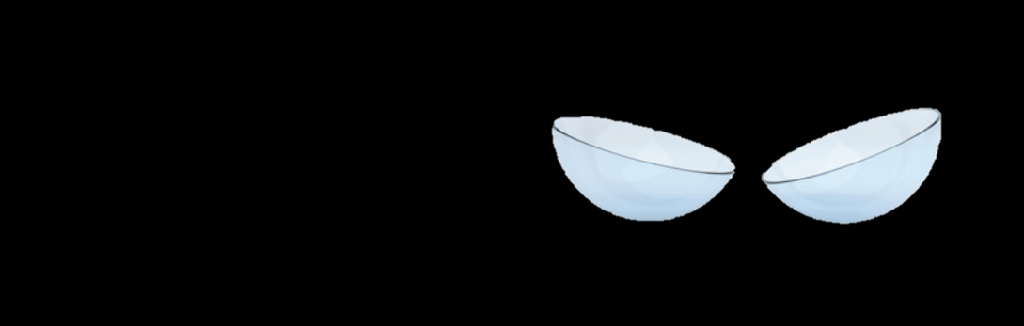
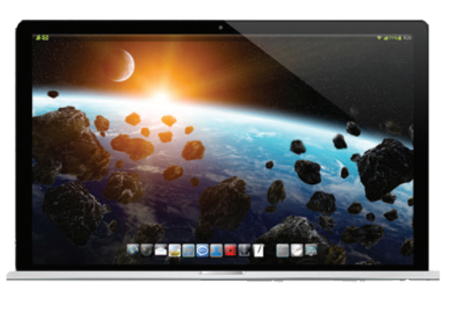
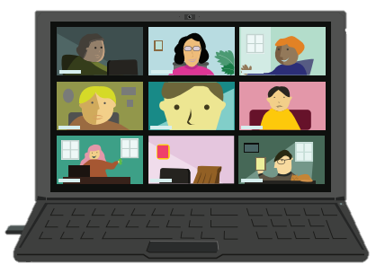
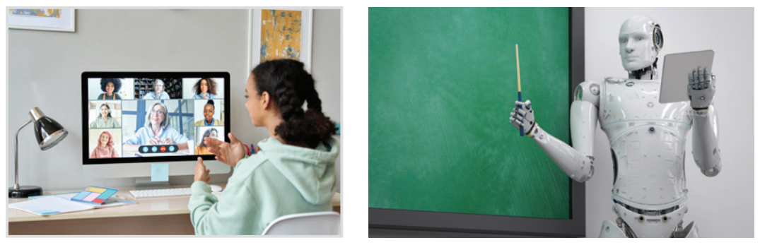

Ex 3. Label each picture with a phrase from the box.
3D contact lenses
Robot teacher
Online class
Computer screen
Breakout rooms
Internet connection

Slide 14
Ex 4. Complete the sentences, using the phrases in 3.
1. I can’t see the documents on the computer very clearly. I need a larger ______________.
2. During our lessons, our teacher puts us into ______________ for group discussions.
3. A ____________ in Korea teaches English to primary students.
4. We had a(n) ____________ yesterday with a teacher in the US.
5. Can I wear ________________ and watch a movie too?
computer screen
breakout rooms
robot teacher
online class
3D contact lenses

Slide 15


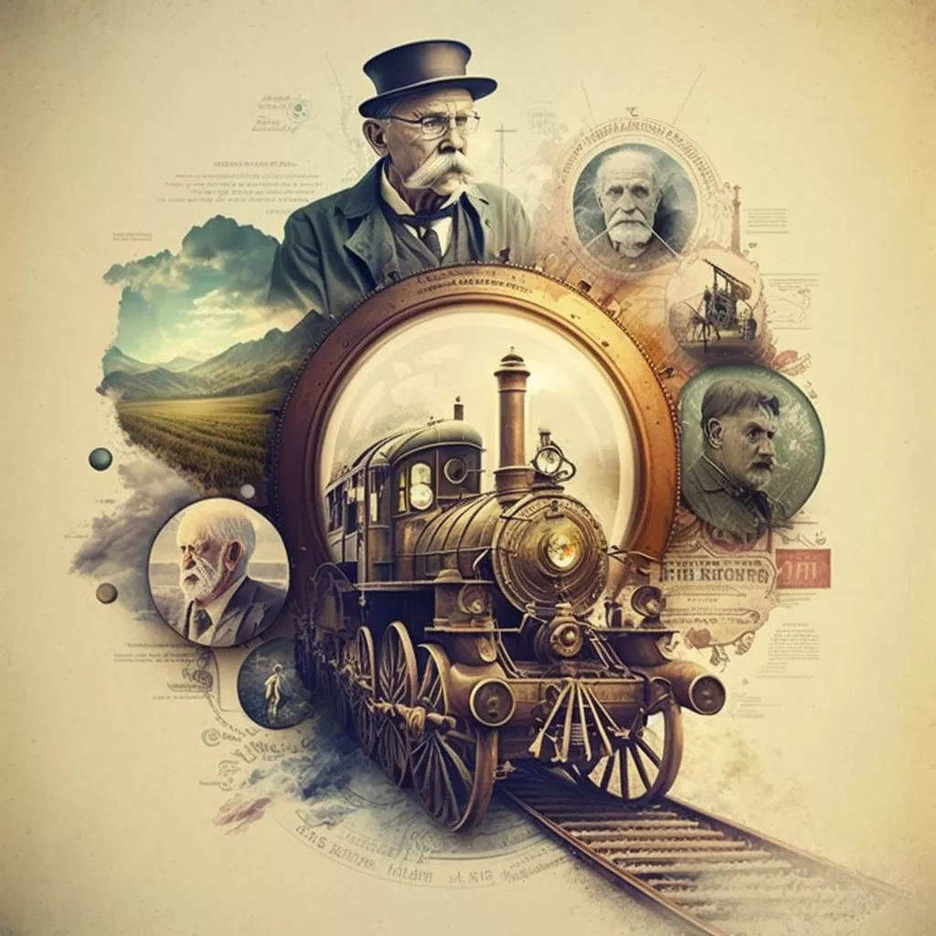


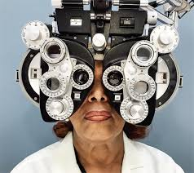
QUIZ. Do you know what things were invented in these years?

Slide 16



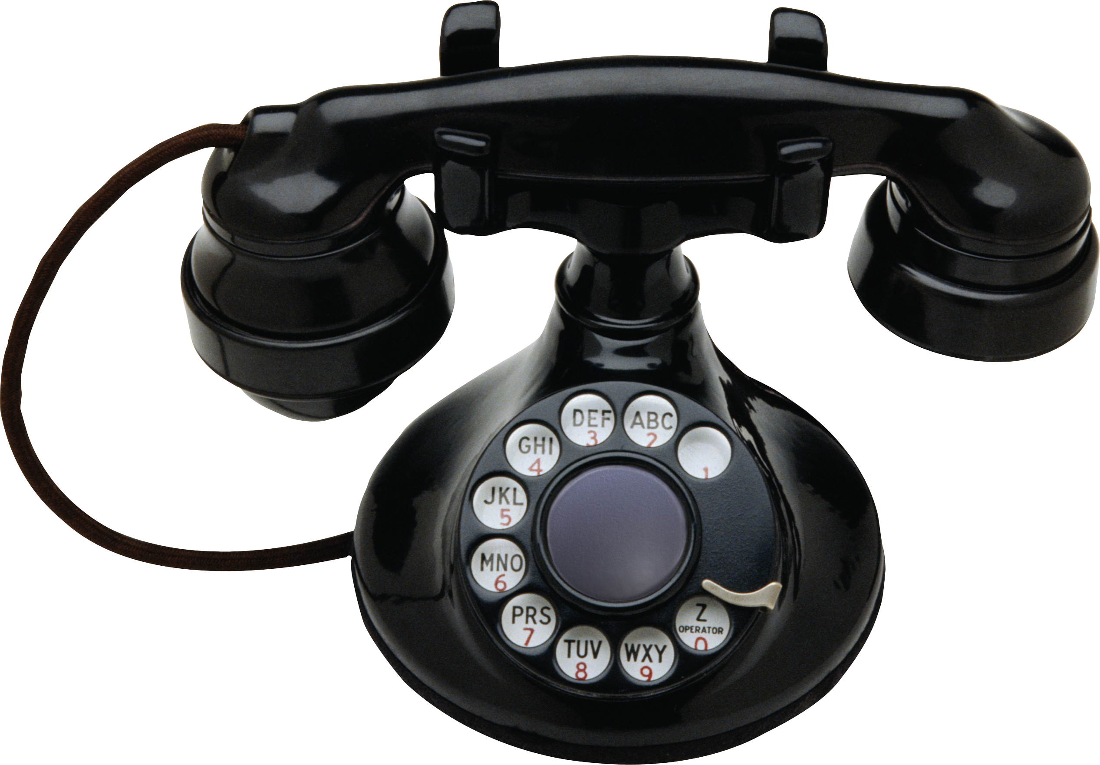
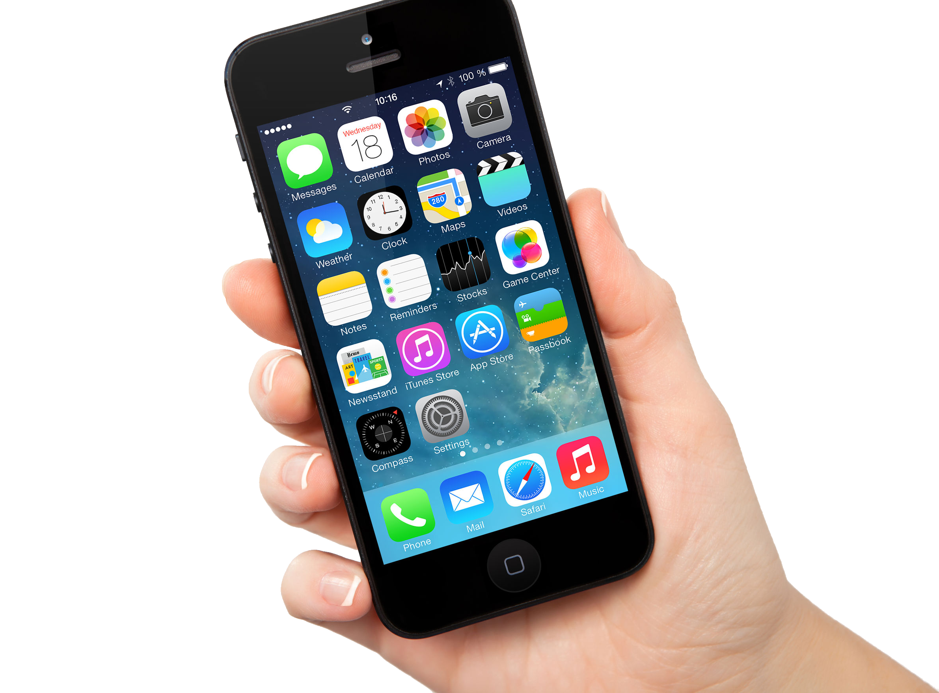

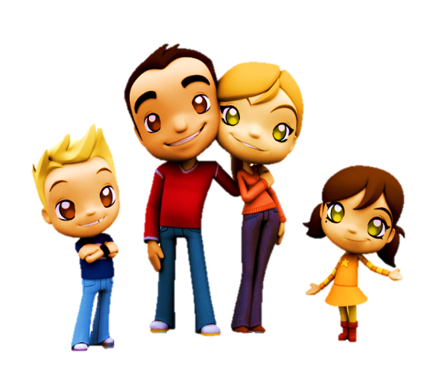
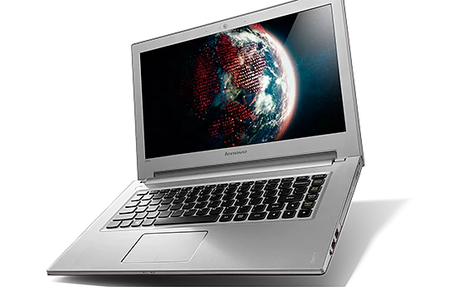
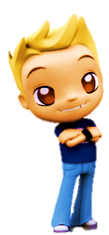
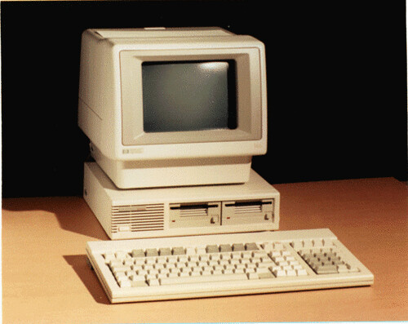
1822: Charles Babbage invented it. Students use it to type essays and to learn online.
1/5
Telephone
TOM
Smart phone
LIZ
Laptop
ANN
Computer
BOB
Click on the right kid
NEXT

Slide 17
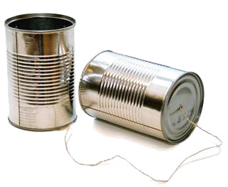
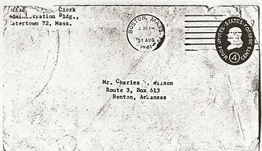
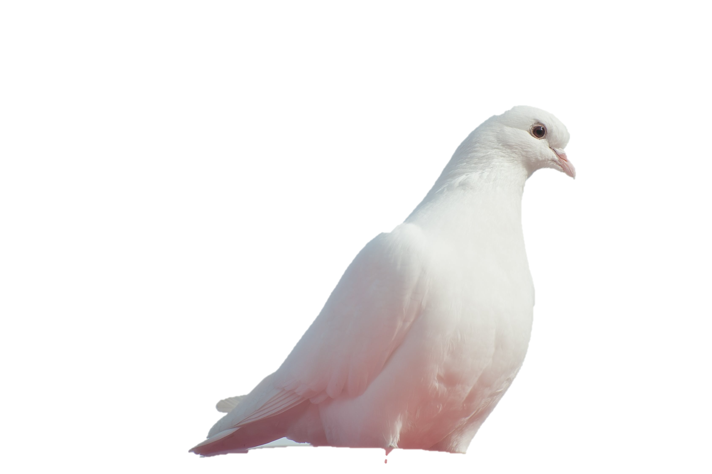
1876: Alexander Graham Bell invented it. We use it to communicate with our friends and families.
2/5
Tin can telephone
TOM
Letter
LIZ
Telephone
ANN
BOB
Dove
Click on the right kid
NEXT

Slide 18



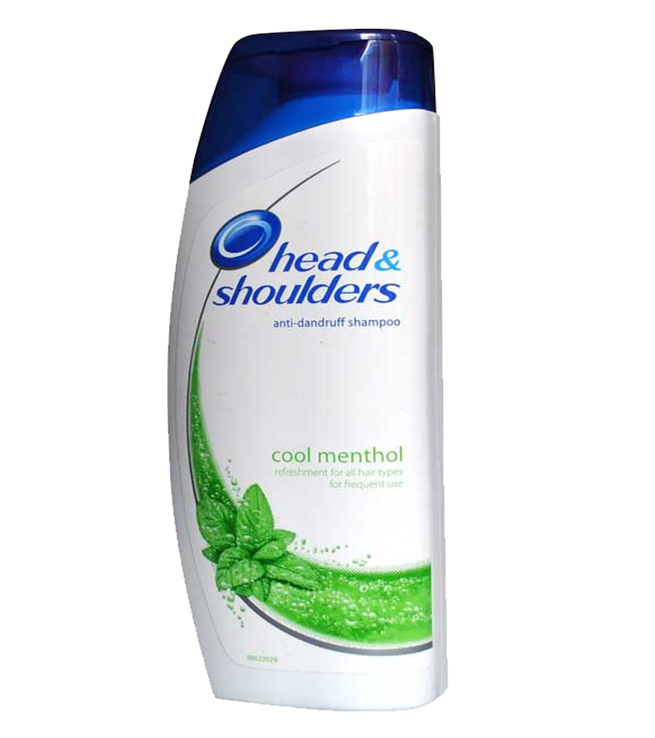
1928: Sir Alexander Fleming discovered it. It was the world’s first antibiotic.
3/5
Poison
TOM
Penicillin
LIZ
Perfume
ANN
Shampoo
BOB
Click on the right kid
NEXT

Slide 19




1989: Tim Berners-Lee invented it. It links information sources so everyone can access them.
4/5
WWW
TOM
Wifi
LIZ
Base Transceiver Station
ANN
Network
BOB
Click on the right kid
NEXT

Slide 20
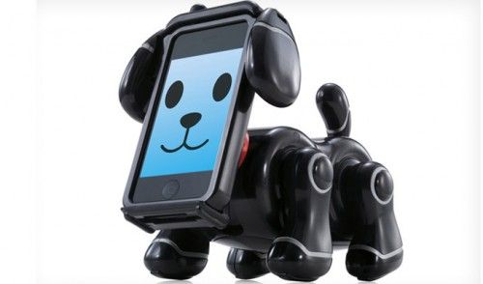
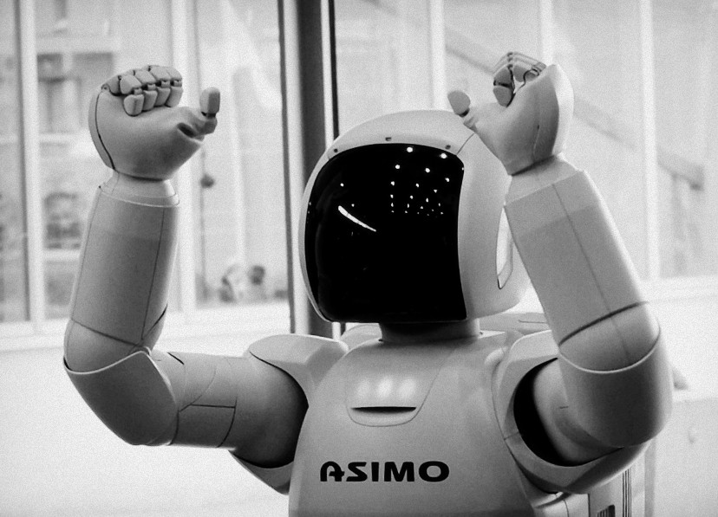
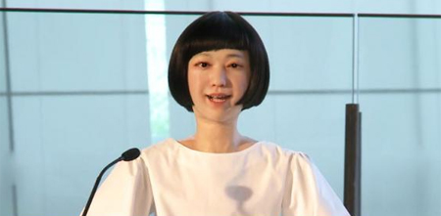
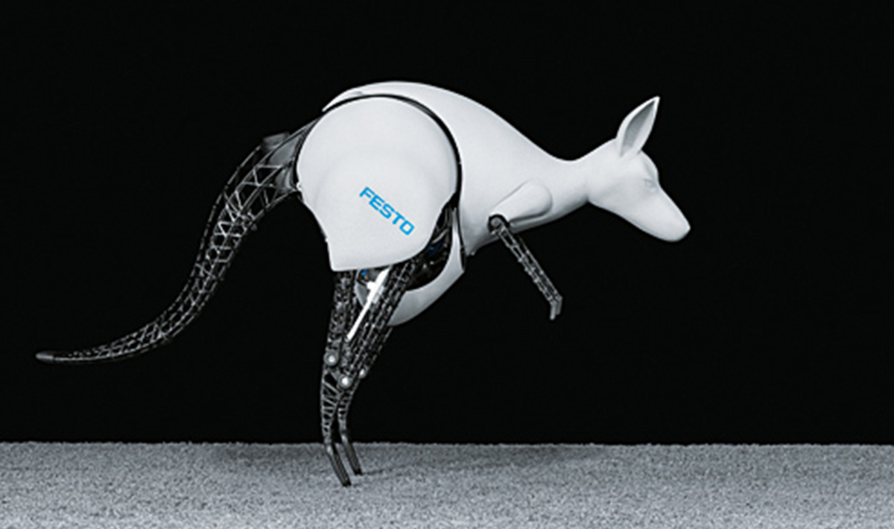
2000: Honda developed it. It can run, jump, and work as a bartender.
5/5
Smartpet
TOM
LIZ
Asimo
ANN
Kodomoroid
BOB
Click on the right kid
NEXT
BionicKangaroo

Slide 21


RECAP
But the Internet connection doesn’t always work _____ enough to learn online.
Well
Good
Better
V + Adv + enough to V
Notes:
Yêu cầu học sinh đóng toàn bộ sách vở trước khi đến phần RECAP

Slide 22


I think online classes are convenient during bad weather or .
RECAP
Viruts
Epidemics
Global warming

Slide 23
RECAP
OVER 550 years ago, the German ______ Johannes Gutenberg began printing with movable type.
invention
invent
inventor

Slide 24
Thanks!
Do you have any questions?

Slide 25
Icon pack

Slide 26
Premium alternative resources
Here’s an assortment of alternative resources whose style fits the one of this template:
Vectors
Home interior background for video conference

