Slide 1





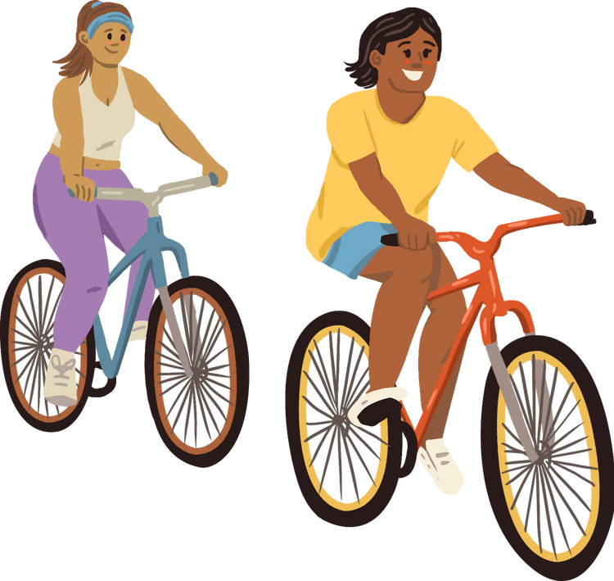
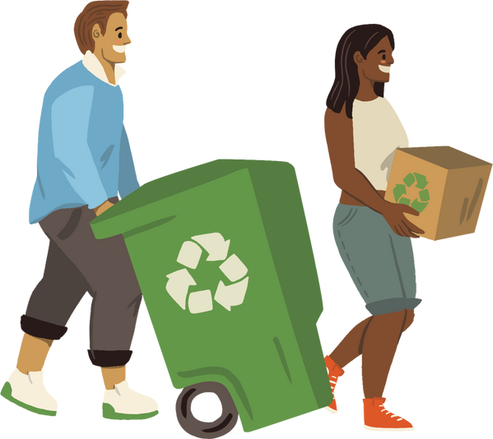
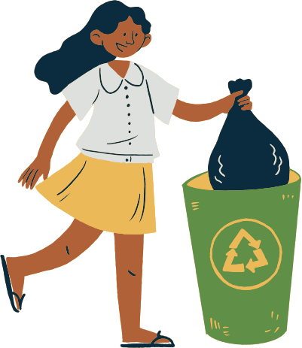
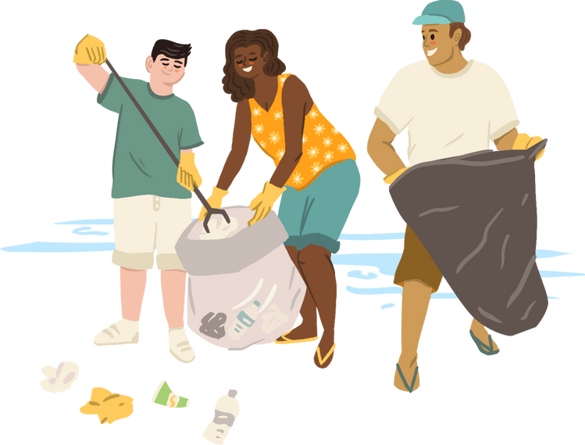

COMMUNITY
SERVICE
Grade 7, Unit 3, lesson 1
By: Ms. Mai

Slide 2
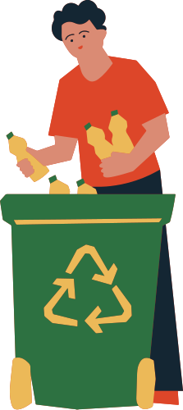
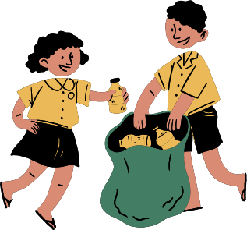
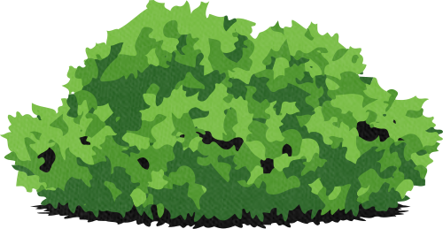
OBJECTIVES
Learn vocabulary about community service activities.
Practice pronunciation of new words.
Listen to a conversation about community service.

Slide 3

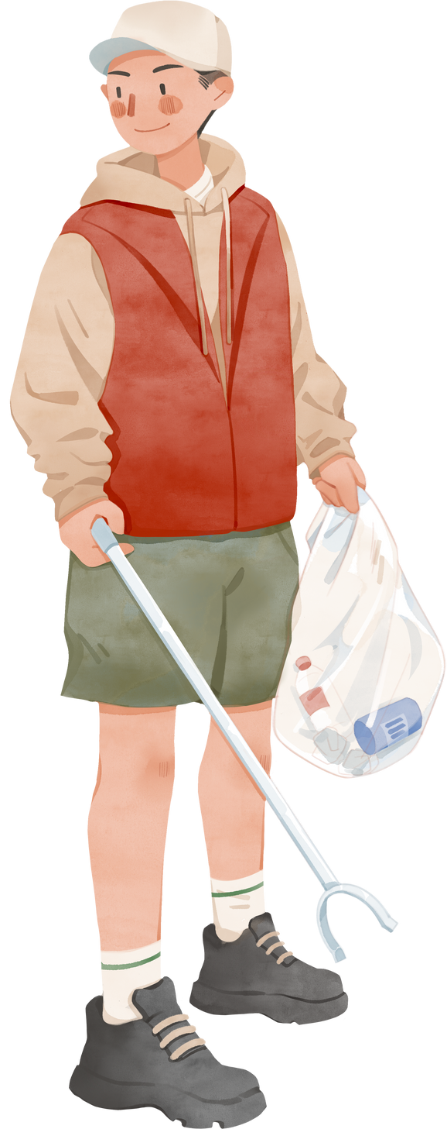
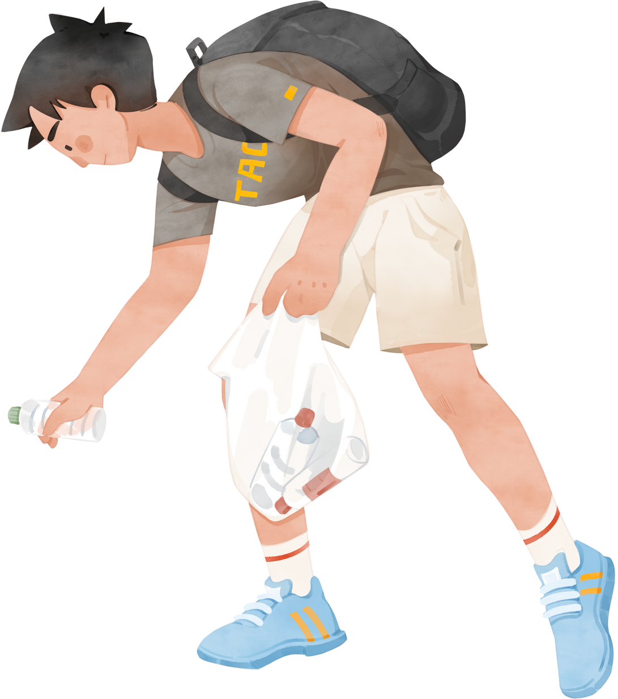

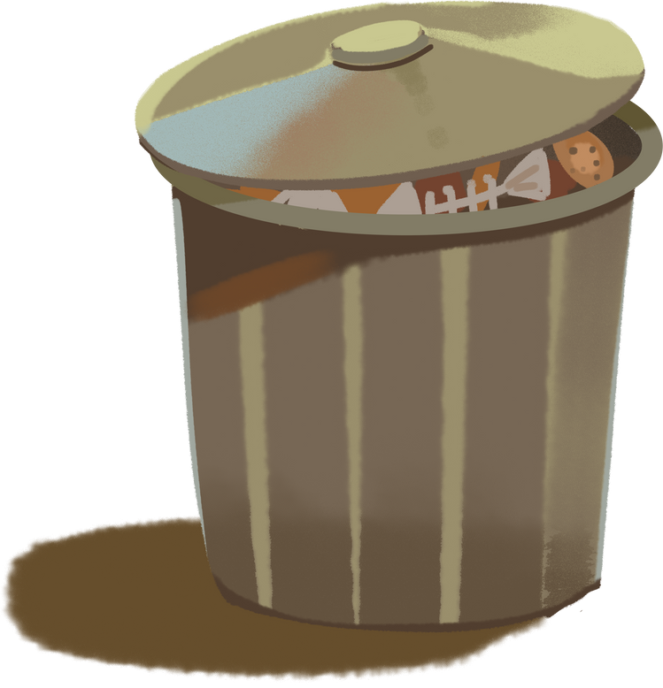

PRESENTATION
Pick up litter
/ˈpɪkɪŋ ʌp ˈlɪtər/

Slide 4
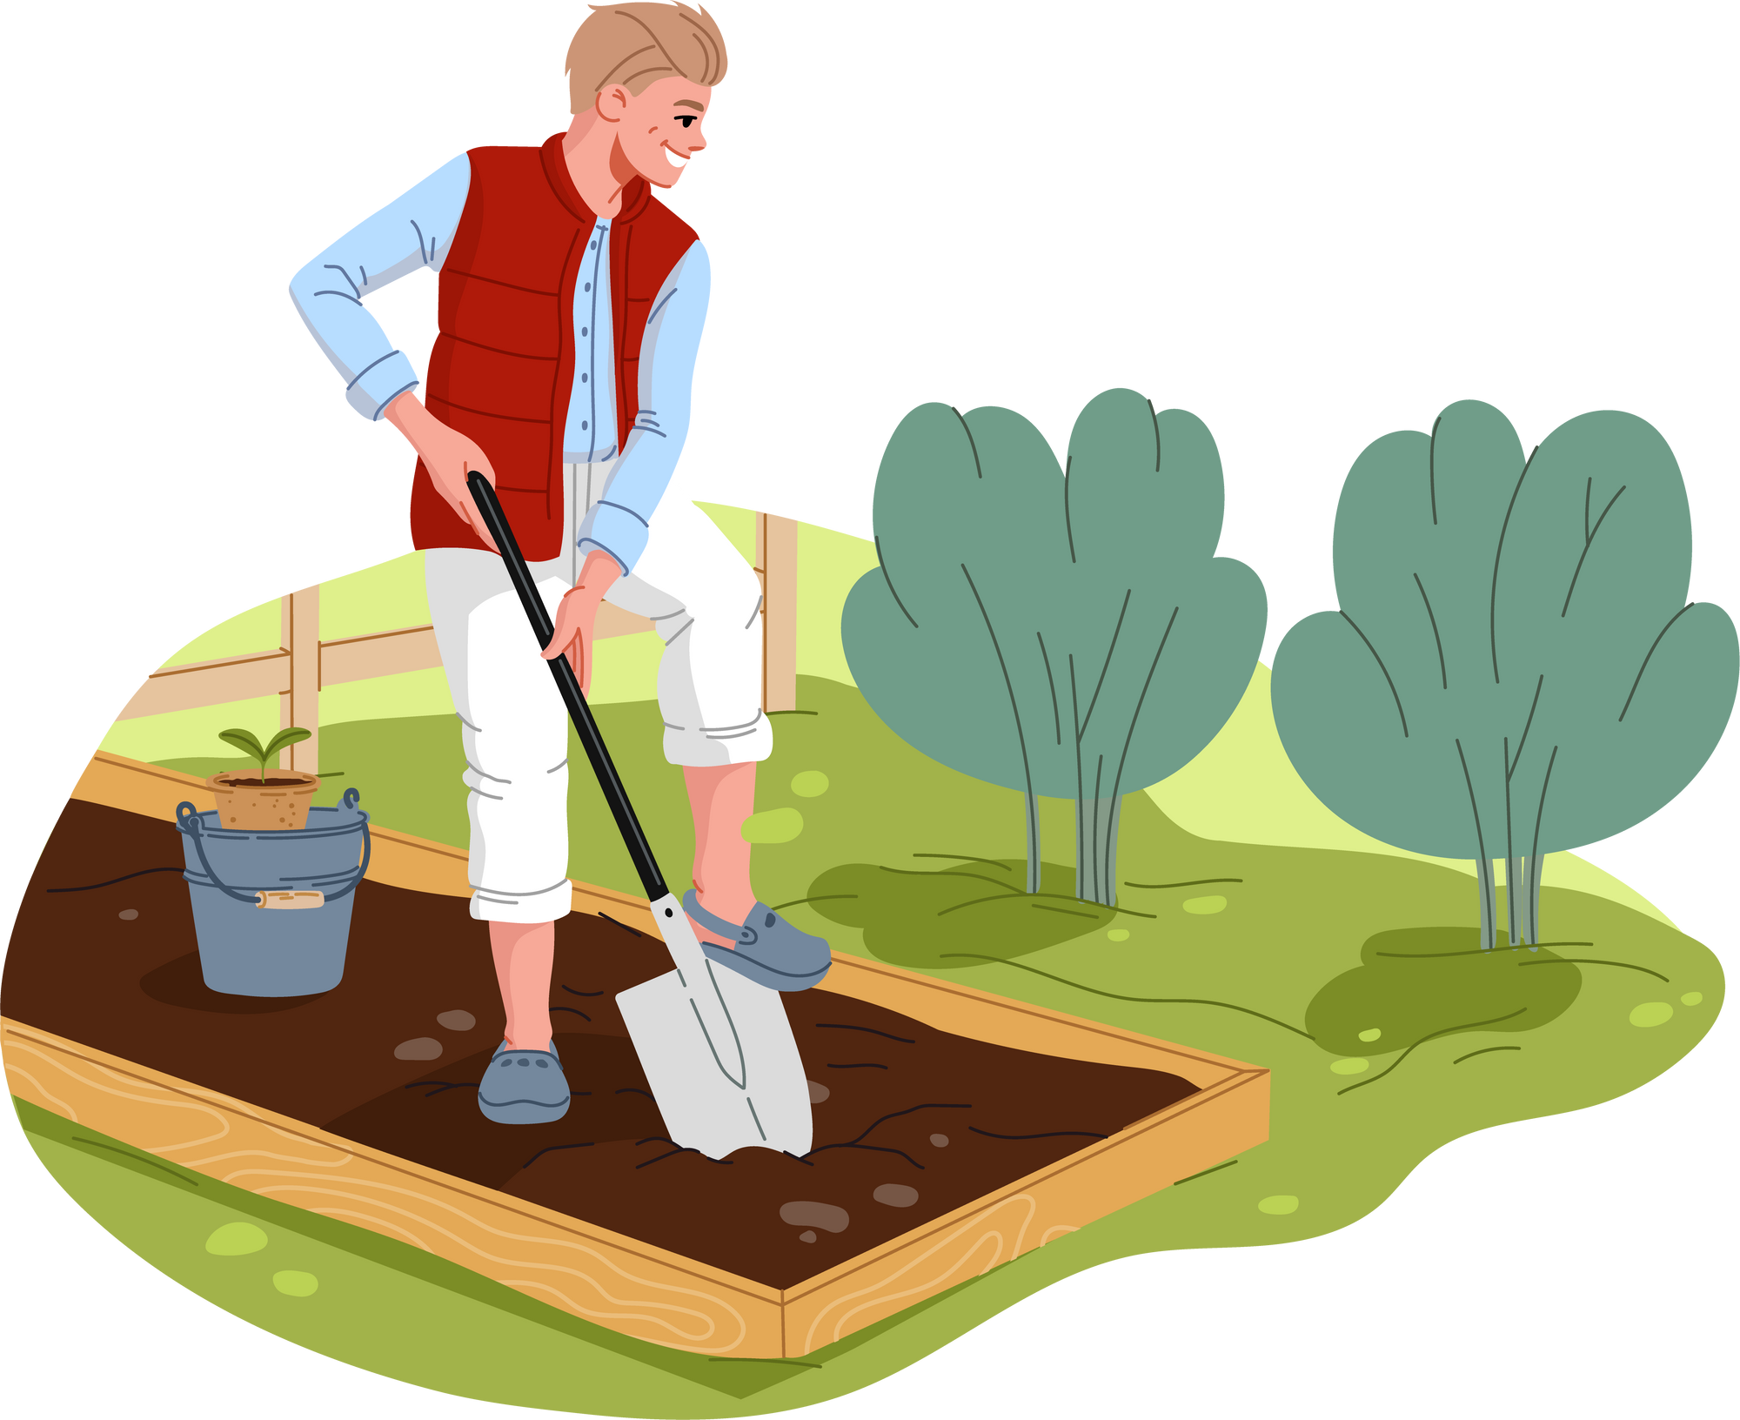
Planting vegetables
/ˈplæntɪŋ ˈvɛdʒtəblz/

Slide 5

Donating books
/ˈdoʊneɪtɪŋ bʊks/

Slide 6

Teaching English
/ˈtiːʧɪŋ ˈɪŋɡlɪʃ/

Slide 7
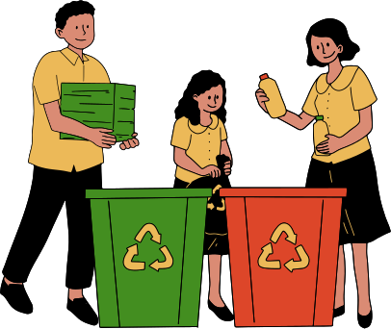
Recycling plastic bottles
/riːˈsaɪklɪŋ ˈplæstɪk ˈbɑːtlz/

Slide 8

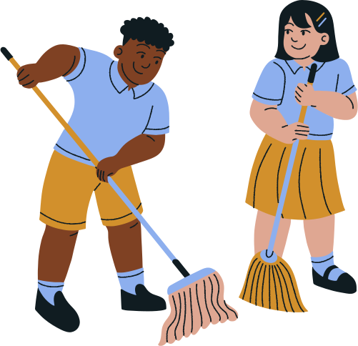
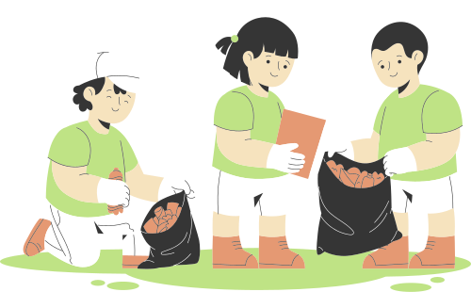
Cleaning the playground
/ˈkliːnɪŋ ðə ˈpleɪɡraʊnd/

Slide 9
PRACTICE
  What did Tom buy Minh?
  What activities are mentioned?

Slide 10

PRACTICE
  Listen and read
Minh: Hi, Tom. Are you back in Ha Noi?
Tom: Yes. I came back yesterday. Can we meet up this Sunday morning? I bought you a board game.
Minh: Sure, I can’t wait! But our Green School Club will have some community activities on that morning.
Tom: What activities does your club do?
Minh: Well, we pick up litter around our school and plant vegetables in our school garden.
Tom: School gardening? That’s fantastic!
Minh: Yes. We donate the vegetables to a nursing home. Does your school have any activities like these?
Tom: Yes. We donate books to homeless children. We also have English classes. Last summer, we taught
English to 30 kids in the area.
Minh: Sounds like great work!
Tom: Thanks.
Minh: ... So, let’s meet in the afternoon then.

Slide 11

PRACTICE
2. Read the conversation again and tick the appropriate box.
Community activity | Minh’s club | Tom’s club
1. picking up litter
2. planting vegetables
3. donating books
4. donating vegetables
5. teaching English

Slide 12
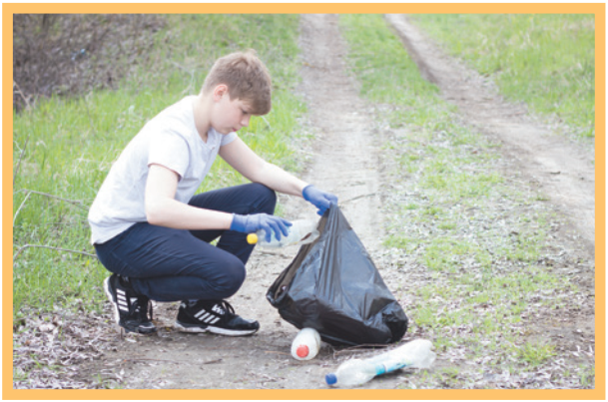
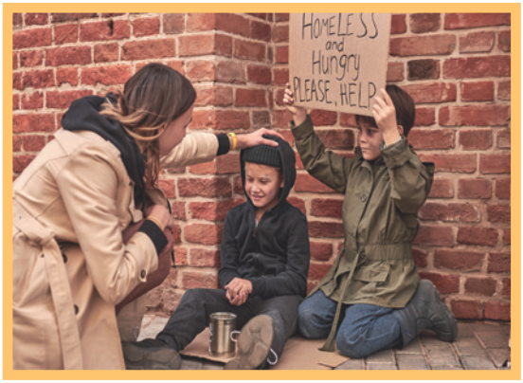
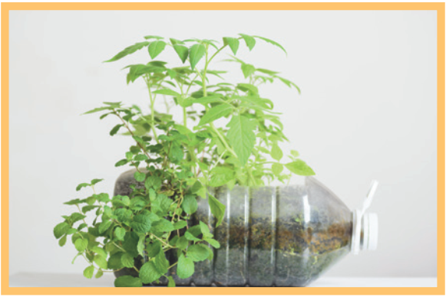
PRACTICE
3
Complete the phrases under the pictures with the verbs below.
pick up clean donate recycle help
recycle
pick up
help
3. _______ plastic bottles
1. ________ litter
2. ______ homeless children

Slide 13
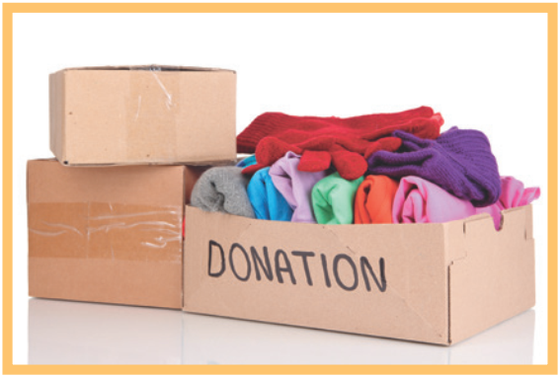
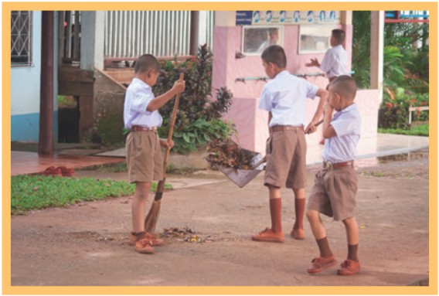
PRACTICE
donate
4. _________ clothes
clean
5. ________ the playground

Slide 14
PRACTICE
4
Complete the sentences with the correct words or phrases below.
old people homeless children planted litter taught
1. We collected clothes and gave them to _________________.
2. Those students picked up all the __________ on the street.
3. We helped ____________ in the nursing home last Sunday.
4. The club members ________ maths to primary students during school holidays.
5. We __________ a lot of trees in the park last summer.
homeless children
litter
old people
taught
planted

Slide 15
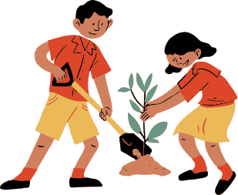
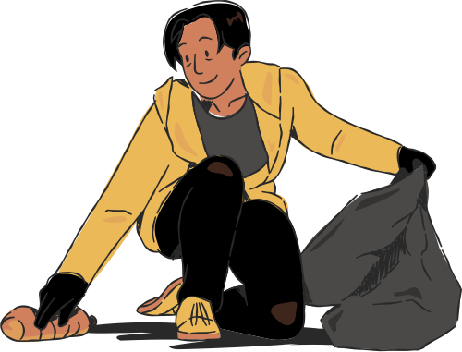
By participating in activities like those we learned about in the lesson, you will help create a cleaner, greener, and more caring community for everyone.

Slide 16

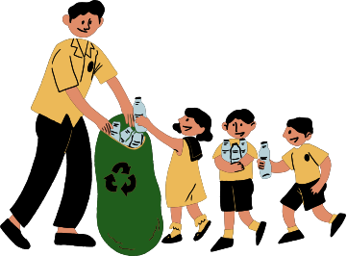




THANK YOU

