Slide 1

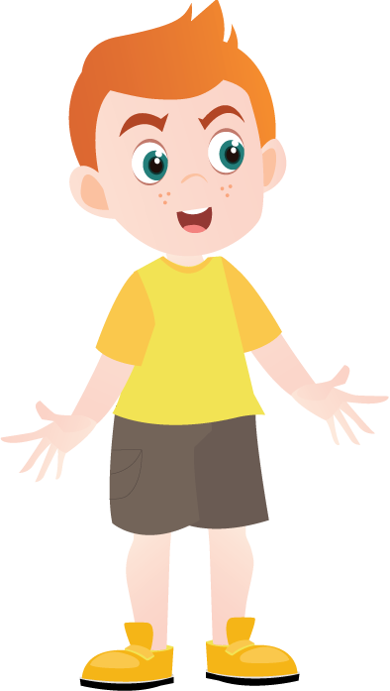

Let's review...
/f/ or /v/ sound?
CLICK

Slide 2

HOW TO PRONOUNCE THESE SOUNDS?

Slide 3
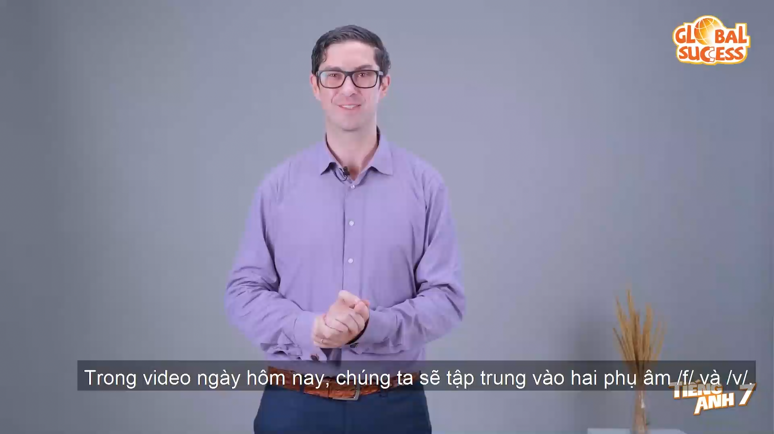

Slide 4

LET’S PRACTICE!

Slide 5



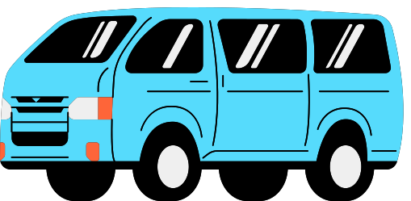



fan van
ferry very
leaf leave
off of

Slide 6
Ex: Say the sentences aloud, paying attention to the underlined words containing the sounds /f/ and /v/
What is the benefit of playing volleyball?
Eat more fruit and vegetables.
Fruit contains a lot of vitamins.
Laughter and love are good for your health.
We should do more physical activities.

Slide 7
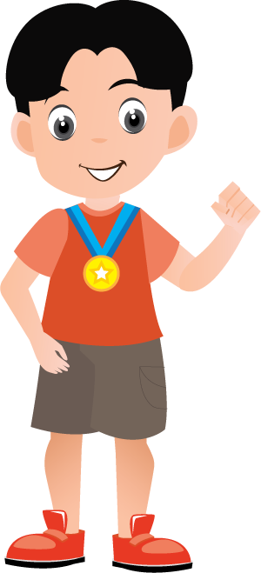
THANK YOU!

