Slide 1


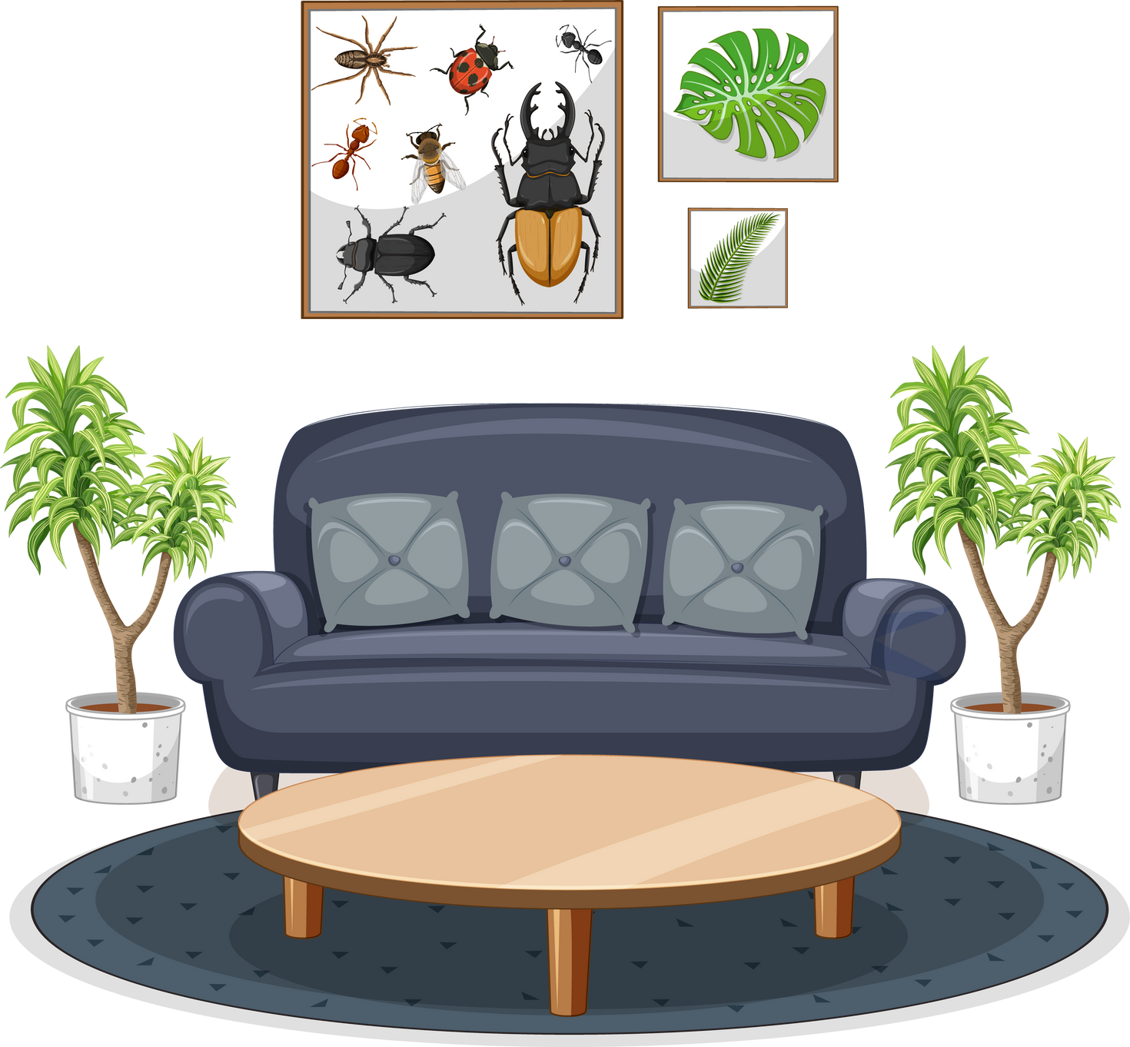
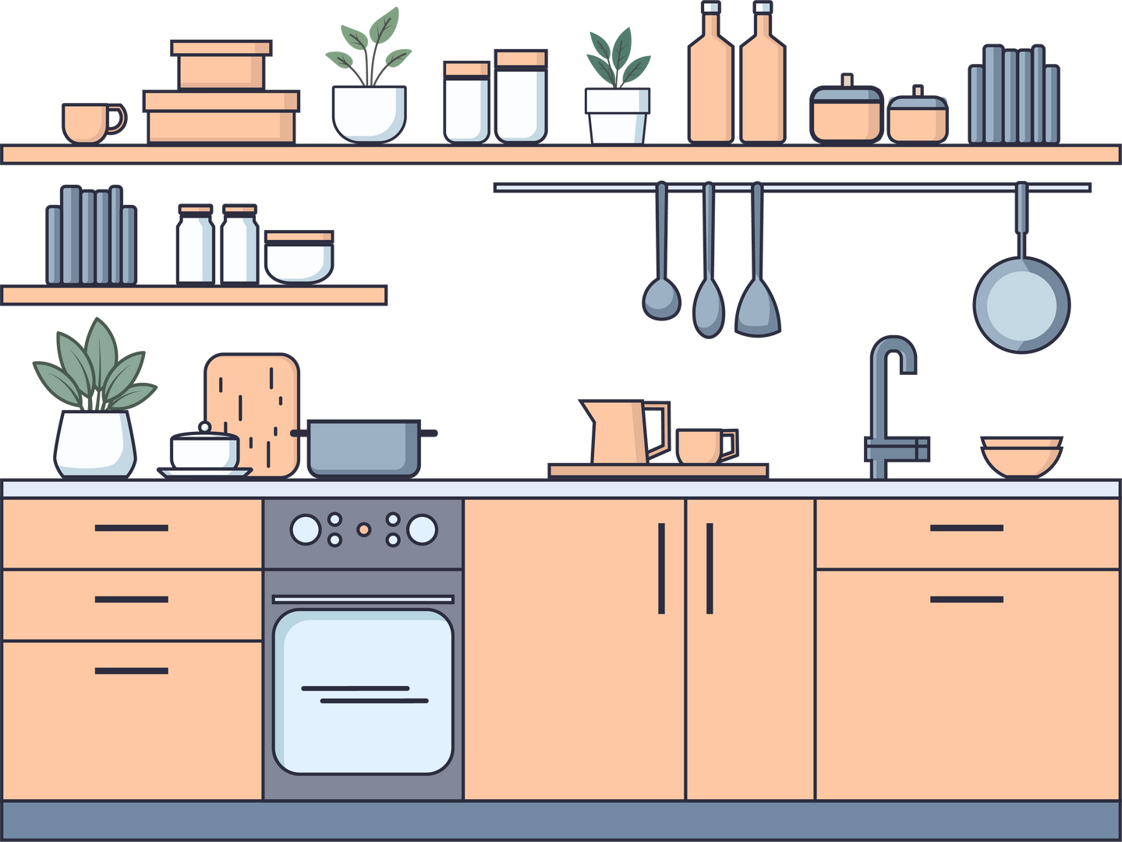
Unit 2: My house
Lesson 1: Getting started

Slide 2



OBJECTIVES
Understand vocabulary related to rooms and furniture in a house.
01
02
Develop listening and speaking skills through dialogues.

Slide 3
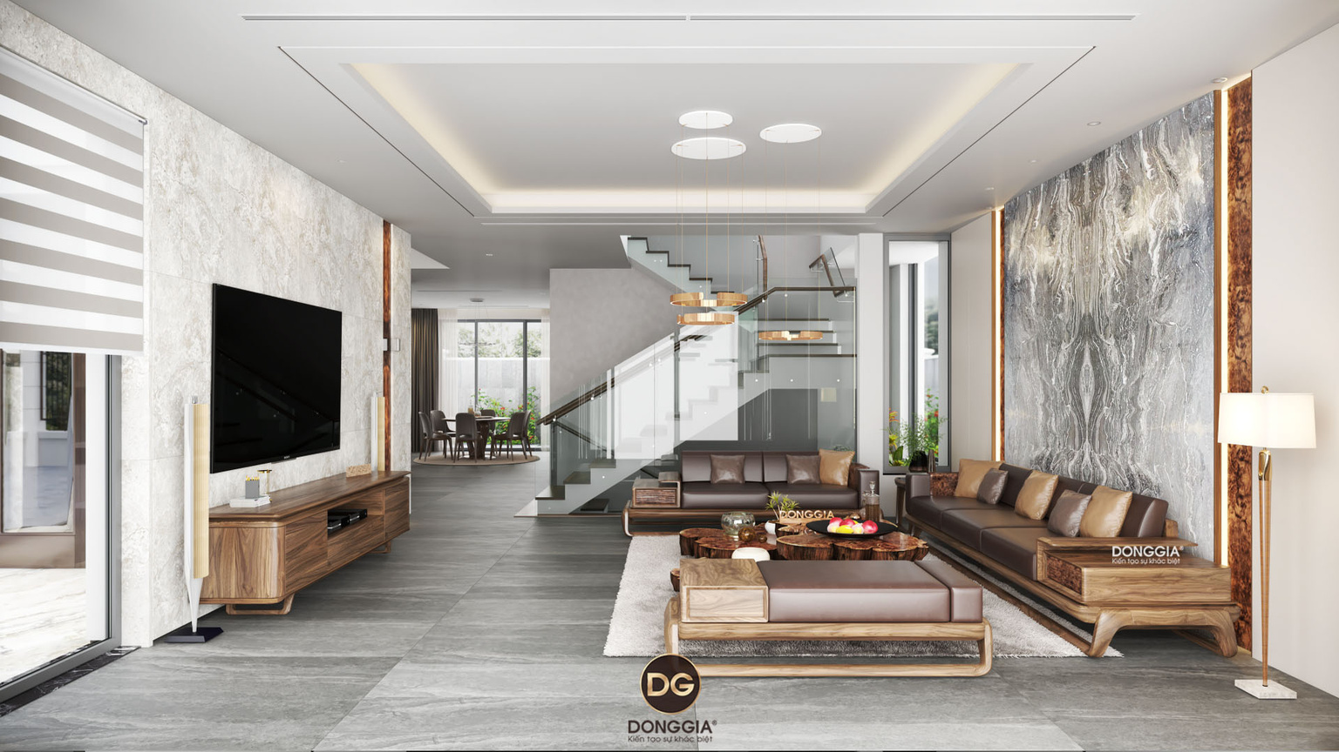
WARM-UP
Warm-up
Guess the room
What is this?
It’s a ...............
living room

Slide 4

PRESENTATION
We have a small house in the______
country

Slide 5
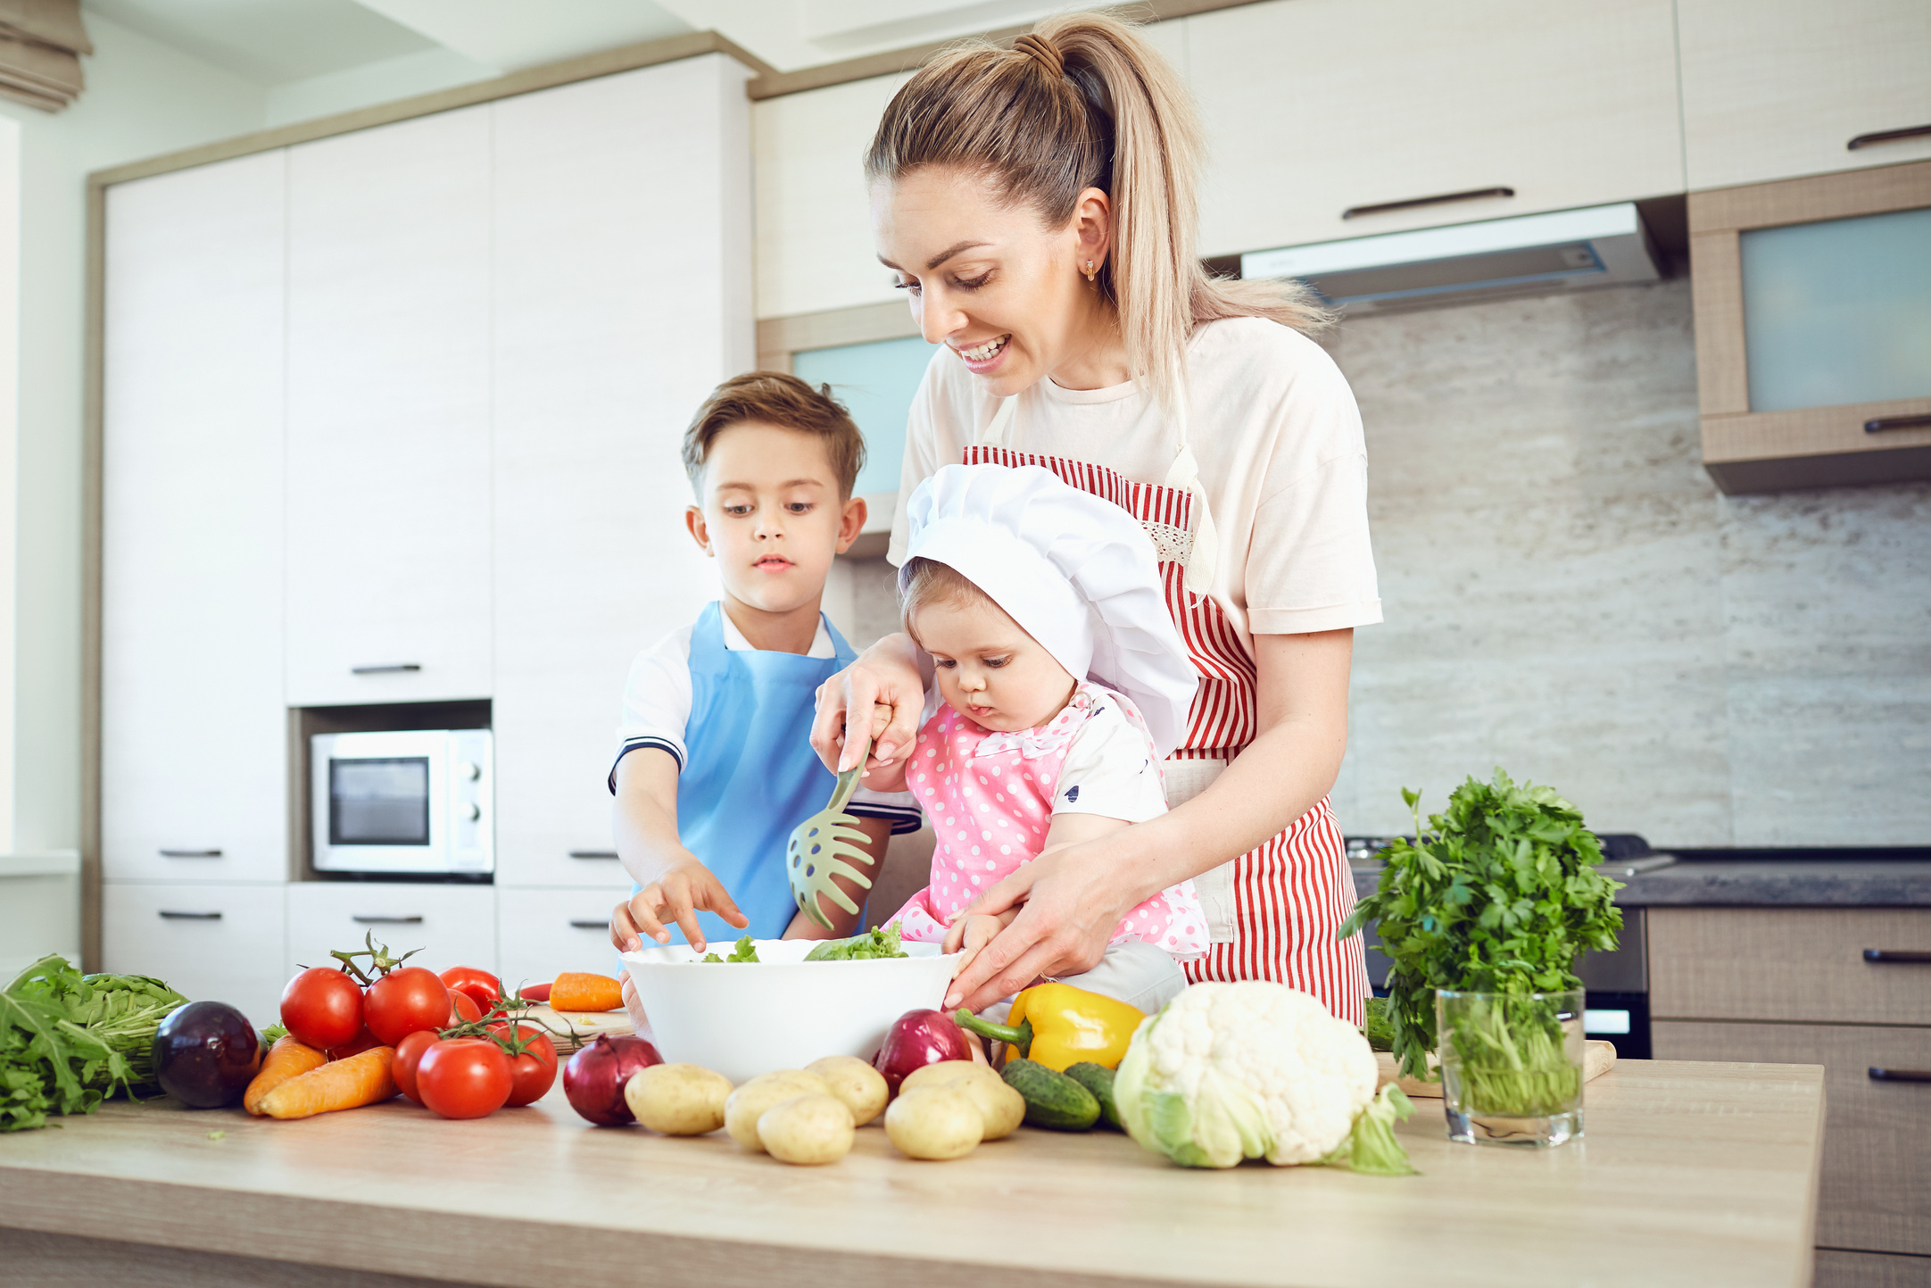
Where are they? They are in the ______
kitchen.

Slide 6
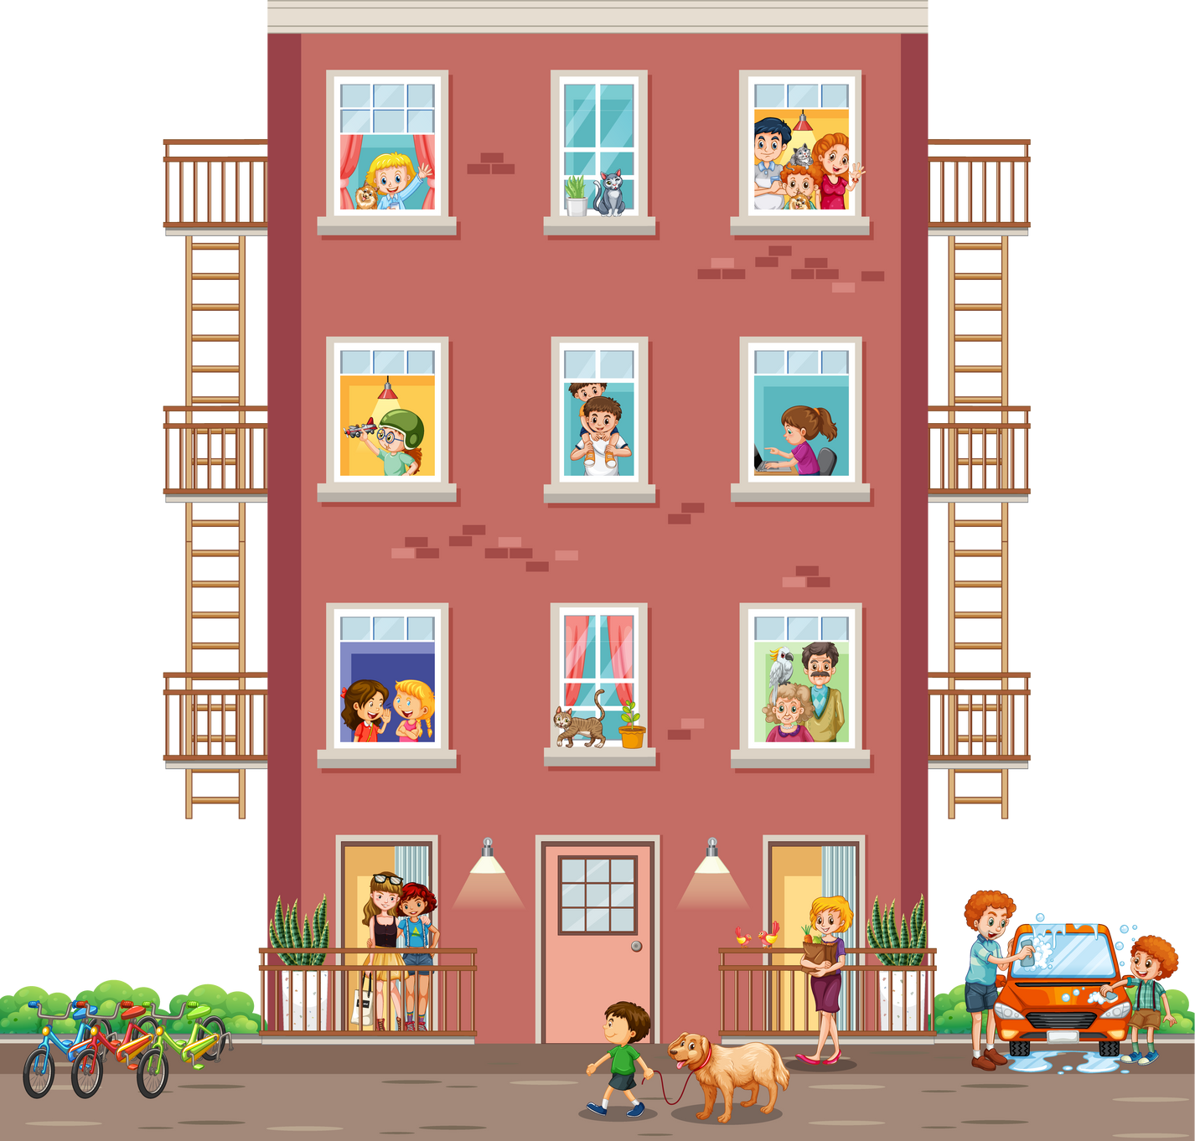

What is it? It’s an ________
apartment .

Slide 7
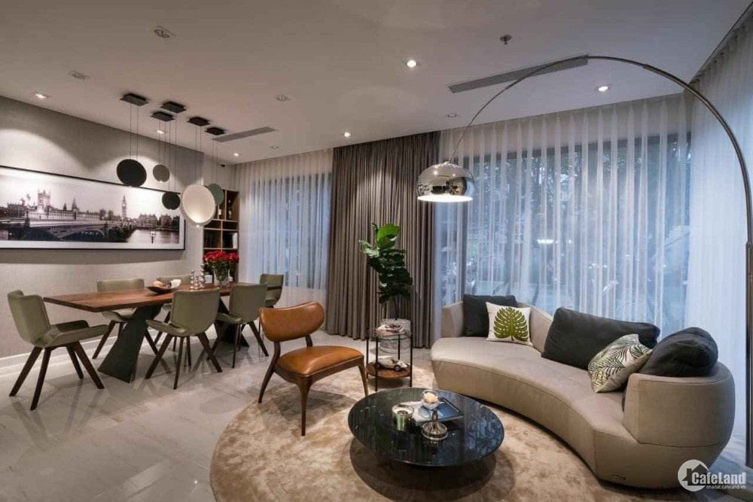
We live in a ___
flat.

Slide 8
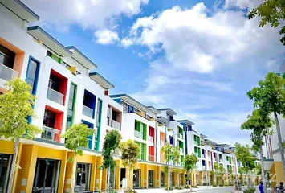
PRESENTATION
Town house
/ˈtaʊn haʊs/
Nhà phố

Slide 9
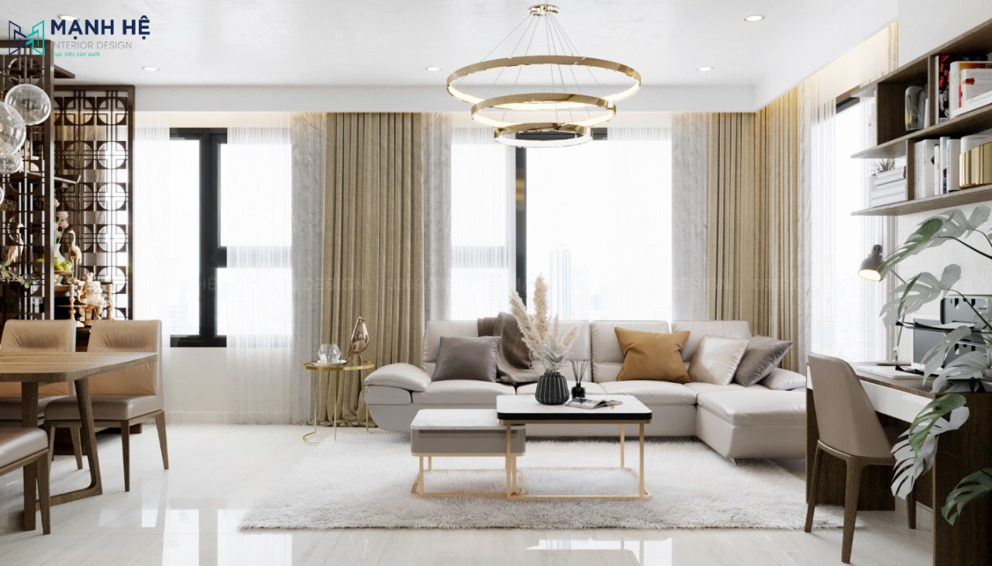
PRESENTATION
Flat
/flæt/
Căn hộ

Slide 10
PRESENTATION
Flat= Apartment
/əˈpɑːtmənt/
Căn hộ

Slide 11

PRESENTATION
Country house
/ˌkʌntri ˈhaʊs/
Nhà ở vùng quê

Slide 12
PRESENTATION
PRESENTATION
New words | Pronunciation | Meaning
1. Town house (n) | /’ taʊn haʊs/ | Nhà phố
2. Country house (n) | /ˌkʌntri ˈhaʊs/ | Nhà ở vùng quê
3. Flat (n) | /flæt/ | Căn hộ
4. Apartment (n) | /əˈpɑːtmənt/ | Căn hộ

Slide 13
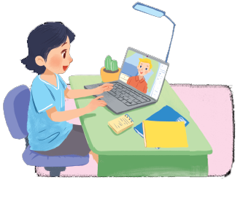
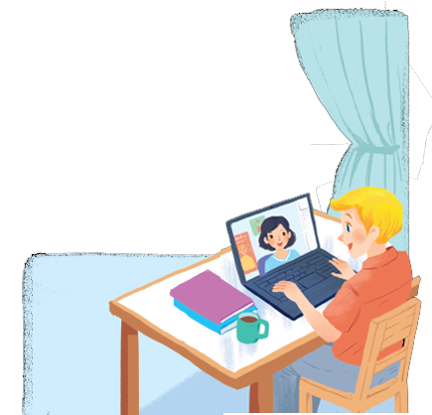
PRACTICE
LESSON 1: GETTING STARTED
What are Nick and Mi doing?
What might they talk about?
1

Slide 14
PRESENTATION
1
A look inside
Listen and read.
Mi: Wow! Your room looks so big, Nick.
Nick: It’s Elena’s room. She’s my sister.
Mi: I see. Is there a TV behind you?
Nick: Yes, there is. Where do you live, Mi?
Mi: I live in a town house. And you?
Nick: I live in a country house. Who do you live with?
Mi: My parents and younger brother. We’re moving to a ﬂat next month!
Nick: Are you?
Mi: Yes. My aunt lives near there, and I can play with my cousin.
Nick: Are there many rooms in your new ﬂat?
Mi: Yes, there are. There’s a living room, three bedrooms, a kitchen and two bathrooms.

Slide 15
PRESENTATION
What are Nick and Mi doing?
→ They are talking online with each other.
LESSON 1: GETTING STARTED
1
What might they talk about?
→ They are talking about their house.

Slide 16
PRESENTATION
2
Which family members does Mi talk about? Put a tick ().
1. | parents
2. | sister
3. | brother
4. | aunt
5. | cousin





Slide 17
PRESENTATION
3
Read the conversation again. Complete each sentence with ONE word.
sister
1. Elena is Nick’s ______.
2. There is a ____ in Elena’s room.
3. Now Mi lives in a _____ house.
4. Nick lives in a ________ house.
5. Mi’s new flat has _____ bedrooms.
TV
town
country
three

Slide 18
CONSOLIDATION
What have we learnt in this lesson?
Vocabulary about house and types of house.
Read and understand content of the conversation.

Slide 19
Thank you for watching!

