Slide 1
Welcome to our class!

Slide 2
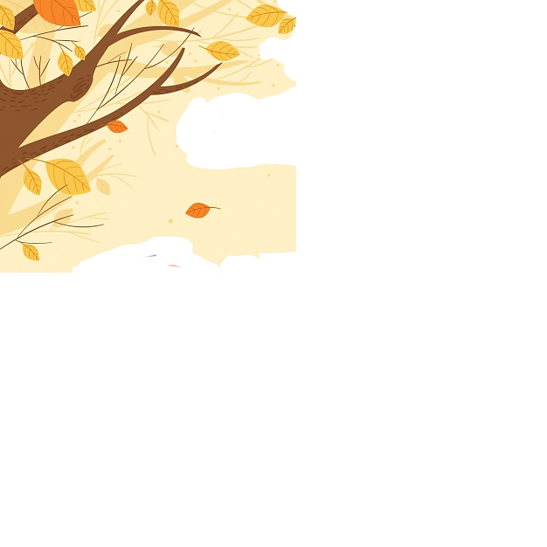

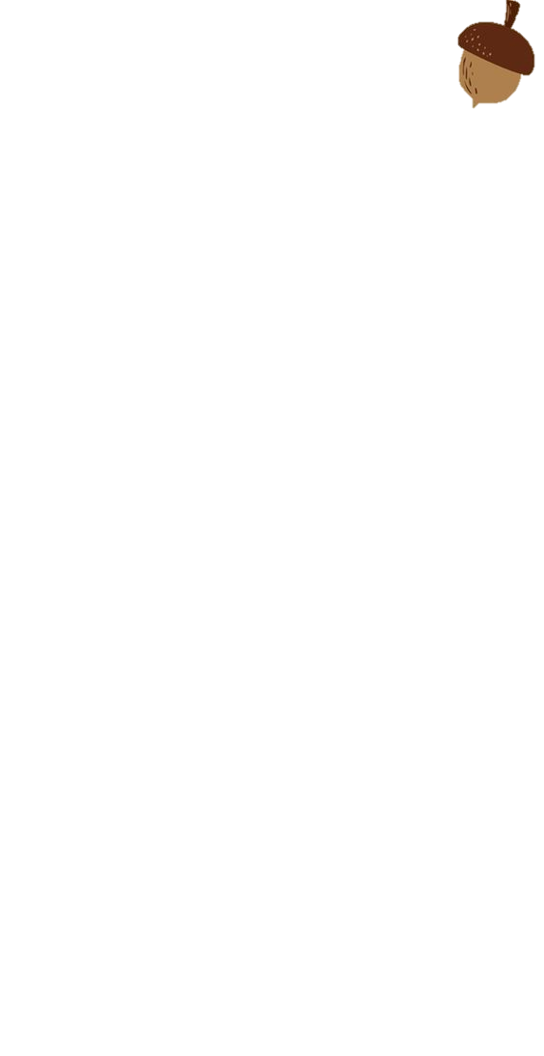


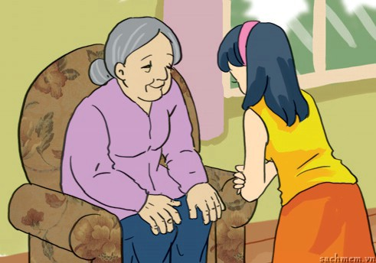

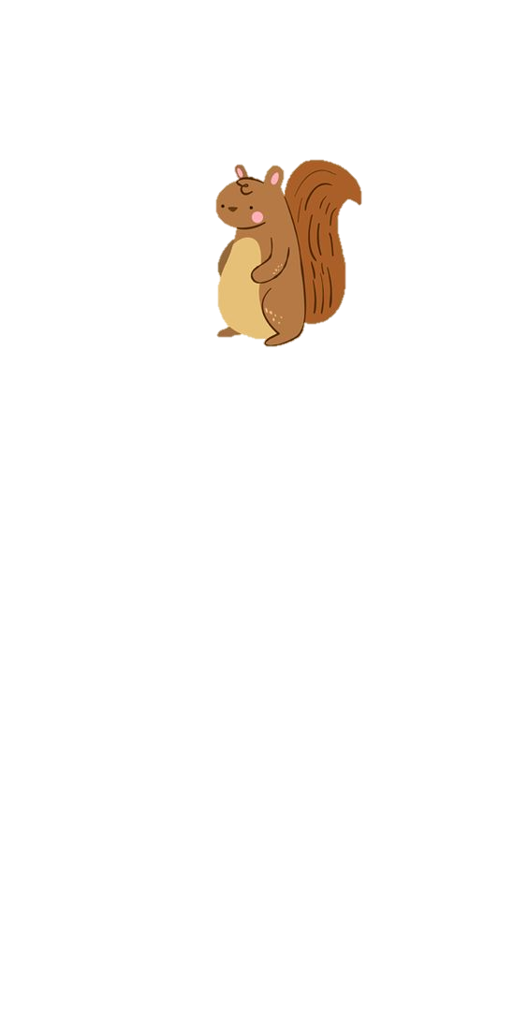

What should/ shouldn’t you do?
1. I __________ respect old people.
A. should
B. shouldn’t

Slide 3
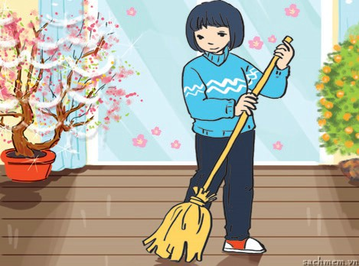
What should / shouldn’t you do?
2. According to tradition, I ________
sweep the floor on the first day of Tet.
A. should
B. shouldn’t

Slide 4
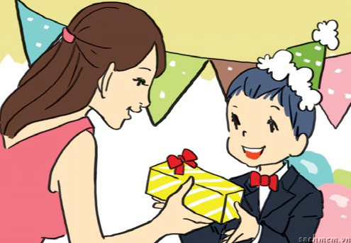
What should / shouldn’t children do?
3. Children __________ take things from adults with both hands.
A. should
B. shouldn’t

Slide 5
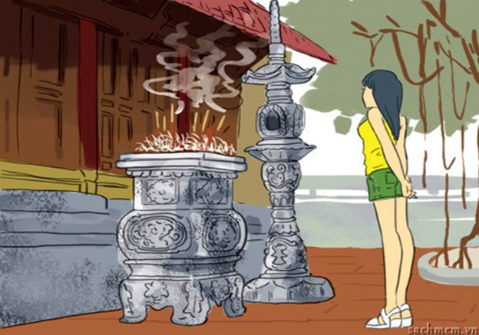
What should / shouldn’t she do?
4. She __________ wear shorts when going to the pagoda.
A. should
B. shouldn’t

Slide 6
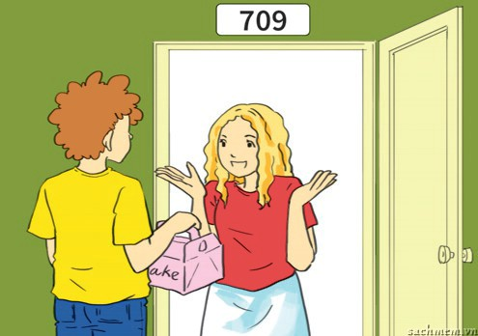
What should / shouldn’t we do?
5. You __________ bring gifts when you visit someone’s house.
A. should
B. shouldn’t

Slide 7
UNIT 4:
Lesson 3: A closer look 2

Slide 8


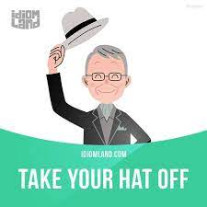
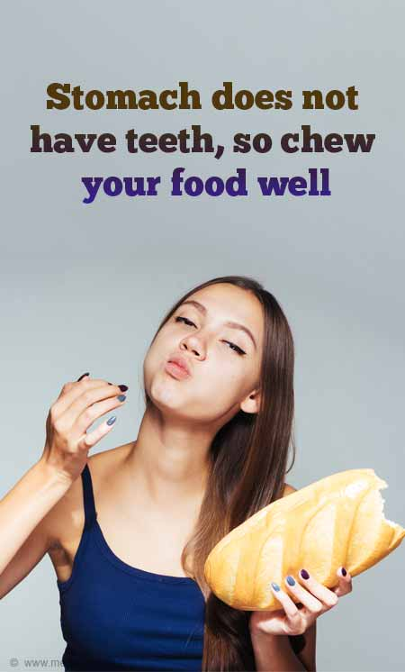
New words
Bring a gift
Respect old people
sweep the floor

Slide 9

New words
-To respect (V)
-tôn trọng
- To sweep (v)
- Quét nhà
- To bring (V)
- mang
- To chew (v)
- nhai
- To take off (V)
- cởi ra

Slide 10
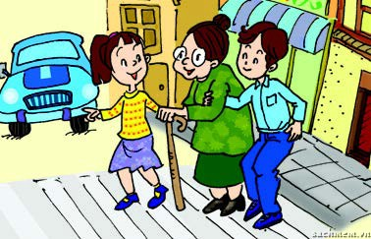
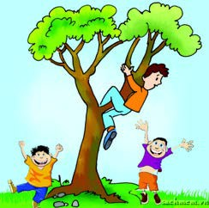
GRAMMAR:
1. Should and shouldn’t to express advice: review
* Form:
S + should/ shouldn’t + V
- We should help old people.
- Children shouldn’t climb trees.

Slide 11
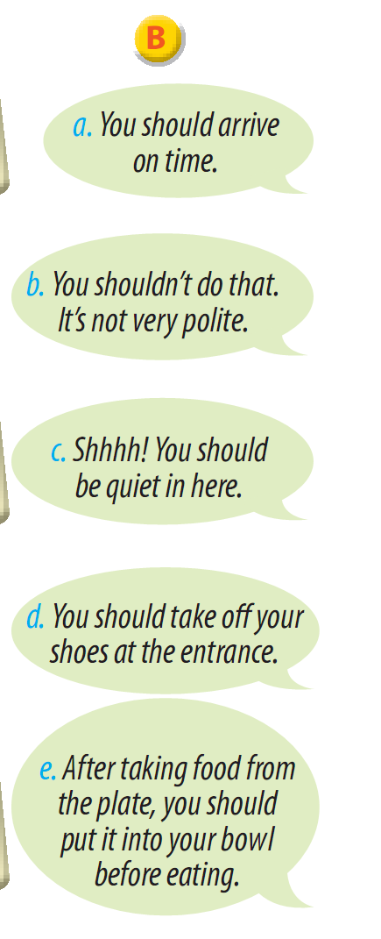
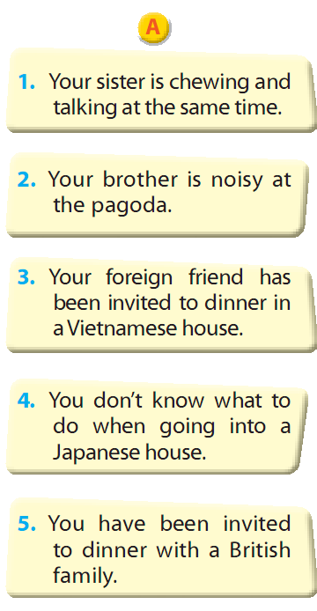
2. Match the situations in A and the advice in B.
key:
1 – b
2 – c
3 – e
4 – d
5 – a

Slide 12
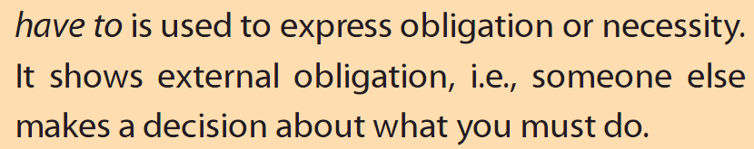
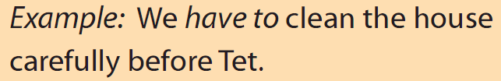
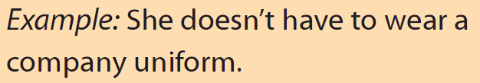
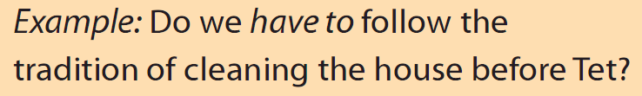
2. ‘Have to’ to express obligation or necessity.

Slide 13
3. Complete the sentences with the correct form of have to.
have to
My mother says that I __________ be home by 9 p.m. sharp.
We __________ go now because our dad is waiting for us.
She __________ wear that costume because it’s the family tradition.
In the past, men __________ wear ao dai, but today they _______________ wear it.
Before leaving the dinner table, __________ your son __________ ask for permission?
We _______________ go to school today because it was raining heavily.
have to
has to
had to
don’t have to
does
have to
didn’t have to

Slide 14
4. Choose A or B to convey the meaning of the first sentence.
You have to take your hat off when going inside the main worship area of the temple.
A. You can take your hat off if you want to.
B. You’re not allowed to wear your hat.
You don’t have to tip in Viet Nam.
A. It’s not necessary to tip in Viet Nam.
B. You’re not allowed to tip in Viet Nam.
Students mustn’t run or be noisy in the school building.
A. Running and being noisy aren’t allowed in the school building.
B. They can run and be noisy if they want to.
In the past, Vietnamese people had to live with their parents even after they got married.
A. They could live with their parents after they got married.
B. They were obliged to live with their parents after they got married.

Slide 15
Remember
01
‘Don’t have to’ is used when it is not necessary to do something.
Ex:
My mother doesn’t have to work on Saturdays.
02
If you want to tell somebody not to do something as an obligation, use ‘must not/ mustn’t’ instead.
Ex:
You mustn’t wear short skirts in here.

Slide 16
5. Mi is going to visit her friend Eri in Japan. Read Eri’s email.
There are six mistakes in it. Can you find and correct them?
Hello Mi,
I’m so excited about your trip. It’s going to be amazing!
I shouldn’t give you some advice, so you can prepare for Japan. We have lots of customs and it can get a bit confusing for visitors.
Firstly, you has to take off your shoes when you go inside. You shouldn’t wear slippers in the house - but you didn’t have to bring any, we have extra pairs for guests. Then you have use different slippers in the bathroom and in the garden, but you’ll get used to it! You should worry - I’ll be there to help you.
All for now, gotta go…
Eri x
2. → have to
3.→ should wear
6.→ shouldn’t worry
4.→ don’t have to
1. → should give
5.→ have to use

Slide 17

Thank you and good bye!

