Slide 1

UNIT 4: MY NEIGHBOURHOOD
LESSON 2: A CLOSER LOOK 1

Slide 2
MINI GAME: MAGIC WORD
1
P
R
K
A
2
H
O
S
P
I
T
A
L
3
M
A
R
K
E
T
4
C
I
N
E
M
A
5
M
U
S
E
U
M
6
S
T
R
E
E
T
S

Slide 3
1. It is a large area of land with a lot of trees. People often go there for pleasure or children can play in it.

Slide 4
2. A place where injured or ill people are taken care of by doctors and nurses.

Slide 5
3. It's a place where people buy or sell things.

Slide 6
4. People often go to the c______ to watch movies.

Slide 7
5. It's a building where objects of historical, scientific or artistic things are kept.

Slide 8
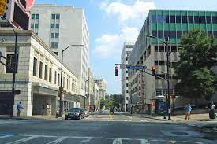
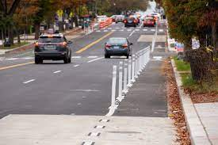
6. What are they?

Slide 9


Activity 1. Listen and repeat. Match the places with the pictures.

Slide 10
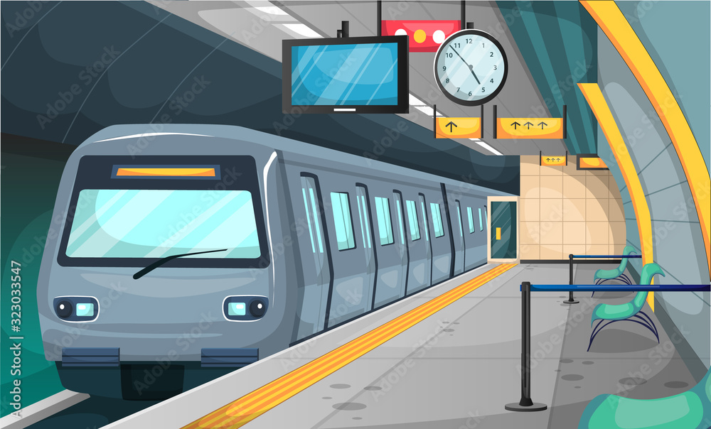
Act 1. Match the places with the pictures.
railway station (n)
/ˈreɪl.weɪ/ /’steɪ.ʃən/
nhà ga

Slide 11
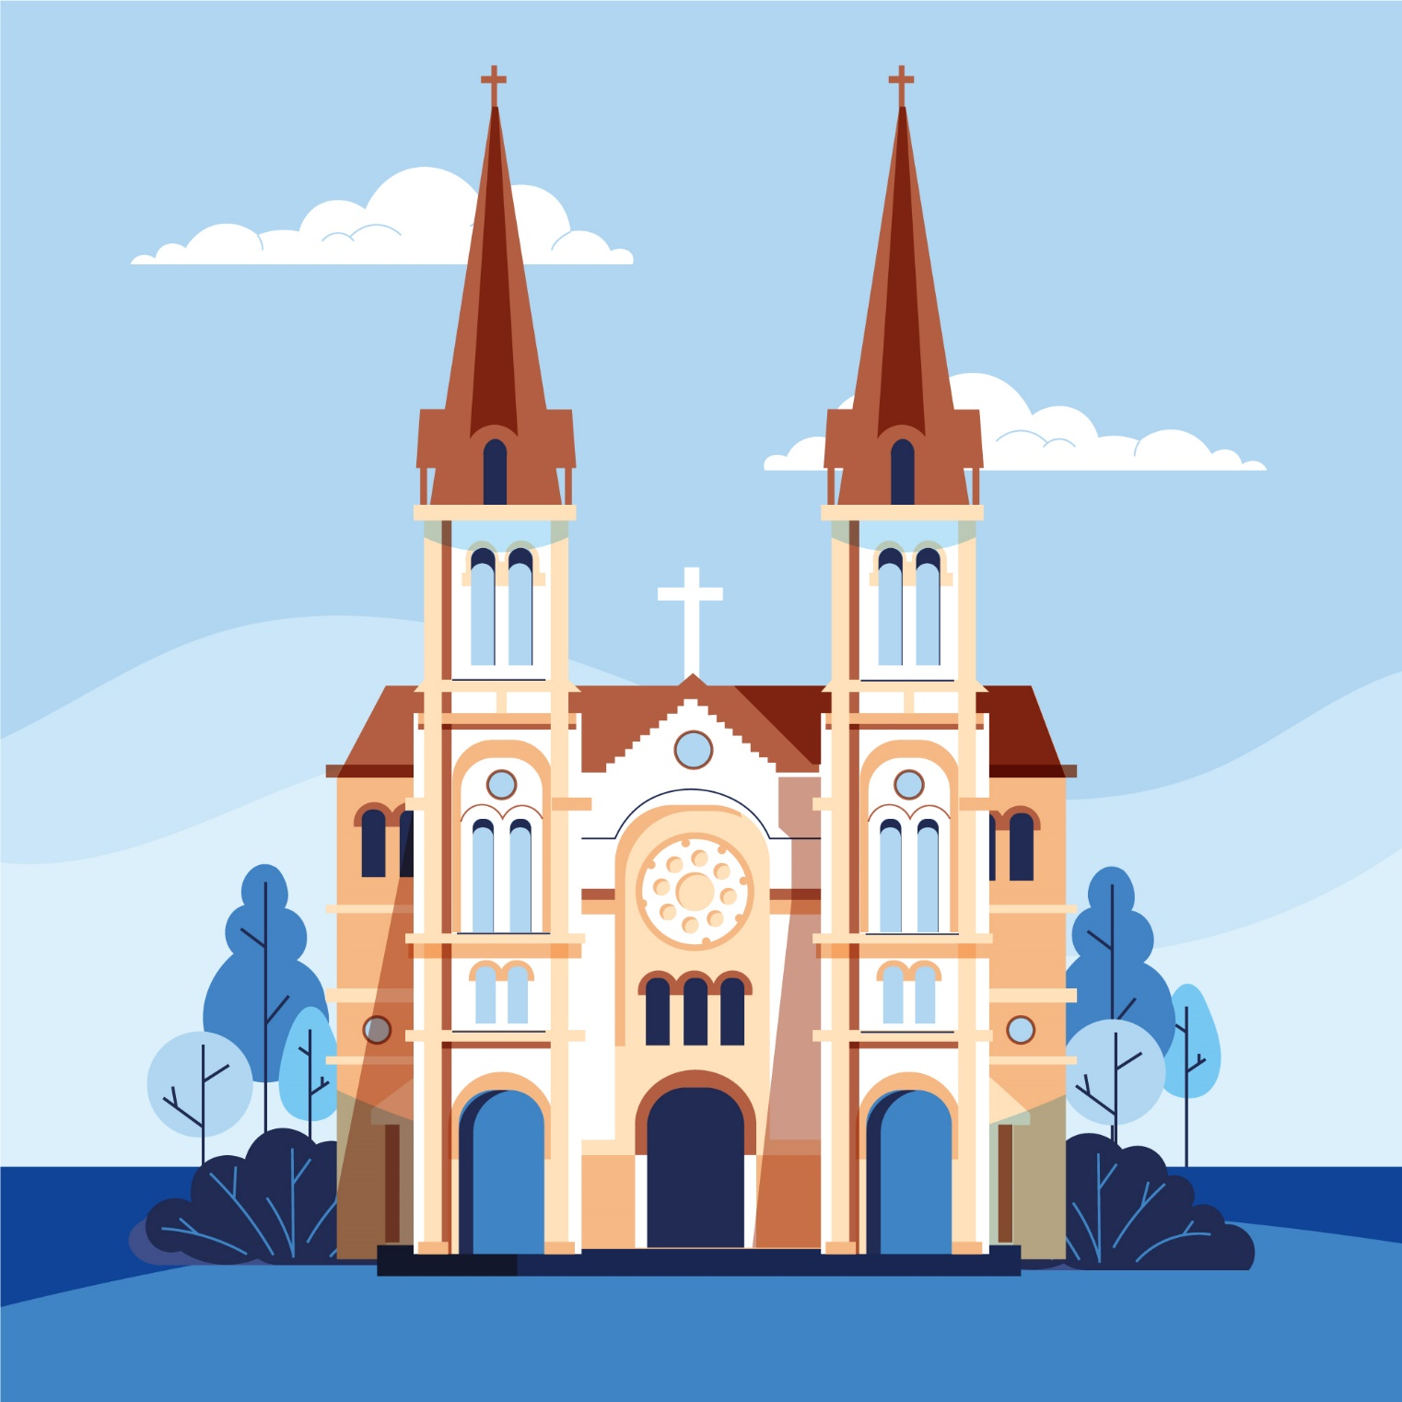
Act 1. Match the places with the pictures.
cathedral (n)
/kəˈθiː.drəl/
nhà thờ

Slide 12
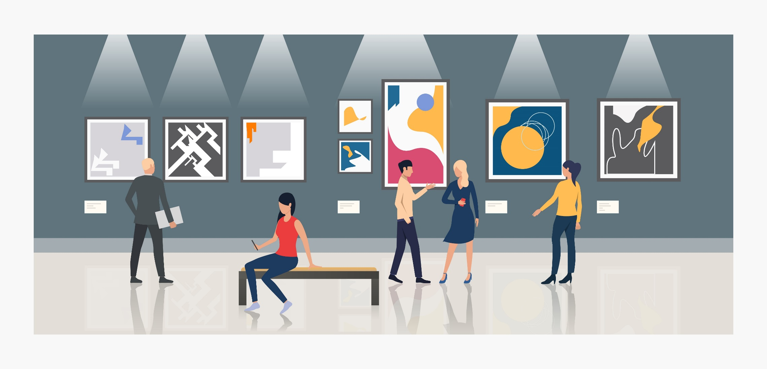
Act 1. Match the places with the pictures.
art gallery (n)
/ˈɑːt/ /’ɡæl.ər.i/
triển lãm
nghệ thuật

Slide 13

Act 1. Match the places with the pictures.
temple (n)
/ˈtem.pəl/
đền, miếu

Slide 14
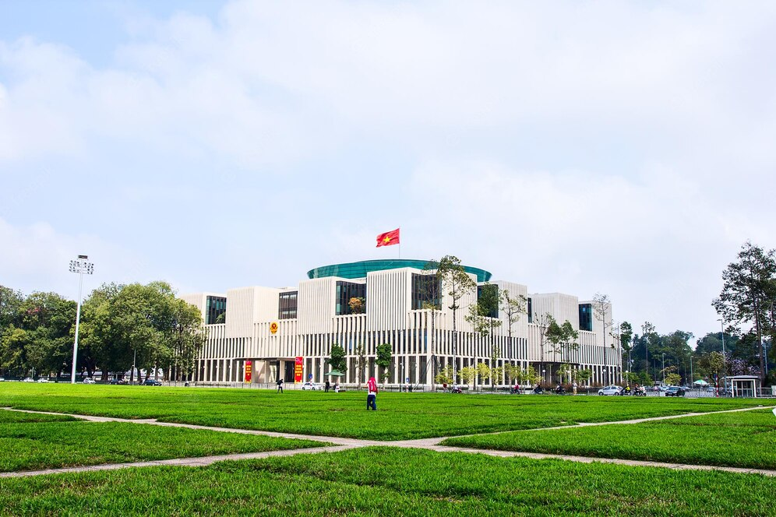
Act 1. Match the places with the pictures.
square (n)
/skweər/
quảng trường

Slide 15
Act 2. MINI GAME: WORD SEARCH
G | N | S | U | V | D | V | I | N | G
M | O | D | E | R | N | K | E | A | M
A | I | R | E | C | U | X | N | L | A
E | S | P | E | A | C | E | F | U | L
D | Y | U | Q | U | I | E | T | X | Y
C | V | X | B | U | K | L | I | S | A
B | E | A | U | T | I | F | U | L | L
B | O | R | I | N | G | B | D | E | V
C | A | B | G | H | M | E | W | T | H
H | I | C | R | O | W | D | E | D | K

Slide 16
MINI GAME: WORD SEARCH
G | N | S | U | V | D | V | I | N | G
M | O | D | E | R | N | K | E | A | M
A | I | R | E | C | U | X | N | L | A
E | S | P | E | A | C | E | F | U | L
D | Y | U | Q | U | I | E | T | X | Y
C | V | X | B | U | K | L | I | S | A
B | E | A | U | T | I | F | U | L | L
B | O | R | I | N | G | B | D | E | V
C | A | B | G | H | M | E | W | T | H
H | I | C | R | O | W | D | E | D | K

Slide 17
Act 3. Ask and answer about your neighborhood.
A: Is your neighborhood quiet?
B: No, it isn't. It's noisy.
A: Is there a cathedral in your neighborhood?
B: Yes, there is.

Slide 18
PRONUNCIATION:
/ɪ/
/i:/
noisy
peaceful
friendly
clean
cheap
expensive
exciting
convenient

Slide 19
PRONUNCIATION:
/ɪ/
/i:/
noisy
convenient
exciting
clean
expensive
cheap
friendly
peaceful

Slide 20
LISTEN AND PRACTISE THE CHANT:
MY NEIGHBORHOOD
My city is very noisy.
There are lots of trees growing.
The people here are busy.
It's a lively place to live in.
My village is very pretty.
There are lots of places to see.
The people here are friendly.
It's a fantastic place to be.

Slide 21
CONSOLIDATION:
- Revise names of different places in your neighborhood.
- List different adjectives to describe a place or a neighborhood.
- Recognize and pronounce the sound /ɪ/ and /i:/ correctly.

Slide 22
HOME WORK:
- Prepare the next lesson: Unit 4 - A closer look 2
- Revise all vocabulary items.
- Practice pronouncing the sound /ɪ/ and /i:/ more at home.

Slide 23

THANK YOU!

