Slide 1
Unit 5
Natural wonders of Vietnam
Lesson 5: Skills 1

Slide 2
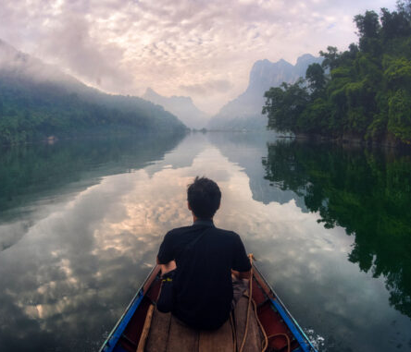
01.
READING

Slide 3

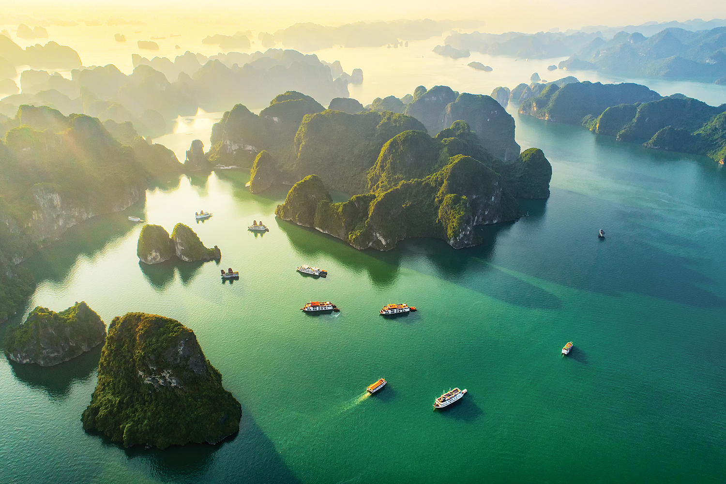
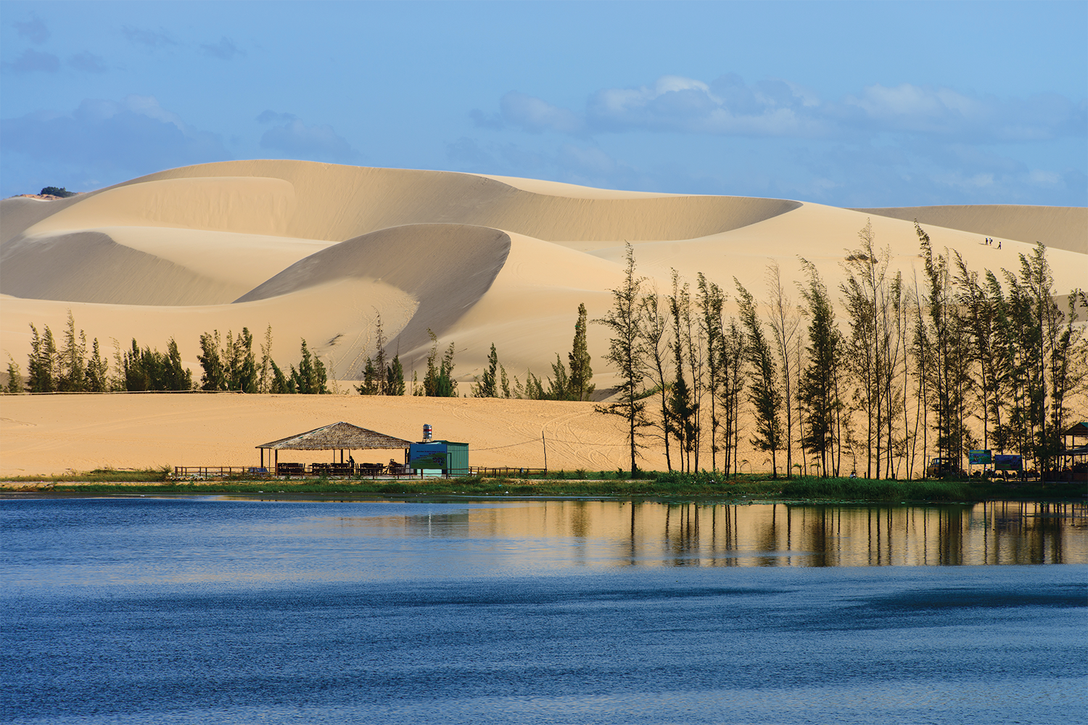
I want to visit some natural wonders in Vietnam. Now, let's read a brochure.
1. Can you guess what is it about?
Ha Long Bay is in Quang Ninh. …
Mui Ne is popular for its amazing landscapes. …
Tom
2. What do you know about these places?

Slide 4
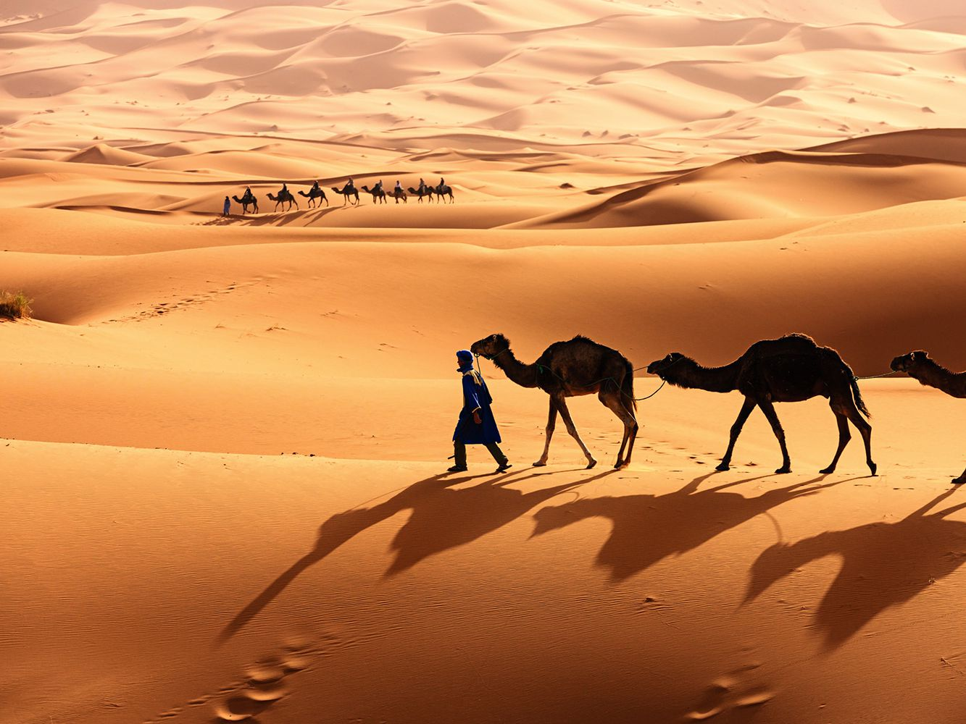
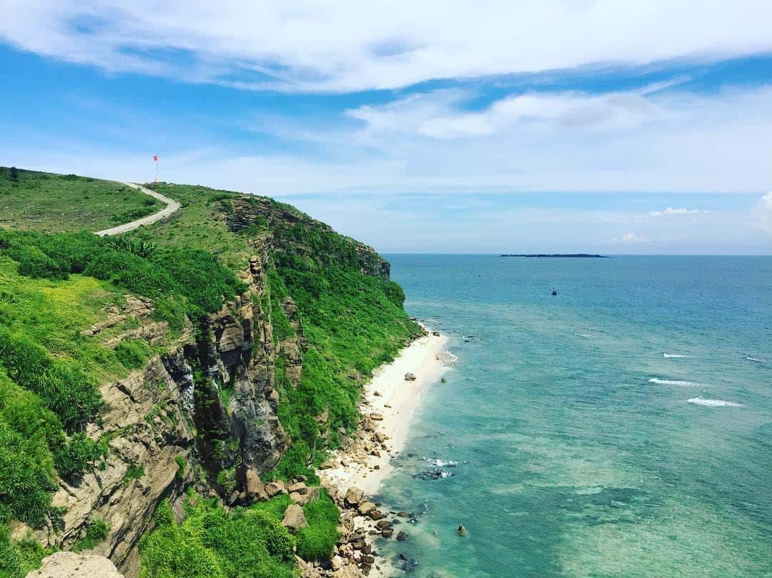
Ex 2 (p.45) Complete the sentences, using the words from the box.
desert wonder visit islands remember
islands
1. Ha Long Bay is famous for its beautiful ________.
2. Ha Long Bay is the number one natural ________ in Viet Nam.
3. A ________ is a large area of land with very little water.
4. __________ to bring an umbrella, as it often rains there.
5. A lot of people ________ Ly Son Island in the summer.
wonder
desert
Remember
visit

Slide 5
Ex 3 (p.45) Before you read, underline the key words.
Ex 3 (p.45) Read the text again. Answer the following questions.
Ha Long Bay is in Quang Ninh. It has many islands and cave. Tuan Chau, with its beautiful beaches, is a popular tourist attraction in Ha Long Bay. There you can enjoy great seafood. And you can join in exciting activities. Ha Long Bay is Viet Nam's best natural wonder.
Mui Ne is popular for its amazing landscapes. The sand has different colours: white, yellow, red ... Its like a desert here. You can ride a bike down the slopes. You can also fly kites. or have a picnic by the beach. The best time to visit the Mui Ne Sand Dunes is early morning or late afternoon. Remember to wear suncream and bring water.
1. Where is Ha Long Bay?
2. What can do at Ha Long Bay?
3. Is there a desert in Mui Ne?
4. Where can you have a picnic in Mui Ne?
5. What is the best time to visit the Mui Ne Sand Dunes?

Slide 6











Notes:
FONT USED: BadaBoom BB

Slide 7







Slide 8







?

Slide 9

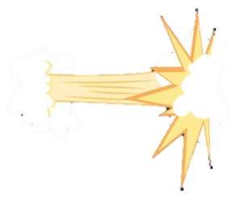







Slide 10







Notes:
Click the icon in the bottom right corner to go to the “Final Battle” bonus round.
I have the students rock paper scissors for who gets to answer the bonus question, but use it however you see fit! ☺

Slide 11
Ex 3 (p.45) Read the text again. Answer the following questions.
Ha Long Bay is in Quang Ninh. It has many islands and cave. Tuan Chau, with its beautiful beaches, is a popular tourist attraction in Ha Long Bay. There you can enjoy great seafood. And you can join in exciting activities. Ha Long Bay is Viet Nam's best natural wonder.
Mui Ne is popular for its amazing landscapes. The sand has different colours: white, yellow, red ... Its like a desert here. You can ride a bike down the slopes. You can also fly kites. or have a picnic by the beach. The best time to visit the Mui Ne Sand Dunes is early morning or late afternoon. Remember to wear suncream and bring water.
1. Where is Ha Long Bay?
2. What can do at Ha Long Bay?
3. Is there a desert in Mui Ne?
4. Where can you have a picnic in Mui Ne?
5. What is the best time to visit the Mui Ne Sand Dunes?
In Quang Ninh.

Slide 12





+ 1
?

Slide 13
Ex 3 (p.45) Read the text again. Answer the following questions.
Ha Long Bay is in Quang Ninh. It has many islands and cave. Tuan Chau, with its beautiful beaches, is a popular tourist attraction in Ha Long Bay. There you can enjoy great seafood. And you can join in exciting activities. Ha Long Bay is Viet Nam's best natural wonder.
Mui Ne is popular for its amazing landscapes. The sand has different colours: white, yellow, red ... Its like a desert here. You can ride a bike down the slopes. You can also fly kites. or have a picnic by the beach. The best time to visit the Mui Ne Sand Dunes is early morning or late afternoon. Remember to wear suncream and bring water.
1. Where is Ha Long Bay?
2. What can do at Ha Long Bay?
3. Is there a desert in Mui Ne?
4. Where can you have a picnic in Mui Ne?
5. What is the best time to visit the Mui Ne Sand Dunes?
In Quang Ninh.
We can enjoy (great) seafood and join in exciting activities.

Slide 14
+ 4
?

Slide 15
Ex 3 (p.45) Read the text again. Answer the following questions.
Ha Long Bay is in Quang Ninh. It has many islands and cave. Tuan Chau, with its beautiful beaches, is a popular tourist attraction in Ha Long Bay. There you can enjoy great seafood. And you can join in exciting activities. Ha Long Bay is Viet Nam's best natural wonder.
Mui Ne is popular for its amazing landscapes. The sand has different colours: white, yellow, red ... Its like a desert here. You can ride a bike down the slopes. You can also fly kites. or have a picnic by the beach. The best time to visit the Mui Ne Sand Dunes is early morning or late afternoon. Remember to wear suncream and bring water.
1. Where is Ha Long Bay?
2. What can do at Ha Long Bay?
3. Is there a desert in Mui Ne?
4. Where can you have a picnic in Mui Ne?
5. What is the best time to visit the Mui Ne Sand Dunes?
In Quang Ninh.
We can enjoy (great) seafood and join in exciting activities.
No, there isn’t.

Slide 16
- 3
?

Slide 17
Ex 3 (p.45) Read the text again. Answer the following questions.
Ha Long Bay is in Quang Ninh. It has many islands and cave. Tuan Chau, with its beautiful beaches, is a popular tourist attraction in Ha Long Bay. There you can enjoy great seafood. And you can join in exciting activities. Ha Long Bay is Viet Nam's best natural wonder.
Mui Ne is popular for its amazing landscapes. The sand has different colours: white, yellow, red ... Its like a desert here. You can ride a bike down the slopes. You can also fly kites, or have a picnic by the beach. The best time to visit the Mui Ne Sand Dunes is early morning or late afternoon. Remember to wear suncream and bring water.
1. Where is Ha Long Bay?
2. What can do at Ha Long Bay?
3. Is there a desert in Mui Ne?
4. Where can you have a picnic in Mui Ne?
5. What is the best time to visit the Mui Ne Sand Dunes?
In Quang Ninh.
We can enjoy (great) seafood and join in exciting activities.
No, there isn’t.
By the beach.

Slide 18
- 2
?

Slide 19
Ex 3 (p.45) Read the text again. Answer the following questions.
Ha Long Bay is in Quang Ninh. It has many islands and cave. Tuan Chau, with its beautiful beaches, is a popular tourist attraction in Ha Long Bay. There you can enjoy great seafood. And you can join in exciting activities. Ha Long Bay is Viet Nam's best natural wonder.
Mui Ne is popular for its amazing landscapes. The sand has different colours: white, yellow, red ... Its like a desert here. You can ride a bike down the slopes. You can also fly kites, or have a picnic by the beach. The best time to visit the Mui Ne Sand Dunes is early morning or late afternoon. Remember to wear suncream and bring water.
1. Where is Ha Long Bay?
2. What can do at Ha Long Bay?
3. Is there a desert in Mui Ne?
4. Where can you have a picnic in Mui Ne?
5. What is the best time to visit the Mui Ne Sand Dunes?
In Quang Ninh.
We can enjoy (great) seafood and join in exciting activities.
No, there isn’t.
By the beach.
Early morning or late afternoon

Slide 20
CHANGE
?

Slide 21
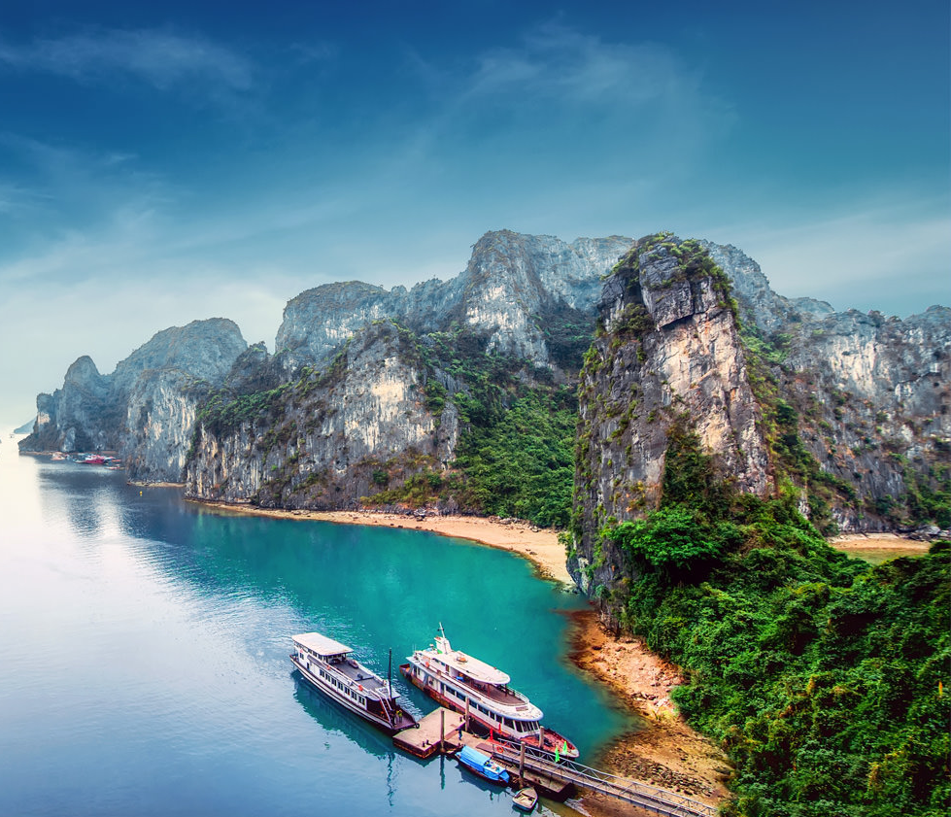
02.
SPEAKING

Slide 22

To describe a tourist attraction, what should you talk about?
Ha Long Bay is in Quang Ninh. It has many islands and cave. Tuan Chau, with its beautiful beaches, is a popular tourist attraction in Ha Long Bay. There you can enjoy great seafood. And you can join in exciting activities. Ha Long Bay is Viet Nam's best natural wonder.
Mui Ne is popular for its amazing landscapes. The sand has different colours: white, yellow, red ... Its like a desert here. You can ride a bike down the slopes. You can also fly kites, or have a picnic by the beach. The best time to visit the Mui Ne Sand Dunes is early morning or late afternoon. Remember to wear suncream and bring water.
Name of the attraction

Slide 23
To describe a tourist attraction, what should you talk about?
Ha Long Bay is in Quang Ninh. It has many islands and cave. Tuan Chau, with its beautiful beaches, is a popular tourist attraction in Ha Long Bay. There you can enjoy great seafood. And you can join in exciting activities. Ha Long Bay is Viet Nam's best natural wonder.
Mui Ne is popular for its amazing landscapes. The sand has different colours: white, yellow, red ... Its like a desert here. You can ride a bike down the slopes. You can also fly kites, or have a picnic by the beach. The best time to visit the Mui Ne Sand Dunes is early morning or late afternoon. Remember to wear suncream and bring water.
Name of the attraction
Its special features / beauty / interesting things

Slide 24
To describe a tourist attraction, what should you talk about?
Ha Long Bay is in Quang Ninh. It has many islands and cave. Tuan Chau, with its beautiful beaches, is a popular tourist attraction in Ha Long Bay. There you can enjoy great seafood. And you can join in exciting activities. Ha Long Bay is Viet Nam's best natural wonder.
Mui Ne is popular for its amazing landscapes. The sand has different colours: white, yellow, red ... Its like a desert here. You can ride a bike down the slopes. You can also fly kites, or have a picnic by the beach. The best time to visit the Mui Ne Sand Dunes is early morning or late afternoon. Remember to wear suncream and bring water.
Name of the attraction
Its special features / beauty / interesting things
What you can do there?
…

Slide 25



Ex 5 (p.45) Some foreign visitors are visiting your city / town / area. You are their tour guide.
Prepare in 3 minutes.
Some interesting things in your place
• Name of the attraction
• Its special features / beauty / interesting things
• What you can do there

Slide 26
Ex 5 (p.45) Some foreign visitors are visiting your city / town / area. You are their tour guide.
Prepare in 3 minutes
Some interesting things in your place
What they must and mustn't do there
• Name of the attraction
• Its special features / beauty / interesting things
• What you can do there
• You must follow all the rules.
• You mustn't take photos when you are in the City Museum.
• …

Slide 27


Slide 28
Wrap-up
1. What skill have you learned today?
Reading & speaking
2. What is the main topic of the text?
Some information about Ha Long Bay and Mui Ne
3. To describe a tourist attraction, what should we include?
• Name of the attraction
• Its special features / beauty / interesting things
• What you can do there

Slide 29

THANKS!
Please keep this slide for attribution

Slide 30
OBJECTIVES
By the end of the lesson, students will be able to:
□ read for specific information about natural wonders
□ talk about tourist attractions, and what you must / mustn’t do there;

Slide 31
Fonts & colors used
This presentation has been made using the following fonts:
Caveat Brush
(https://fonts.google.com/specimen/Caveat+Brush)
Anaheim
(https://fonts.google.com/specimen/Anaheim)
#fffcf4ff
#1c4587
#ffd7bf
#c9e6e0
#bfd0a2

