Slide 1





UNIT 5:
Natural wonders of Viet Nam
Lesson 6: Skills 2

Slide 2




OBJECTIVES
By the end of the lesson, students will be able to:
  Listen for specific information about a natural wonder
  Write a paragraph about a natural wonder

Slide 3






LISTENING

Slide 4

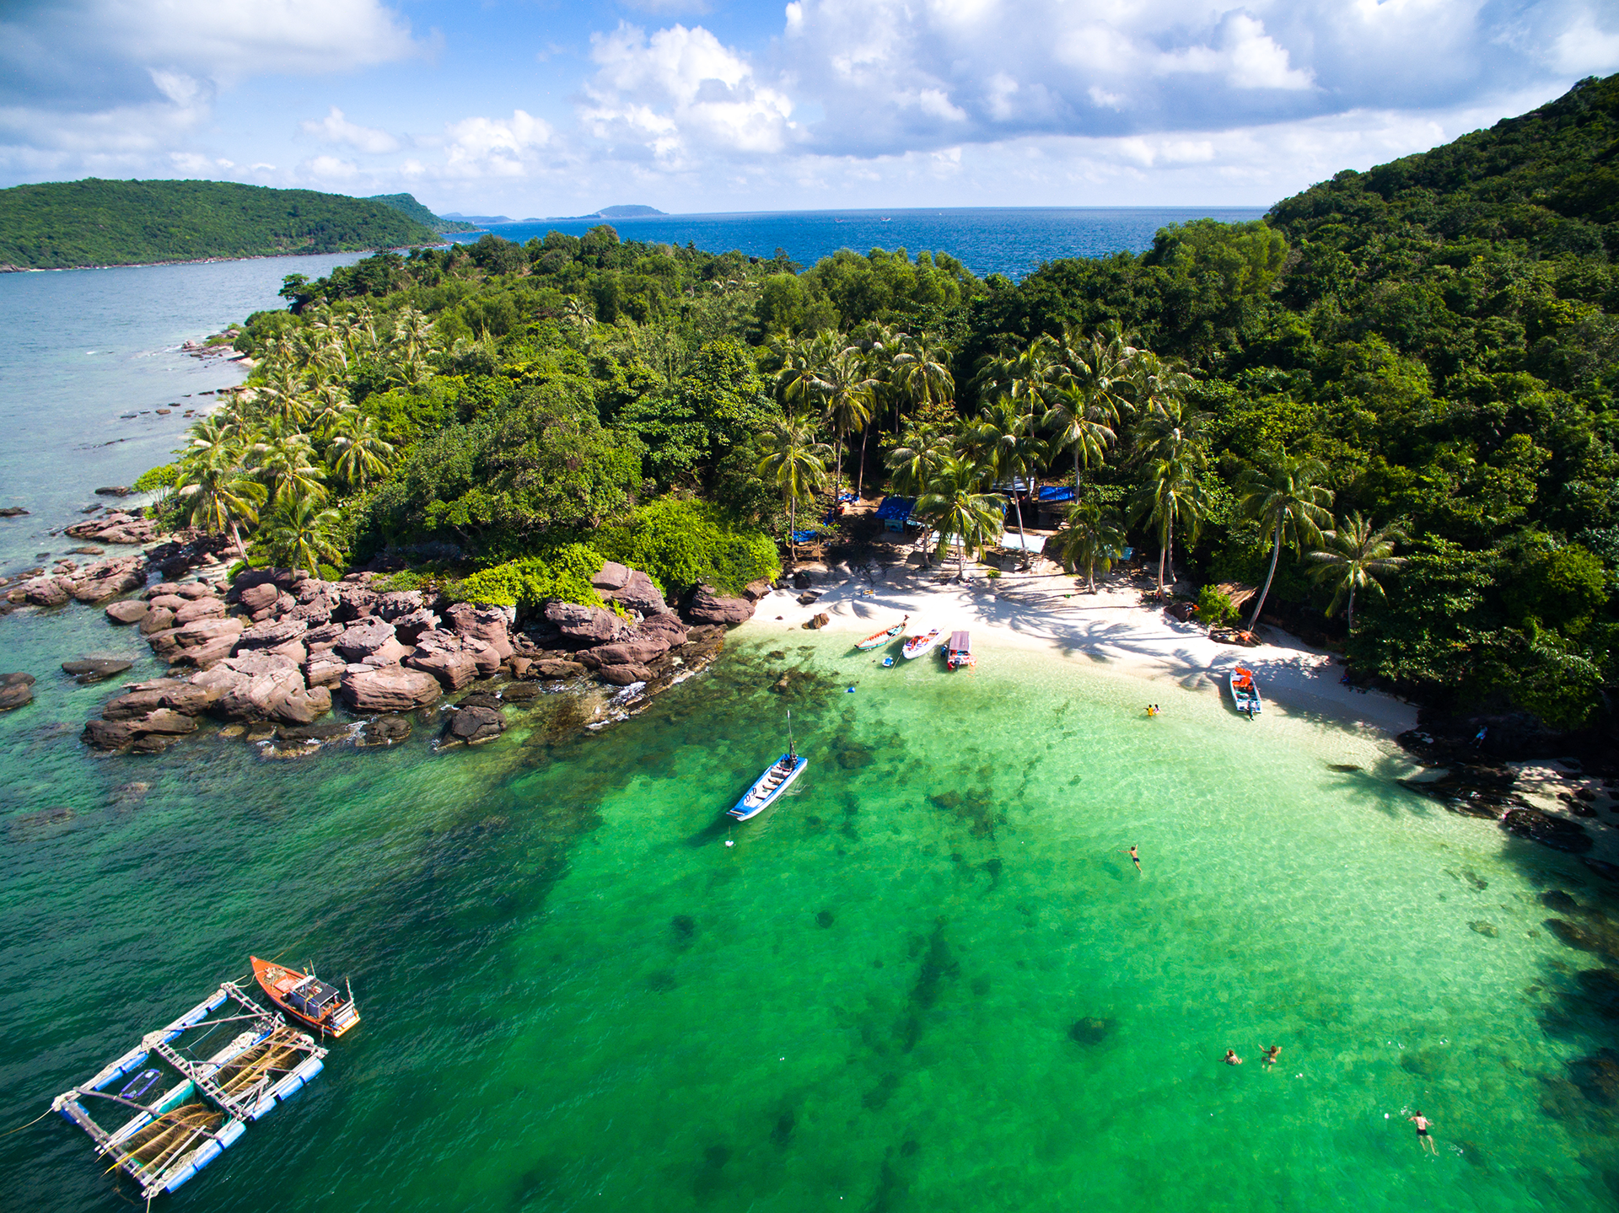


PHU QUOC ISLAND
Where is it?
What do you know about Phu Quoc Island?
Listen and check your answers.
Notes:
I really want to travel. Let’s guess the place I wanna go to.

Slide 5


2. Listen again and tick () T (True) or F (False).
 |  | T | F
1. | Phu Quoc is a very beautiful island in Viet Nam.
2. | There are no green forests in Phu Quoc.
3. | Tourists can visit fishing villages and national parks there.
4. | You cannot play water sports in Phu Quoc.
5. | People sell interesting things at the markets.

Slide 6
Let’s check
 |  | T | F
1. | Phu Quoc is a very beautiful island in Viet Nam.
2. | There are no green forests in Phu Quoc.
3. | Tourists can visit fishing villages and national parks there.
4. | You cannot play water sports in Phu Quoc.
5. | People sell interesting things at the markets.
Phu Quoc is a very beautiful island in Viet Nam. It is in Kien Giang.
Phu Quoc is a very beautiful island in Viet Nam. It is in Kien Giang.


Slide 7
Let’s check
 |  | T | F
1. | Phu Quoc is a very beautiful island in Viet Nam.
2. | There are no green forests in Phu Quoc.
3. | Tourists can visit fishing villages and national parks there.
4. | You cannot play water sports in Phu Quoc.
5. | People sell interesting things at the markets.

It has beautiful beaches and green forests. It also has resorts, hotels, and bars.
It has beautiful beaches and green forests. It also has resorts, hotels, and bars.


Slide 8
Let’s check
 |  | T | F
1. | Phu Quoc is a very beautiful island in Viet Nam.
2. | There are no green forests in Phu Quoc.
3. | Tourists can visit fishing villages and national parks there.
4. | You cannot play water sports in Phu Quoc.
5. | People sell interesting things at the markets.


Tourists can visit fishing villages, national parks, pagodas and temples.
Tourists can visit fishing villages, national parks, pagodas and temples.


Slide 9
Let’s check
 |  | T | F
1. | Phu Quoc is a very beautiful island in Viet Nam.
2. | There are no green forests in Phu Quoc.
3. | Tourists can visit fishing villages and national parks there.
4. | You cannot play water sports in Phu Quoc.
5. | People sell interesting things at the markets.



They also like to eat the seafood here. It is delicious. Sailing and fishing are popular water sports.
They also like to eat the seafood here. It is delicious. Sailing and fishing are popular water sports.


Slide 10
Let’s check
 |  | T | F
1. | Phu Quoc is a very beautiful island in Viet Nam.
2. | There are no green forests in Phu Quoc.
3. | Tourists can visit fishing villages and national parks there.
4. | You cannot play water sports in Phu Quoc.
5. | People sell interesting things at the markets.




You can buy interesting things at the markets on the island.
You can buy interesting things at the markets on the island.


Slide 11
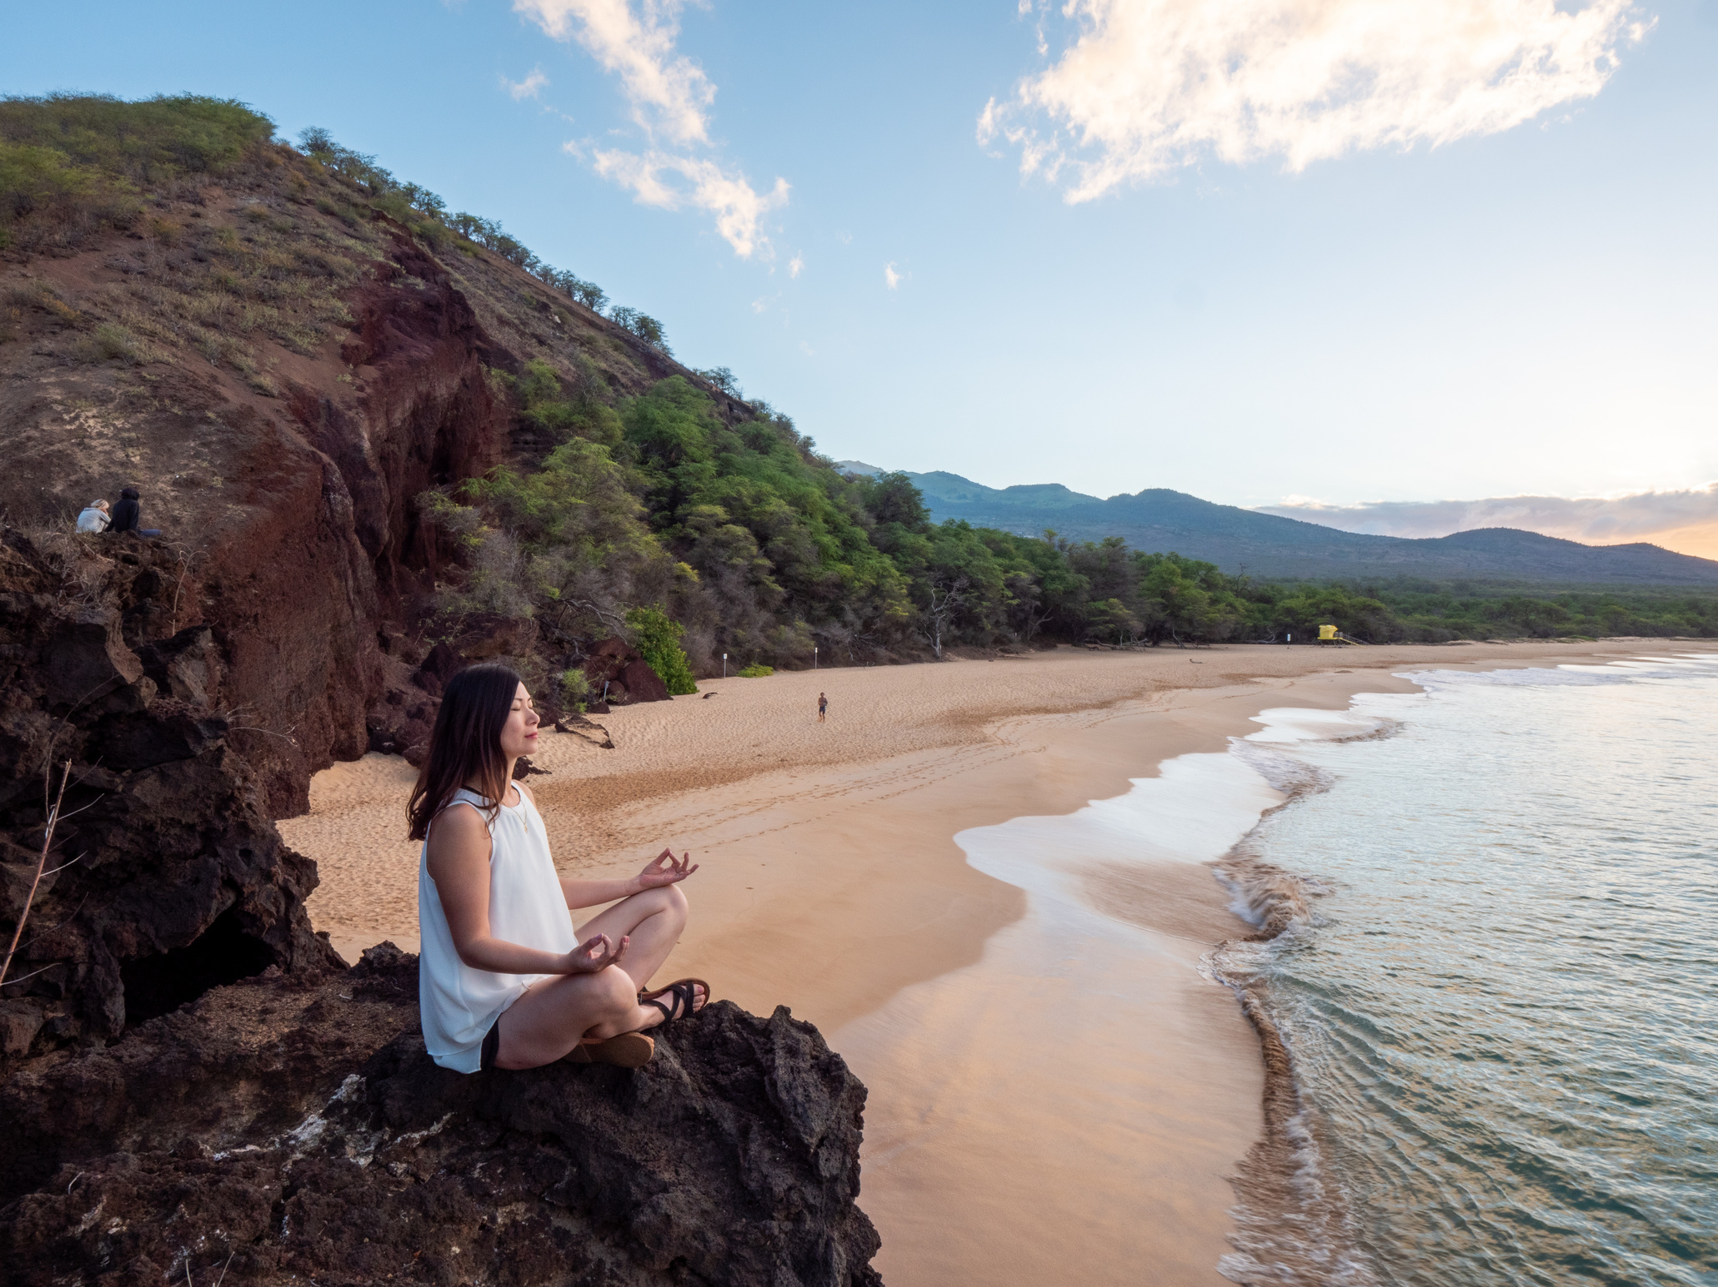


Where do you want to visit?
Let’s write about it!
Notes:
That’s the place where I want to visit/ What’s about you. Where do you want to visit

Slide 12


WRITING

Slide 13



3. Fill each blank in the network.
Think of a travel attraction you know
Note the information about it
3 minutes
(3) How can you go there?
(2) Where is it?
(1) Name of the attraction
(5) What can you do there?
(4) What is special about it?

Slide 14
3. Fill each blank in the network.
For example:
(3) How can you go there?
(2) Where is it?
Kien Giang
By plane
(1) Name of the attraction
Phu Quoc
(5) What can you do there?
(4) What is special about it?
visit fishing villages, national parks, pagodas and temples, …
beautiful beaches and green forests

Slide 15


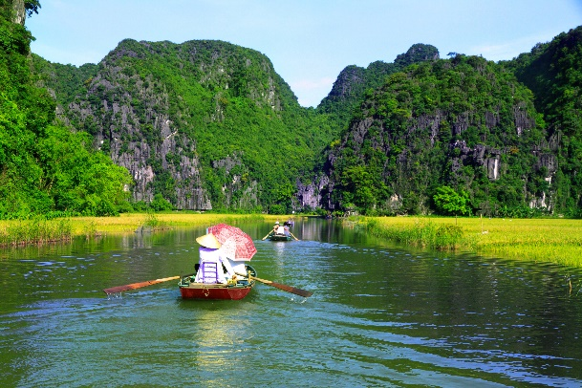
4. Write about a travel attraction you know.
Use the notes in 3 to write a paragraph
about 50 words.
10 minutes
I am writing about
It is in

Slide 16

Example
I am writing about Phu Quoc Island. It is in Kien Giang. Visitors can go there by plane. Phu Quoc Island has beautiful beaches and green forests. It also has resorts, hotels, and bars. The people here are friendly. Tourists can visit fishing villages, national parks, pagodas and temples. They also like to eat the seafood here. It is delicious. Sailing and fishing are popular water sports. You can buy interesting things at the markets on the island.

Slide 17
Peer check
Criteria | Yes | No
1. Are the verbs in the correct form?
2. Are the nouns in the correct form?
3. Is the spelling correct?
4. Has the paragraph answered all questions?

Slide 18

Rewrite your paragraph.
The 2nd draft

Slide 19



Thank you for listening!

