Slide 1
UNIT 2: MY HOUSE
LESSON 7: LOOKING BACK

Slide 2
OBJECTIVES
Review the vocabulary and grammar of Unit 2

Slide 3
PRONUNCIATION

Slide 4
/s/ | /ɪz/ | /z/
Những từ kết thúc bằng /k/, /t/, /f/, /p/, /θ/ | Những từ kết thúc bằng các phụ âm gió như: /z/, /s/, /ʒ/, /∫/, /dʒ/ và /t∫/ | Các động từ nguyên mẫu không thuộc hai trường hợp trên
books /bʊks/ hats /hæts/, laughs /lɑːfs/ lips /lɪps/ months /mʌnθs/ | rises /raɪziz/ races /reɪsiz/ kisses /kɪsiz/ garages /ɡəˈrɑːʒiz/ washes /wɒʃiz/ fridges /frɪdʒɪz/ witches /wɪtʃiz/ | sees /siːz/, gloves /ɡlʌvz/, dreams /driːmz/, says /seɪz/

Slide 5
Mark the letter A, B, C or D on your answer sheet to indicate the word whose underlined part differs from the other three in pronunciation in each of the following questions.
1. A. coughs B. sings C. stops D. sleeps
2. A. signs B. profits C. becomes D. survives
3. A. walks B. steps C. shuts D. plays
4. A. wishes B. practices C. introduces D. leaves
5. A. grasses B. stretches C. comprises D. potatoes
6. A. desks B. maps C. plants D. chairs
7. A. pens B. books C. phones D. tables`
Cách phân âm đuôi s/es
1. phát âm là /s/
âm cuối là âm vô thanh: /f/, /t/, /k/, /p/, /θ/
2. phát âm là /iz/
kết thúc là các phụ âm gió sau: /s/, /z/, /∫/, /t∫/, /dʒ/, /ʒ/
3. phát âm là /z/
âm cuối là âm hữu thanh
/kɒfs/ /sɪŋz/ /stɒps/ /sliːps/
/saɪnz/ /ˈprɒfɪts/ /bɪˈkʌmz/ /səˈvaɪvz/
/wɔːks/ /steps/ /ʃʌts/ /pleɪz/
/wɪʃɪz/ /ˈpræktɪsɪz/ /ˌɪntrəˈdjuːsɪz/ /liːvz/
/ɡrɑːsɪz/ /stretʃɪz/ /kəmˈpraɪzɪz/ /pəˈteɪtəʊz/
/desks/ /mæps/ /ˈplɑːnts/ /tʃeə(r)z/
/penz/ /ˈbʊks/ /fəʊnz/ /ˈteɪblz/

Slide 6
VOCABULARY

Slide 7
VOCABULARY
apartment, co – op, townhome, cabin, chalet, multi – family, in – law suite, tiny house, mobile house, palace, villa, underground house, flat, country house, etc.
Type of house:
Rooms:
living room, bedroom, dining room, bathroom, kitchen, basement, attic, laundry, basement, toilet, etc.
Furniture:
sofa, window, desk chair, aimchair, stool, bed, clock, fan, clothes valet, pillow, mirror, table lamp, television, boolshelf, etc.

Slide 8
Ex1: Put the words into the correct group. Add a new word to each group.
kitchen
bedroom
dishwasher
country house
sink
fridge
town house
chest of drawers
flat
bathroom
cupboard
living room
Types of house | Rooms | Furniture
flat
bedroom
chest of drawers
town house
bathroom
sink
country house
kitchen
fridge
living room
dishwasher
cupboard

Slide 9
GRAMMAR

Slide 10
POSSESSIVE CASE (SỞ HỮU CÁCH)
Do we use ‘s after a singular noun (Danh từ số ít) or plural noun (Danh từ số nhiều) ?
The boy’s book
The girl’s dog
singular noun’s
Ben’s friend
What do we use after a proper name (tên riêng) to show possession (sự sở hữu)?
proper name’s

Slide 11
Ex2: Complete the second sentence with the correct possessive form.
1.
My teacher has a house next to our house.
teacher’s
→ Our house is next to my _____________ house.
2.
My brother has a TV.
brother’s
→ This is my _____________ TV
3.
Elena has a big bookshelf in her bedroom.
Elena’s
→ There’s a big bookshelf in _____________ bedroom
4.
My grandfather likes the kitchen the best.
grandfather’s
→ The kitchen is my _____________ favourite room
5.
My aunt has a daughter, Vy.
Vy’s
→ I’m _____________ cousin.

Slide 12








PREPOSITION OF PLACE (GIỚI TỪ CHỈ NƠI CHỐN)
in / inside
on
at
under
between
behind
in front of
next to

Slide 13
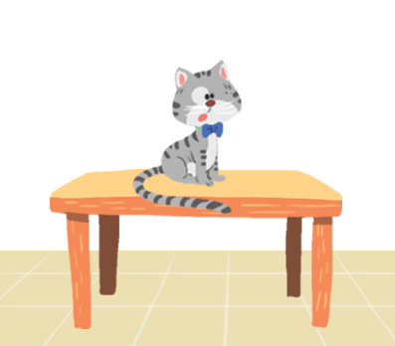
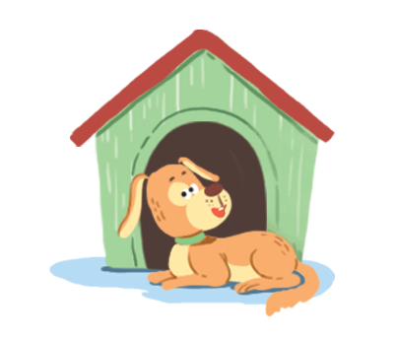
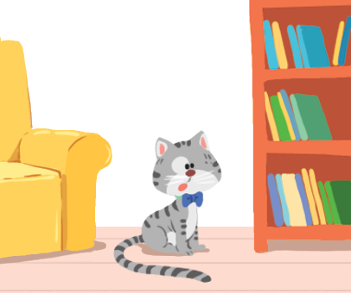

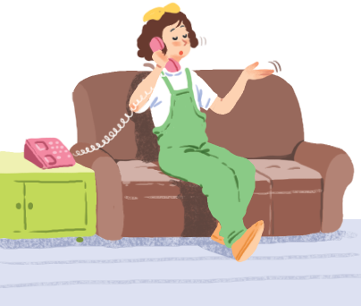
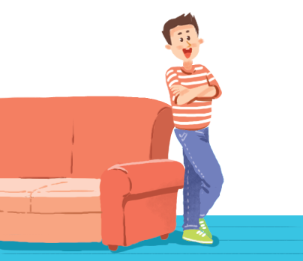
Ex3: Make sentences. Use prepositions of place.
on
in front of
between
1
2
3
behind
on
next to
4
5
6

Slide 14
Ex3: Make sentences. Use prepositions of place.
is on the table
1. The cat _______________.
is in front of the doghouse
2. The dog _______________________.

Slide 15
Ex3: Make sentences. Use prepositions of place.
3. The cat _______________________________.
is between the sofa and the bookself
is behind the computer
4. The cat _______________________.

Slide 16
Ex3: Make sentences. Use prepositions of place.
is on the sofa
is next to the sofa
5. The girl ____________________.
6. The boy __________________.

Slide 17
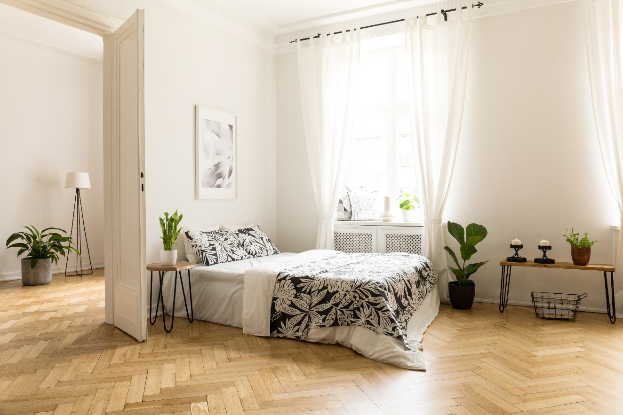
Ex4: Write three sentences to describe your favourite room in your house. Write the sentences in your notebook.
Example:
There’s a big bed next to the door.

Slide 18
Thanks!
SEE YOU NEXT TIME

