Slide 1
Unit 4:
My neighbourhood
Lesson 7:
Looking back

Slide 2
Objecttives
Review the vocabulary and grammar of Unit 4

Slide 3
VOCABULARY
Places in a neighbourhood:
bank, temple, hotel, gas station, hair salon, library, police station, hospital, movie theater, park, zoo, square, art gallery, airport, school, café, etc.

Slide 4
PRONUNCIATION
/i/ | /i:/
Village, shortage, sit, ship, begin, become, remind, build, guitar.
Sea, easy see, free, she, we, ceiling, receive, believe, relieve

Slide 5
GRAMMAR: Comparative adjectives
1. So sánh hơn với tính từ ngắn
S1 + S-adj + er/ S-adv- er + than + S2 + Axiliary V
S1 + S-adj + er/ S-adv- er + than + O/ N/ Pronoun
Trong đó : S-adj-er: là tính từ được thêm đuôi “er”
S-adv-er: là trạng từ được thêm đuôi “er”
S1: Chủ ngữ 1 (Đối tượng được so sánh)
S2: Chủ ngữ 2 (Đối tượng dùng để so sánh với đối tượng 1)
Axiliary V: trợ động từ
(object): tân ngữ
N (noun): danh từ
Pronoun: đại từ
Ví dụ:
- This book is thicker than that one.
- They work harder than I do. = They work harder than me.

Slide 6
GRAMMAR: Comparative adjectives
2. So sánh hơn với tính từ dài
S1 + more + L-adj/ L-adv + than + S2 + Axiliary V
S1 + more + L-adj/ L-adv + than + O/ N/ Pronoun
Trong đó:
L-adj: tính từ dài.
L-adv: trạng từ dài.
Ví dụ:
- He is more intelligent than I am = He is more intelligent than me.
- My friend did the test more carefully than I did = My friend did the test more carefully than me.
Lưu ý: So sánh hơn được nhấn mạnh bằng cách thêm much hoặc far trước hình thức so sánh
Ví dụ: My house is far more expensive than hers.

Slide 7
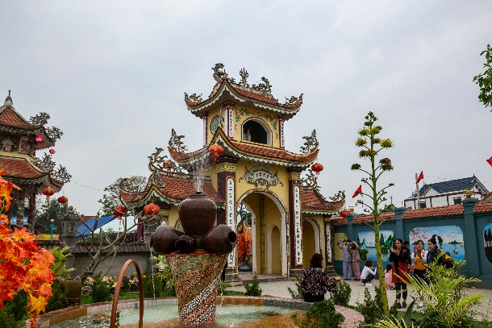
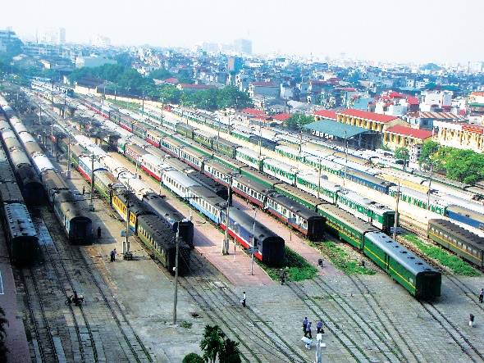
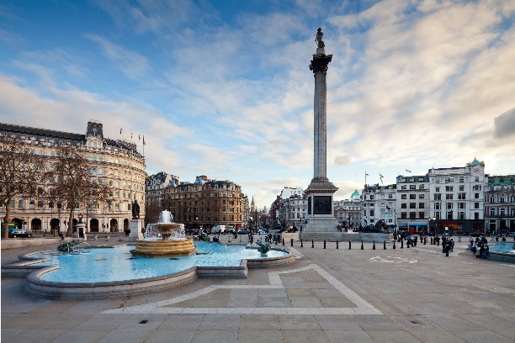
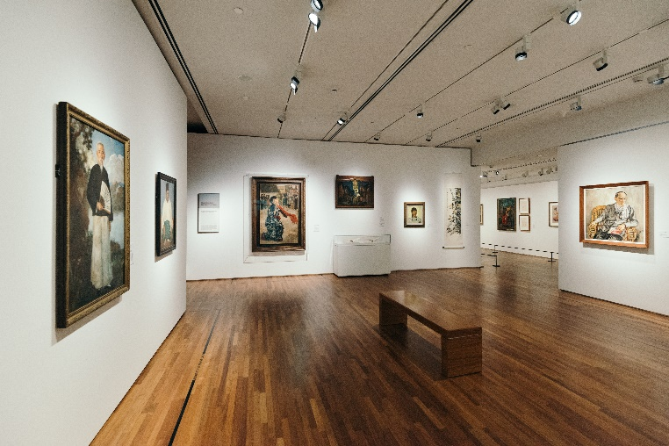
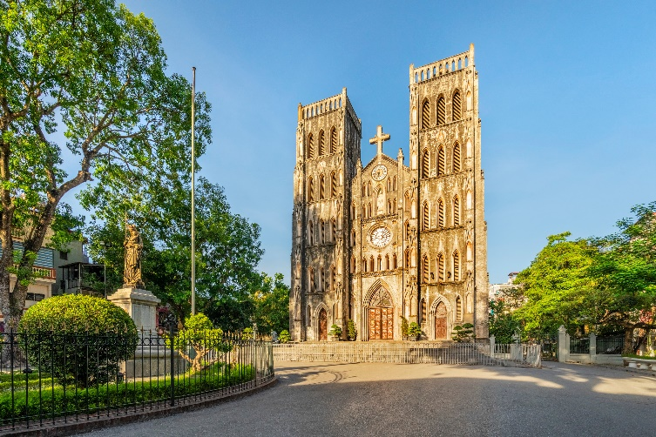
Ex1: Write the name for each picture.

Slide 8
Ex1: Write the name for each picture.
temple
railway station
square

Slide 9
Ex1: Write the name for each picture.
art gallery
cathedral

Slide 10

Ex2: Put the following adjectives in the correct column.
One syllable | Two syllables | Three or more syllables
fast
heavy
expensive
hot
noisy
exciting
large
quite
beautiful

Slide 11
Ex3: Now write their comparative forms in the table below.
Adjectives | Comparative form
fast | faster
beautiful
noisy
expensive
hot
exciting
quiet
heavy
large
more beautiful
noisier
more expensive
hotter
more exciting
quieter
heavier
larger

Slide 12
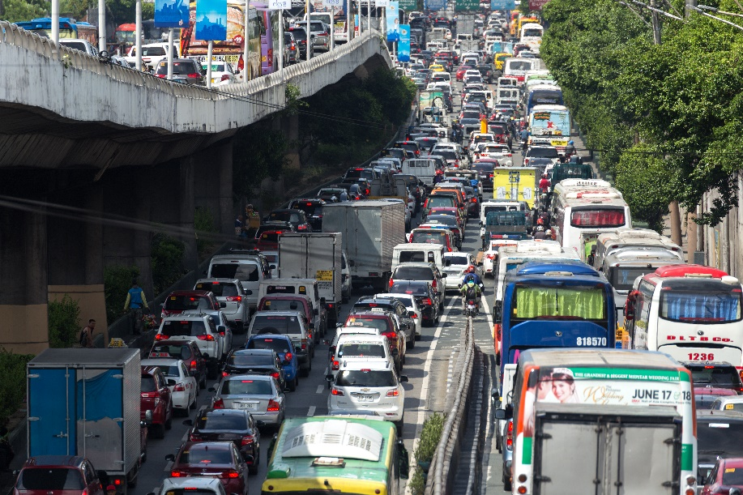
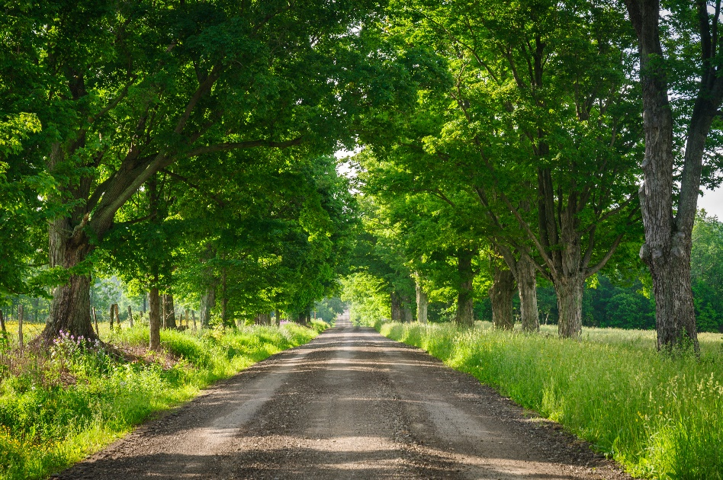
Ex4:Complete the sentences comparing the pictures. Use the comparative forms of the adjectives below.
expensive noisy modern peaceful
noisier
1. The street is ______________ than that one.

Slide 13
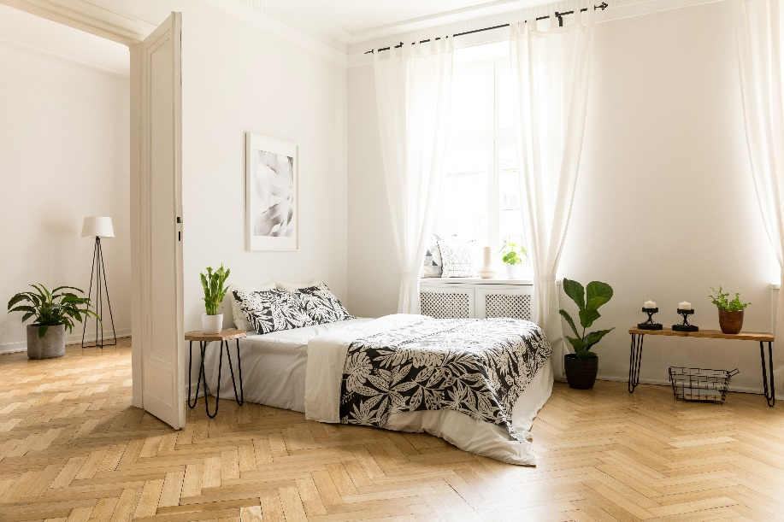
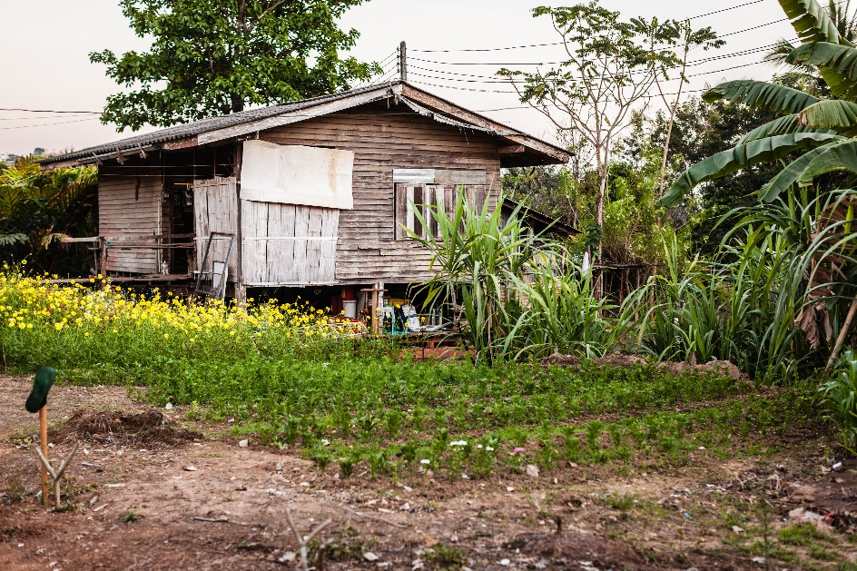
Ex4:Complete the sentences comparing the pictures. Use the comparative forms of the adjectives below.
expensive noisy modern peaceful
more modern
2. A city house is _______________ than a country house.

Slide 14
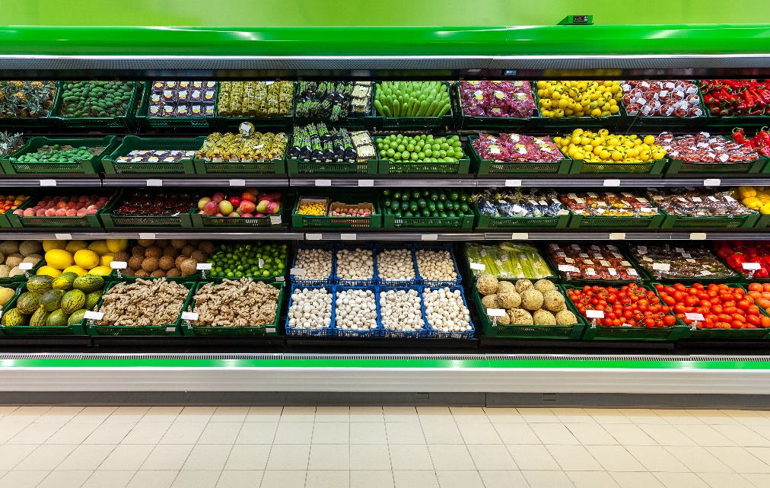
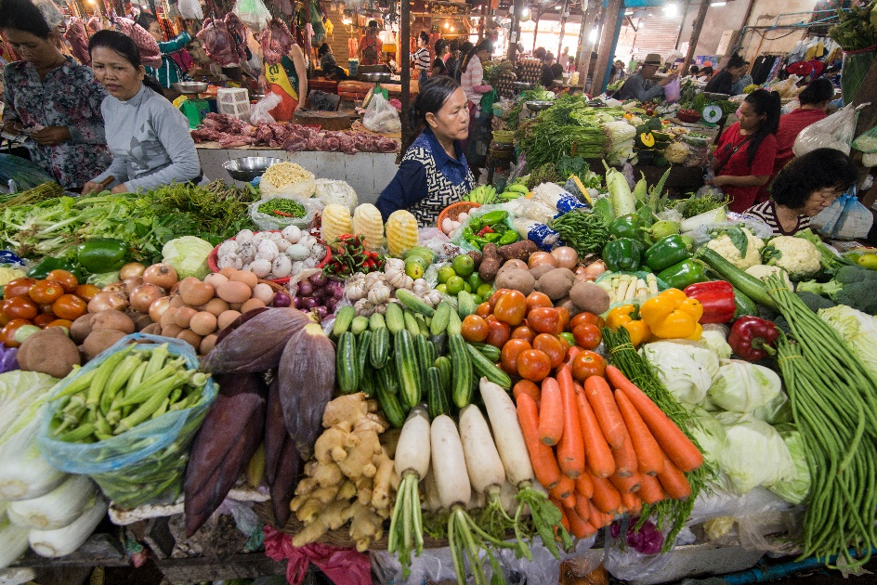
Ex4:Complete the sentences comparing the pictures. Use the comparative forms of the adjectives below.
expensive noisy modern peaceful
more expensive
3. Things at a corner shop are _______________ than things at a village market.

Slide 15
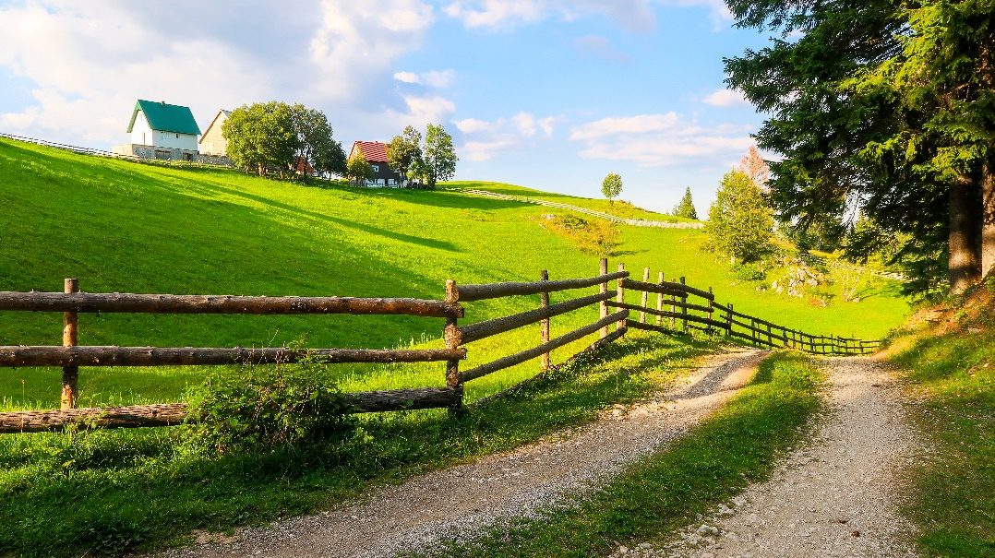
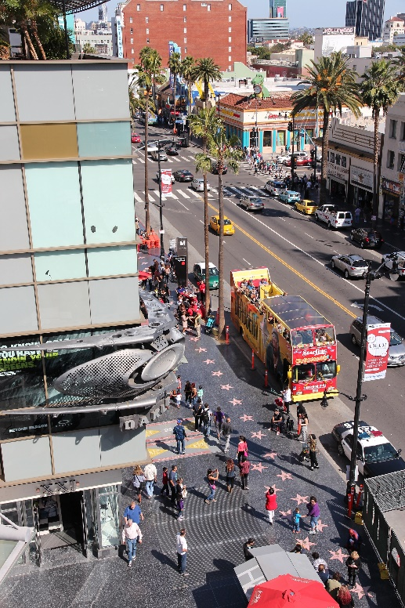
Ex4:Complete the sentences comparing the pictures. Use the comparative forms of the adjectives below.
expensive noisy modern peaceful
more peaceful
4. Life in the countryside is _______________ than life in the city.

Slide 16
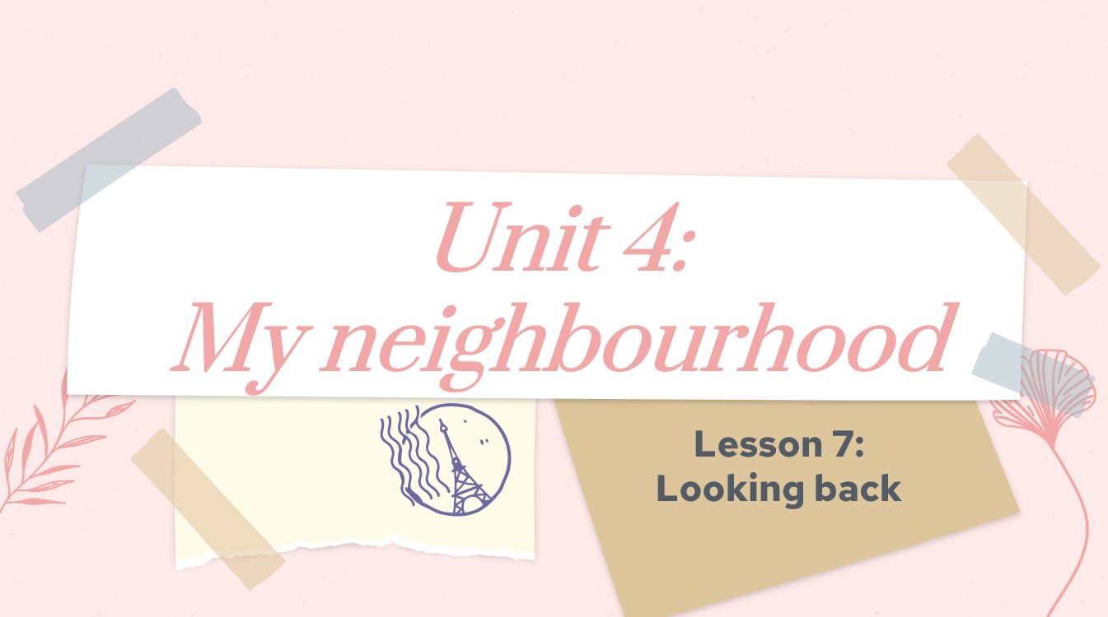
THANK YOU !

