Slide 1

Warmly welcome
all teachers to class 6A1

Slide 3

Watch the video clip

Slide 4
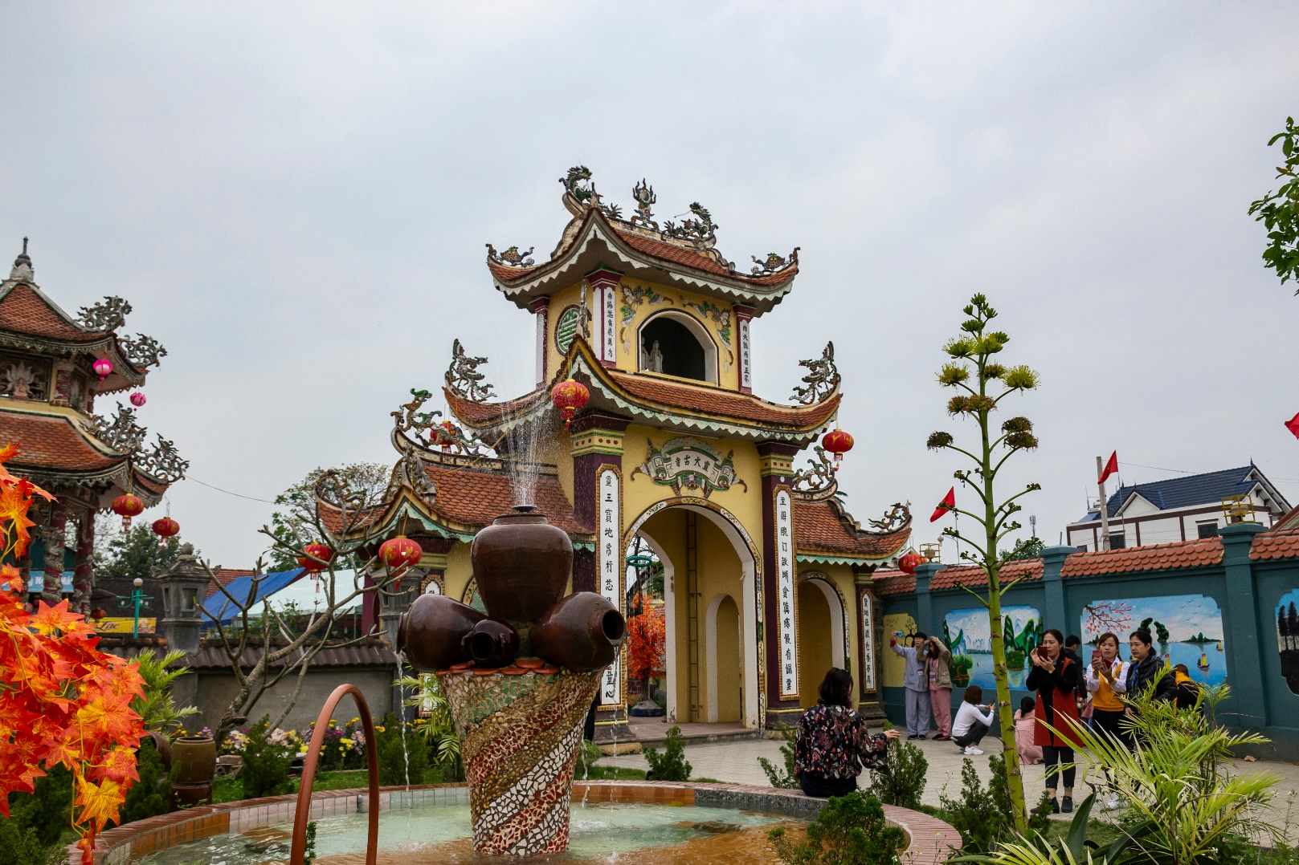
1. temple

Slide 5
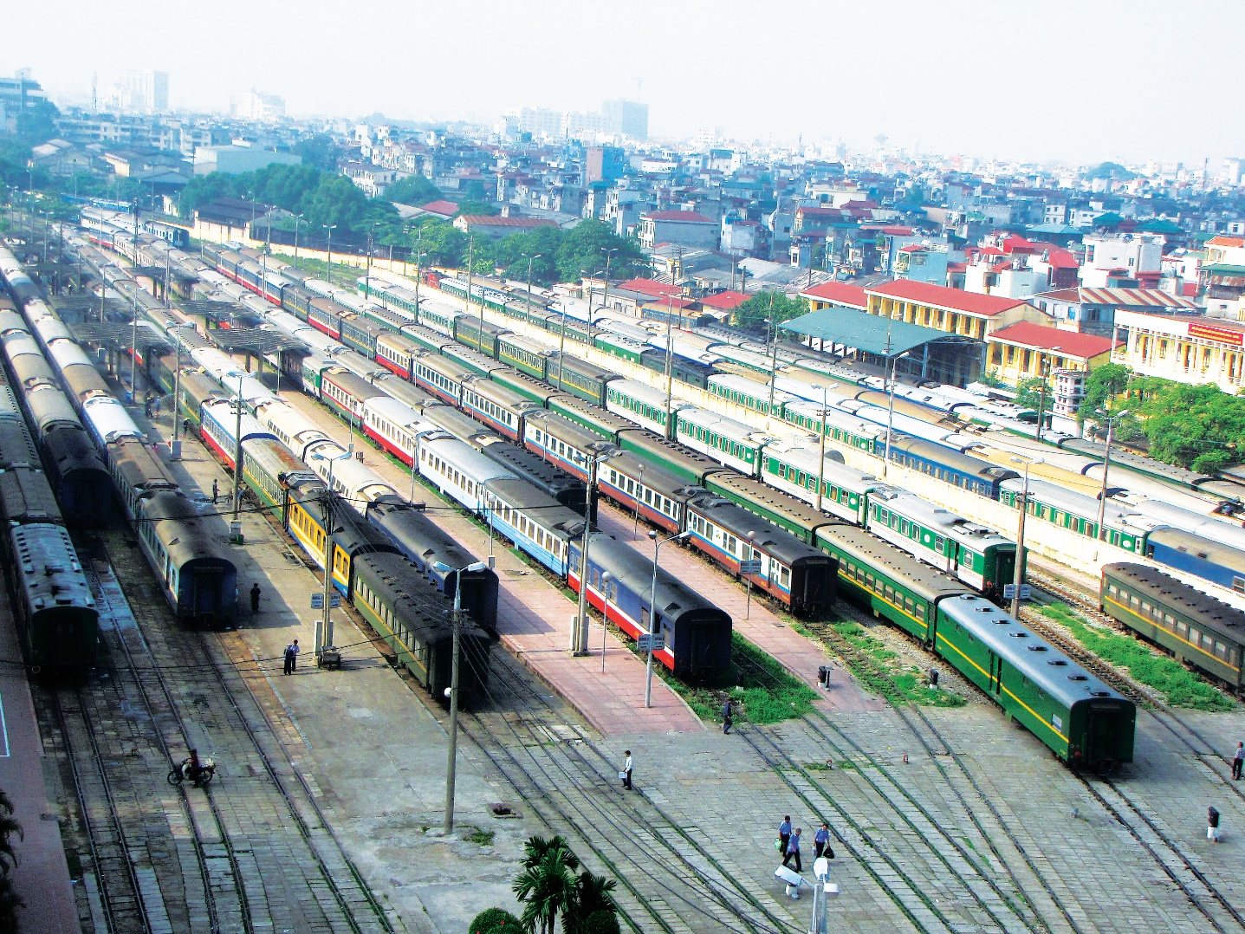
2. railway station

Slide 6
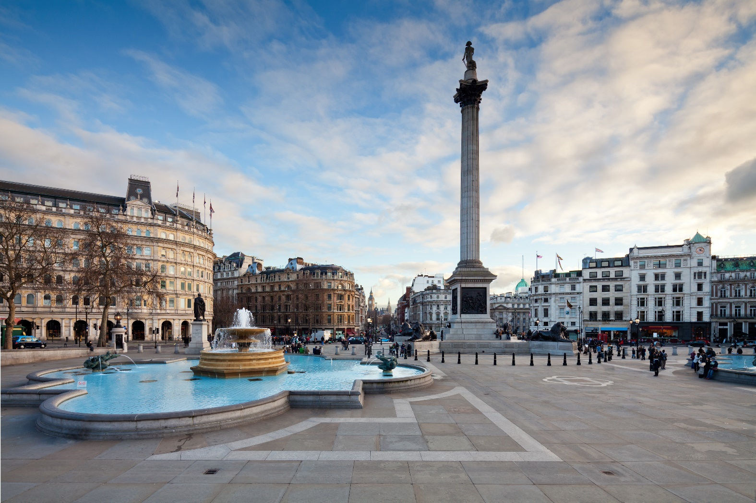
3. square

Slide 7
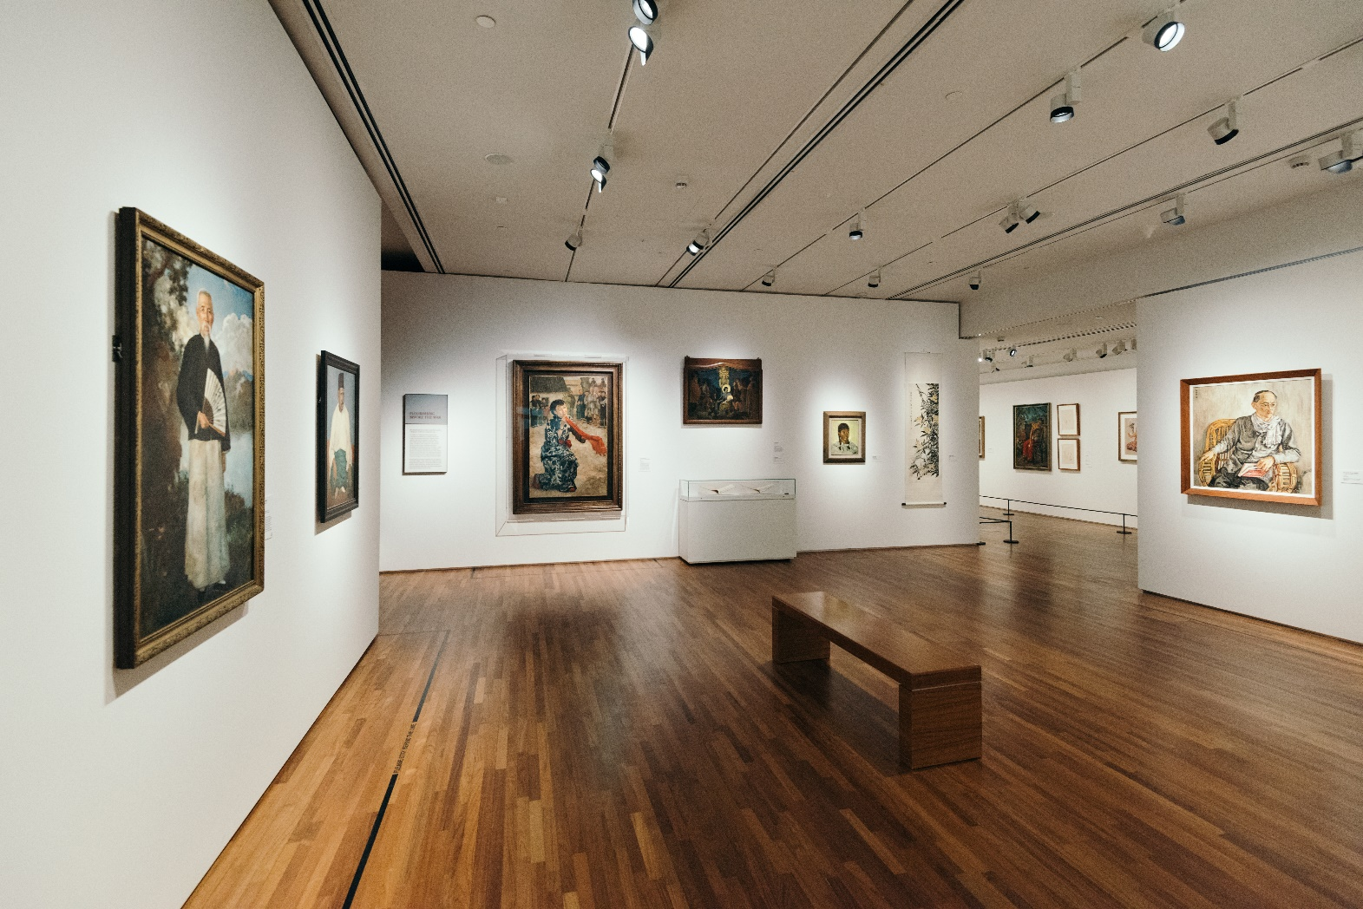
4. art gallery

Slide 8
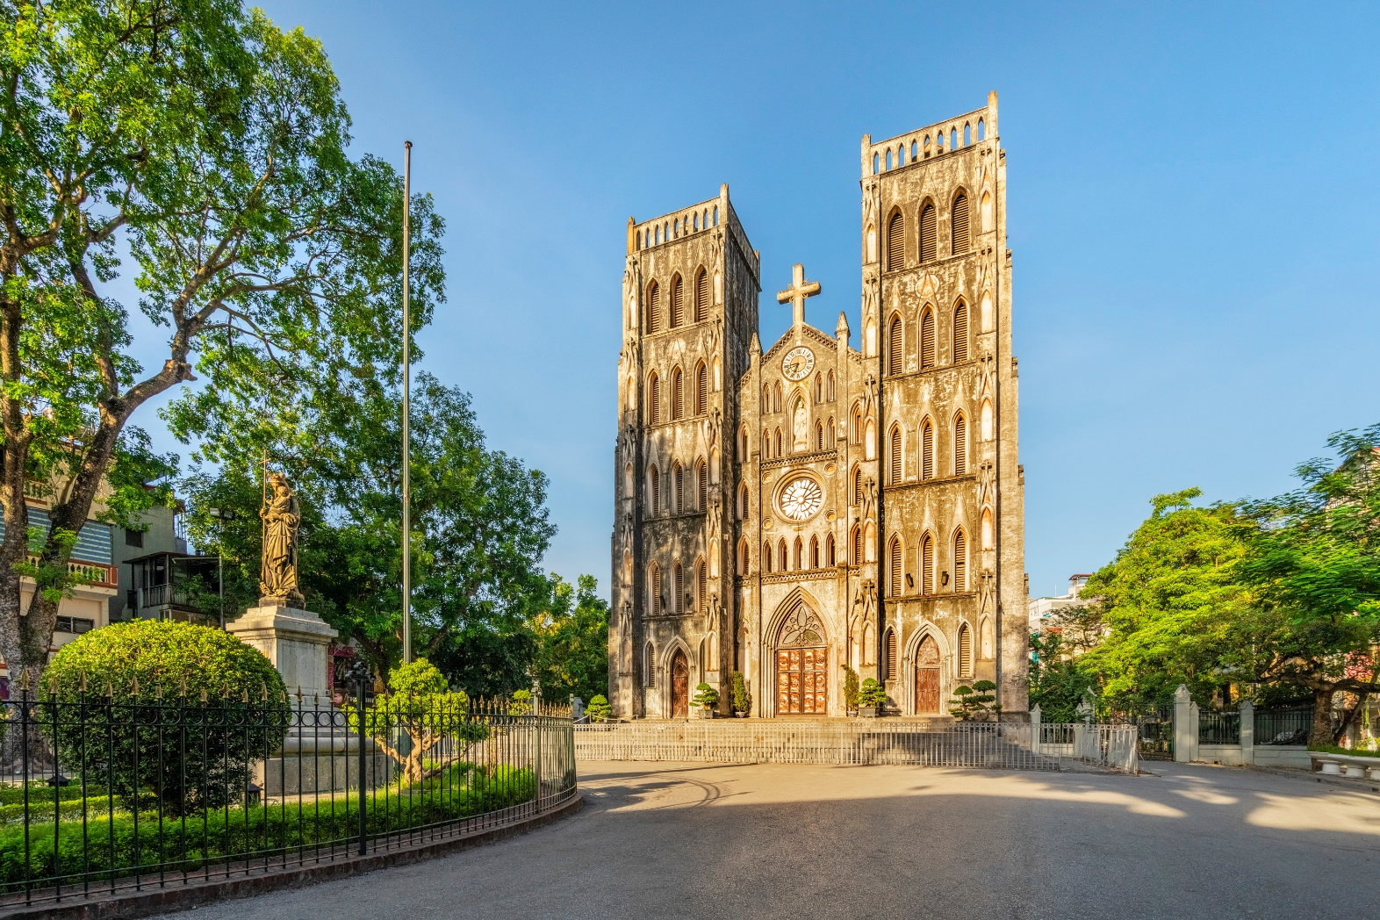
5. cathedral

Slide 9
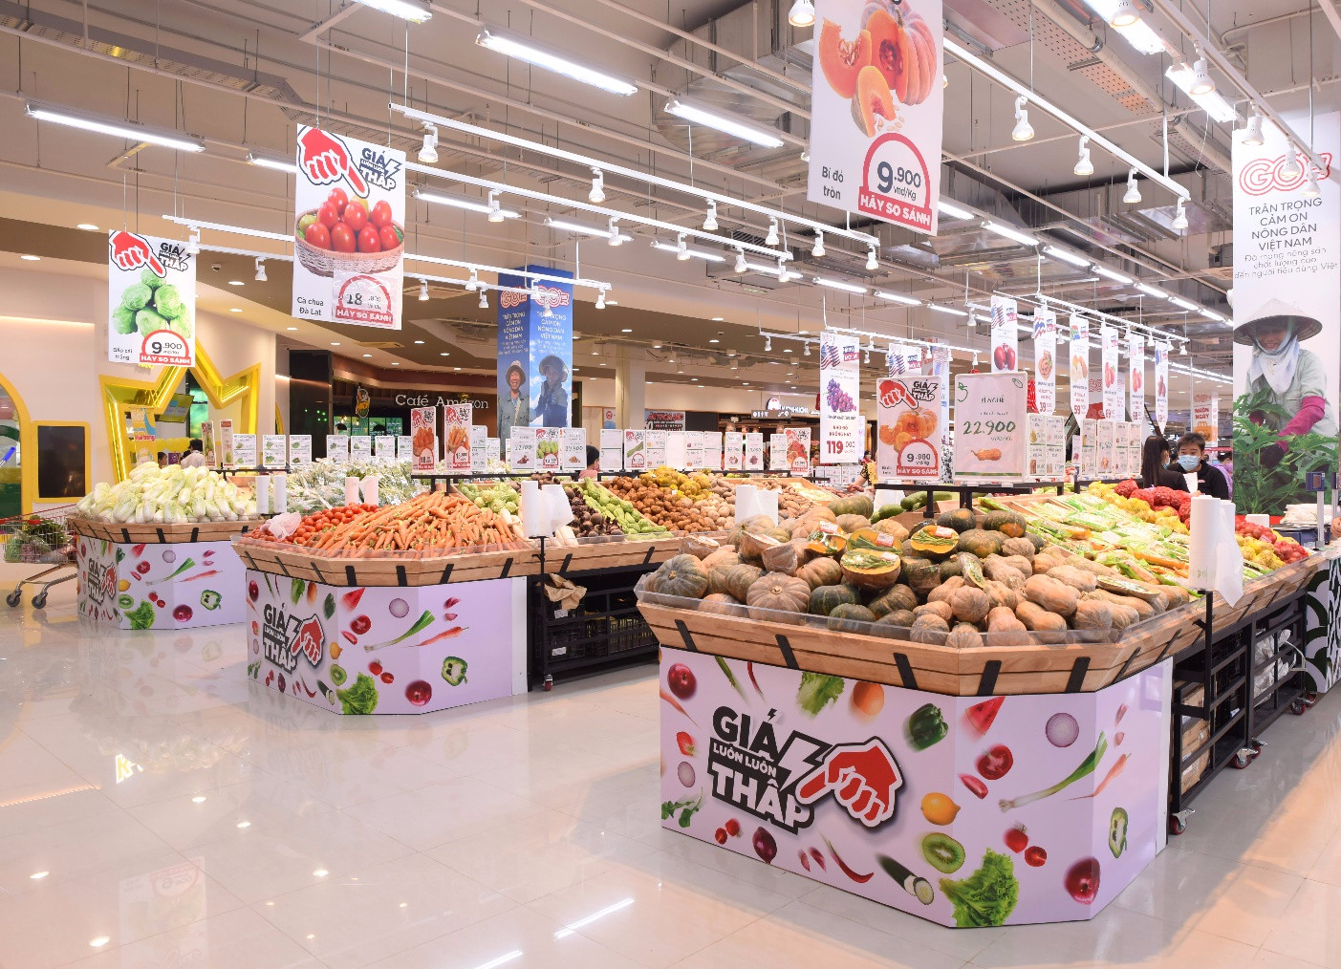
6. supermarket

Slide 10
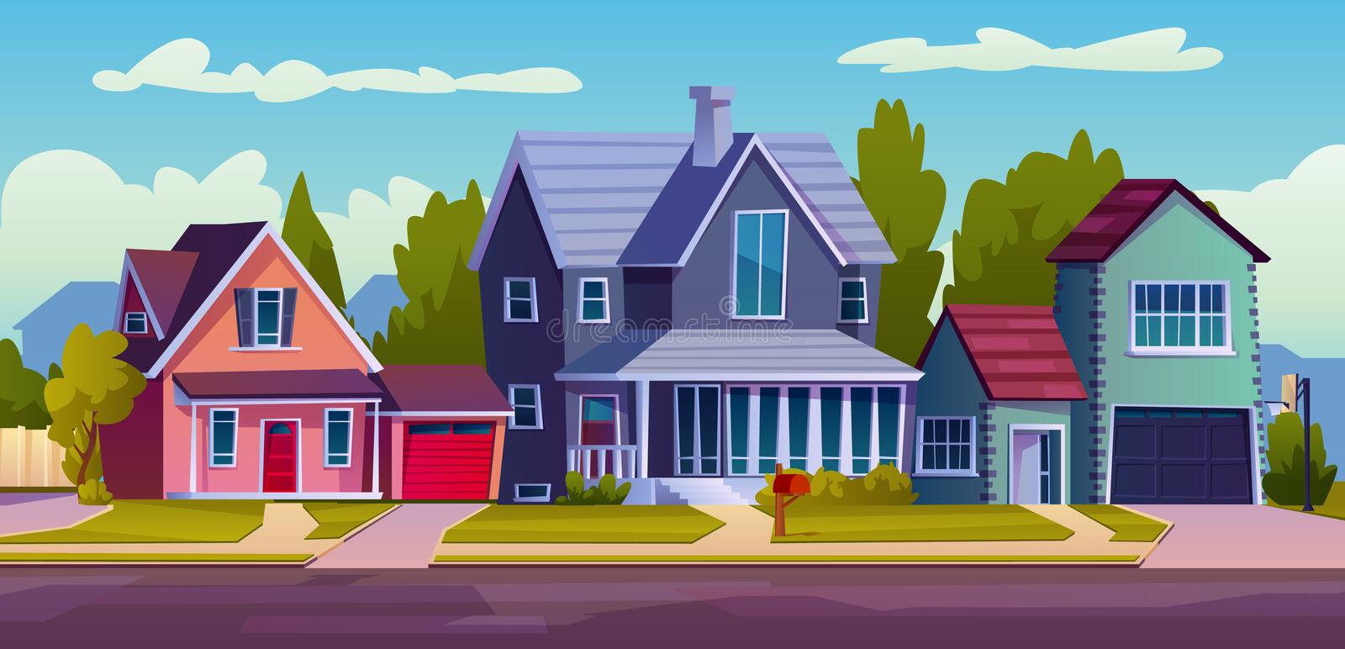
Unit 4: My neighbourhood
Lesson 7: Looking back and project

Slide 11


II- Grammar

Slide 12
6. supermarket

Slide 13


Put the following adjectives in the correct column.
fast
noisy
expensive
exciting
fast
large
expensive
exciting
heavy
hot
quiet
beautiful
beautiful
One syllable | Two syllables | Three syllables

Slide 14
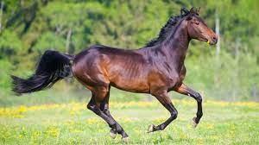
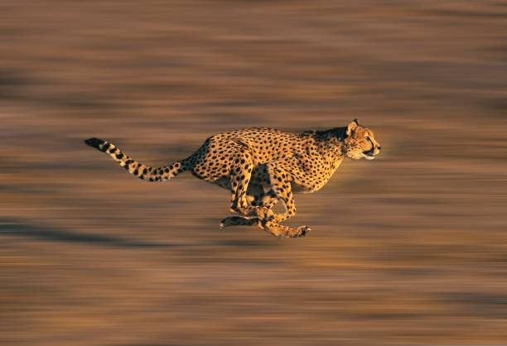
The cheetah is the horse
faster than
→ Comparative adjectives

Slide 15
Grammar: comparative adjectives
1. Short adjectives
have 1 syllable or 2 syllables ending with -y, - le, -ow, - et, -er
2. Long adjectives
have 2 syllables or more than 2 syllables
One syllable | Two syllables | Three syllables
fast hot large | quiet heavy noisy | expensive beautiful exciting
Short adjectives
Long adjectives

Slide 16
One syllable | Two syllables | Three syllables
fast hot large | quiet heavy noisy | expensive beautiful exciting
Short adjectives
Long adjectives
Adjectives | Comparative form
fast
faster
more peaceful
peaceful
peacefuler?

Slide 17

Now write their comparative forms in the table below.
Adjectives | Comparative form
1. beautiful
2. noisy
3. expensive
4. hot
5. exciting
6. quiet
7. heavy
8. large
0. fast
faster
00. peaceful
more peaceful

Slide 18
Now write their comparative forms in the table below.
Adjectives | Comparative form
1. beautiful
2. noisy
3. expensive
4. hot
5. exciting
6. quiet
7. heavy
8. large
more beautiful
noisier
more expensive
hotter
more exciting
quieter
heavier
larger

Slide 19

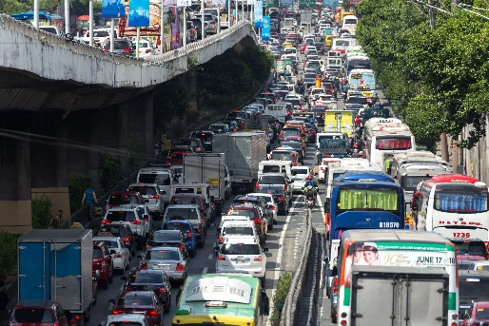
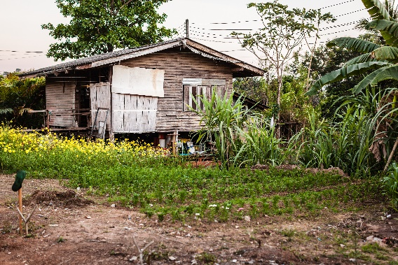
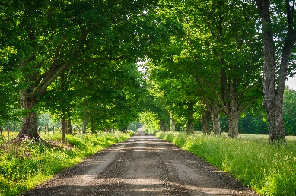
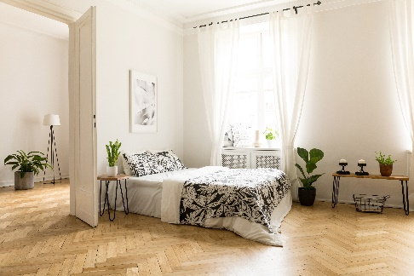
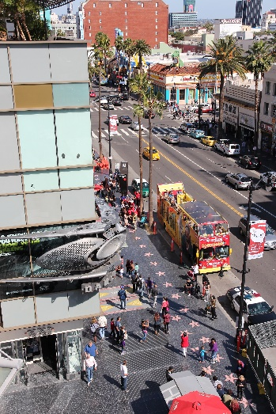
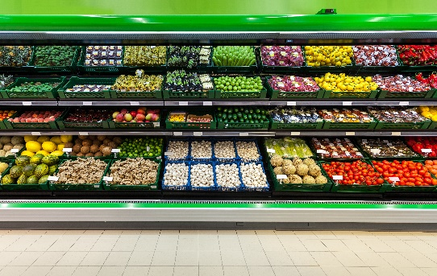
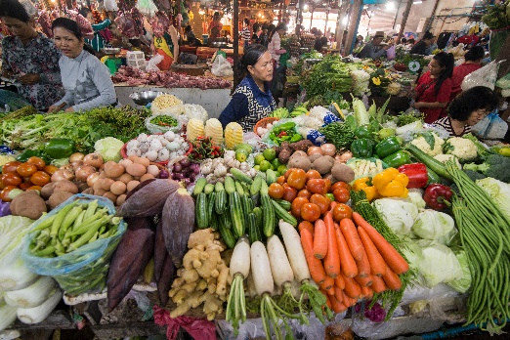
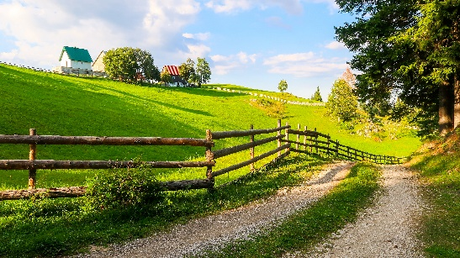
Complete the sentences comparing the pictures. Use the comparative forms of the adjectives below.
expensive
noisy
modern
peaceful

Slide 20
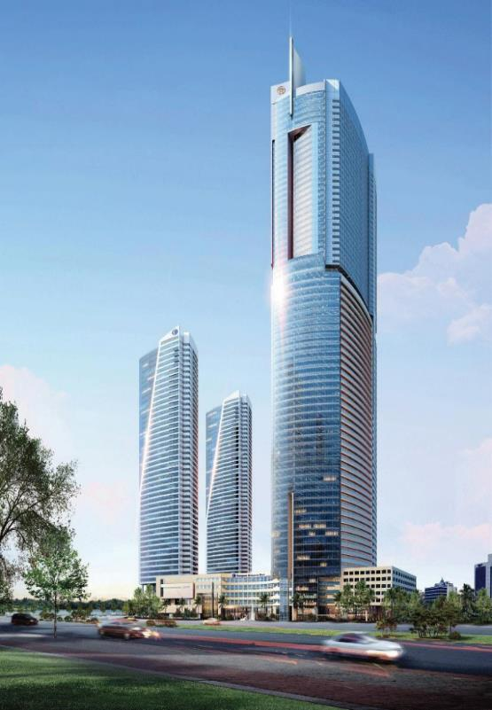
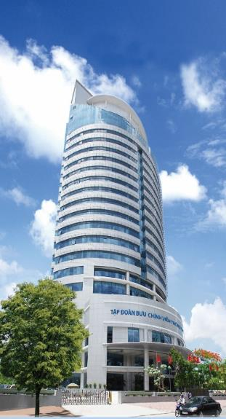
expensive
noisy
modern
peaceful
tall
150m
70m
0. This building is ______than that building.
taller

Slide 21
Complete the sentences comparing the pictures. Use the comparative forms of the adjectives below.
expensive
noisy
modern
peaceful

Slide 22
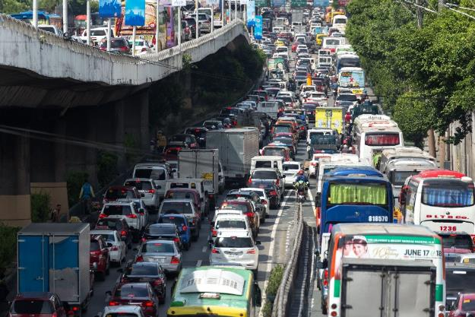

expensive
noisy
modern
peaceful
1.
noisier
This street is than that one.

Slide 23


expensive
noisy
modern
peaceful
more modern
2. A city house is than a country house.

Slide 24
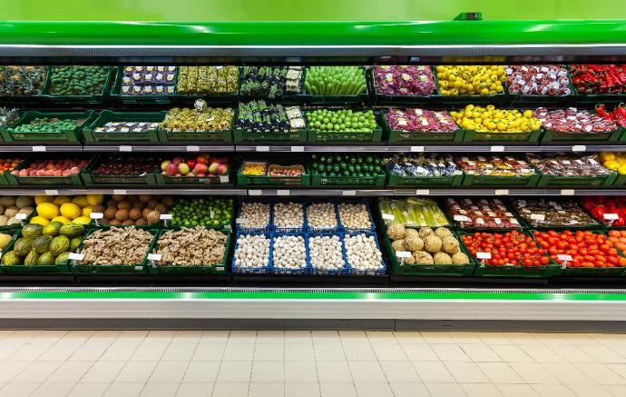

expensive
noisy
modern
peaceful
more expensive
3. Things at a corner shop are than things at a village market.

Slide 25


expensive
noisy
modern
peaceful
more peaceful
4. Life in the countryside is ____________ than life in the city.

Slide 26



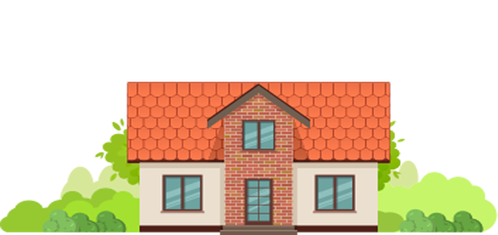
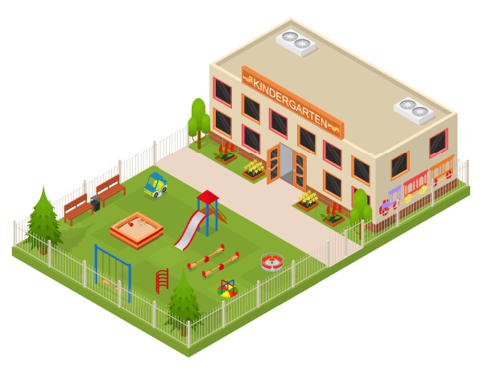
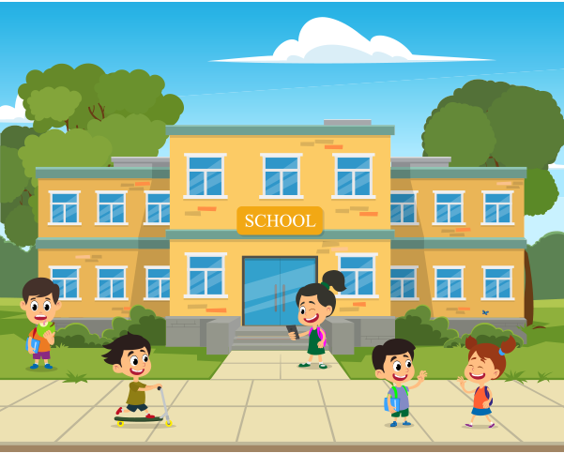
Draw a map of a neighbourhood. Write names of at least five places on your map.
Work in groups. Take turns to ask for and give directions to the places on the map.

Slide 27

What have you learnt in this lesson?
1. Places in the neighbourhood
2. Comparative adjectives
3. Giving directions

Slide 28

HOMEWORK
- Rewrite about your own
neighbourhood.
- Prepare for the next lesson:
Unit 5 – Lesson 1: Getting started.

Slide 29

Thank you
for your attention!

