Slide 1

Unit 5.
Food and Drink
Lesson 3. A closer look 2

Slide 2

Objectives
By the end of this lesson, Ss will be able to:
Review the measurement words and phrases - some and a lot of / lots of used with countable and uncountable nouns.
Understand and use How many/ How much to ask and answer about quantities.

Slide 3
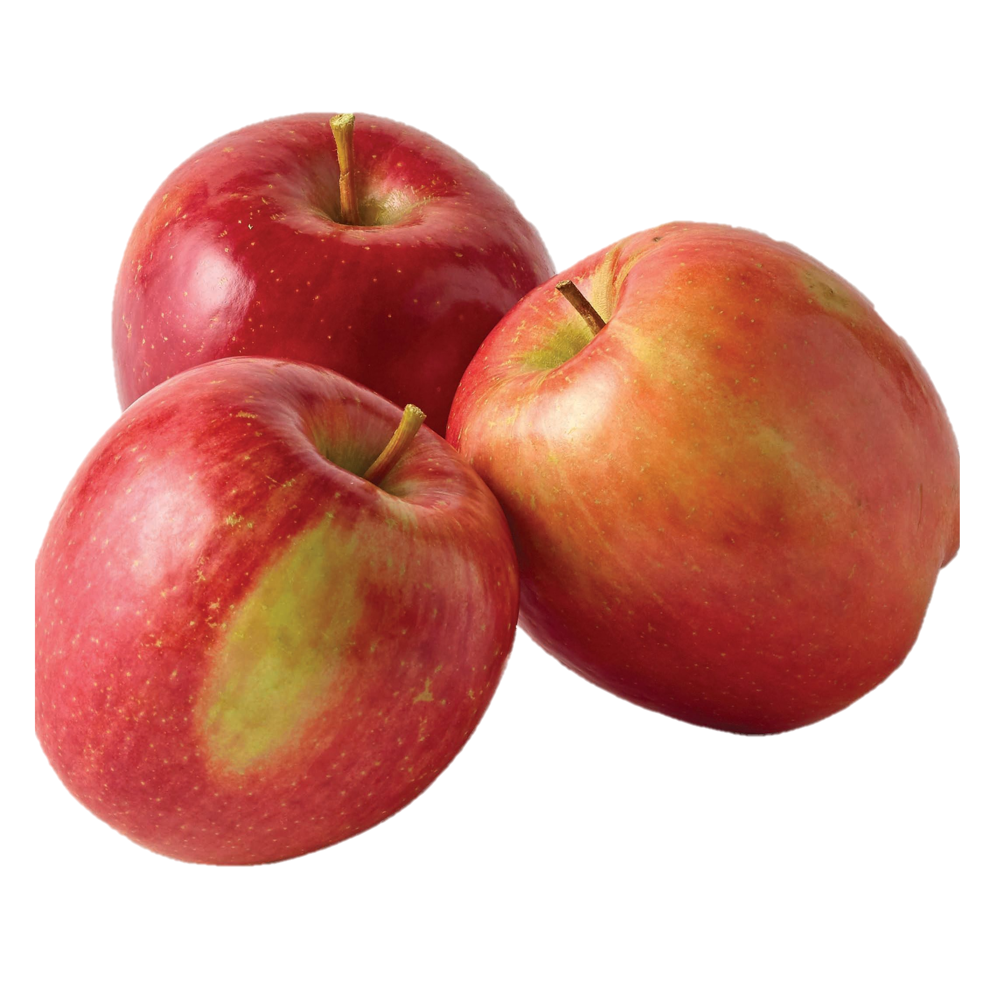

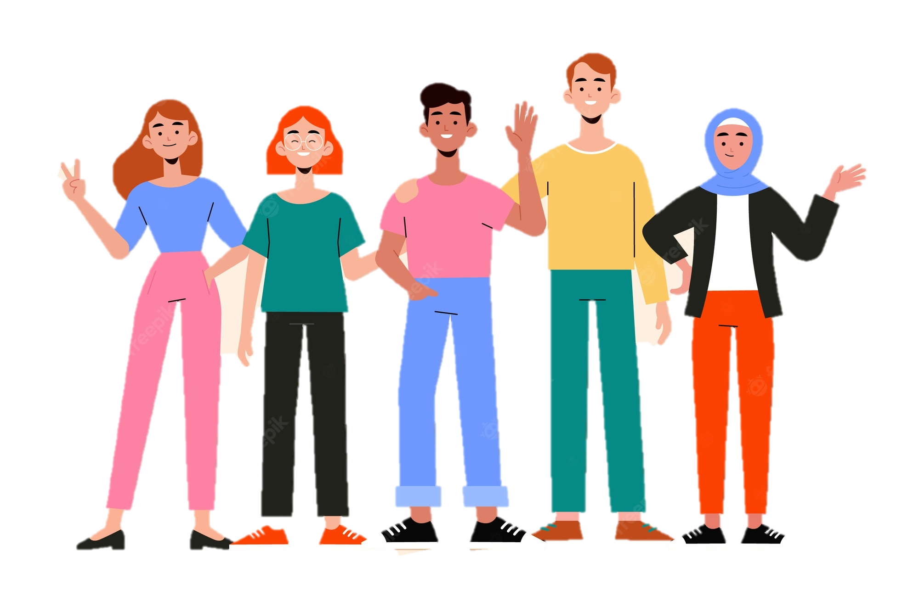
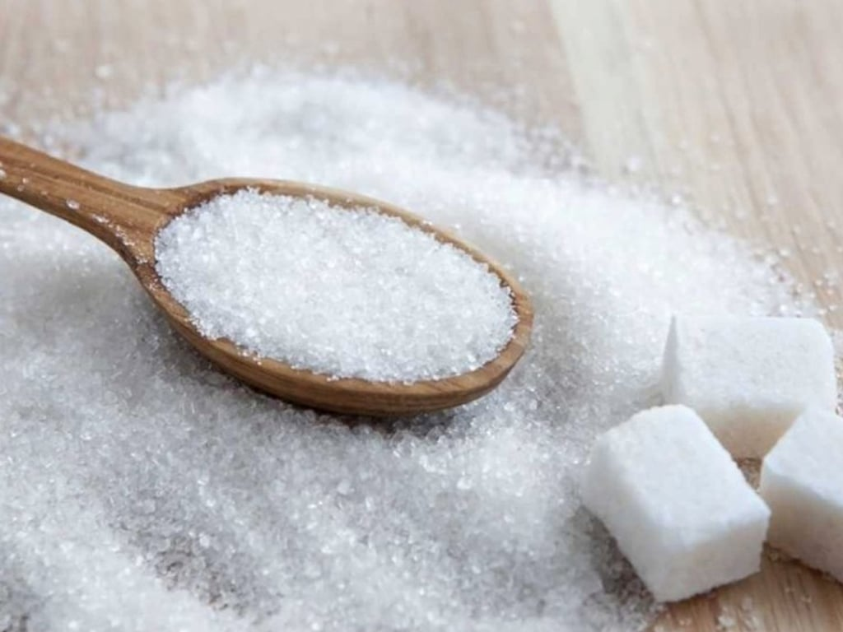
Who’s faster
Can you add more?
Device them into correct column.
What are they?
people
sugar
apples
water
Countable nouns
Uncountable nouns

Slide 4
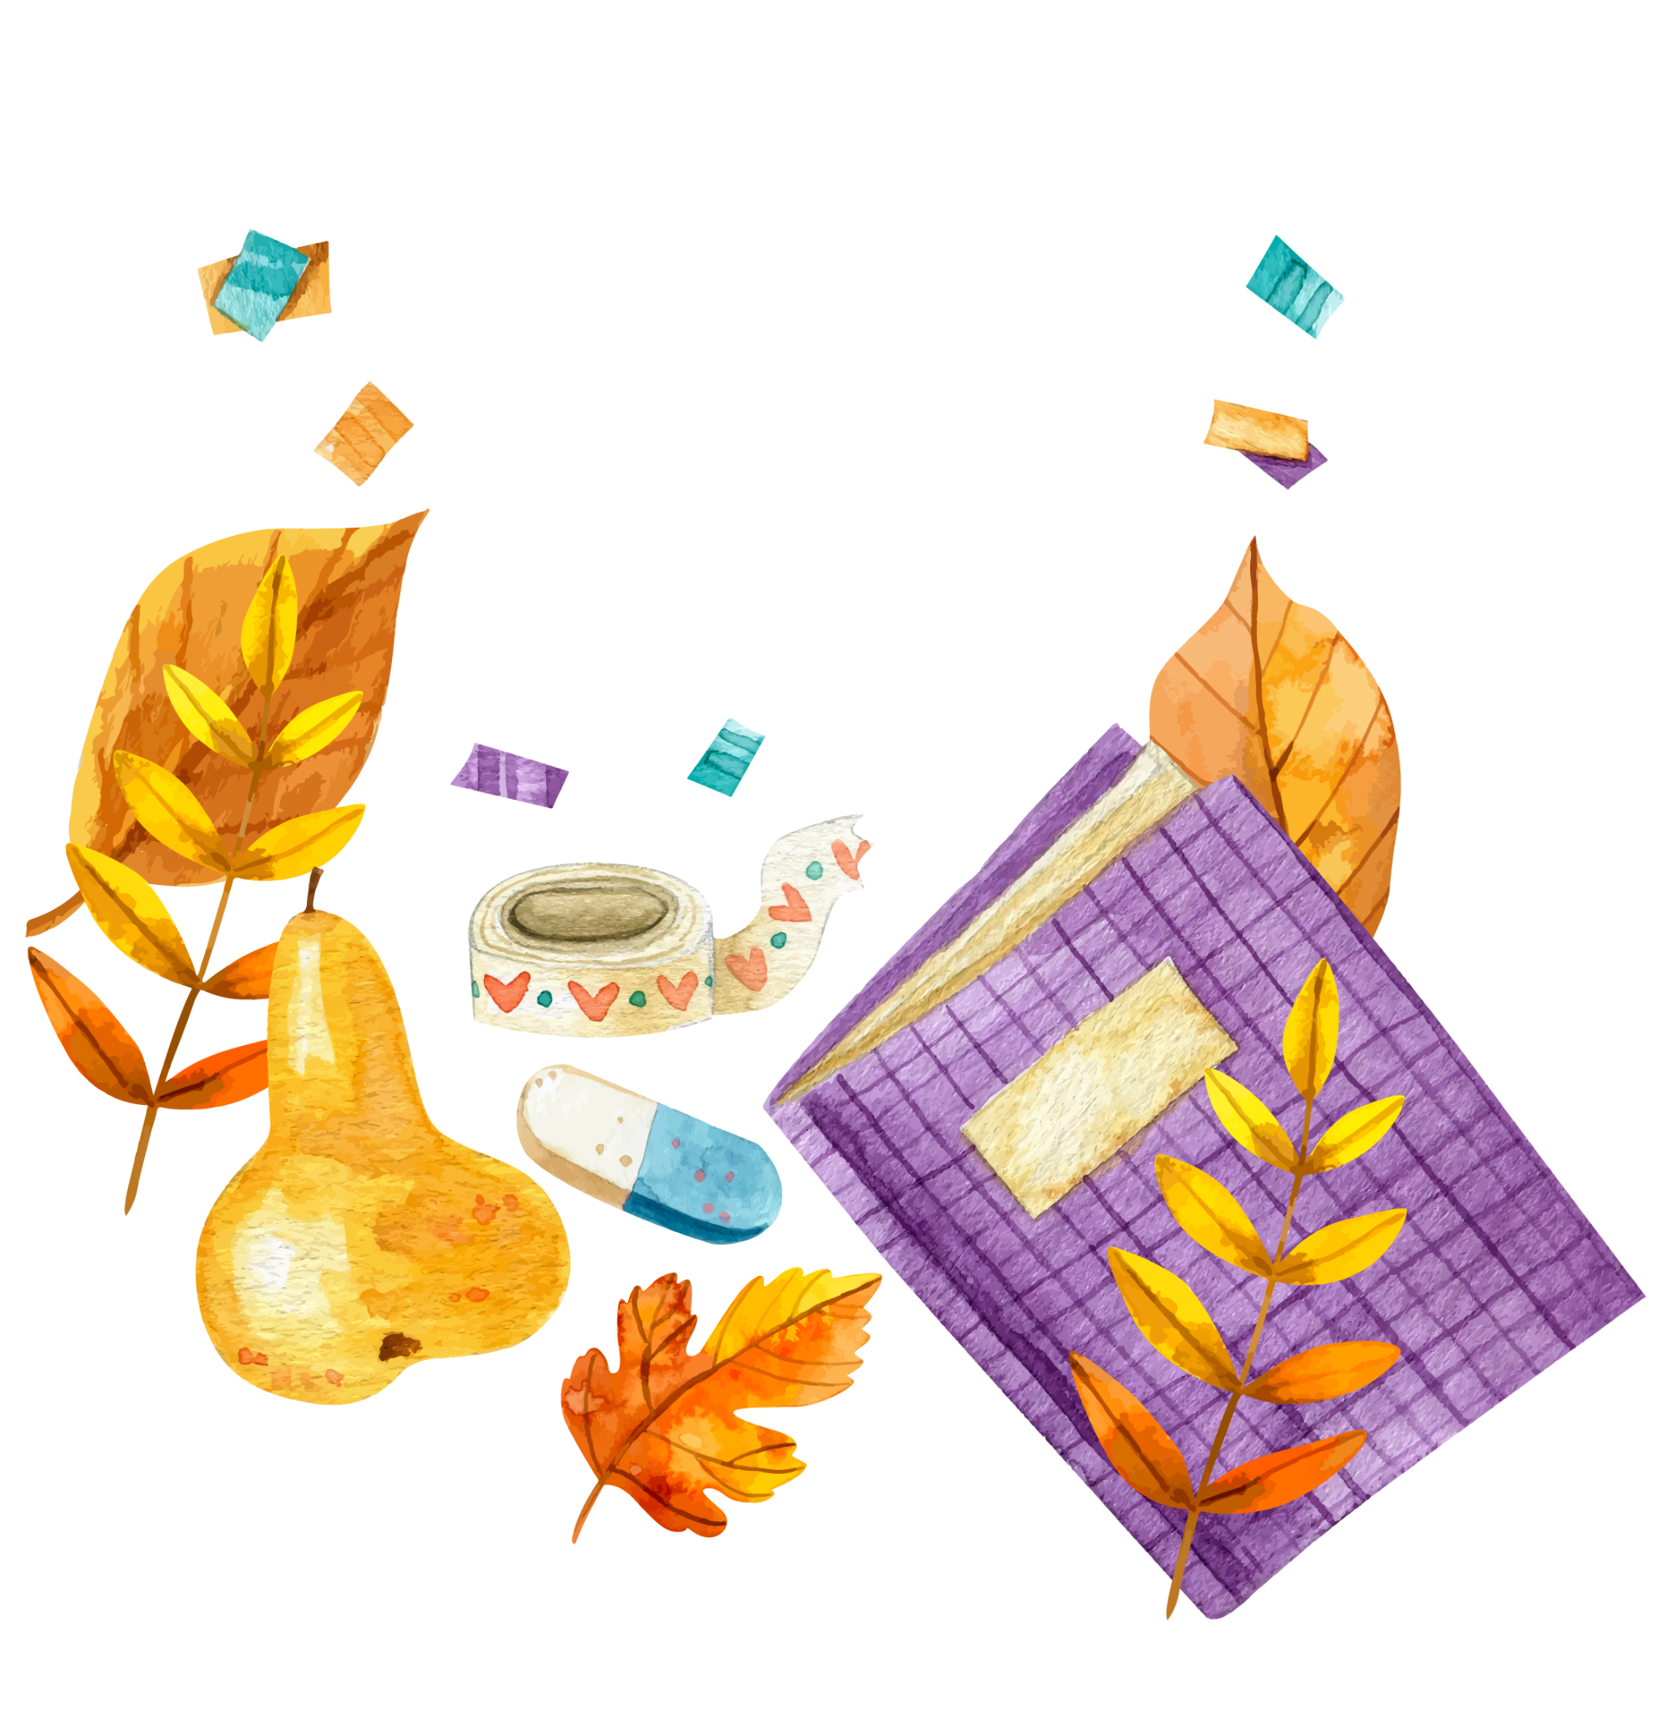
Remember!
We use some, a lot of, lots of with both countable nouns and uncountable nouns to describe quantities.
Example:
- I need some apples for this recipe.
- There's some water in the bottle.
- There are a lot of/ lots of people in the room.
- She likes coffee with a lot of / lots of sugar.

Slide 5

Ex 1. (p 53) Circle the correct words or phrases.
1. Minh is very popular. He has got some / a lot of friends.
- very popular
- friends → countable noun
1. Minh is very popular. He has got some / a lot of friends.
2. Linh is very busy. She has got some / lots of homework.
- very busy
- homework → uncountable noun
2. Linh is very busy. She has got some / lots of homework.
3. Put some / a lot of sugar in my tea. But not too much.
- sugar → uncountable noun
- But not too much.
3. Put some / a lot of sugar in my tea. But not too much.
4. There are some / a lot of cars in our city. Too many. I don't like it.
- cars → countable noun
- too many. I don’t like it.
4. There are some / a lot of cars in our city. Too many. I don't like it.
5. There is some / lots of rice left. Not much but just enough for our breakfast.
- rice left → uncountable noun
- Not much but just enough.
5. There is some / lots of rice left. Not much but just enough for our breakfast.

Slide 6
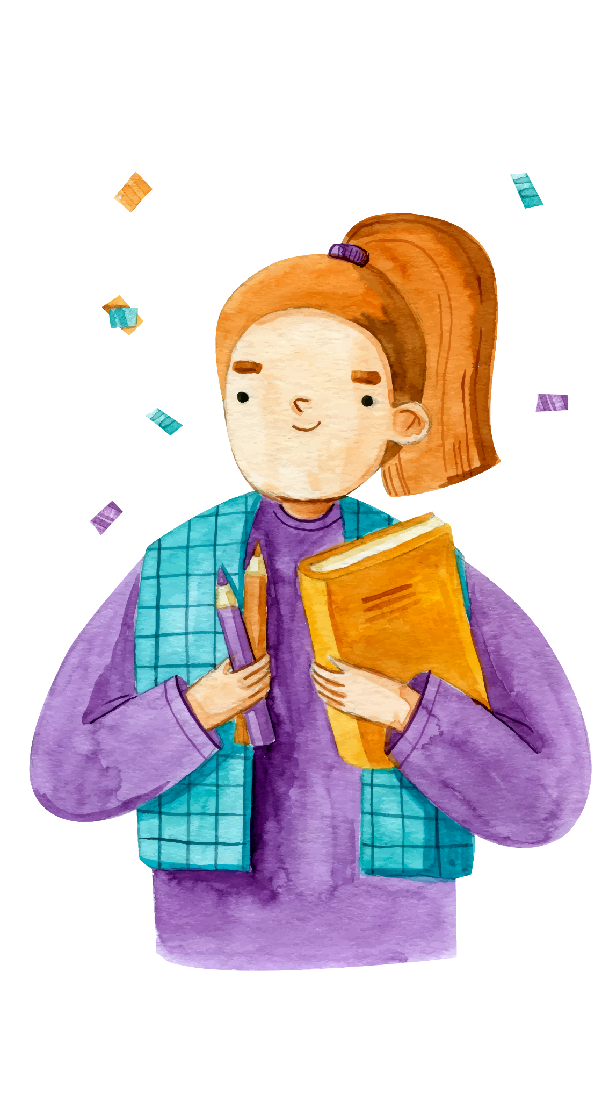
How to use “any”?
What’s type of sentences?
What’s type of nouns?
- Is there any lemon cake left?
- Is there any lemon cake left?
- We couldn’t buy any food because all the shops were closed.
- We couldn’t buy any food because all the shops were closed.
- We use ‘any’ in negative sentences and questions.
- We use ‘any’ for uncountable and countable nouns.

Slide 7

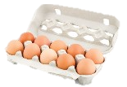



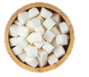
Ex 2. (p 52) Look at picture. Write ‘some, any, or a lot of/ lots of’ in the blanks.
Example: There is some orange juice in the glass.
Example: There is _____ orange juice in the glass.
1. There are a lot of/ lots of eggs in the carton.
- full of eggs in carton.
- eggs → countable noun
1. There are _____________ eggs in the carton.
2. There aren't any biscuits on the plate.
- aren’t → negative sentence.
- biscuits → countable noun
2. There aren't _________ biscuits on the plate.
3. Susie went to the cinema with ______ friends.
- Only 3 people in picture.
- friends → countable noun
3. Susie went to the cinema with some friends.
4. I'd like a pizza with a lot of/ lots of cheese.
4. I'd like a pizza with ____________ cheese.
- cheese → uncountable noun
5. There is a lot of/ lots of sugar in the bowl.
- sugar → uncountable noun
5. There is _____________ sugar in the bowl.

Slide 8

How much/ How many
These question words are used to ask about quantities and measures of things.
How much + uncountable nouns
Example:
How many students are there in your class?
How many + plural countable nouns
Example:
How much water do you drink every day?

Slide 9




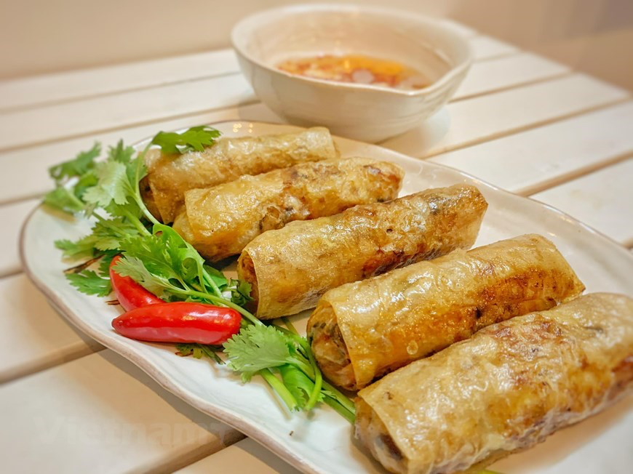
Ex 3. (p 52) Answer the questions, using the pictures.
Ex 3. (p 52) Fill in each blank with ‘How many or How much’.
water → uncountable noun.
2L
2 litres.
1. __________ water do you drink every day?
1. How much water do you drink every day?
books → plural countable noun.
2. ___________ books did you read last month?
2 books.
2. How many books did you read last month?
films → plural countable noun.
2 films.
3. ___________ films did you watch last year?
3. How many films did you watch last year?
bananas → plural countable noun.
4. ___________ bananas do you eat every week?
3 bananas.
4. How many bananas do you eat every week?
5. ___________ spring rolls did your mother cook last month?
5. How many spring rolls did your mother cook last month?
spring rolls → plural countable noun.
5 spring rolls.

Slide 10


Ex 4. (p 54) Work in pairs. Ask and answer, using the questions in Ex 3.
01
How much water do you drink every day?
02
How many books did you read last month?
03
How many films did you watch last year?
04
How many bananas do you eat every week?
→ Two litres.
05
How many spring rolls did your mother cook last month?

Slide 11
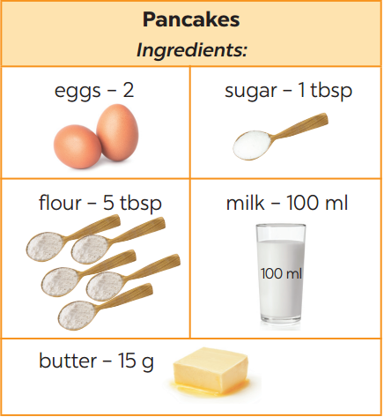
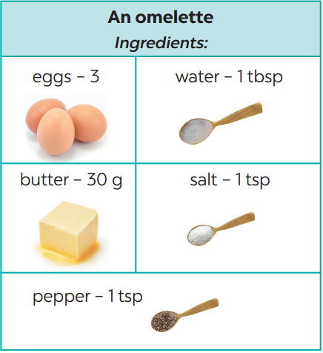
Ex 5. (p 54) Work in groups. Take turns to ask and answer about the receipes.
Which words can be replaced in example?
Example:
A: What do we need to make pancakes?
B: We need eggs, sugar, flour, milk, and butter.
A: How many eggs do we need?
B: Two.
Example:
A: What do we need to make pancakes?
B: We need eggs, sugar, flour, milk, and butter.
A: How many eggs do we need?
B: Two.

Slide 12

RECAP
Choose the best answer.
Which word is uncountable noun?
A. Oil B. Sandwich C. Potatoes
2. Which word is countable noun?
A. Meat B. Coffee C. Grape
3. __________ bread do you want?
A. How many B. How much C. Any
4. Do you have _______ tea?
A. some B. any C. lots of
5. There is _______ water in the tank.
A. any B. a lot of C. some

Slide 13

Thank you

