Slide 1
WELCOME TO OUR CLASS
– 8A1-
Teacher: Nguyen Thi Thanh Hoa

Slide 2
Game: What am I?
I am a noun
01
02
I am an environmental problem
03
I start with “P”

Slide 3
POLLUTION

Slide 4
UNIT 7: POLLUTION
PROJECT

Slide 5


Types of pollution.
noise pollution
radioactive pollution
air pollution
light pollution
Types of pollution
visual pollution
thermal pollution
land/soil pollution
water pollution

Slide 6
GROUPS’ PRESENTATIONS
07 GROUPS

Slide 7
EVALUATION OF THE COMPLETED PRODUCTS
Order | Content of evaluation | Criteria | Max points | Real points
1 | Report | How to make the product | 2
2 |  | Messages | 1
3 |  | Presenting and contacting with observers to make and answer questions | 1
4 | Product | Using recycled materials | 2
5 |  | Creation and art | 1
6 |  | Economy | 1
7 |  | Application | 2
 |  | Total points | 10

Slide 8
MY MESSAGE
Don’t just throw things!
Try to find out another use for them

Slide 9
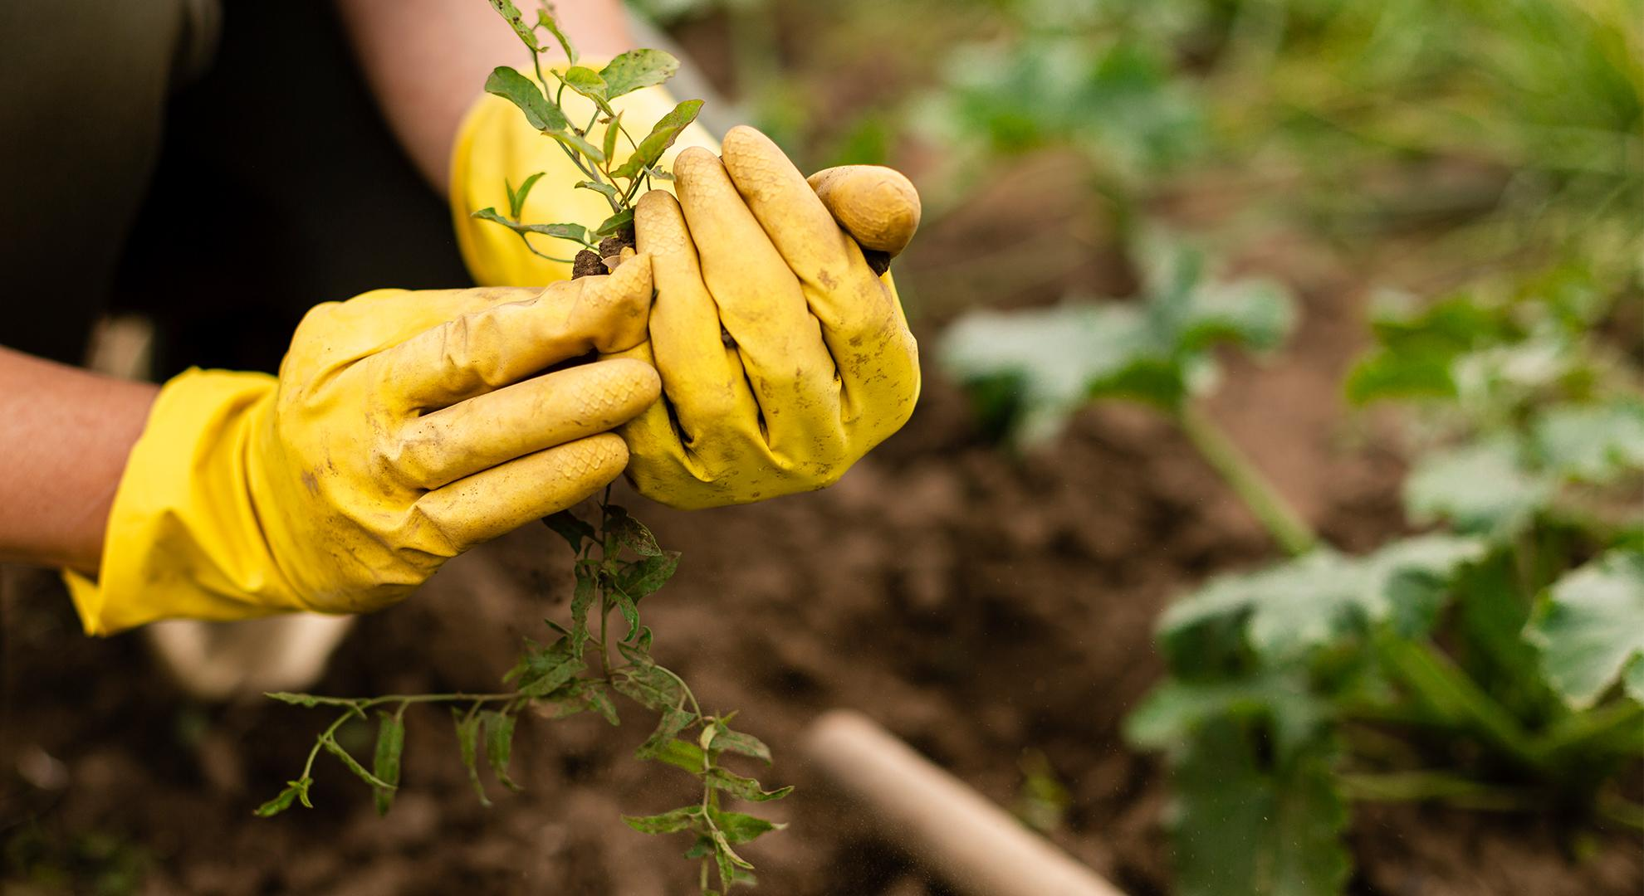
A PICTURE IS WORTH A THOUSAND WORDS

Slide 10
THANKS FOR YOUR ATTENTION

