Slide 1


Slide 2

Welcome to our English class 4a9

Slide 3



My week
3
LESSON 2 - PERIOD 3
SUNDAY
SUNDAY
MONDAY
TUESDAY
WEDNESDAY
THURSDAY
FRIDAY
SATURDAY

Slide 4
Table of contents
01
Warm-up
04
02
03
Let’s talk.
Look, listen and repeat.
05
wrap-up
Listen, point and say.

Slide 5
01
Warm-up

Slide 6

Let’s sing!

Slide 7
New words

Slide 8

study at school

Slide 9
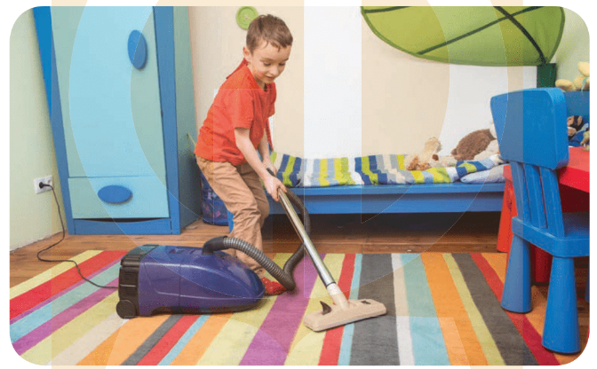
do housework

Slide 10

listen to music

Slide 11

New words
study at school
( học ở trường )
do housework
( làm việc nhà)
listen to music
( nghe nhạc )

Slide 12
What’s missing?

Slide 13
02
Activity 1 Look, listen and repeat.

Slide 14

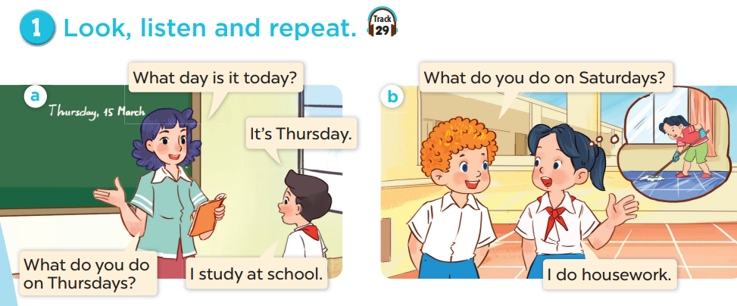

Slide 15
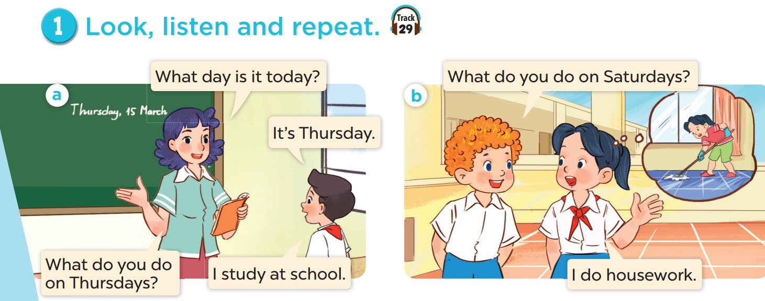
Explore the dialogues.
Notes:
EXPLORE THE QUESTIONS

Slide 17
Model sentences
The days of the week
What do you do on Thursdays?
Saturdays?
I study at school
do housework
Activities

Slide 18
03
Activity 2 Listen, point and say.

Slide 19
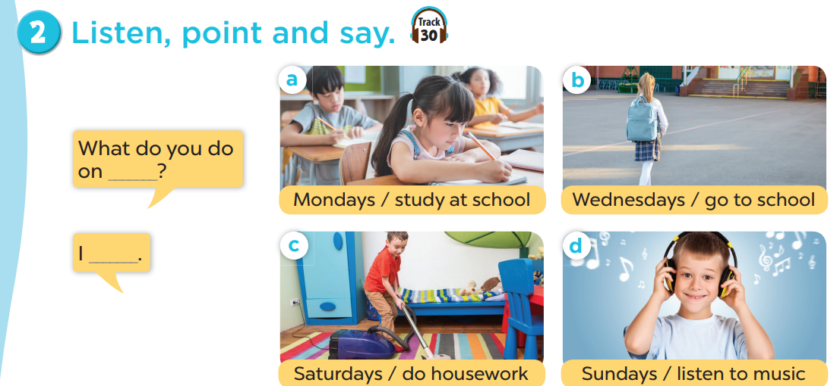

Slide 20
Practise in pairs.
What do you do on Mondays?
I study at school.

Slide 21

What do you do on Mondays?
Mondays
I study at school.

Slide 22

What do yon do on Wednesdays?
Wednesdays
I go to school.

Slide 23
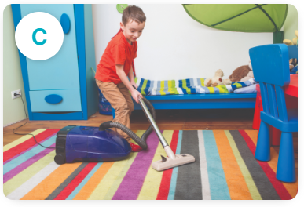
What do yon do on Saturdays?
Saturdays
I do housework.

Slide 24

What do yon do on Sundays?
Sundays
I listen to music.

Slide 25
Extension:
What does she/ he do on Sundays?
She/He does housework.
What do they do on Sundays?
They do housework.

Slide 26
04
Activity 3 Let’s talk.

Slide 27


Slide 28
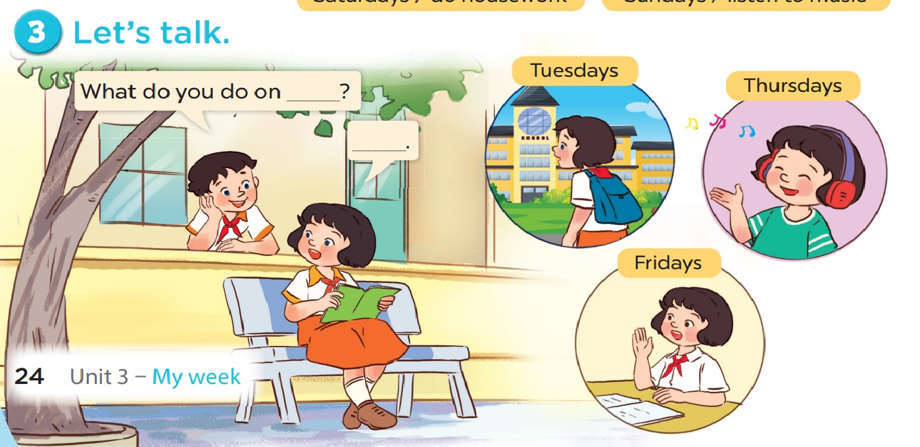

Slide 29
Talk Show
Activities on the days of the week

Slide 30
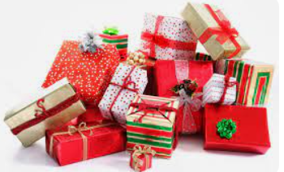
Listen and answer
Receive some gifts

Slide 31
New words
study at school
do housework
Lesson 1
Listen to music
Model sentences
What do you do on_____?
I____________________.

Slide 32
Home link
Practise the model sentences and new words at home.
Prepare Unit 3 lesson 2 (4,5,6).

Slide 33


Thank you for listening!

