Slide 1


Slide 2



WARM-UP

Slide 3

Watch a video of 5 films and take notes
Name of the film | Type of the film
1.
2.
3.
4.
5.

Slide 4
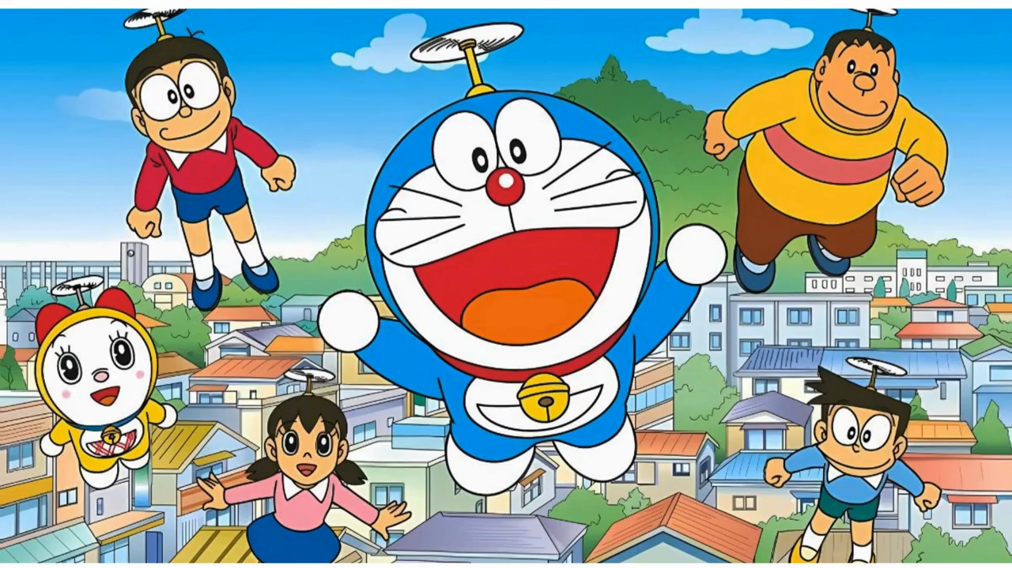


Slide 5


Slide 6
Watch a video of 5 films and take notes
Name of the film | Type of the film
1. Doreamon | cartoon
2. Mr. Bean | comedy
3. Titanic | romantic film
4. IT | horror film
5. Ho Chi Minh / Uncle Ho | documentary

Slide 7
What’s your favourite film?
What kind of film is it?
What do you think of it?

Slide 8


UNIT 8: FILM
Lesson 6: Skills 2

Slide 9
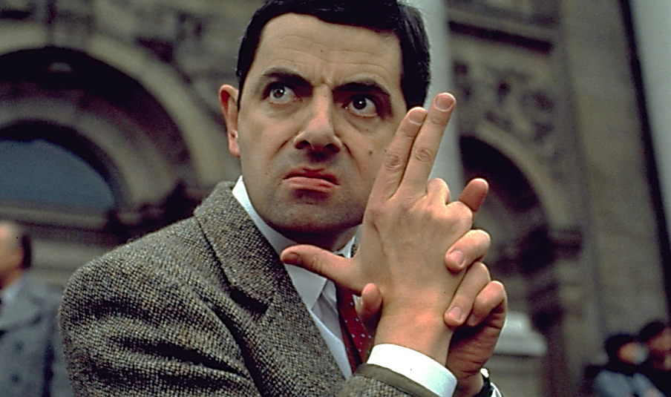
Mr. Bean

Slide 10
Which comedies did you see?

Slide 11
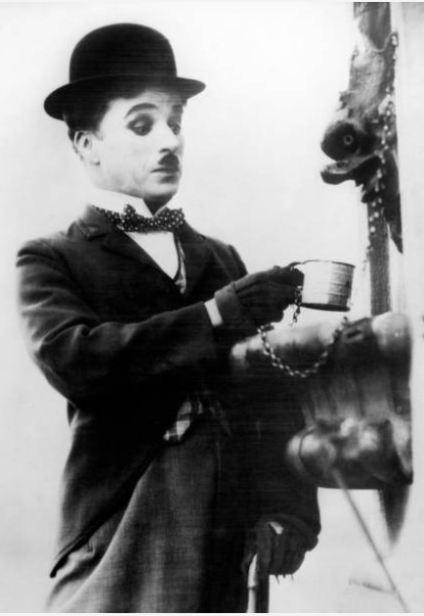




Slide 12


1. What do you like about a comedy?
2. What do you dislike about a comedy?

Slide 13

1. Work in pairs. Discuss the following questions.
1. What do you like about a comedy?
2. What do you dislike about a comedy?

Slide 14

01
LISTENING

Slide 15


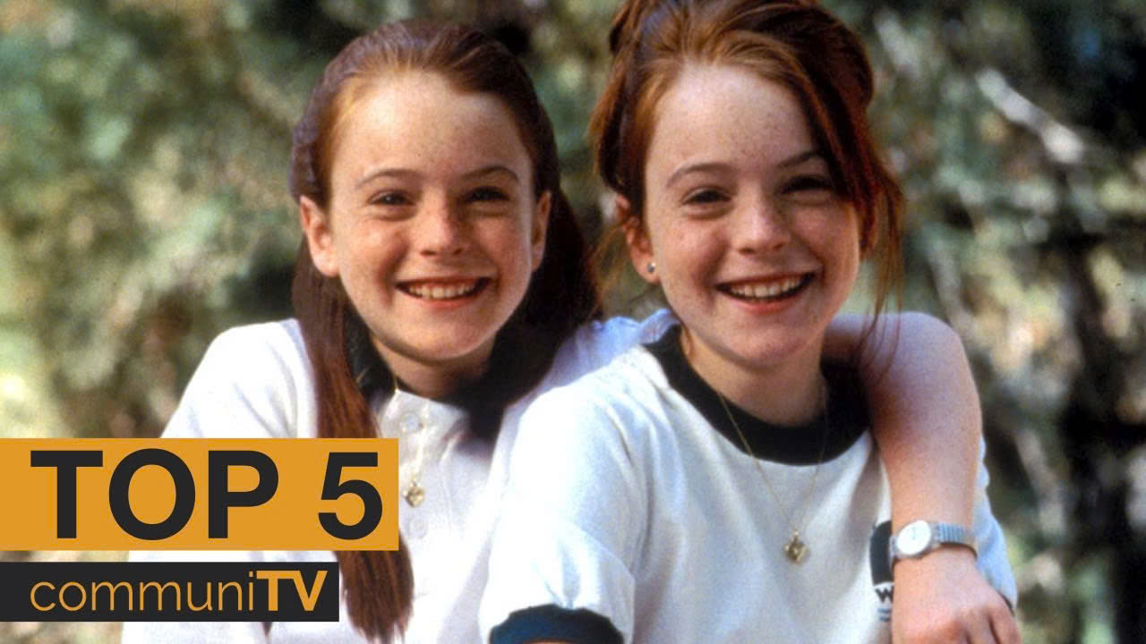
2.Mark and Hoa are talking about the film Naughty Twins.
Hoa
Mark
Listen. Who stars in the film?
A. Linda Smith and Susan Brown
B. Linda Brown and Susan Smith
C. Susan Linda and Brown Smith
Hoa: I like Simon's films. Who stars in it?
Mark: Linda Brown and Susan Smith.

Slide 16
3. Listen to the conversation again. Choose the best answer to each question below.
1. Naughty Twins is a ___.
A. comedy
B. science fiction film
C. horror film
2. The main characters are ___.
A. old classmates
B. twin brothers
C. twin sisters
3. Where do the twins meet each other for the first time?
A. At a summer camp.
B. At a summer school.
C. At a hospital.
4. People say Naughty Twins is a film that ___.
A. young people should see
B. young people shouldn’t see
C. is shocking

Slide 17
3. Listen to the conversation again. Choose the best answer to each question below.
1. Naughty Twins is a ___.
A. comedy
B. science fiction film
C. horror film
2. The main characters are ___.
A. old classmates
B. twin brothers
C. twin sisters
3. Where do the twins meet each other for the first time?
A. At a summer camp.
B. At a summer school.
C. At a hospital.
4. People say Naughty Twins is a film that ___.
A. young people should see
B. young people shouldn’t see
C. is shocking

Slide 18
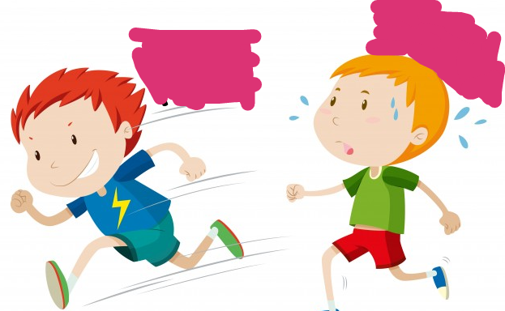
Who is faster?

Slide 19
3. Listen to the conversation again. Choose the best answer to each question below.
1. Naughty Twins is a ___.
A. comedy
B. science fiction film
C. horror film
Hoa: Mark, what film did you see last week?
Mark: Naughty Twins. It’s a comedy and its director is Nancy Simon.

Slide 20
3. Listen to the conversation again. Choose the best answer to each question below.
Hoa: What is it about?
Mark: It's about two naughty girls. Although they are twins, they don't grow up together after their parents' marriage ends.
2. The main characters are ___.
A. old classmates
B. twin brothers
C. twin sisters

Slide 21
3. Listen to the conversation again. Choose the best answer to each question below.
3. Where do the twins meet each other for the first time?
A. At a summer camp.
B. At a summer school.
C. At a hospital.
Hoa: What happens next? Mark: The twins meet each other for the first time at a summer camp.
Notes:
Hoa: I like Simon's films. Who stars in it? Mark: Linda Brown and Susan Smith. Hoa: They're well-known actresses. What is it about? Mark: It's about two naughty girls. Although they are twins, they don't grow up together after their parents' marriage ends. Hoa: What happens next? Mark: The twins meet each other for the first time at a summer camp. They make a plan to bring their parents back together. And then many funny things happen. Hoa: Did it receive good reviews? Mark: Yes, most people say it's a must-see for young people because it's funny and moving. The acting and music are excellent, too....

Slide 22
3. Listen to the conversation again. Choose the best answer to each question below.
Hoa: Did it receive good reviews?
Mark: Yes, most people say it's a must-see for young people because it's funny and moving.
4. People say Naughty Twins is a film that ___.
A. young people should see
B. young people shouldn’t see
C. is shocking
Notes:
Hoa: I like Simon's films. Who stars in it? Mark: Linda Brown and Susan Smith. Hoa: They're well-known actresses. What is it about? Mark: It's about two naughty girls. Although they are twins, they don't grow up together after their parents' marriage ends. Hoa: What happens next? Mark: The twins meet each other for the first time at a summer camp. They make a plan to bring their parents back together. And then many funny things happen. Hoa: Did it receive good reviews? Mark: Yes, most people say it's a must-see for young people because it's funny and moving. The acting and music are excellent, too....

Slide 23

Work in pairs. Talk about the film “Naughty Twins”

Slide 24


Slide 25


02
WRITING

Slide 26

4. Make notes about one of your favourite films.
Name of the film: _________________________
Type of film: __________________________
Its main actors/ actresses or director: ______________________
A short summary of the film: ______________________________
Other features of the film (the acting, music, etc): _____________
Reviews about the film: ___________________________________

Slide 27
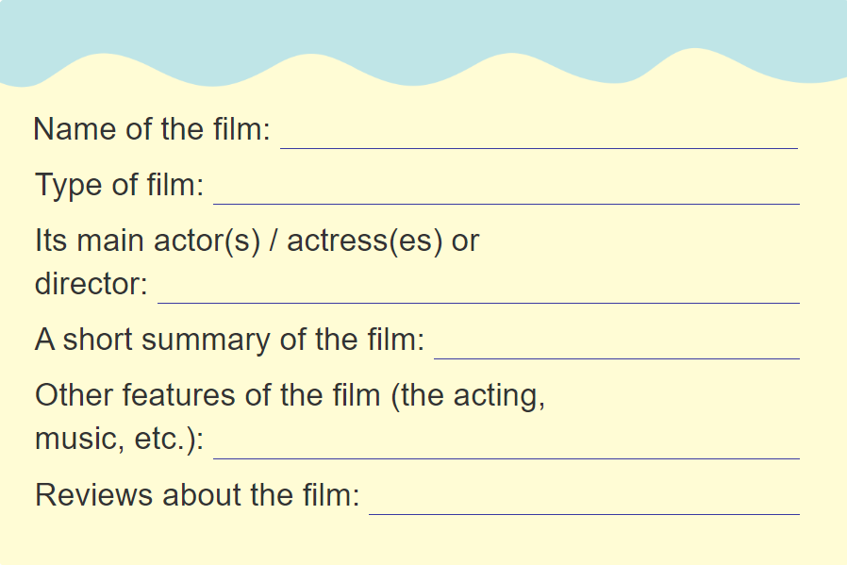


4. Make notes about one of your favourite films in 2 mins.

Slide 28
My favourite film is _____.
_____ is the movie I like the best.
I like / love watching _____.
I’m interested in _____.
I'm a big fan of _____.
1. Name
It’s a/an _____ film.
It falls into the _____ genre.
2. Type
How to write about your favourite film
The main actors and actresses are _____.
The film / it stars _____.
3. Actors
It is about _____.
The film tells the story of _____.
4. Summary
5. Features
The acting is _____ and music is also _____.
6. Reviews
People say / think the film is _____.

Slide 29
WRAP UP
LISTENING
listen for specific information about a film
WRITING
write a paragraph about one's favourite film

Slide 30
HOMEWORK
Rewrite the paragraph at home
Do exercises 1,2 (part D – Workbook)
Prepare the next lesson
Lesson 7 – Looking back and project

Slide 31
THANKS FOR
YOUR ATTENTION!

